Slide 1
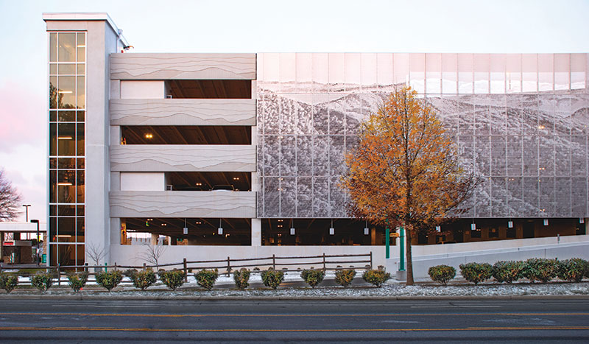
Maximizing the health and lifespan of parking garage structures through expert assessments and maintenance strategies.
Ensuring the longevity of
parking garage structures
Roth IAMS Webinar Series: September 21, 2023

Slide 2


Introductions
Andrej Culen, P.Eng.
Structural, Practice Lead
Roth IAMS
Dr. Rahul Pratap Singh, PhD Structures
Roth IAMS

Slide 3
Agenda
Typical Parking Garages Structures
The Three-phase Approach For Owners And Property Managers To Consider In Their Maintenance Program To Address Deterioration And Overall Parking Garage Structure Health,
Preventive Maintenance Measures To Implement And Minimize Deterioration To Extend The Service Life,
Cost And Risk Implications When Creating Your Maintenance Plan
Short Case Study With Lessons Learned

Slide 4

Setting the Table
What once was the humble parking structure has become a showpiece for innovation and creativity.
Facility managers are even more compelled to stay on top of parking garage maintenance
The imperative is the same: proactive condition assessment and diligent maintenance.
If problems are overlooked, they will quickly accelerate deterioration into hazardous conditions.
Notes:
With new innovative designs, featuring parking structures with realistic artwork, sculptural lighting, and eye-catching metal scrims, today’s parking garages are a stunning piece of modern architectural design.
As owners of such facilities embrace the possibilities of garages open design for everything from traditional parking to dining and integrated retail, the architecture of what once was the humble parking structure has become a showpiece for innovation and creativity.
Investing in such innovative designs, however, means that facility managers are even more compelled to stay on top of parking garage maintenance, which, with a structure that is exposed to weather inside and out, can be demanding.
Whether the parking facility is a freestanding multi-level garage or a few below-grade levels under a high-rise building or plaza, the imperative is the same: proactive condition assessment and diligent maintenance.
If problems are overlooked, the severe environment in garages, including corrosive deicing chemicals, freeze-thaw cycling, and the stress of thousands of vehicles traversing the deck, will quickly accelerate deterioration into hazardous conditions.

Slide 5
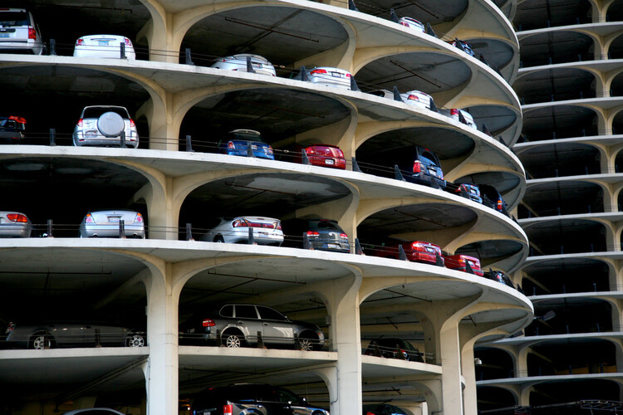
Overview
Facility managers should prioritize parking structure evaluation and maintenance to avert problems and avoid possible liability.
Where maintenance has been deferred, complications progress and facility managers must follow a deterrent approach to garage upkeep.
Maintaining your parking facility is significant for aesthetics as well as safety.
Parking facilities are open to wear and tear, excess moisture, temperatures, and harsh weather conditions that can cause serious structural damage.
Notes:
With the integrity of the garage and the safety of users at stake, facility managers should prioritize parking structure evaluation and maintenance to avert problems and avoid possible liability.
For facilities where maintenance has been deferred, complications may be progressed enough to demand expensive and disruptive repair. To avoid that, facility managers must follow a deterrent approach to garage upkeep.
Maintaining your parking facility is significant for aesthetics as well as safety. However, while all buildings need maintenance, parking structures need periodic repairs and touch-ups because of how much damage they take.
Exposure to vehicular traffic, foot traffic, and the outdoors means that they’re open to wear and tear, excess moisture, temperatures, and harsh weather conditions. These elements can cause serious structural damage.

Slide 6
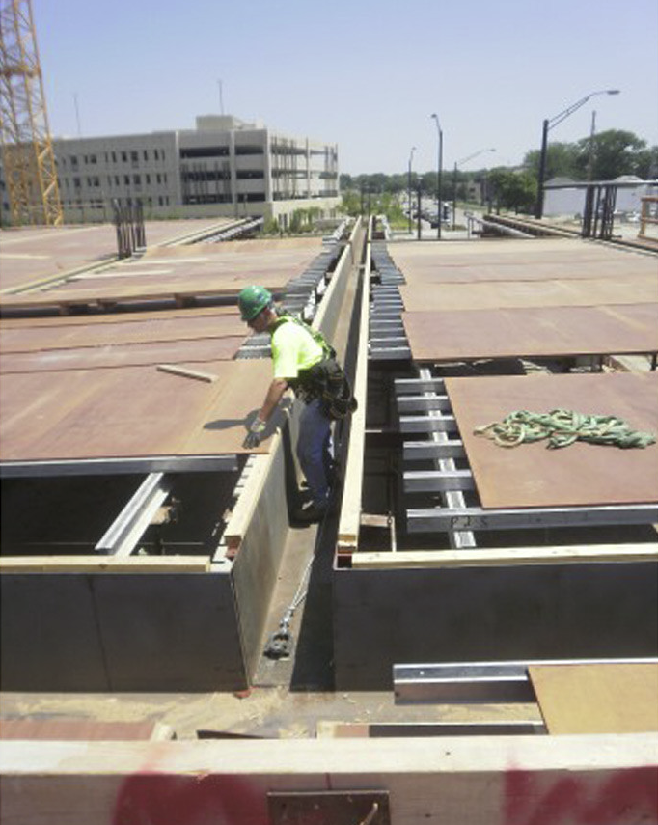
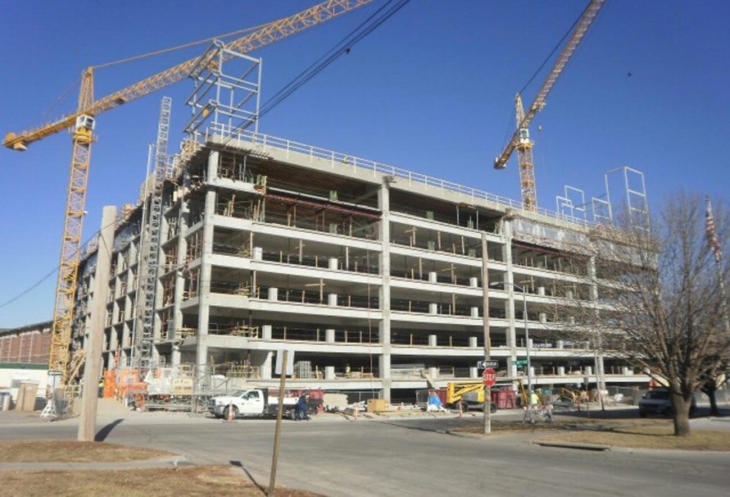
Typical parking garage structures
Cast-in-Place Concrete Garages have their own set of typical problems:
Possibility for error in creating a long-lasting and durable product.
Concrete properties get affected by transporting, placement, or finishing activities
Prior to concrete placement, steel reinforcement must be placed on site in forms.
Insufficient concrete cover can result in steel that is too close to the surface
Corrosion can lead to expansion of the steel, delamination of the concrete, and ultimately spalling
Notes:
Cast-in-Place Concrete Garages
While cast-in-place garages do not suffer from connection failures, they have their own set of typical problems.
Because the concrete is mixed in a plant and then transported to and cured on site, where conditions are variable, there is a possibility for error in creating a long-lasting and durable product.
If the concrete properties get affected by transporting, placement, or finishing activities, the finished concrete may be more susceptible to cracking and chloride intrusion from deicing chemicals or freeze-thaw cycling from winter weather, leaving it prone to premature deterioration.
Prior to concrete placement, steel reinforcement must be placed on site in forms. Placement of reinforcement is crucial not only to achieve the specified structural capacity of the members, but also for durability.
Insufficient concrete cover can result in steel that is too close to the surface, increasing potential for corrosion from chloride-laden moisture.
Corrosion can lead to expansion of the steel, delamination of the concrete, and ultimately spalling, where the surface of the concrete breaks apart.

Slide 7
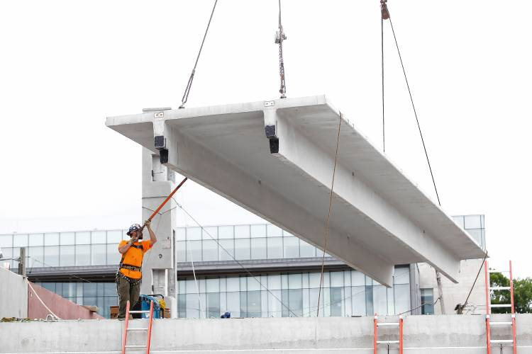
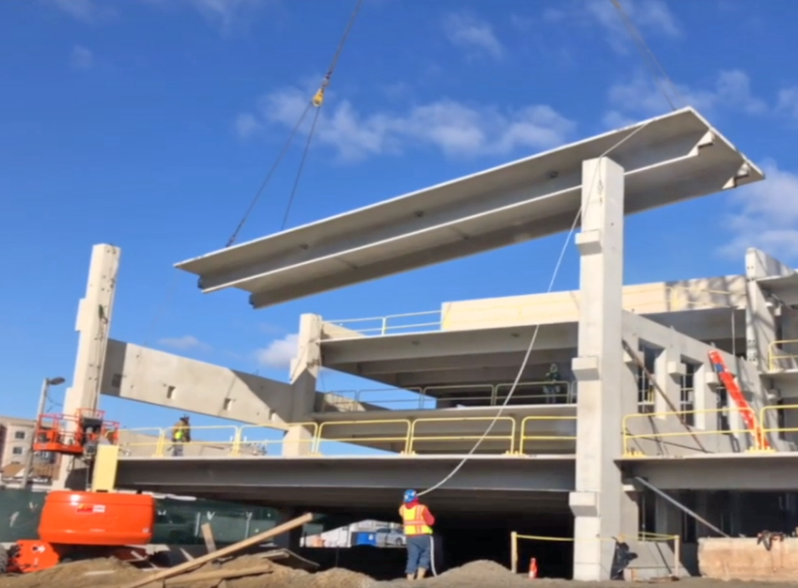
Typical parking garage structures
Precast Concrete Garages
Precast decks have a far greater number of joints than their cast-in-place counterparts.
Each time a car passes through one of these joints, the connections experience stress reversals from the up-and-down motion.
Welded steel connections along the joint may become fatigued, and the joint “unzips”.
Structural integrity of the parking structure is compromised.
Important to thoroughly investigate parking deck joints for signs of distress and failure.
Notes:
Precast elements are cast in a factory and assembled in the field, which means that precast decks have a far greater number of joints than their cast-in-place counterparts.
Each time a car passes through one of these joints, the connections experience stress reversals from the up-and-down motion.
After millions of these reversals, the welded steel connections along the joint may become fatigued, and the joint “unzips” along its length as connections fracture.
As this happens at more and more connections, the structural integrity of the parking structure is compromised.
This makes it important to thoroughly investigate parking deck joints for signs of distress and failure.

Slide 8
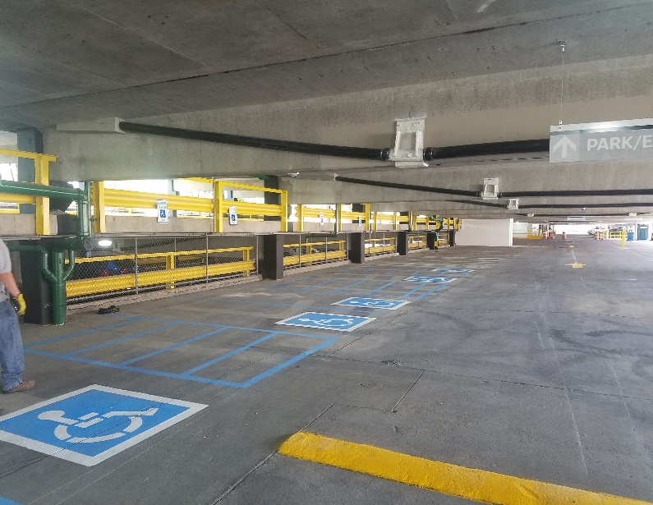
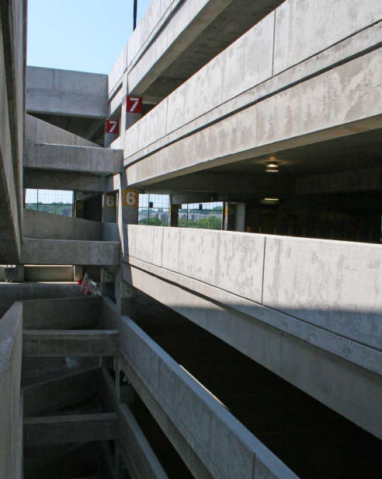
Typical Parking Garage Structures
Post Tensioned Cast-In-Place Concrete Garages
Cost to maintain is typically less
Growing solution to lower maintenance and a lighter environmental footprint
Virtually crack-free, maintenance free and great aesthetic freedom and flexibility
Structural floor configurations are virtually limitless
Allows long column-free spans and is adaptable to other functional requirements
Accommodates slopes to drains, ramps, warped surfaces
and irregular layouts
Higher structural integrity, redundancy and resistance to catastrophic loading
Notes:
Post Tensioned Cast-In-Place Concrete Garages
Post tensioned cast in place concrete construction is one of the most economical construction systems available for parking garages. Over the life of the structure, the cost to maintain cast-in-place, post-tensioned parking garages is typically less than that of alternative systems.
In today’s marketplace, design and construction solutions must go beyond durability and economy to also offer low maintenance and a lighter footprint on the environment. Post-tensioned structures are a growing solution to meet this need.
Properly designed and detailed, cast-in-place post-tension concrete parking structures are virtually crack-free, maintenance free and offer great aesthetic freedom and flexibility for today’s architectural designs. Cast-in-place, post-tensioned construction allows for versatility in structural layout. Structural floor configurations are virtually limitless.
Construction with post-tensioning allows long column-free spans and is adaptable to other functional requirements of parking structures.
Post-tensioned structures can easily accommodate slopes to drains, straight or curved ramps, warped surfaces that provide smooth transitions between ramps and level floors, and irregular plan layouts.
Well detailed cast-in-place post-tensioned structures have significantly higher structural integrity, redundancy and resistance to catastrophic loading than precast systems.

Slide 9
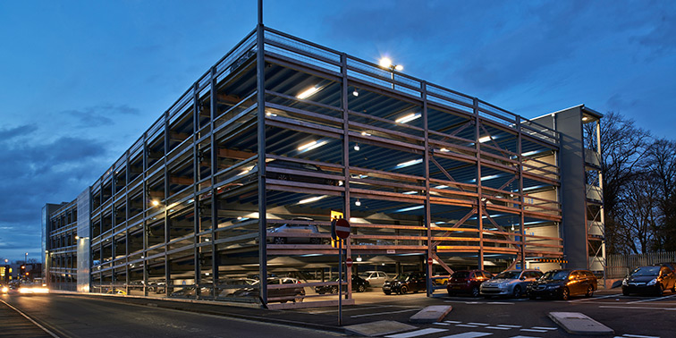
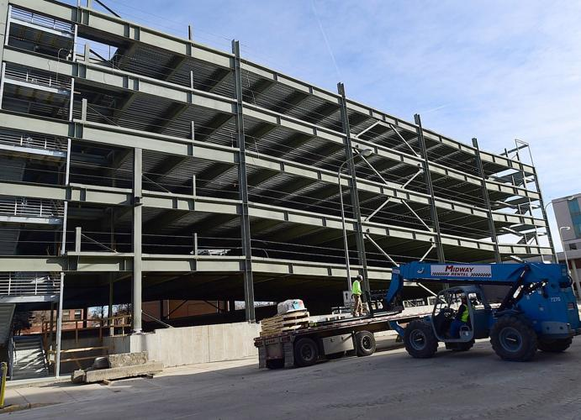
Typical parking garage structures
Steel-Framed Garages
Contain structural steel framing members which support concrete parking decks.
Either formed and cast as conventionally reinforced concrete slabs or cast on galvanized metal forms or composite deck (corrugated steel).
Metal deck components within steel-framed garages are subject to deterioration
Steel is susceptible to corrosion in wet, chloride-rich environments,
Galvanized coating can become worn or compromised over time
Notes:
Steel-Framed Garages
Steel-framed parking structures contain structural steel framing members which support concrete parking decks. These decks are either formed and cast as conventionally reinforced concrete slabs, or they are cast on galvanized metal forms or composite deck (corrugated steel).
The metal deck components within steel-framed garages are subject to deterioration via chloride-laden moisture from above, they are also directly exposed to atmospheric moisture from humidity and condensation.
Steel is susceptible to corrosion in wet, chloride-rich environments, which are often present in coastal regions or in areas where deicing chemicals are used.
Steel deck typically contains a sacrificial galvanized coating, and structural steel is coated with paints for protection. Nonetheless, these coatings can become worn or compromised over time, allowing exposure to moisture and initiation of the corrosion process. On exposed structural steel elements, this corrosion can be readily visible and evaluated.

Slide 10
Three Investigation Phases
Those involved in the operation, maintenance, and restoration are key to ensuring structures are maintained in a state of good repair. Failure to do so leads to:
    Increased repair costs,
    Potential loss of revenue due to closure of the facility
    Structural failure resulting in a loss of life.
Investigation strategies are divided in to three phases:
1st Phase
Early Indicators
2nd Phase
Advancing Corrosion in Reinforcing Steel.
3rd Phase
Advanced Corrosion and Deterioration
Notes:
Parking garages and other concrete structures are often exposed to severe corrosive environments leading to deterioration that necessitate the need for evaluations, repairs, and rehabilitation.
Owners, engineers, architects, and contractors involved in the operation, maintenance, and restoration of parking garages play a key role in ensuring the structures are maintained in a state of good repair.
Failure to do so lead to increased repair costs, potential loss of revenue due to closure of the facility, and, in the absolute worst case, structural failure resulting in a loss of life.
To counter such issues, the investigation strategies are divided in to three phases.
First Phase – Early Indicators.
Second Phase – Signs of Advancing Corrosion in Reinforcing Steel.
Third Phase - Advanced Corrosion and Deterioration.

Slide 11
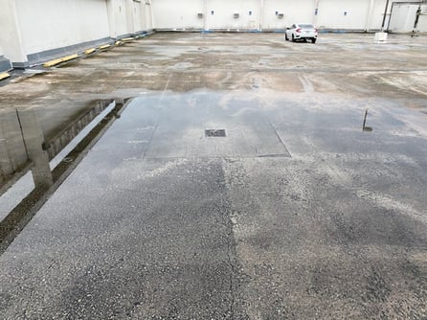
First Phase – Early Indicators
Early indicators commonly seen that accelerate the deterioration process include:
  Water Entry
  Water Ponding
  Drainage system defects
  Chloride and deicing salt
  Carbonation
Notes:
Parking structures are exposed to several harsh conditions. Temperature changes, exposure to de-icing salts, ultra-violet rays and the occasional vehicle collision add to their performance challenges.
The result is deterioration and damage to the structural system, often occurring in as little as three years after initial construction. These frequently used structures are exposed to the environment and often neglected, resulting in dripping ceilings, cracked concrete, rusted steel and pot-holed drive aisles.
To avoid such damages the property managers should take proactive measures to detect such conditions in their early stages and provide necessary repairs to stop further propagation of the deterioration.
Few of the early indicators commonly seen that accelerate the deterioration process include-
Water Entry
Water Ponding
Drainage system defects
Chloride and deicing salt
Carbonation

Slide 12
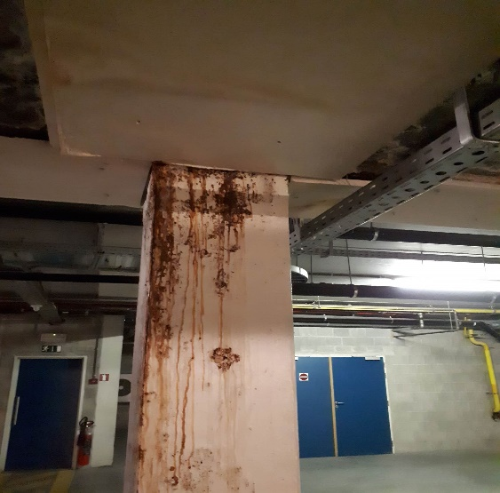
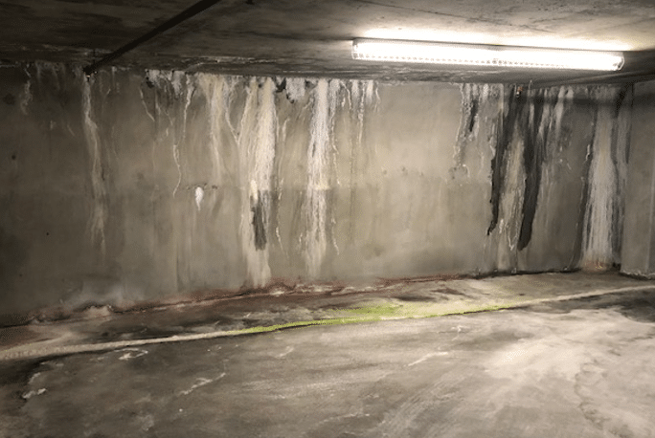
First Phase – Early Indicators
Water Entry - Parking structures are susceptible to a lot of water damage.
Three indicators that water leakage is occurring are: exposed metals rusting, rust stains along the walls and efflorescence.
Water leakages in the ceiling can sometimes cause efflorescence, visible as white mineral crystals. This is a sign that water is entering the concrete, which can cause serious damage to embedded steel.
Efflorescence can also show up on the vertical faces of beams and slabs, which could lead to failure of the post-tensioning system.
Note if there are any rust stains along the walls.
The longer the condition is left unattended, the more expensive the consequences can become.
Notes:
Water Entry
Parking structures are susceptible to a lot of water damage.
Leaking water is evident that a parking garage needs repairs. The longer the condition is left unattended, the more expensive the consequences can become.
Water leakages in the ceiling can sometimes cause efflorescence, visible as white mineral crystals. Although the crystals themselves are nothing to be concerned with, this is a sign that water is entering the concrete, which can cause serious damage to embedded steel.
Efflorescence can also show up on the vertical faces of beams and slabs, which could lead to failure of the post-tensioning system.
When checking for water leaks, also note if there are any rust stains along the walls. Normally, the longer you leave water leaks unattended, the more it will cost you to repair in the future.
Three indicators that water leakage is occurring are: exposed metals rusting, rust stains along the walls and efflorescence.

Slide 13
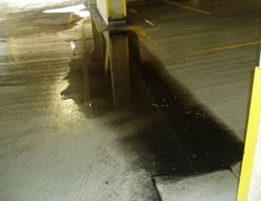
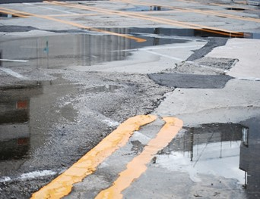
First Phase – Early Indicators
Ponding Water - parking garages are designed to remain dry and drain water and snow easily
Water and parking garages do not associate well, and standing water is an issue.
In many cases, ponding water causes concrete to sag, which can lead to water ponding in other areas.
To ensure water ponding does not happen again in your parking garage, complete any necessary repairs to the drains and to the protective waterproof membrane.
A simple drain installation or protective waterproof membrane will prevent future, larger problems.
Notes:
Ponding Water
Properly constructed parking garages are designed to remain dry and drain water and snow easily.
Water and parking garages do not associate well, so standing water is an issue. So, if there’s pooling water found during your condo parking garage inspection, don’t ignore it.
In many cases, ponding water causes concrete to sag, which can lead to water ponding in other areas.
To ensure water ponding does not happen again in your parking garage, complete any necessary repairs to the drains and protective waterproof membrane.
A simple drain installation or protective waterproof membrane will prevent future, larger problems.

Slide 14
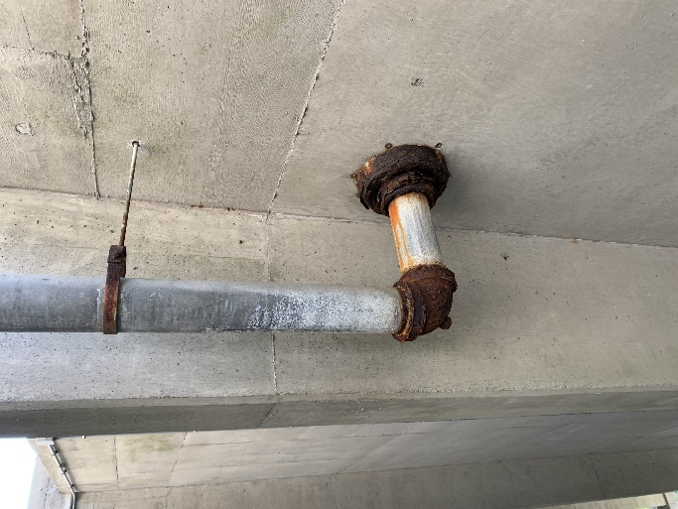
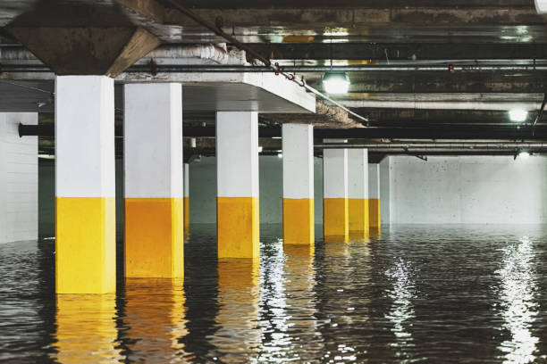
First Phase – Early Indicators
Drainage Systems
One of the biggest problems with parking garage drainage systems is frequent clogs, especially if you have large grates.
Car fluids, weed killers and road salt are highly corrosive. When these chemicals flow into your parking garage drains, they can quickly cause the metal of the plumbing pipes to rust and corrode.
Once the pipes are cracked, it can cause further deterioration of the structure.
Notes:
Drainage Systems
One of the biggest problems with parking garage drainage systems is frequent clogs, especially if you have large grates.
Car fluids, weed killers and road salt are highly corrosive. When these chemicals flow into your parking garage drains, they can quickly cause the metal of the plumbing pipes to rust and corrode.
This can cause holes and cracks in your parking garage drainage system.
Once the pipes are cracked, it can cause further deterioration of the structure.

Slide 15
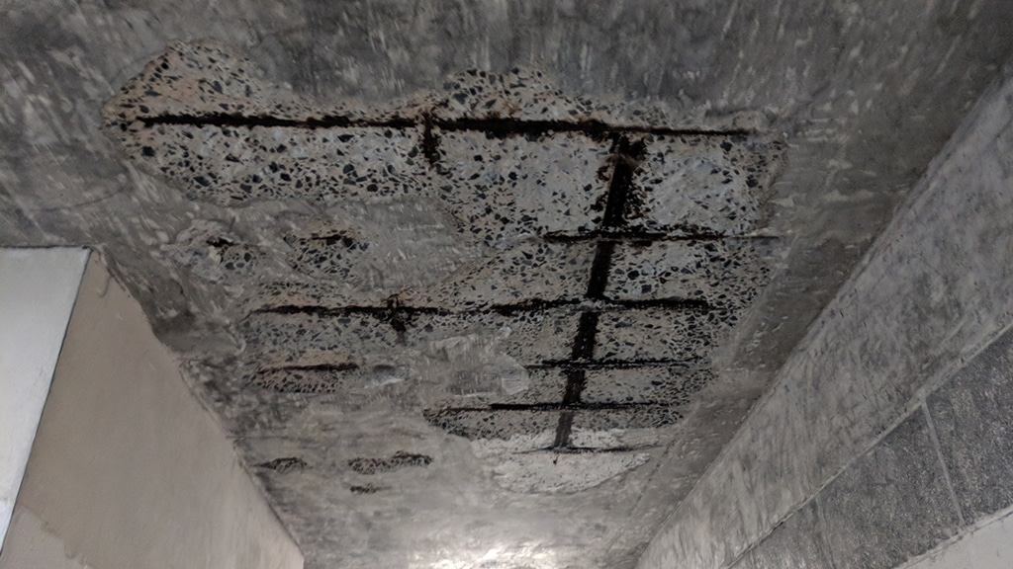
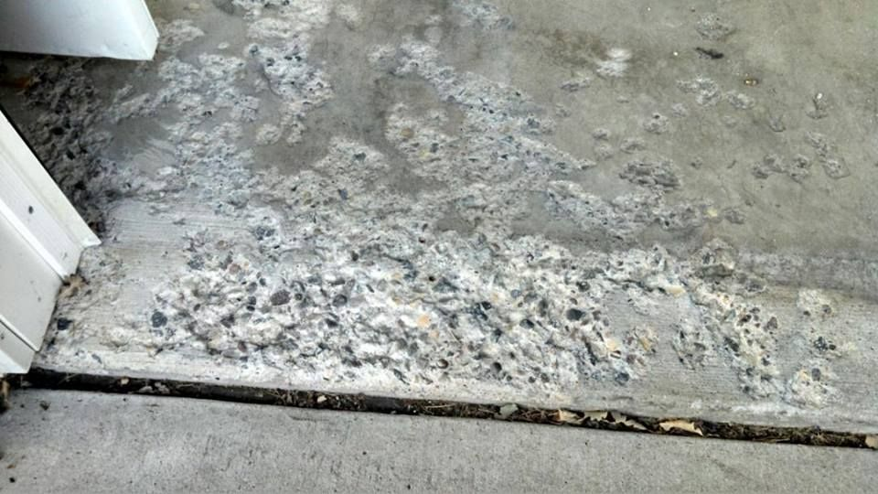
First Phase – Early Indicators
Winter and Coastal Environmental Effects – De-Icing Salts, Salt Water, Chlorides
Exposure of reinforced concrete to chloride ions is the primary cause of premature corrosion of steel reinforcement
Chloride ions, present in deicing salts and seawater, into reinforced concrete can cause steel corrosion if oxygen and moisture are also available to sustain the reaction.
Chlorides dissolved in water can permeate through sound concrete or reach the steel through cracks.
No other contaminant is documented as extensively in the literature as a cause of corrosion of metals in concrete than chloride ions.
Notes:
Winter and Coastal Environmental Effects – De-Icing Salts, Salt Water, Chlorides
Exposure of reinforced concrete to chloride ions is the primary cause of premature corrosion of steel reinforcement .
The intrusion of chloride ions, present in deicing salts and seawater, into reinforced concrete can cause steel corrosion if oxygen and moisture are also available to sustain the reaction.
Chlorides dissolved in water can permeate through sound concrete or reach the steel through cracks.
No other contaminant is documented as extensively in the literature as a cause of corrosion of metals in concrete than chloride ions.

Slide 16
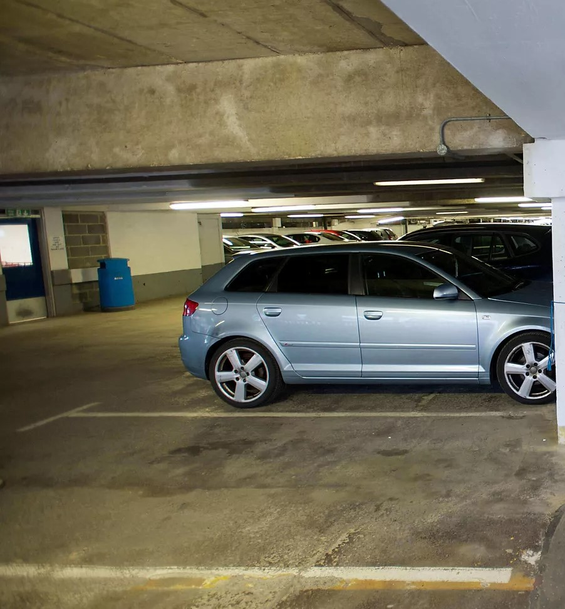
First Phase – Early Indicators
Carbonation - enclosed Parking Garages, Automobile Exhaust
Carbonation:
  Occurs when carbon dioxide from the air penetrates the concrete and reacts with hydroxides, such as calcium hydroxide, to form carbonates.
  Is highly dependent on the relative humidity of the concrete.
Carbonation-induced corrosion often occurs on areas of building facades that are exposed to rainfall, shaded from sunlight, and have low concrete cover over the reinforcing steel.
Notes:
Carbonation, enclosed Parking Garages, Automobile Exhaust
Carbonation occurs when carbon dioxide from the air penetrates the concrete and reacts with hydroxides, such as calcium hydroxide, to form carbonates.
Carbonation is highly dependent on the relative humidity of the concrete.
Carbonation-induced corrosion often occurs on areas of building facades that are exposed to rainfall, shaded from sunlight, and have low concrete cover over the reinforcing steel.

Slide 17
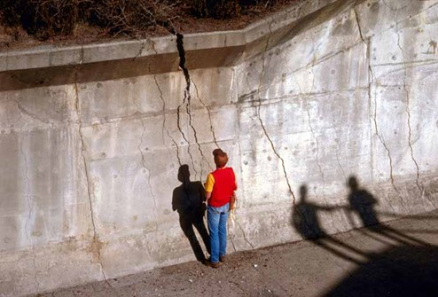
First Phase – Creating Your Preventative Maintenance Plan and Extending your Expected Useful Life
Basis of the Useful Life Preventative Maintenance Strategy
Continual Visual Inspections are key
  Monitoring should be done from day one during construction and once construction is complete
  By maintenance staff, daily, weekly
  Inspections during rain and snow melt events to observe environmental effects
Deal with the early indicators, the essential structure envelope protection systems need to be reviewed, assessed, and maintained.
Notes:
Basis of the Useful Life Preventative Maintenance Strategy
Continual Visual Inspections and monitoring should be done from day one during construction and once construction is complete by maintenance staff, daily, weekly as planned by Professional Engineers for expert opinions and recommendations.
Inspections during rain and snow melt events to observe environmental effects
To extend deal with the early indicators, the essential structure envelope protection systems need to be planned to be visually reviewed, assessed, and maintained.

Slide 18
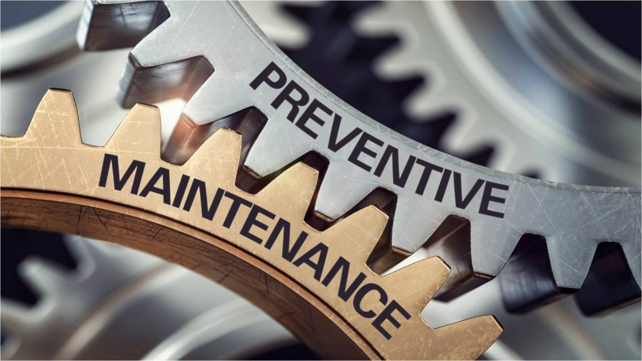
First Phase – Creating Your Preventative Maintenance Plan and Extending your Expected Useful Life
The main structure envelope and control elements
to be continually monitored:
  Traffic Coating, Waterproof Membranes, Sealants
  Expansion Joints
  Ensuring Proper Drainage and deck sloping
  Interior Humidity Control – keeping things dry
Notes:
The main structure envelope and control elements to be continually monitored:
Traffic Coating, Waterproof Membranes, Sealants
Expansion Joints
Ensuring Proper Drainage and deck sloping
Interior Humidity Control – keeping things dry

Slide 19
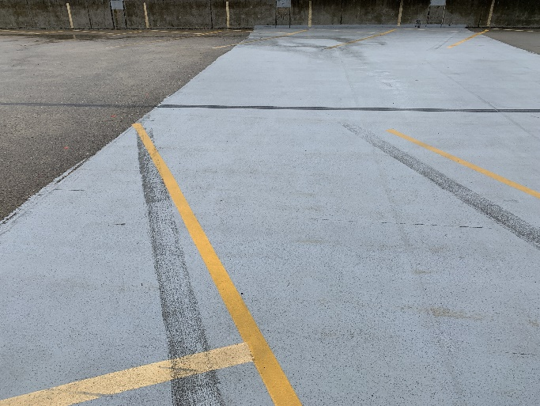
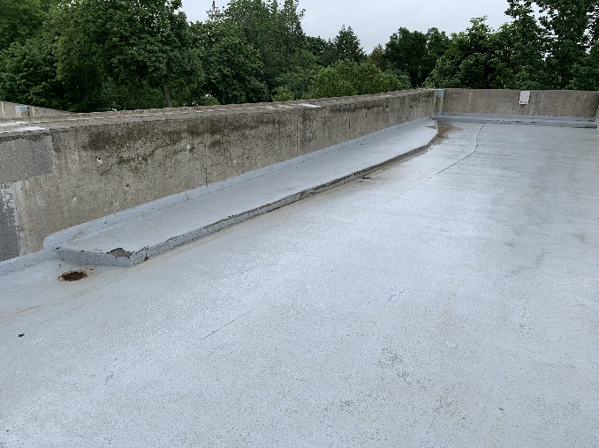
First Phase – Inspection and Preventative Maintenance Strategies
Traffic Coating and Waterproof Membranes
Biannual traffic coating/ waterproof membrane, expansion joint inspection and repair/ replacement strategies
Rubberized Traffic Coating
Protective Waterproof Sealants, coatings, and membranes need to be maintained
Any compromises in coating needs to be repaired as soon as possible.
Notes:
Biannual traffic coating/ waterproof membrane, expansion joint inspection and repair/ replacement strategies
Rubberized Traffic Coating
Protective Waterproof Sealants, coatings, and membranes need to be maintained
Any compromises in coating needs to be repaired as soon as possible.

Slide 20
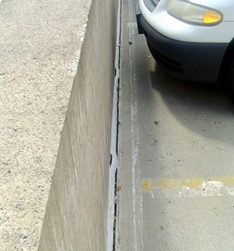
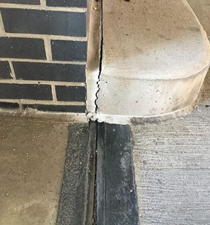
First Phase – Inspection and Preventative Maintenance Strategies
Visual Monitoring – First Lines of Defense
Expansion Joint Failure:
Provides another possibility for water to penetrate and reach the reinforcing steel and T-to-T connector plates.
Repairing is much easier than resolving issues created by corroded reinforcing steel and connector plates.
Responding quickly to make repairs will be beneficial in the long run.
Wear at the T-to-T joints, expansion joint failure and flange connection deterioration are commonly found in Double Tee Precast structures.
Notes:
Visual Monitoring – First Lines of Defense
Expansion Joints
Expansion Joint Failure – Failed expansion joints provide another possibility for water to penetrate and reach the reinforcing steel and T-to-T connector plates. Repairing expansion joints is much easier than resolving issues created by corroded reinforcing steel and connector plates. Detecting expansion joint problems and responding quickly to make repairs will be beneficial in the long run. Wear at the T-to-T joints, expansion joint failure and flange connection deterioration are commonly found in Double Tee Precast structures.

Slide 21
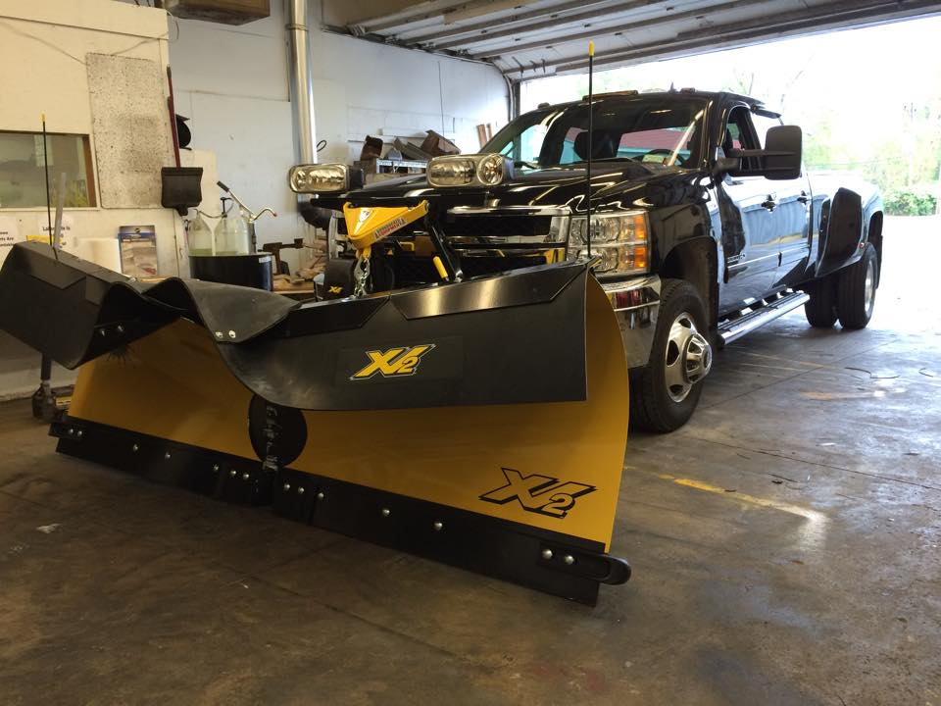

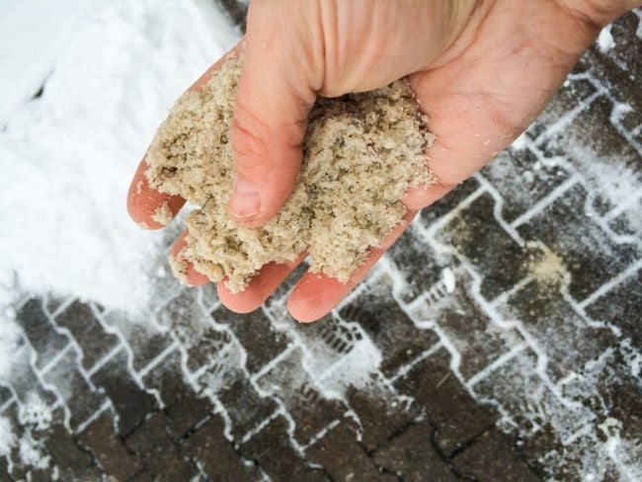



First Phase – Inspection and Preventative Maintenance Strategies
First Phase Preventative Maintenance Strategies:
Snow Removal Plan/Strategy,
No De-Icing Salts, Use Sand
Rubber Grating Guards
Marking out Expansion joints for snow clearing to protect integrity
Notes:
First Phase Preventative Maintenance Strategies
Snow Removal Plan/Strategy,
No De-Icing Salts, Use Sand
Rubber Grating Guards, Marking out
Expansion joints for clearing to protect
Drainage strategy, slope, and drains

Slide 22
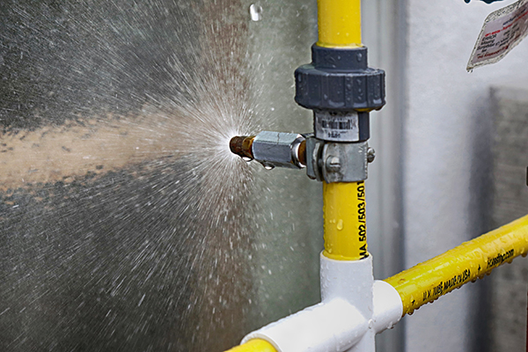
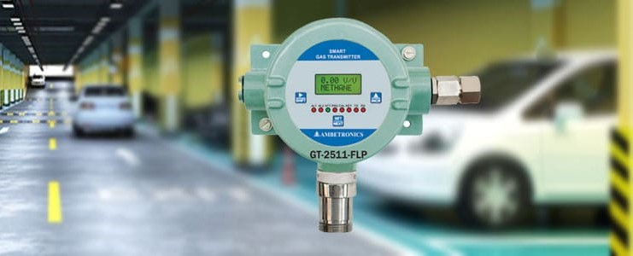
First Phase – Inspection and Preventative Maintenance Strategies
Some simple tests during phase one visual inspections:
Water Tests for reviewing leaking, drains, expansion joints
Moisture/ Humidity Readings
CO₂ Exhaust Monitors

Slide 23
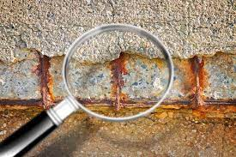
Second Phase – Signs of Advancing Corrosion in Reinforcing Steel
Reinforcing Corrosion - Cracking and Delamination.
Corrosion of reinforcing steel and other embedded metals is the leading cause of deterioration in concrete.
Expansion creates tensile stresses in the concrete, which can eventually cause cracking, delamination, and spalling.
Along with delaminating and spalling, vertical and horizontal cracks in the concrete also correspond to impending areas of weakness.
This type of damage is commonly seen on Post-Tensioned and Conventional Cast-In-Place concrete parking garages.
Notes:
Second Phase- Reinforcing Corrosion: Cracking and Delamination.
Corrosion of reinforcing steel and other embedded metals is the leading cause of deterioration in concrete. When steel corrodes, the resulting rust occupies a greater volume than the steel.
This expansion creates tensile stresses in the concrete, which can eventually cause cracking, delamination, and spalling. Concrete is bound to crack at some locations. Delaminated or spalled concrete is when a piece of concrete detaches from the structure.
Along with delaminating and spalling, vertical and horizontal cracks in the concrete also correspond to impending areas of weakness. These issues are problematic as they can lead to structural damage because they allow water to reach the garage’s reinforcing steel. This type of damage is commonly seen on Post-Tensioned and Conventional Cast-In-Place concrete parking garages.

Slide 24
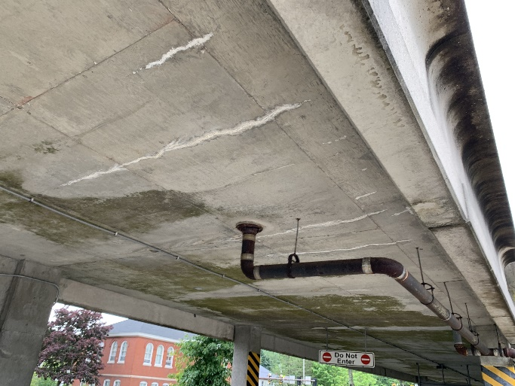
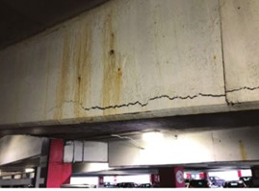
Second Phase – Signs of Advancing Corrosion in Reinforcing Steel
Cracking - Parking garage concrete deterioration can require costly remediation if left untreated.
Parked cars leave behind salt and water that pool together, eventually causing dips or cracks in the concrete.
Emissions can also settle into the concrete slab, causing cracks and allowing water to seep in between
Water seepage corrodes rebar, compromising the structural integrity of the parking deck
Older concrete parking garages are particularly vulnerable to deterioration and if left untreated can change from a small repair to a total parking deck re-build.
Notes:
Cracking
Parking garage concrete deterioration is caused by many factors and can require costly remediation if left untreated.
Parked cars leave behind salt and water that pool together, eventually causing dips or cracks in the concrete.
Emissions left trapped in the garage can also settle into the concrete slab, interfering with the chemical makeup of the aggregates, causing cracks and allowing water to seep in between and creating more damage.
Water seepage also corrodes rebar, eventually compromising the structural integrity of the parking deck, due to the expansive nature of rust.
Older concrete parking garages are particularly vulnerable to deterioration and if left untreated can change from a small repair to a total parking deck re-build.

Slide 25
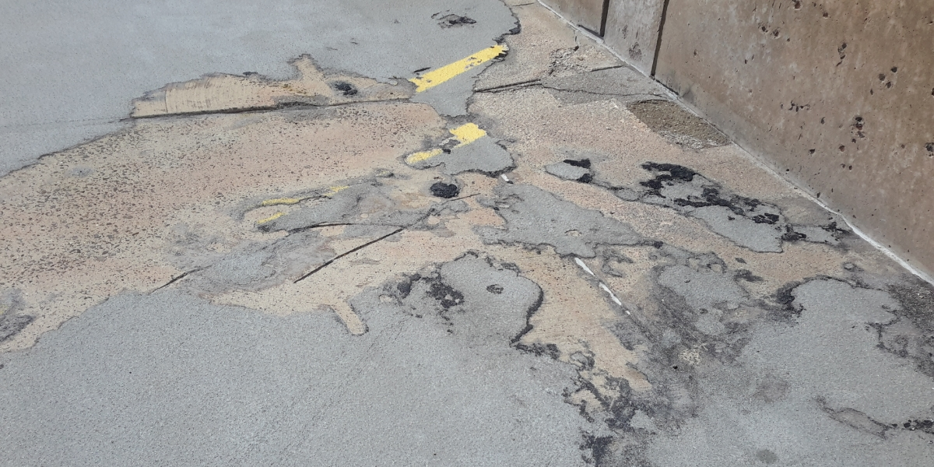
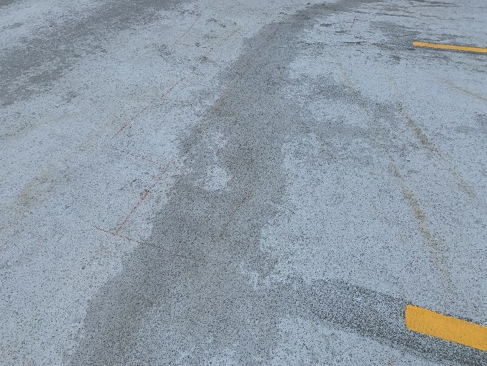
Second Phase – Signs of Advancing Corrosion in Reinforcing Steel
Delamination
Mostly due to premature and improper finishing and a thin layer of air or water causing the separation.
Affected area may range in size depending on the severity of the delamination
Happens when reinforcing steel in the upper layer rusts, breaking the bonding between the steel and surrounding concrete.
More apt to occur with a thin concrete cover and with permeable concrete
Risk of delaminated concrete increases when conditions for rapid drying of the surface are present i.e., low humidity, sun, and wind.
Notes:
Delamination
This is mostly due to premature and improper finishing and a thin layer of air or water causing the separation.
An affected area may range in size depending on the severity of the delamination, from several square inches to square feet.
This situation happens when reinforcing steel in the upper layer rusts which breaks the bonding between the steel and surrounding concrete.
It’s more apt to occur with a thin concrete cover and with permeable concrete which allows chloride penetration to the steel layer.
The risk of delaminated concrete increases when conditions for rapid drying of the surface are present, such as low humidity, sun, and wind.

Slide 26
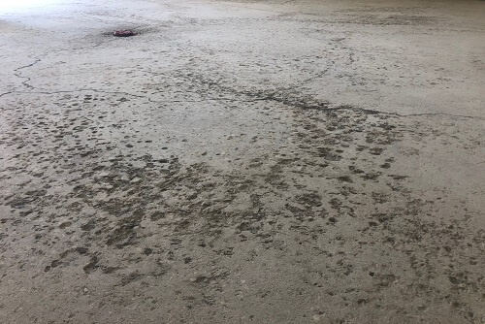
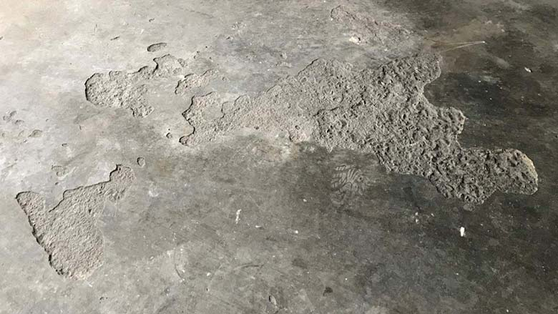
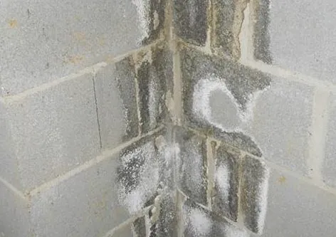
Second Phase – Signs of Advancing Corrosion in Reinforcing Steel
Concrete Pitting, Flaking and Staining
Pitting is when the surface of a concrete structure begins to deteriorate. It’s defined by a cluster of small holes that appear on the surface of the concrete caused by a problem with the concrete’s structural integrity,
  Pitting is extremely dangerous; because it indicates a problem with the concrete’s integrity, it means that your concrete is structurally weak.
Concrete flaking is very similar to pitting. It also refers to the deterioration of a concrete structure’s surface.
  Concrete flaking is caused by water exposure and the freeze-thaw effect.
Concrete Staining include efflorescence, mold, discoloration and rust stains.
Notes:
Concrete Pitting, Flaking and Staining
Concrete may seem like one of the toughest materials in the world but, as you examine it closer, you’ll realize that it has one major flaw: its porosity.
By allowing water to seep through, concrete makes itself vulnerable to erosion. Water is an erosive element capable of displacing concrete particles. At first, the damage done by erosion is trivial, but as time goes on, things get more and more severe as the concrete gets weaker.
Weak concrete cracks a lot easier, and the cracks only serve to allow even more water through. Concrete pitting is when the surface of a concrete structure begins to deteriorate. It’s defined by a cluster of small holes that appear on the surface of the concrete.
Concrete pitting is extremely dangerous; because it indicates a problem with the concrete’s integrity, it means that your concrete is structurally weak.
Concrete flaking is very similar to pitting. It also refers to the deterioration of a concrete structure’s surface. The difference between concrete pitting and concrete flaking lies in the different causes and in how the concrete itself is affected. Concrete pitting is caused by a problem with the concrete’s structural integrity, but concrete flaking is caused by water exposure and the freeze-thaw effect.
Concrete Staining include efflorescence, mold, discoloration and rust stains.

Slide 27
Second Phase – Advancing Corrosion and Concrete Deterioration - Planning for the Unexpected and Avoiding the Worst
Use this phase to understand and create the Second Part of a comprehensive Useful Life Preventative Maintenance Strategy
Continual Visual Inspections along with monitoring
Utilizes more thorough investigation with expert knowledge
Engineering Studies and Invasive Testing methods
Implementing advanced methods of preventative measures for repair (Concrete deterioration and reinforcing corrosion)
Notes:
Basis of the Useful Life Preventative Maintenance Strategy
Continual Visual Inspections and monitoring
Should be done from day one during construction, once construction is complete by maintenance staff, daily, weekly. As planned by Professional Engineers for expert opinions and recommendations.
Inspections during rain and snow melt events to observe environmental effects
To extend deal with the early indicators, the essential structure envelope protection systems need to be planned to be visually reviewed, assessed, and maintained

Slide 28
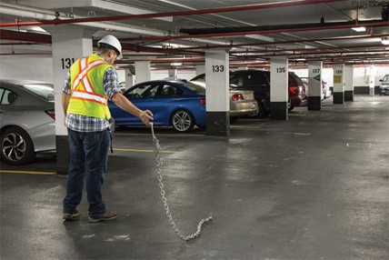
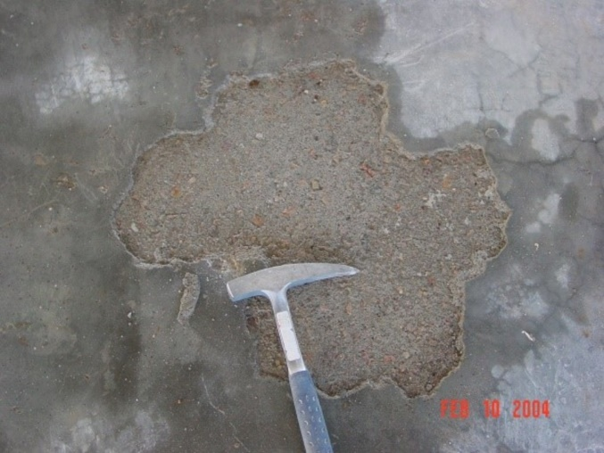
Second Phase – Signs of Advancing Corrosion and Concrete Deterioration
Second Phase Investigation Strategy and Testing Methods
Structural Engineering Studies and Monitoring – Non-Invasive:
Site inspections to review existing conditions
Engineering reports with failure analysis and recommendations
Seismic evaluation
Chain dragging
Corrosion Half Cell Tests
Hammer sounding
Delamination documentation
Crack Gauge Monitoring
Condition reporting
Notes:
Structural Engineering Studies – Non-Invasive:
Site inspections to review existing conditions
Engineering reports with failure analysis and recommendations
Seismic evaluation
Chain dragging
Hammer sounding
Delamination documentation
Condition reporting

Slide 29
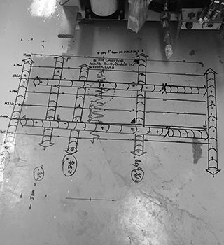
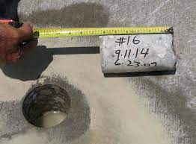
Second Phase – Signs of Advancing Corrosion and Concrete Deterioration
Second Phase - Investigation Strategy and Testing Methods
Structural Engineering Studies – Invasive:
Invasive and technical inspections utilizing technical
sub – contractor trades
GPR (Ground Penetrating Radar) scans – checking concrete cover
Concrete cores analysis - composition and strength analysis
Concrete Chloride Ion Testing
Notes:
Structural Engineering Studies – Invasive:
Invasive and technical inspections utilizing technical sub – contractor trades
GPR (Ground Penetrating Radar) scans
Concrete cores analysis - composition and strength analysis
Crack monitoring/ assessment

Slide 30
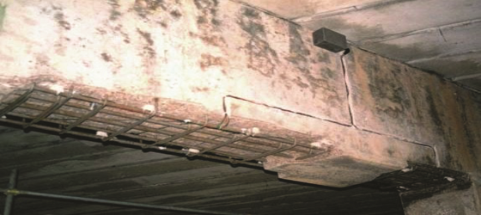
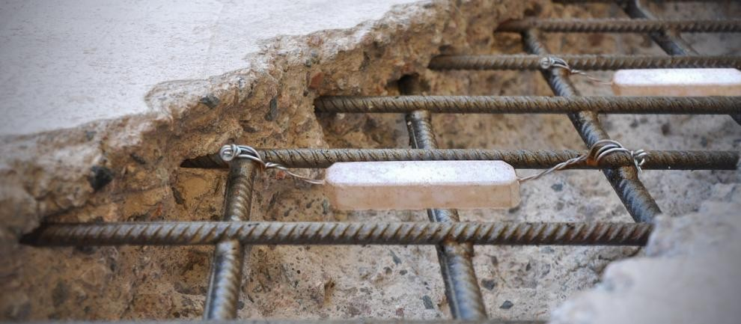
Second Phase – Signs of Advancing Corrosion and Concrete Deterioration
Second Phase Repair methods:
Latest developments in technology have provided new and effective ways to prolong the life of parking structures. Such developments consist of conventional means, including better coatings and sealants, as well as all new methods of handling challenging concrete repairs. Parking structure restoration services that may be utilized include:
Cathodic and Sacrificial Galvanic Anode protection
Shotcrete (spray applied concrete)
Post Tension Reinforcing – Strand Impregnation
Traditional Crack Repairs such as Epoxy and Chemical Grout
Notes:
Second Phase Repair methods:
Latest developments in technology have provided new and effective ways to prolong the life of parking structures. Such developments consist of conventional means, including better coatings and sealants, as well as all new methods of handling challenging concrete repairs. Parking structure restoration services that may be utilized include:
Cathodic protection.
Shotcrete (spray applied concrete).
Sacrificial galvanic anodes.

Slide 31

Third Phase – Advanced Corrosion and Deterioration
This should be avoided at all costs!
Advanced deterioration
Immediate Major Structural and Concrete Replacement/ Repairs are required

Slide 32
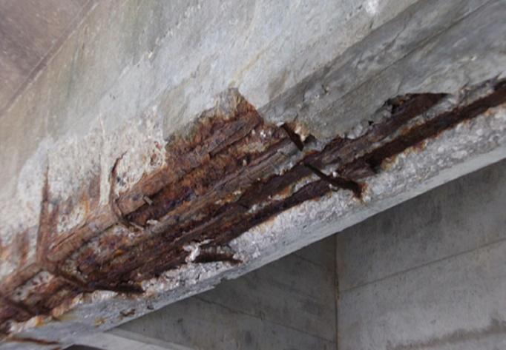
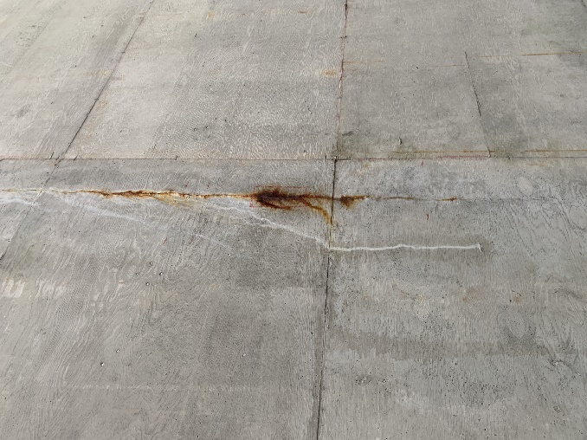
Third Phase – Advanced Corrosion and Deterioration
Advanced Reinforcing Bar Corrosion
Corrosion of reinforced steel makes up more than 80 per cent of all damage to reinforced concrete structures
Corrosion affects a concrete structure’s integrity when the products of corrosion (rust) occupy a greater overall volume than the original steel.
By the time the signs of damage become visible externally, the extent of the corrosion of reinforcement steel has reached an advanced stage.
When steel begins to rust and have pit or holes in its surface, reduced strength capacity is seen, negatively affecting the structure’s viability.
Corrosion affects a concrete structure’s integrity when the products of corrosion (rust) occupy a greater overall volume than the original steel.
Notes:
Advanced Reinforcing Bar Corrosion
Corrosion of reinforced steel in concrete is a global problem, deteriorating structures at an extremely high rate. The issue makes up for more than 80 per cent of all damage to reinforced concrete structures, continuing to rack up the repair costs for countries.
With repair to steel in concrete climbing, sustainability measures cannot be feasibly met. The steel rebar used in concrete strengthens the structure by providing a solid tensile strength concrete normally lacks.
When the steel begins to rust and produce pits or holes in its surface, a reduced strength capacity is seen, which negatively affects the structure’s viability.
Corrosion begins to affect a concrete structure’s integrity when the products of corrosion (rust) occupy a greater overall volume than the original steel.
This expansion then creates tensile stresses in the concrete that cause the concrete to stain, crack, and spall.
By the time the signs of damage become visible externally, as in on the outside of the concrete structure, the extent of the corrosion of reinforcement steel has reached an advanced stage.
At this point, regardless of where the site is located, the rehabilitation costs will be expensive, and the repair process complicated.

Slide 33
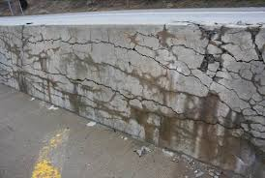
Third Phase – Advanced Corrosion and Deterioration
ASR Effects - a chemical reaction between alkalis from the cement paste, and silica from reactive aggregates.
Pressure develops in the ASR gel and causes tensile stresses in the surrounding material. Micro cracks develop in a diffuse pattern.
A structural assessment of an ASR-affected concrete structure, includes tests that can assess the degree of damage and expansion of concrete.
Non-destructive test methods (ultrasonic pulse velocity, dynamic modulus of elasticity and electrical resistivity) can be used to identify the extent of the damage.
Destructive methods, by drilling cores for mechanical testing and petrographic examination, are the most promising tools to assess
Notes:
ASR Effects
Alkali-silica reaction (ASR) in concrete is a chemical reaction between alkalis mostly from the cement paste, and silica from reactive aggregates.
The product of the reaction is a hydrophilic gel that swells by water absorption. Pressure develops in the ASR gel and causes tensile stresses in the surrounding material.
Consequently, micro cracks develop in a diffuse pattern. The effect of ASR on the concrete is expansion (strains) and degradation of material properties like stiffness and strength.
To perform a structural assessment of an ASR-affected concrete structure, tests are needed that can assess the degree of damage and expansion of the concrete.
Non-destructive test methods (ultrasonic pulse velocity, dynamic modulus of elasticity and electrical resistivity) can be used to identify the extent of the damage but destructive methods by drilling cores for mechanical testing and petrographic examination are the most promising tools to assess the current state.

Slide 34
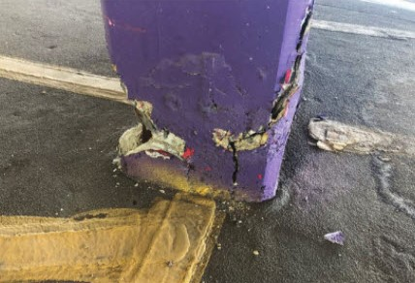
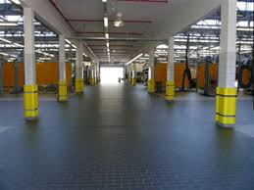
Third Phase – Advanced Corrosion and Deterioration
Structural Damage - High density, insufficient lighting, tight traffic patterns and the always-unpredictable vehicle operator can lead to structural damage in parking garages.
Damage can be caused to the facility through dents, scratches and material deterioration.
Routine maintenance and a proactive risk management approach can go a long way toward ensuring continued safe use and long-term durability.
New solutions have cut costs by mitigating the damage caused by vehicle collisions. A thin layer of protective material is wrapped around the column, softening any impact and reducing or eliminating damage.
Structural maintenance costs may be high in the short term, but it can be much less expensive than a complete structural replacement
Notes:
Structural Damage
High density, insufficient lighting, tight traffic patterns and the always-unpredictable vehicle operator can lead to structural damage in parking lots.
While some problems, like fender benders, can be caused to other cars, damage can also be caused to the facility itself through dents, scratches and material deterioration.
However, routine maintenance and a proactive risk management approach to protecting parking facilities can go a long way toward ensuring their continued safe use and long-term durability.
In recent years, new solutions have cut costs by mitigating the damage caused by vehicle collisions. In many cases, a thin layer of protective material is wrapped around the column, softening any impact and reducing or eliminating damage.
Structural maintenance costs may be high in the short term, but it can be much less expensive than a complete structural replacement in the long run.

Slide 35
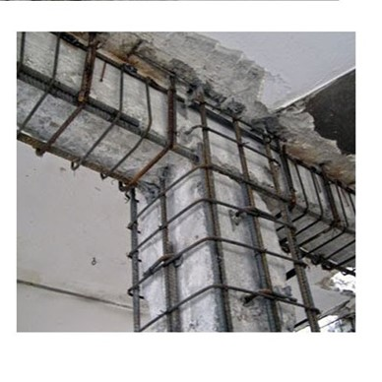
Third Phase – Advanced Reinforcement
Corrosion and Concrete Deterioration
Third Phase Repair Strategy and Methods
Parking structure restoration services that would be required:
Building Remediation/ Repair design, drafting services, construction services
Structural repair and remediation project from design to drawing preparation to construction and final inspection.
Wall or column stabilization and/ or capacity increase
Connection repair
Latest developments in technology have provided new and effective ways to prolong the life of parking structures, including better coatings and sealants and, new methods of handling challenging concrete repairs.
Notes:
Third Phase Repair methods:
Latest developments in technology have provided new and effective ways to prolong the life of parking structures. Such developments consist of conventional means, including better coatings and sealants, as well as all new methods of handling challenging concrete repairs. Parking structure restoration services that may be utilized include:
Building Remediation/ Repair design, drafting services, construction services
Structural repair and remediation project from design to drawing preparation to construction and final inspection.
Wall or column stabilization and/ or capacity increase
Connection repair
Epoxy injections.
Chemical grout injections.
Cathodic protection.
Shotcrete (spray applied concrete).
Sacrificial galvanic anodes.

Slide 36
Third Phase – Advanced Reinforcement Corrosion and Concrete Deterioration
Rehabilitation of major defects to overall structural elements
Carbon fiber reinforced polymer methods - (CFRP) strips installed on beams to enhance shear capacity.
External post‐tensioning methods for beams
  First added to the bottom flanges
  Subsequently, additional prestressing was added to the beam web.
Post Tension Connection Repairs (Button Head End Connection Replacement)
Notes:
Rehabilitation
Carbon fiber reinforced polymer methos - (CFRP) strips were installed on several beams to enhance their shear capacity.
External post‐tensioning methods for beams
First added to the bottom flanges
Subsequently, additional prestressing was added to the beam web.

Slide 37

Cost and Risk Implications
Costing Scenario Example:
4 Story, Open Air, Northern Climate, 200,000 Sqft Cast-In Place Concrete Parking Garage Structure
Overall Replacement Cost is $14,000,000
Overall Structure Estimated Useful Life (EUL) – 50 Yrs
Protective Envelope Waterproof Elements
Exterior Sealants EUL – 5 yrs
Traffic Coating EUL – 10 yrs
Expansion Joints – 30 yrs

Slide 38
Cost and Risk Implications
Worst Case
Neglect – with No Preventative Maintenance
Parking Garage does not reach its Expected Useful Life of 50 years
EUL cut in half 25 – 30 years
Risks : Extreme high risk and danger to public with concrete structure steel reinforcing deterioration
If no maintenance was implemented, could expect to replace the parking garage 3 x in a 75 year span
Notes:
Worst Case
Parking Garage does not reach Expected Useful Life of 50 years
EUL in half 25 – 30 years
Extremely high risk and danger to public

Slide 39
Cost and Risk Implications
Better Case
Building 75 Year Preventative Maintenance Plan, Inspections, and Protective Envelope Repairs (Phase 1):
Overall cost for repairs and maintenance are smaller and can be spread out
How does this plan look:
Up to Year 5 – Visual Inspections for Deficiencies in Envelope Original Design should be completed ($5,000 Study)
Up to Year 10 – Visual Inspections for Deficiencies in Structural Original Design should be completed ($10,000 Study) Site and review of original drawings
Years 10, 20, 30, 40, 50, 60, 70 - $30,000 allowance for Envelope Assessment Inspections and planned repairs for Traffic Coating and Parking Garage Sealants
Years 15, 25, 35, 45, 55, 65, 75 – $100,000 allowance for Full Traffic Coating and Waterproof Sealant Replacement
Years 25 and 55 – additional $100,000 allowance for full Expansion Joint Replacement
Total Base Preventative Maintenance Plan Cost (Phase 1) = $1,125,000 over the 75 years
Extends the EUL from 50 years to 75 or 80 years
Notes:
75 Year Preventative Maintenance Plan, Inspections, and Protective Envelope Repairs (Phase 1):
- Overall cost for repairs and maintenance are smaller and can be spread out
- An ongoing maintenance plan will be required with minimal overall costs, but expensive engineering studies and monitoring studies will not be required until new bridge reaches end of useful life
- Up to Year 5 – Visual Inspections for Deficiencies in Envelope
- Up to Year 10 – Visual Inspections for Deficiencies in Structural
- Years 10, 20, 30, 40, 50, 60, 70 - $60,000 allowance for Envelope Assessment Inspections and planned repairs for Traffic Coating and Parking Garage Sealants
- Years 15, 25, 35, 45, 55, 65 - $150,000 allowance for Full Traffic Coating and Waterproof Sealant Replacement
- Years 25 and 55 - $150,000 allowance for Expansion Joint Replacement

Slide 40
Cost and Risk Implications
Risks:
Essential to review any construction/ design deficiencies in first 5 years (Envelope), 10 years (Structural). Risk of missing any deficiencies are costly repairs in the future.
Missing essential repairs and full replacement of protective waterproof envelope systems form the maintenance plan, can allow for potential main structural elements being affected which allows for the advancement of concrete deterioration and steel reinforcing corrosion, entering into(Phase 2)
Notes:
Risks:
- Essential to review any construction/ design deficiencies in first 5 years (Envelope), 10 years (Structural). Risk of missing any deficiencies are costly repairs in the future.
- Missing essential repairs and full replacement of protective waterproof envelope systems allow for potential deterioration and eventual Phase 2 concrete deterioration and steel reinforcing corrosion

Slide 41
Cost and Risk Implications
Best Case
Including in your 75 Year Maintenance Plan allowance for Engineering Studies, Invasive Investigations, and Proactive Corrosion and Concrete Deterioration Maintenance and repairs. (Phase 2):
What does this look like:
Years 30, 50, 70 - $20,000 and $40,000 for Engineering Assessment Inspections and Repair Design
Years 35, 55, 75 - $100,000 and $150,000 for Repairs, Corrosion and Concrete Protection Methods (Expect Double for Post Tensioning Investigations and Preventative Repairs)
Total Proactive Corrosion Control and Concrete Deterioration Maintenance Plan = $500,000
Risks/ Con: - The Cost… Hopefully this would not happen, but reserve funding needs to be allowed for.

Slide 42
Cost and Risk Implications
Best Case – Combined Plan
75 Year Maintenance Plan Combined – Phase 1 and 2 Considered
Combined Total Cost 75 Year EUL = $1,625,000
By planning for this - Risks of safety to the public are eliminated and Major (Phase 3) Structural Rehabilitation costs are avoided.

Slide 43

CASE STUDY -Lessons Learned
1970 4-Storey Cast in Place Post Tensioned Parking Garage Structure – Northern Climate
Overall Construction Make Up:
Post-Tensioned, paper wrapped seven wire strand reinforcement, Cast in Place Concrete Beams and Elevated Slabs
Cast in Place Reinforced Concrete Columns
Main floor – was Cast in Place slab on grade
Architecturally - Precast concrete perimeter wall panels
Notes:
Case Study
1970 4-Storey Cast in Place Post Tensioned Parking Garage Structure – Northern Climate
Overall Construction Make Up:
- Cast in Place Reinforced Concrete Columns
- Post-Tensioned, paper wrapped seven wire strand reinforcement, Cast in Place Concrete Beams and Elevated Slabs
- Cast in Place slab on grade main floor
- Precast perimeter floor wall panels

Slide 44

CASE STUDY-Lessons Learned
Overall Replacement Cost Estimate:
$10,000,000
Estimated Expected Useful Life (EUL): 50 yrs
Well maintained Parking Garage Structures with a good Preventative Maintenance Plan should extend EUL by 20 – 25 years or more.
Notes:
Case Study
Overall Replacement Cost Estimate:
$10,000,000
Estimated Expected Useful Life (EUL): 50 yrs
Well maintained Parking Garage Structures should extend EUL by 20 – 25 years or more.

Slide 45

CASE STUDY-Lessons Learned
Historical Information
No existing Structural Drawings on file
No early maintenance/ inspection or repair details on file (Phase 1)
Earliest Structural Engineering reports were provided from 1990, at the 20-year life stage
In 1990s slab repairs were completed along with Waterproof Traffic Coating and Waterproof Spray Coatings on top of lower-level elevated slabs.
Notes:
History
- No existing Structural Drawings on file
- No early maintenance/ inspection or repair details on file (*Phase 1)
- Earliest Structural Engineering reports were provided from 1990, at the 20-year life
- Invasive and Non-Invasive Investigations were done at this time due to some visual indications of cracking in the top floor elevated slab.
- (*Phase 2)
- Report indicated that after investigations – there was corrosion in some post tensioning slab reinforcement. Repairs were recommended on the observed cracking slab areas.
- the report also indicated that the top elevated slab traffic coating/ waterproof coating was damaged and needed to be replaced

Slide 46


CASE STUDY -Lessons Learned
Current Investigations
An initial Phase 1 visual assessment review was completed
Lower-level post tensioned slabs and beams were in good condition.
Waterproof Slab sealant on lower levels were maintained and in good condition.
Top floor elevated slabs show areas of cracking with efflorescence and corrosion stains.
Levels of cracking and corrosion in the top level slab indicated a Phase 2 assessment was required with further Invasive investigations.
Notes:
Engineering Reports, Investigations and Repair reports from 1990 to present day were provided
- In 1990s slab repairs were completed along with Waterproof Traffic Coating and Waterproof Spray Coatings on top of lower-level elevated slabs.
Engineering Reports, Investigations and Repair reports from 1990 to present day were provided
- In 1990s slab repairs were completed along with Waterproof Traffic Coating and Waterproof Spray Coatings on top of lower-level elevated slabs.

Slide 47


CASE STUDY -Lessons Learned
Invasive Investigations (Phase 2)
Invasive and Non-Invasive Investigations were done at this time due to some visual indications of cracking, corrosion and delamination in the top floor elevated slab.
After opening the soffit of the slab – there was corrosion in some post tensioning reinforcement strands.
A strand beside the cracked and corroded area was investigated for comparison, and it was in good condition
Repairs were required at all observed cracking slab areas.
During the assessment, it was also observed that the top elevated slab traffic coating/ waterproof coating was nonexistent.
Notes:
Lower-level post tensioned slabs and beams are in good condition with Waterproof Spray Coating maintained and in good condition.
Top floor elevated slabs show areas of cracking with efflorescence and corrosion stains.

Slide 48

CASE STUDY -Lessons Learned
Current Investigations
Invasive Investigations (Phase 2)
Investigation were completed throughout on the Post Tensioned structural elements.
Including: GPR slab testing, corrosion half cell tests, slab strand invasive investigations, beam strand invasive investigations, air communication on strands and end post tensioned anchor investigations.
Notes:
Lower-level post tensioned slabs and beams are in good condition with Waterproof Spray Coating maintained and in good condition.
Top floor elevated slabs show areas of cracking with efflorescence and corrosion stains.

Slide 49

CASE STUDY -Lessons Learned
Extensive damage, including significant delamination and corrosion of the reinforcement and transverse prestressing cables were observed in the top slab
Determined the main cause of the deterioration was due to Snow removal, and the damage to Traffic Coating during Phase 1 maintenance
While new top floor Traffic Coating was applied, this was scraped off by snow clearing equipment with metal bucket graters.
Unfortunately, this was not considered by the maintenance staff and new Traffic coating was not replaced for a substantial time period causing substantial corrosion in the steel reinforcing.
Notes:
Case Study - Lessons Learned
- Extensive damage, including significant delamination and corrosion of the reinforcement and transverse prestressing cables were observed
Snow removal, damage to Traffic Coating during Phase 1
- Phase 2 investigation – Post Tensioning Strands End Connections, 3 out 5 end connections were not filled with Grout during construction, high corrosion observed
- RISK – not investigating and dealing with this corrosion…..

Slide 50

CASE STUDY -Lessons Learned
(Good) Phase 2 investigations were initiated to review the Parking Garage Structure
While this may be more costly for these investigations, it was essential to be completed
(Good and Bad) – the Post Tensioning Strands End Connections, 3 out 5 end connections were not filled properly with Grout during construction, and high corrosion was observed
The RISK - if this was not investigated or this corrosion in the end beam post tensioning connections are not repaired – could be catastrophic.
Notes:
Case Study - Lessons Learned
- Extensive damage, including significant delamination and corrosion of the reinforcement and transverse prestressing cables were observed
Snow removal, damage to Traffic Coating during Phase 1
- Phase 2 investigation – Post Tensioning Strands End Connections, 3 out 5 end connections were not filled with Grout during construction, high corrosion observed
- RISK – not investigating and dealing with this corrosion…..

Slide 51

For the overall Health, and to extend the Estimated Useful life of Parking Garage Structures it is essential to consider a three-phase approach.
Include and plan for the first two phases when developing your Useful Life Preventative Maintenance Strategy.
This can easily double the expected useful life of your parking garage structure
Avoid the third phase of major structural rehabilitation repairs - as long as possible
Above all - keep the public and owners that use the parking garage structures safe!
Notes:
Case Study - Lessons Learned
- Extensive damage, including significant delamination and corrosion of the reinforcement and transverse prestressing cables were observed
Snow removal, damage to Traffic Coating during Phase 1
- Phase 2 investigation – Post Tensioning Strands End Connections, 3 out 5 end connections were not filled with Grout during construction, high corrosion observed
- RISK – not investigating and dealing with this corrosion…..

Slide 52



Q & A

Slide 53


Thank You for Attending
Visit our website at rothiams.com
Follow us on LinkedIn for more content
Connect with us directly through email at: Andrej.culen@rothiams.com

