Slide 1
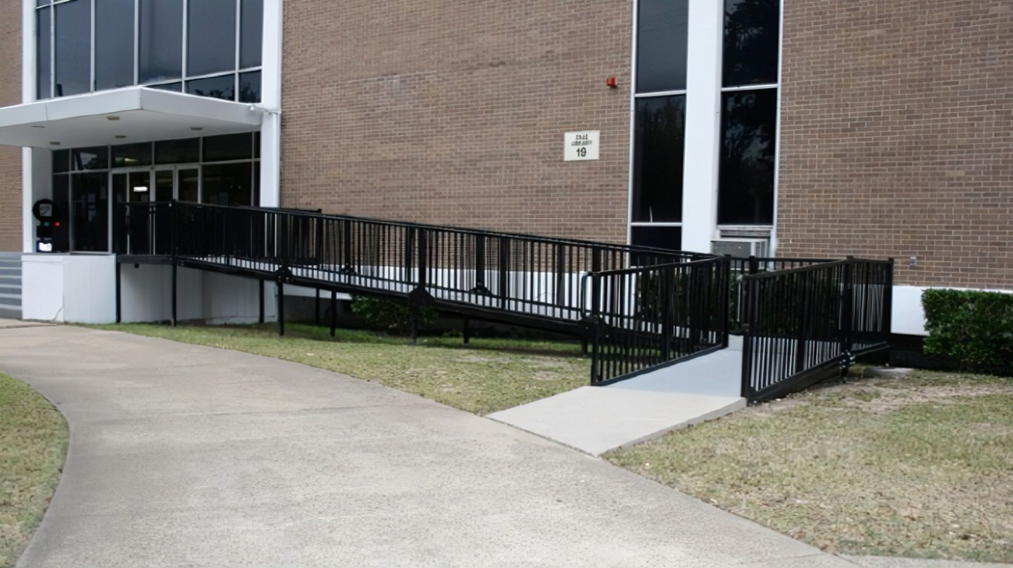
Webinar
Integrated Facility Assessments (IFA) and Accessibility Assessment (AA)
October 30th, 2024

Slide 2
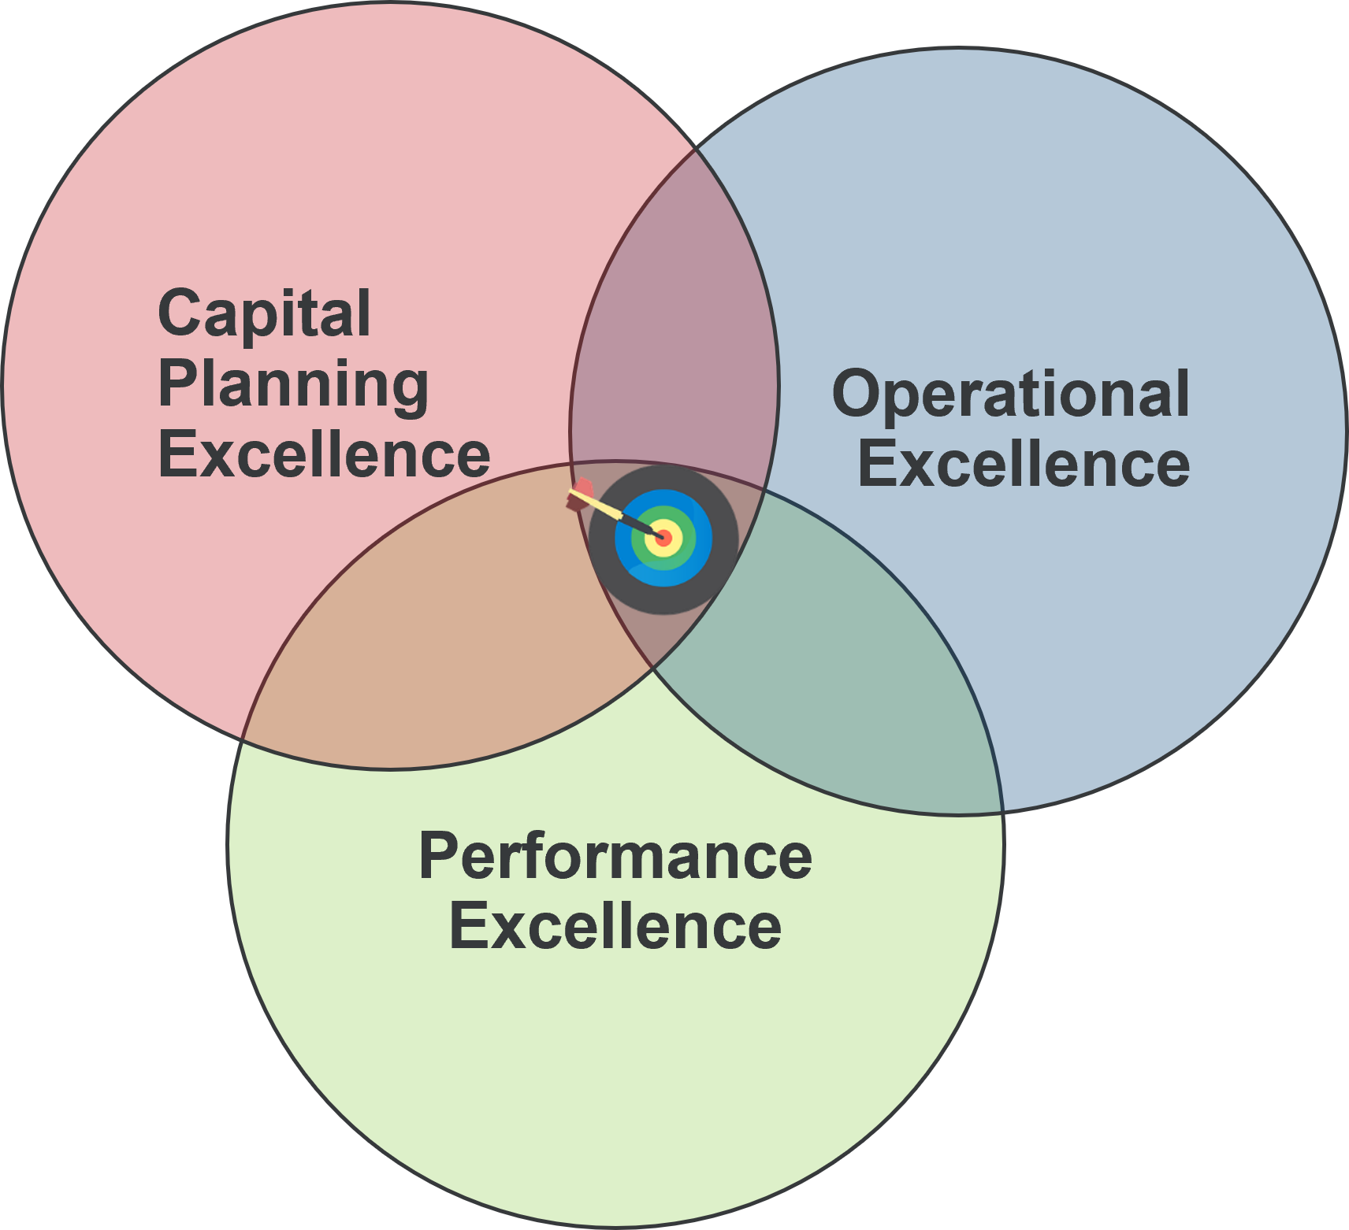
About Roth IAMS
Roth IAMS is one of the largest firms in North America that focuses exclusively on existing infrastructure asset management. We have provided services across North America for public and private sector clients since 2014. Our vision is to solve the world’s deferred capital renewal and maintenance (DCRM) backlog crisis.

Slide 3
Today’s Speaker
Andrew Chow, P.Eng., M.Eng., CPI, RHFAC Professional Practice Leader - Accessibility, Senior Facility Assessor, Technical Reviewer, Roth IAMS
13 years of building condition assessment experience
10 years accessibility audit experience
Responsible for creating methodology and approach for accessibility audits at Roth IAMS
Rick Hansen Foundation Accessibility Certified
One of the primary assessors for IFAs

Slide 4
Agenda/Outline
What is an IFA?
Disciplines Involved
Financial Analysis
Why an IFA?
“One-stop” Shop
Holistic View of Capital Needs
Integration of an Accessibility Assessment in an IFA
Comprehensive Accessibility Assessment
Integration with Capital Plan
Using an IFA to Build a Business Case

Slide 5
What is an IFA?
IFA
Integrated Facility Assessment
Combination of several assessments
Building Condition Assessment (BCAs)
Accessibility Audit
Energy Audit
Desktop Code Review
On-site Code Review Checklist
Space Requirement Analysis
(if applicable)

Slide 6
What is an IFA?
IFA’s contain:
Site Observations & Analysis
Recommendations for all disciplines
Financial Information
Capital needs
Existing needs to address building condition (repairs and capital renewal)
Improvement needs (accessibility/energy)
Future needs to address expansion
Facility Condition Index (FCI)

Slide 7
Facility condition index (FCI)
FCI is a benchmark used by industry to index the relative condition of a facility
Calculated as a ratio of:
Sum of capital and maintenance renewal requirement costs over a set period of time
Current Replacement Value (CRV) of the asset
FCI = $\frac{Renewal Requirements in X Years}{Current Replacement Value}$ (%)

Slide 8
Facility Condition Index
FCI = $\frac{Renewal Requirements in X Years}{Current Replacement Value}$ (%)
The higher the FCI, the poorer in condition

Slide 9
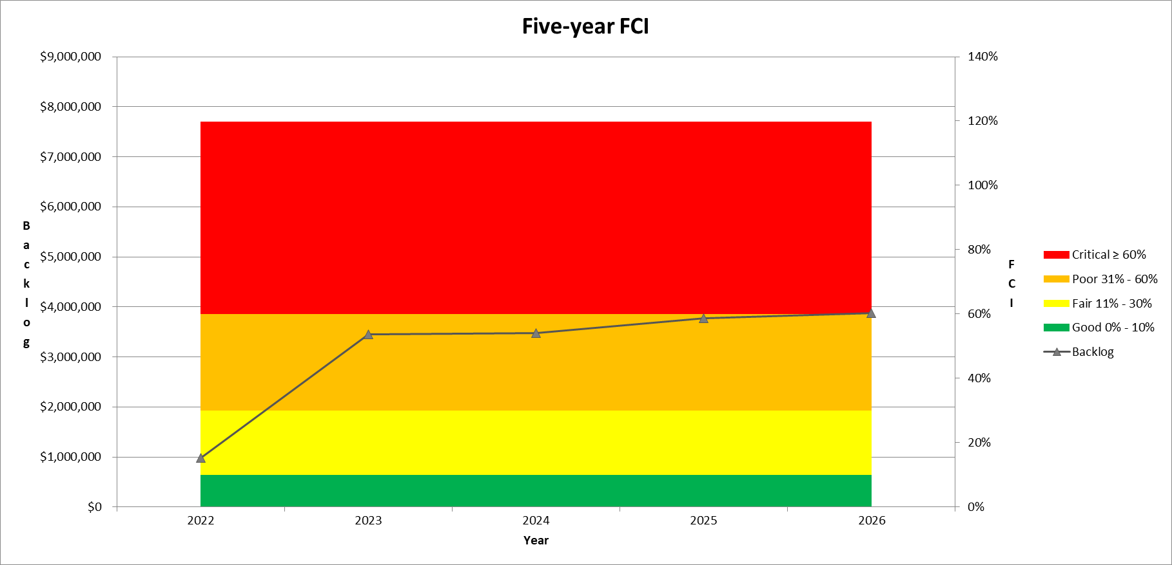
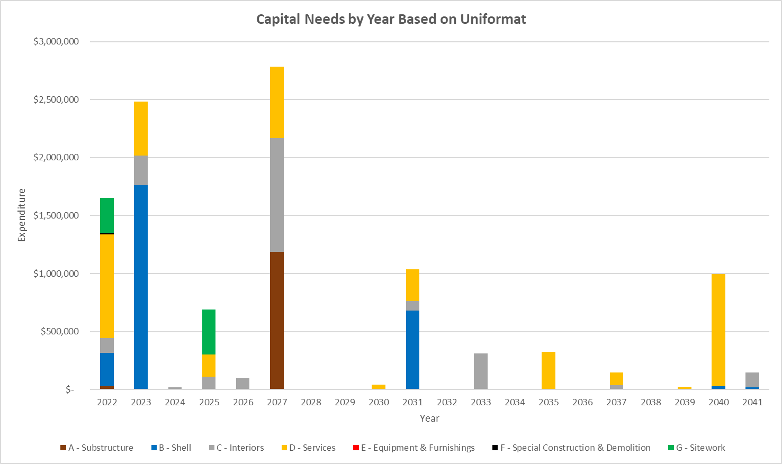
Financial Analysis
FCI’s and the total capital needs can facilitate business decisions such as:
Maintain current building
Construct new building
Sell current building

Slide 10
It’s time for A Poll question

Slide 11
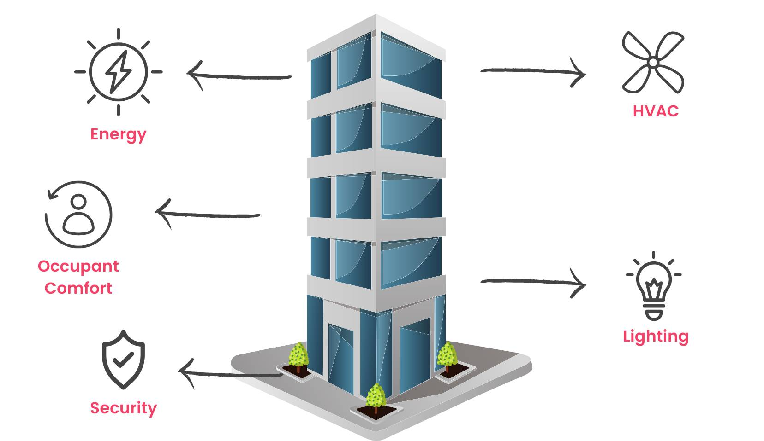
Why an IFA?
Buildings are complex
Capital needs are not only based on condition or one discipline
Other needs to consider:
Accessibility
Energy
Space requirements

Slide 12
Why an IFA?
Why? Efficiency & Convenience
One-stop Shop
All services provided in a single assessment
Reduces the need to procure services from multiple consultants
Save on:
Time
On-site assessment condensed to a few days instead of weeks/months
Review one report instead of several separate reports
Money
Reduced fees (travel disbursements)

Slide 13
Why an IFA?
Why? Consistent (and defensible) data
Completing assessments by numerous consultants results in:
Inconsistent data (mainly costing)
Incomplete data
Dis-organized data
(multiple reports stored in separate locations)

Slide 14
Why an IFA?
Capital Planning:
Holistic view of a building’s capital needs
Building Acquisition
Understand total investment
(purchase + capital needs)
Building Decommission
Cost analysis (capital needs vs. new build cost)

Slide 15
Why an IFA?
IFA provide a holistic view of a building's needs
Data is consolidated in a report and database
Advantages:
Easier to keep track (recommendations, projects)
Complete view of financial needs
Report findings and analysis are organized in one package

Slide 16
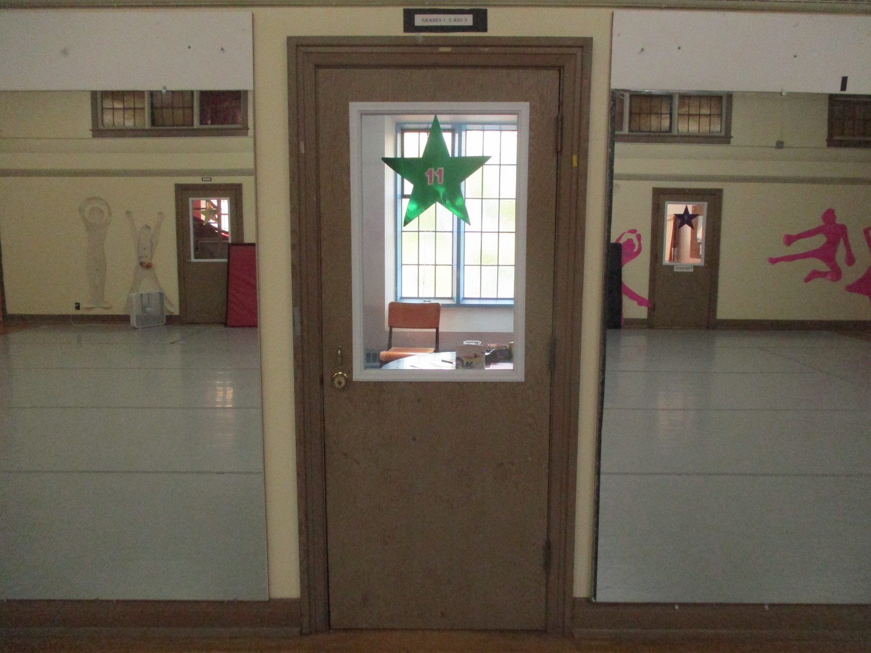
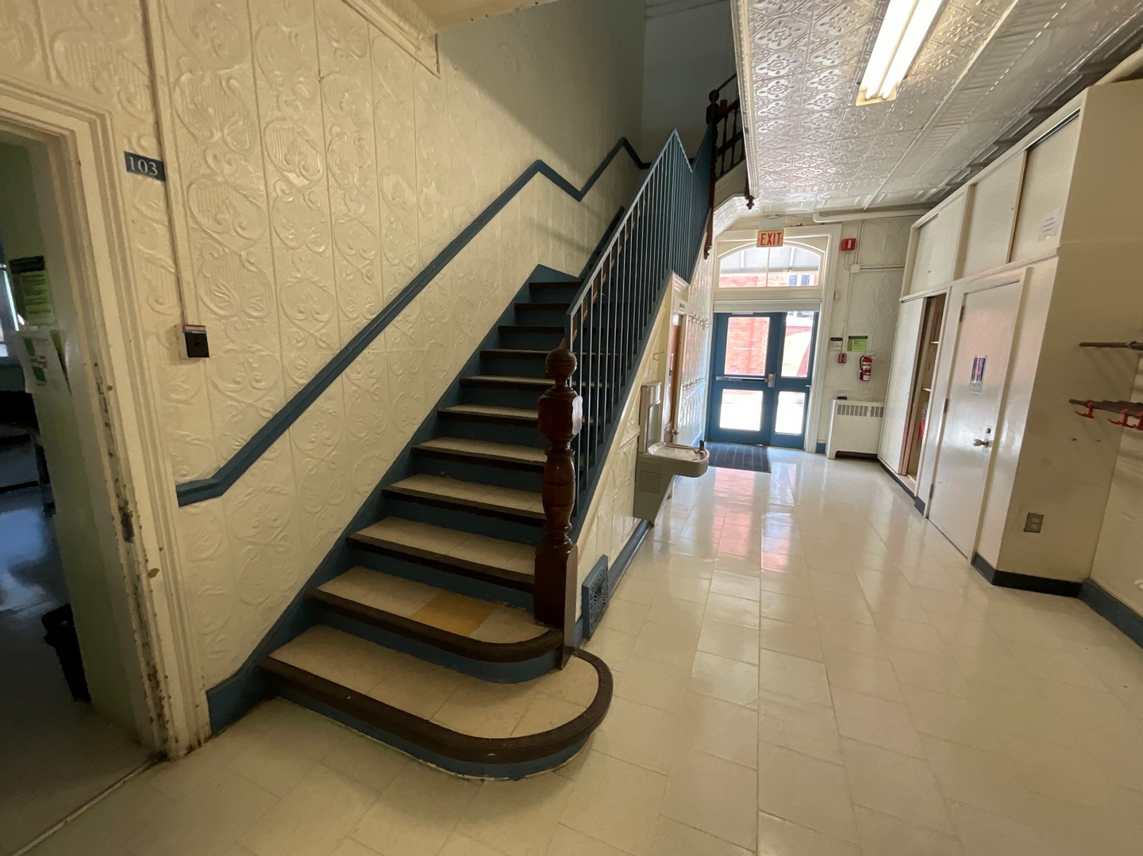
Why an IFA?
Building design standards continue to be updated (e.g. renewal of building code)
Aged buildings become “non-compliant”
What is the cost to bring up the current building to meet existing standards?
Multiple design standards to consider:
Building code
Accessibility
Space requirements

Slide 17
It’s time for A Poll question

Slide 18
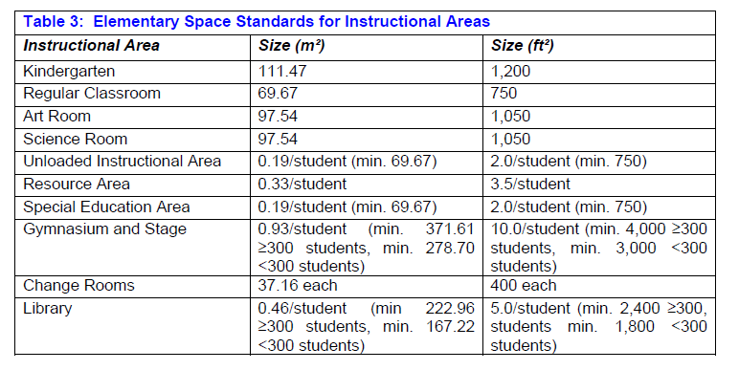
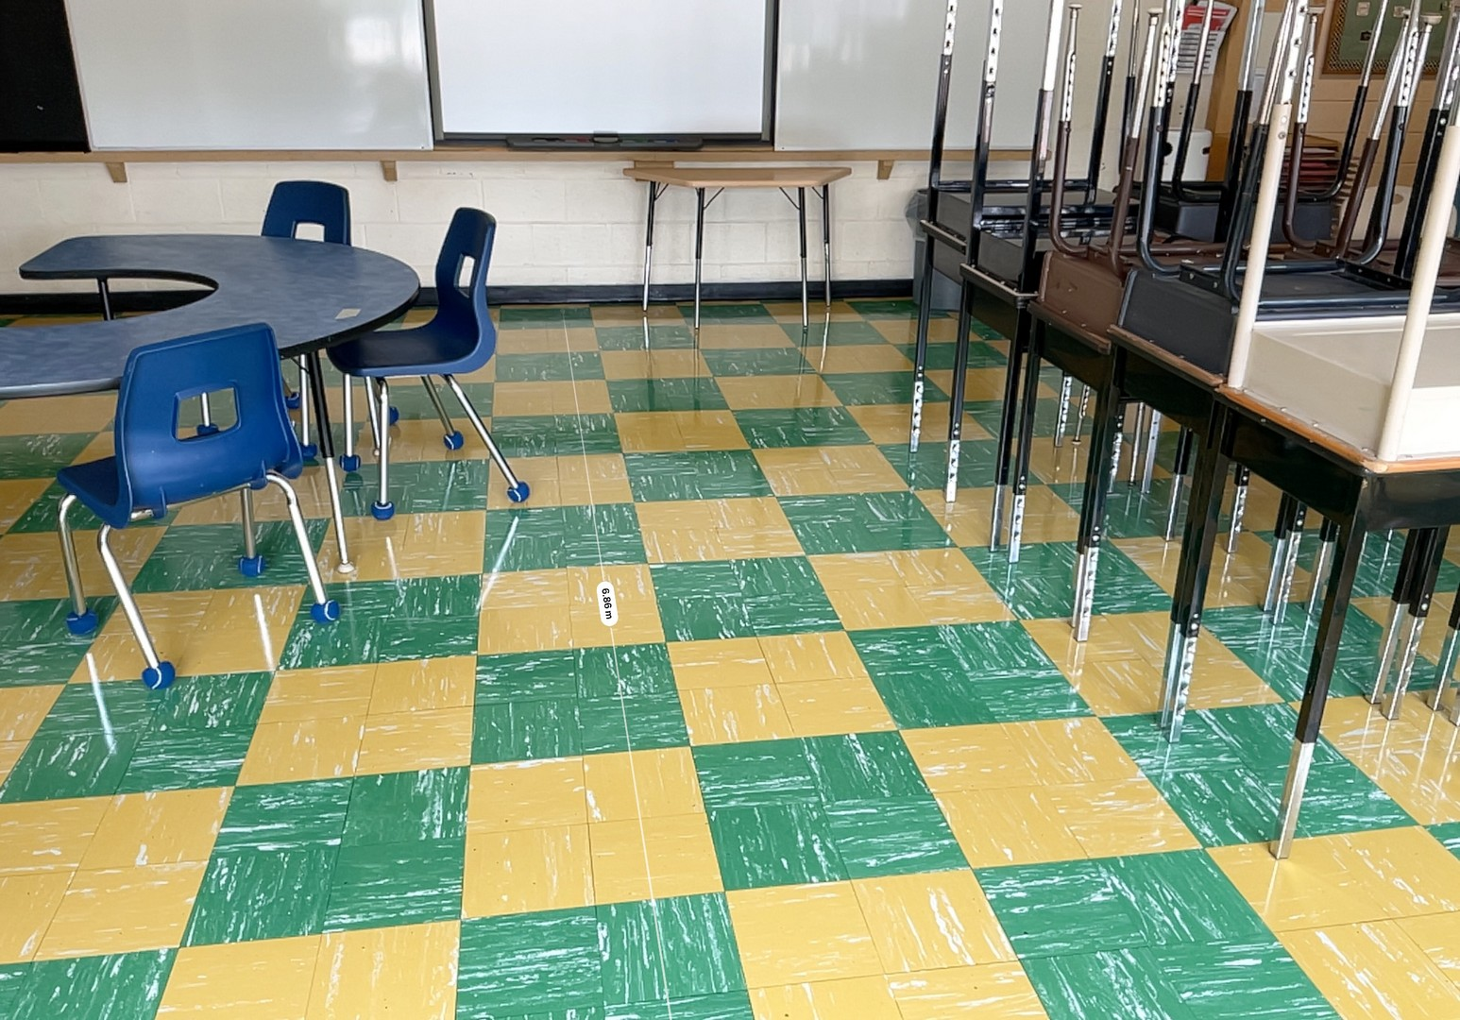
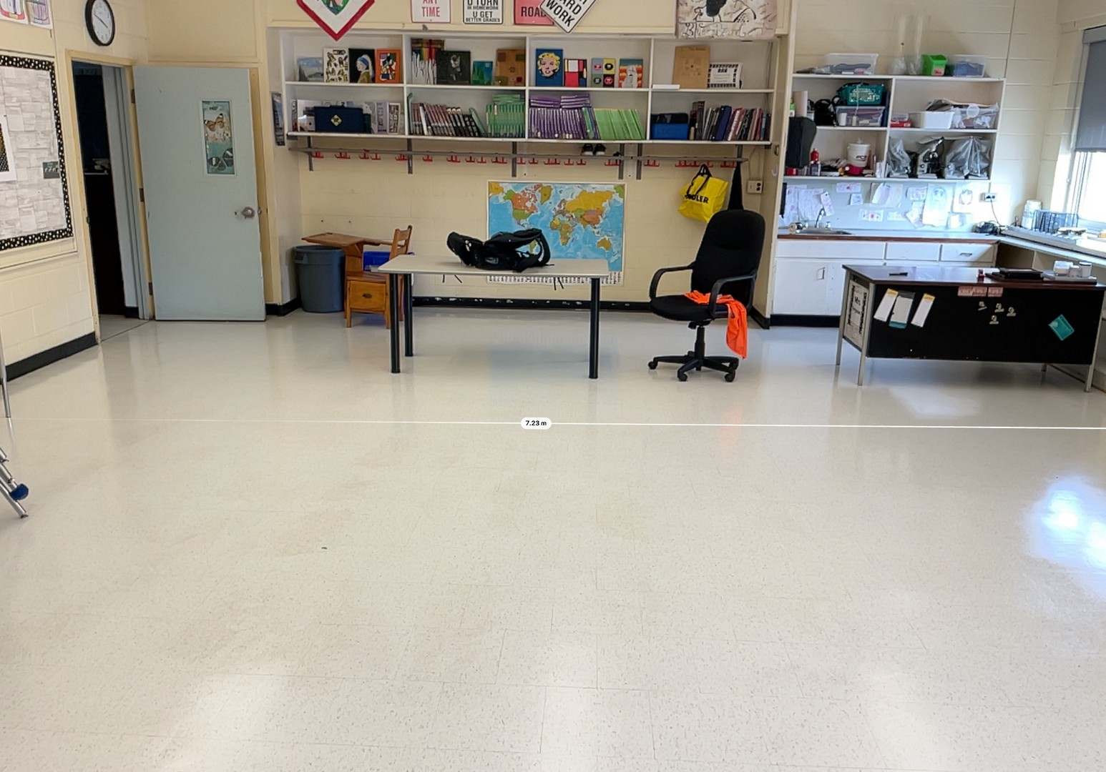
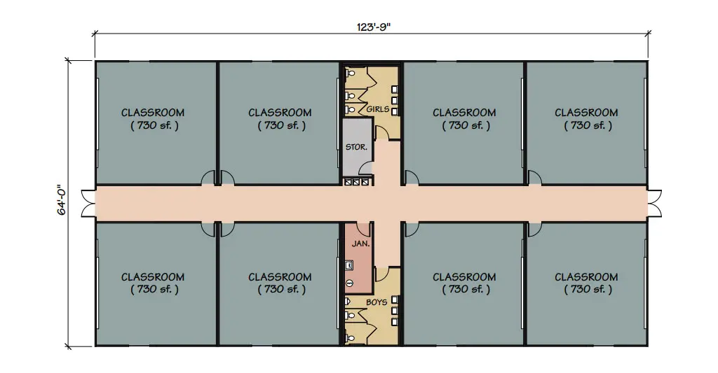
Space Requirements
Comparison of existing building to a new build
On-site measurements of the building compared to design guidelines

Slide 19
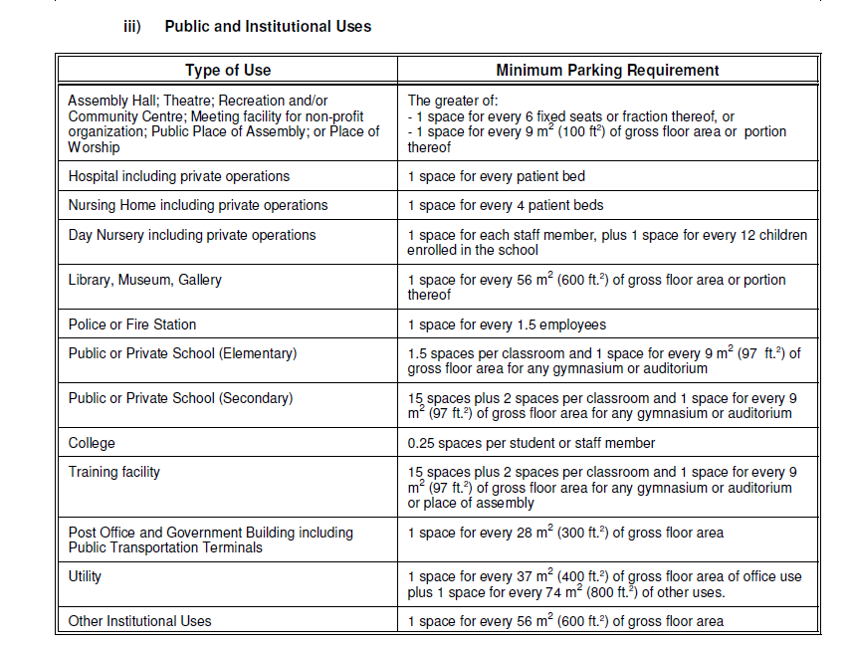
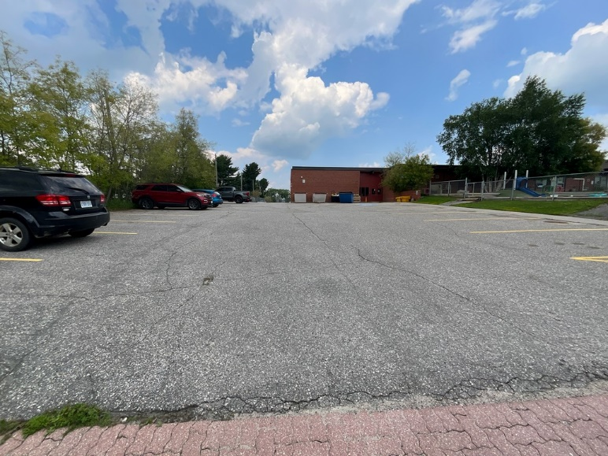
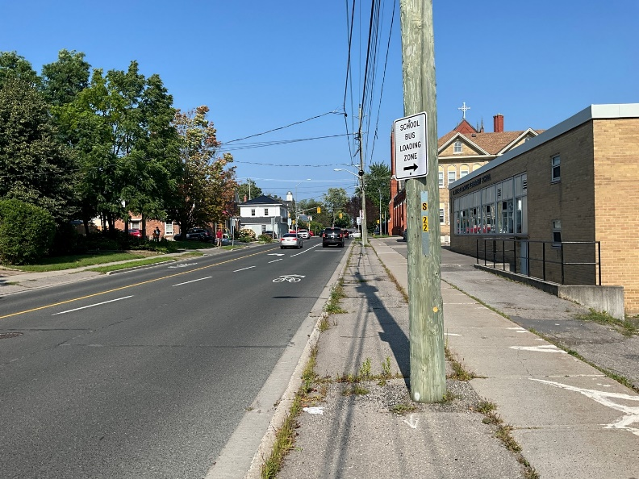
Space Requirements
Comparison of existing site (parking lot, school bus loading zone, etc.) to local by-laws
Provide estimate to expand the facility and the site

Slide 20
Integrating Accessibility needs in an IFA

Slide 21
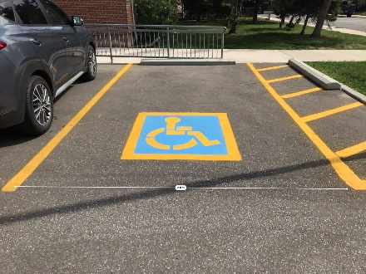
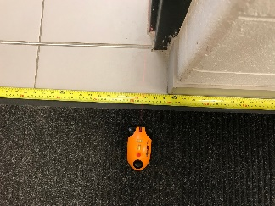
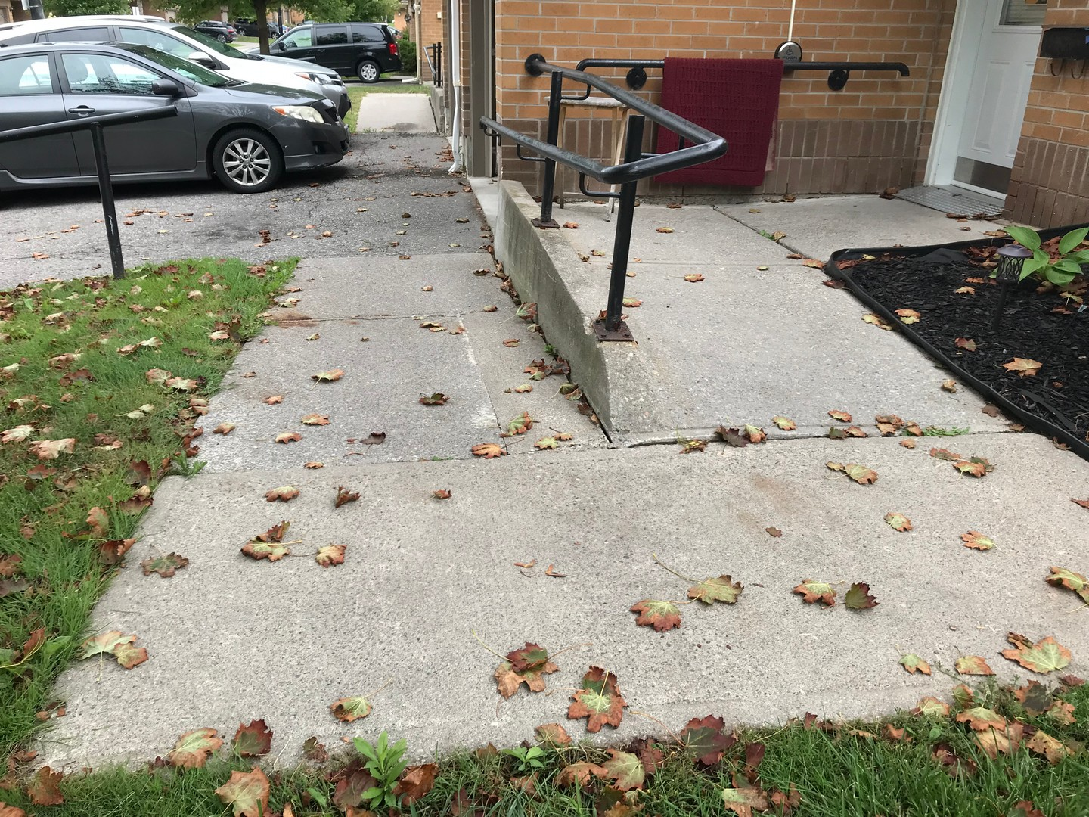
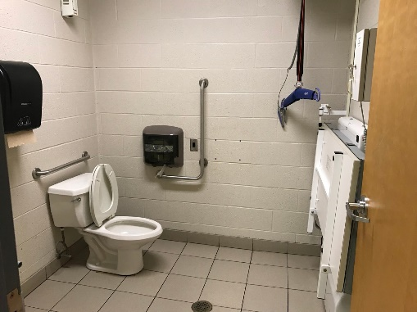
Choosing the Accessibility audit
Barriers can be identified in several ways:
Comprehensive Accessibility Audit
Rick Hansen Foundation Accessibility Certification (RHFAC) Survey
Roth IAMS offers a high-level accessibility checklist, but it is not recommended for IFA’s

Slide 22
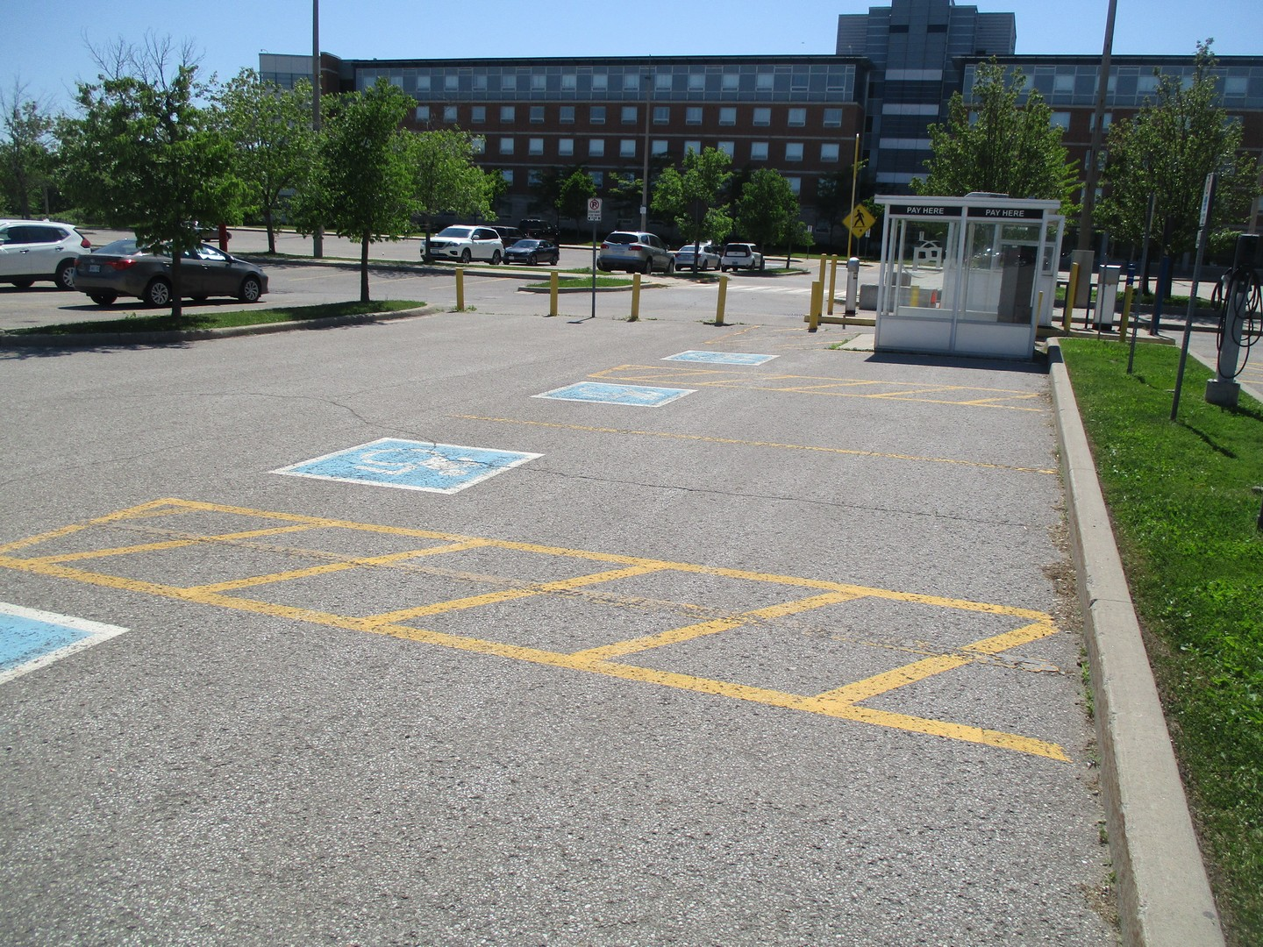
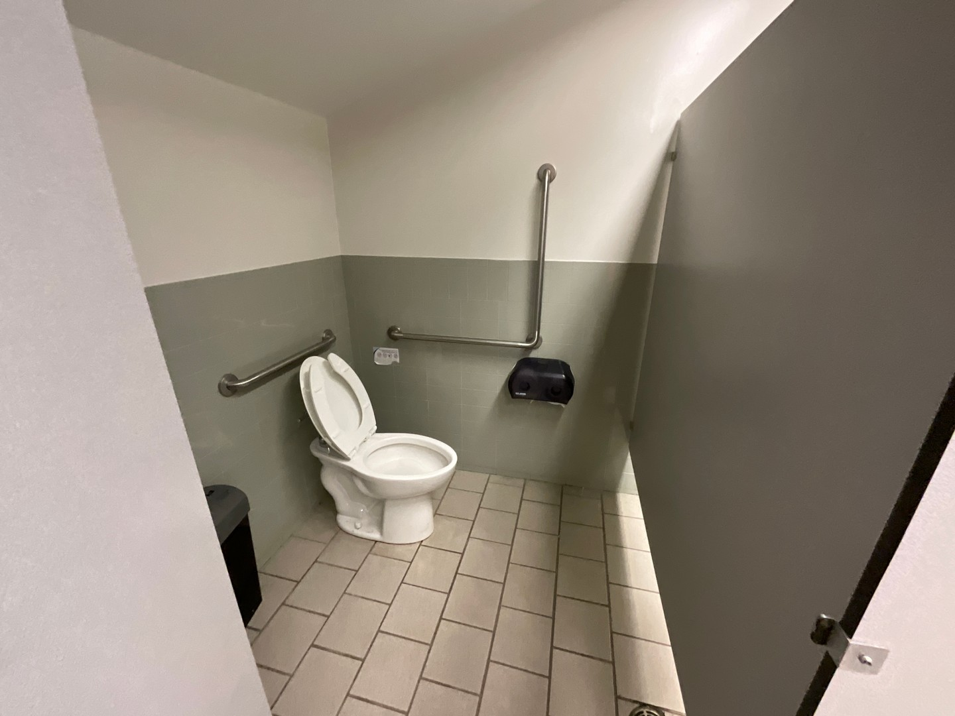
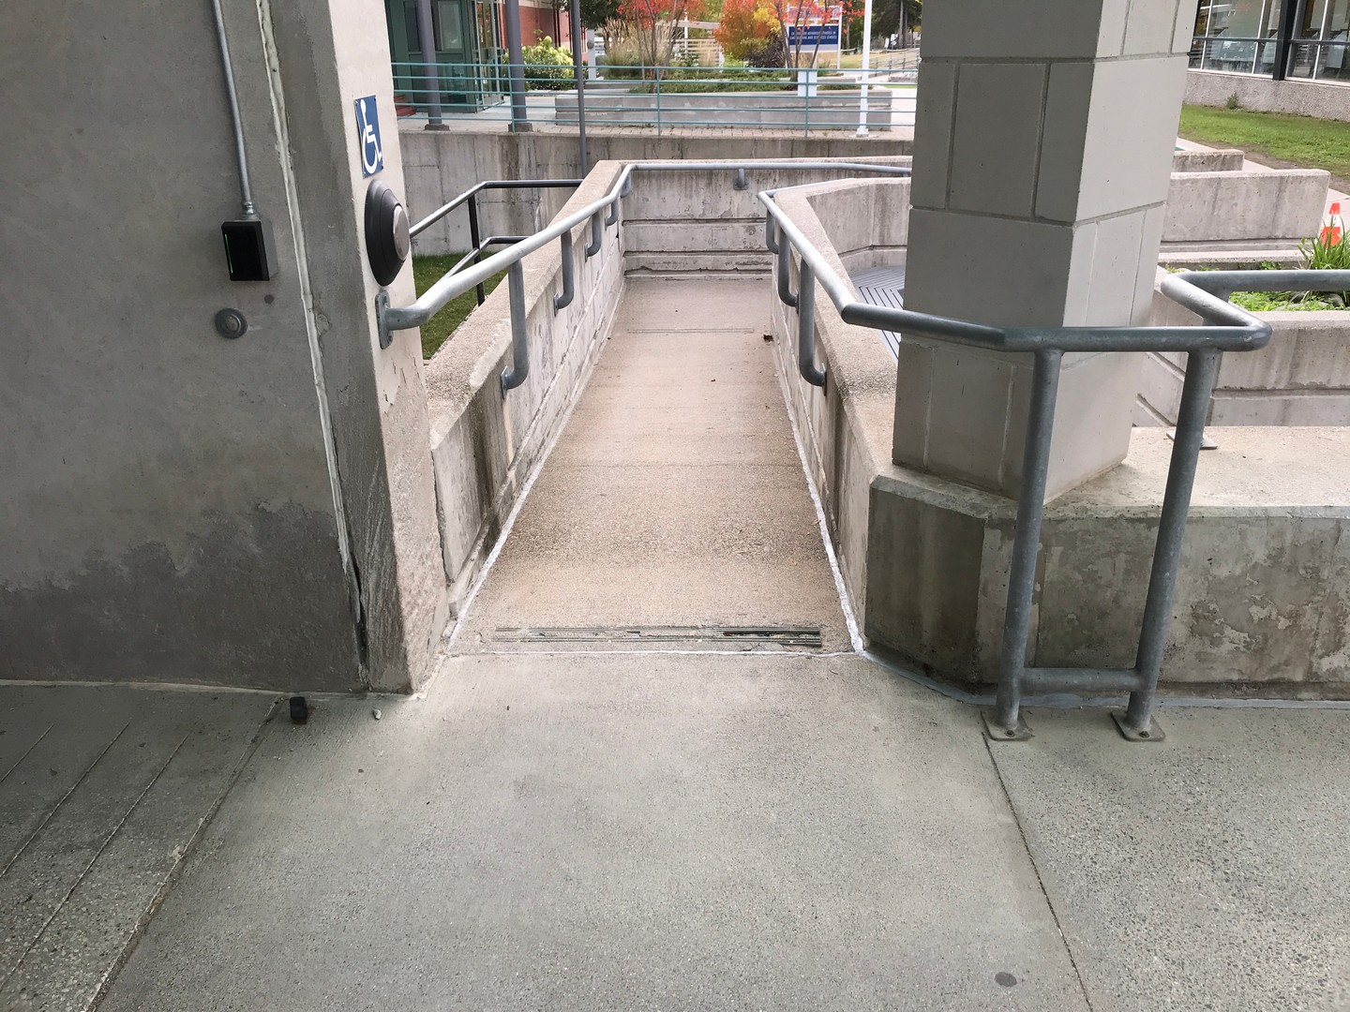
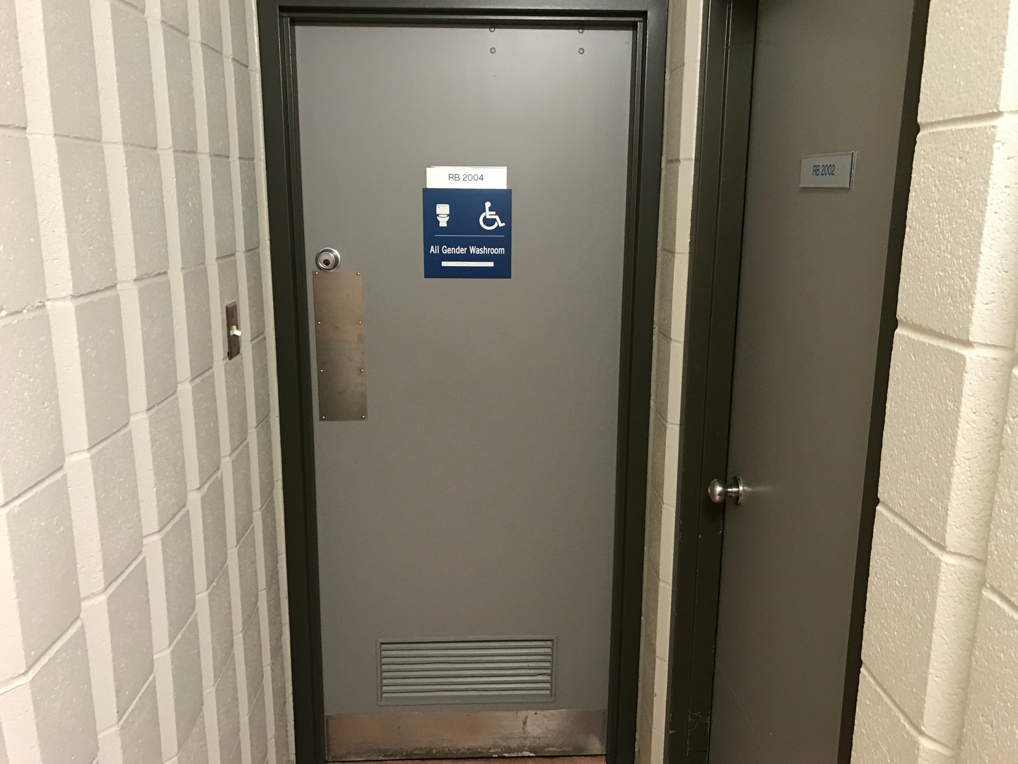
Why Not a Baseline Checklist
Baseline checklists can only provide a high-level understanding of the barriers on site
Baseline checklists do not encompass all code requirements
For IFA’s, a complete picture of the non-compliances and all accessibility improvements would be preferred.
Examples of elements that “appear” compliant:

Slide 23
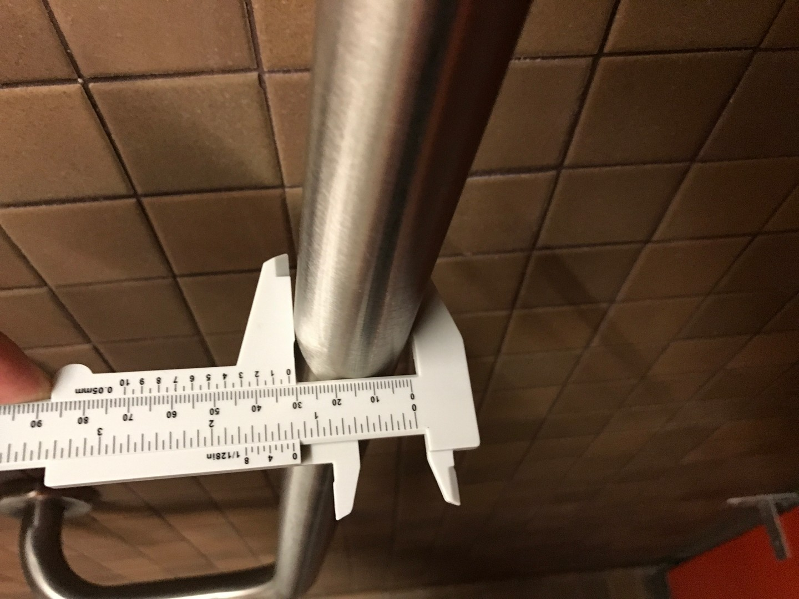
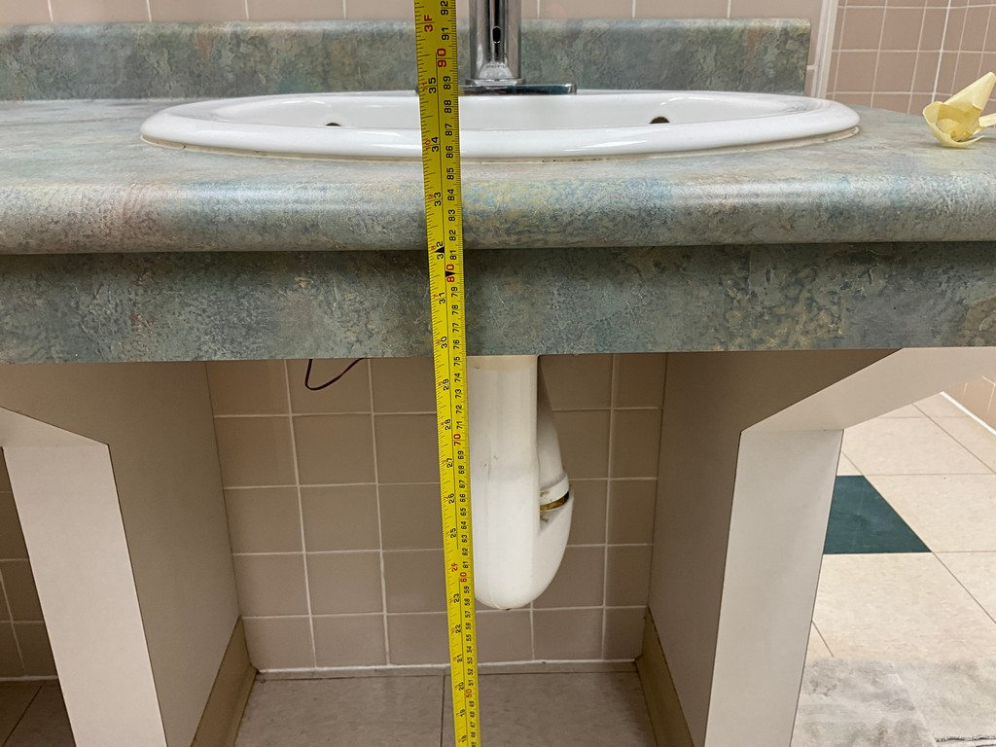
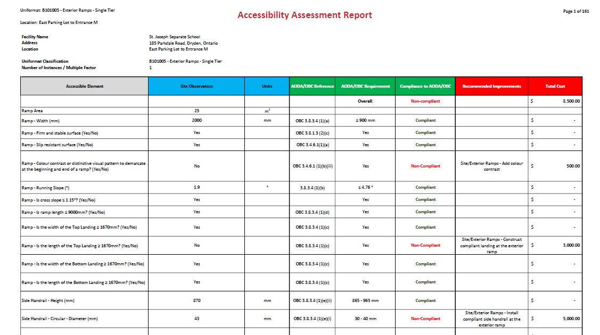
Comprehensive Accessibility Audit
Detailed audit that compares the parameters of a barrier with OBC/IASR
Optional inclusion of FADS
Comprehensive audit evaluates compliance to the code or design guideline line-by-line
Each non-compliance is assigned a recommendation

Slide 24
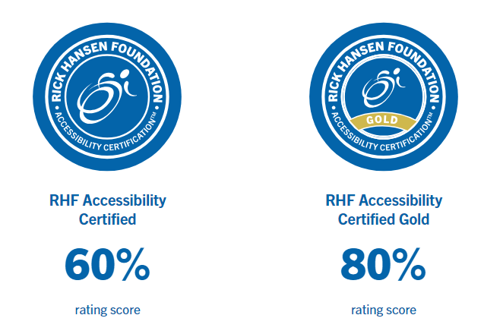
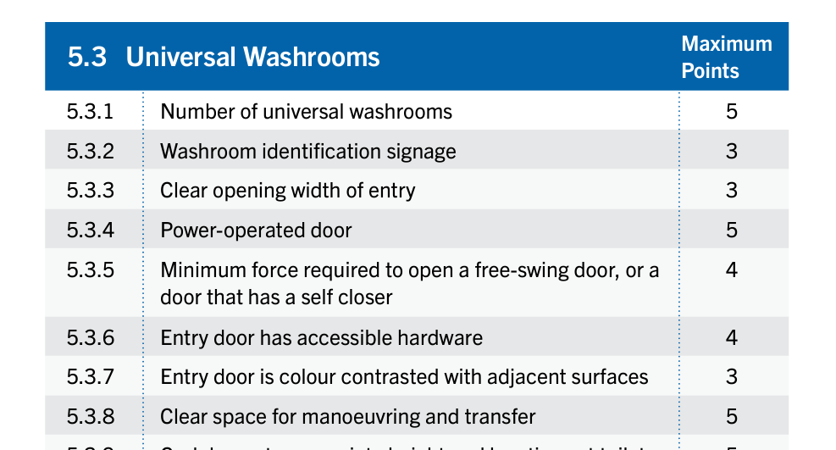
Rick Hansen Survey
Similar to comprehensive audit but using the Rick Hansen Rating Survey / Scoring System
Ideal for:
Promoting a particular asset (i.e. town hall)
Comparing levels of meaningful access between various assets
Note: Survey does not specifically address guidelines based on code
Recommendations to improve the facility can be incorporated into the IFA

Slide 25
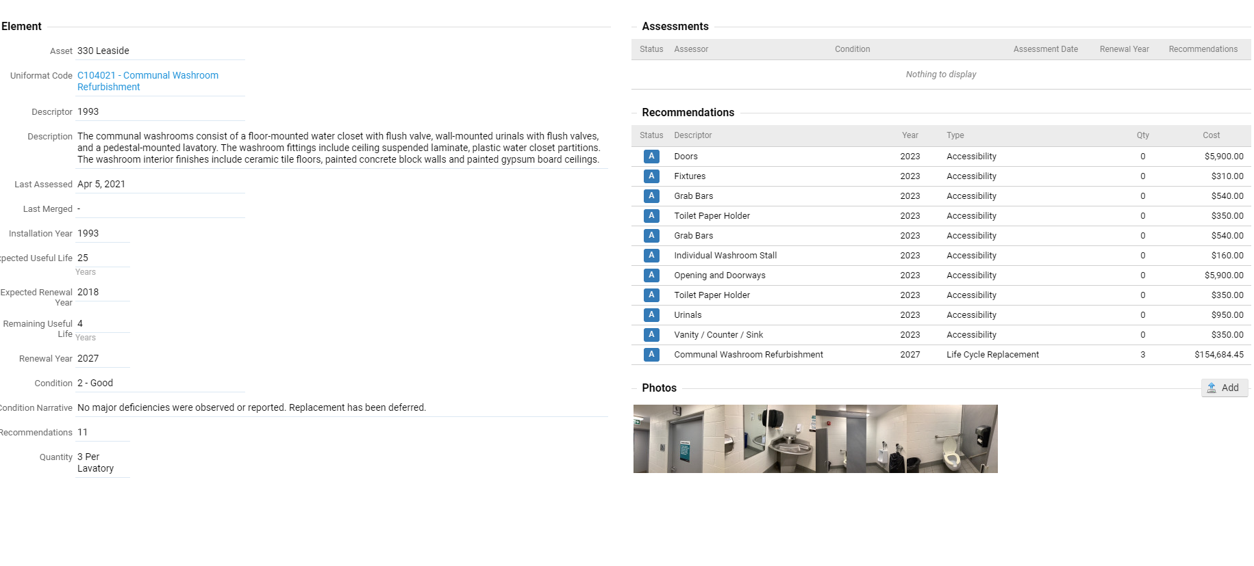
Integration INTO IFA
Incorporate accessibility improvement recommendations - IFA and capital plan
Advantages:
Centralized data
Consistent data
Analyze data based on multiple scenarios
Systematically plan capital renewals
Plan projects with accessibility improvements

Slide 26
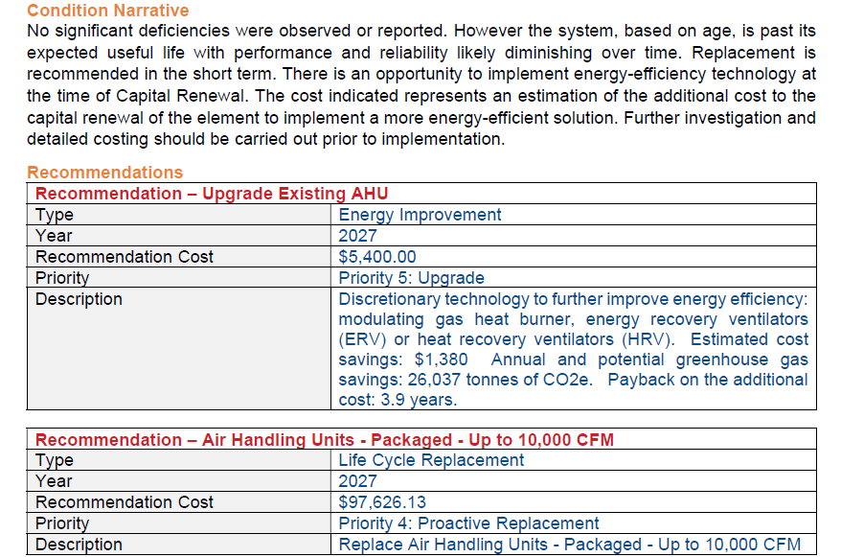
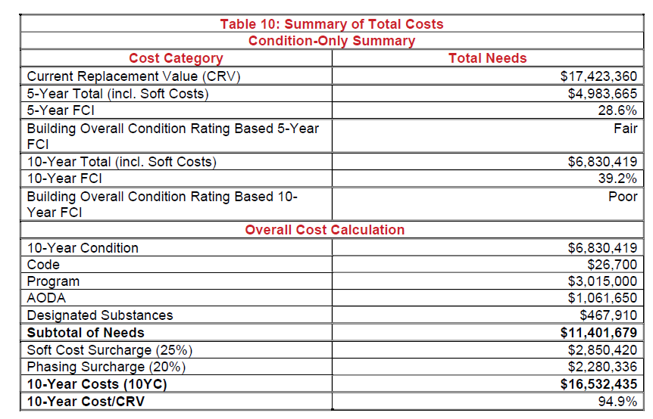
One Complete Report
The IFA is delivered in a single report with all analysis and findings
Each element can be associated with recommendations from various assessments (e.g. BCA + energy + accessibility)
The report will contain a summary of costs that provides all the capital costs involved in the IFA

Slide 27
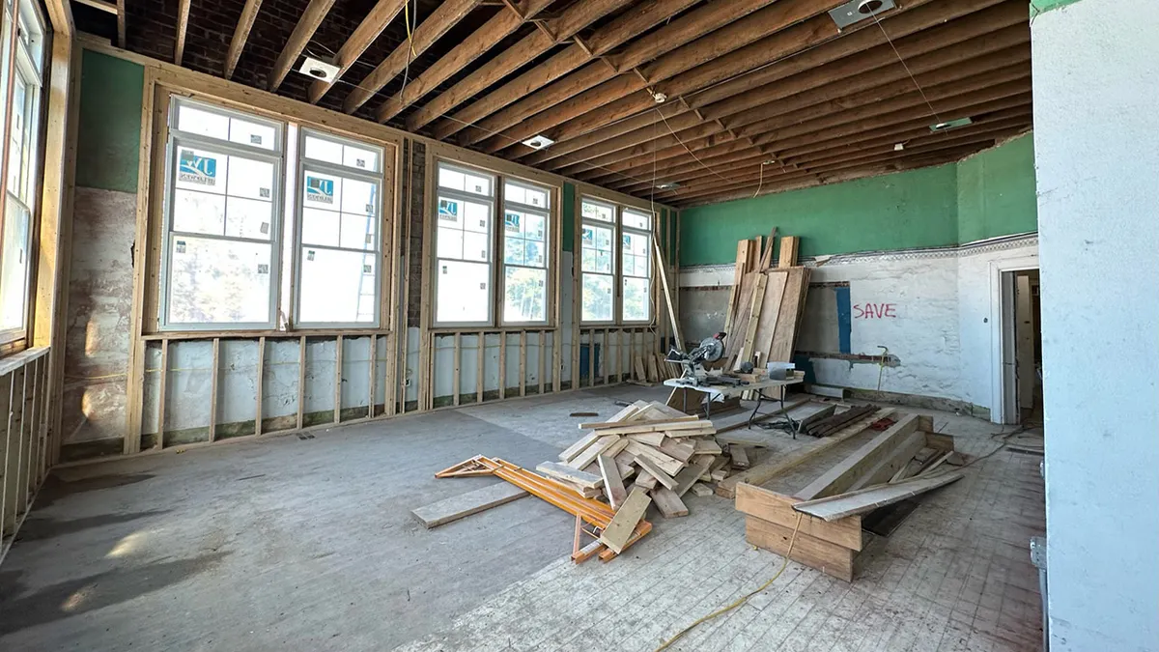
How an IFA can Help you Build your Business Case
Building Acquisition
What kind of investment is required to get to the functionality our organization needs
Building Decommission
A brand new building will always have a higher functionality than an older building (accessibility, sustainability, space needs). How do we compare the two apples to apples?
Capital Planning
Getting a full overview of a building in one centralized report

Slide 28
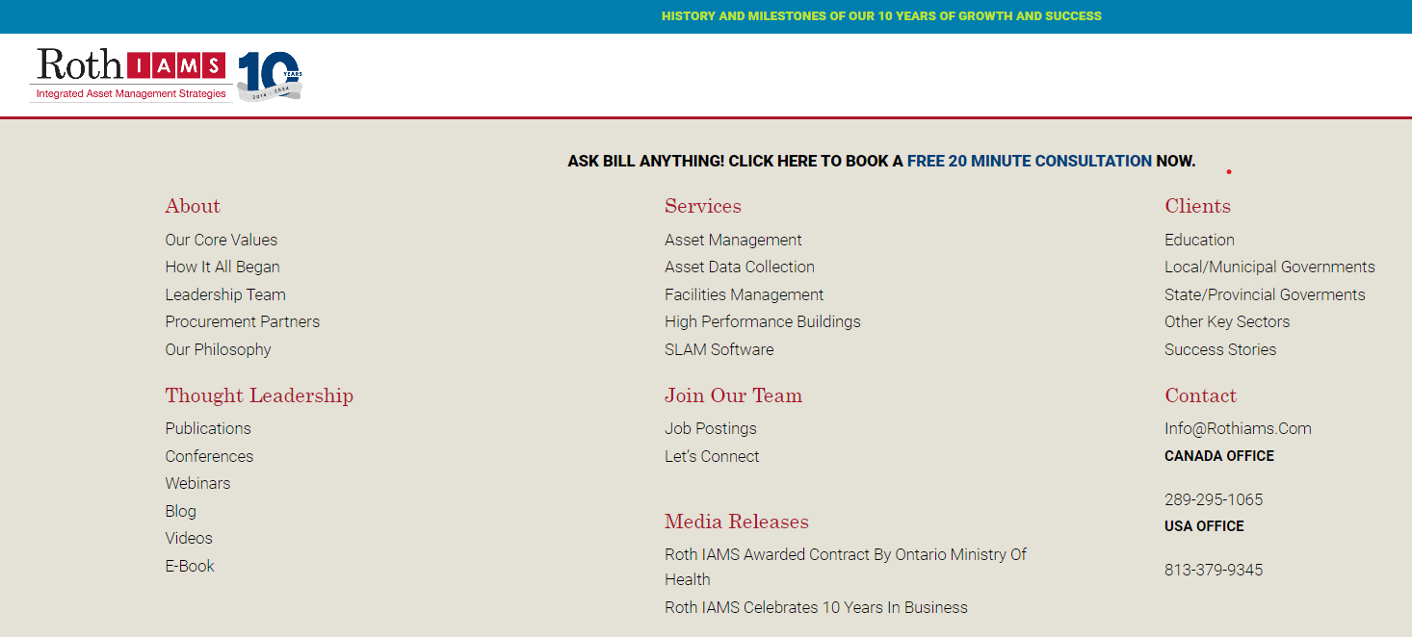
Questions?
Visit our website at rothiams.com
Follow us on LinkedIn
Connect with us directly through email at sales@rothiamsmarketing.com
Visit our Thought Leadership
page

