Slide 1
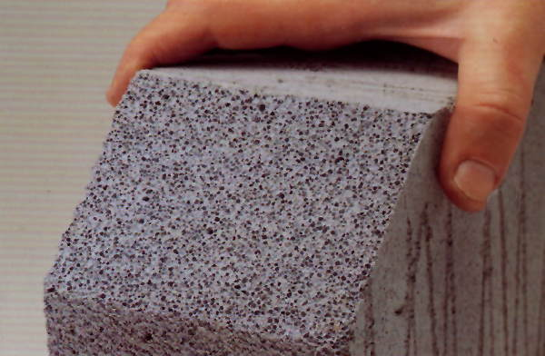
Assessing and Maintaining Facilities containing RAAC (Reinforced Autoclaved Aerated Concrete).
Reinforced Autoclaved Aerated Concrete
October 3, 2024

Slide 2
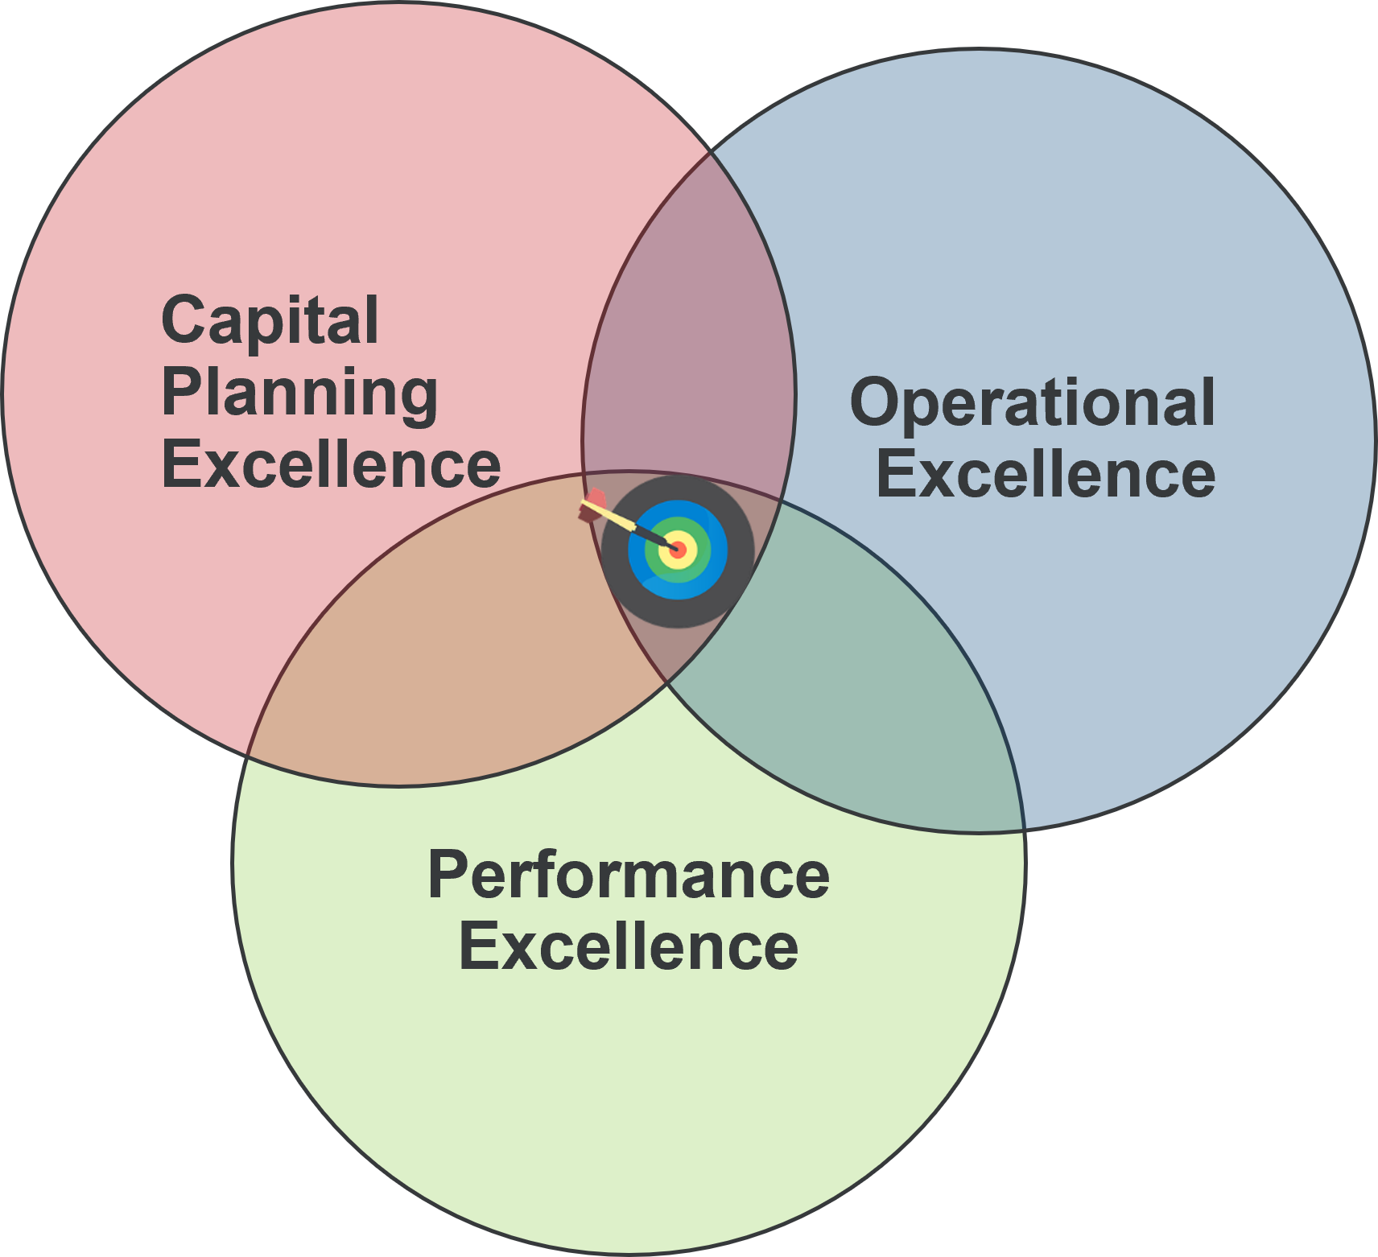
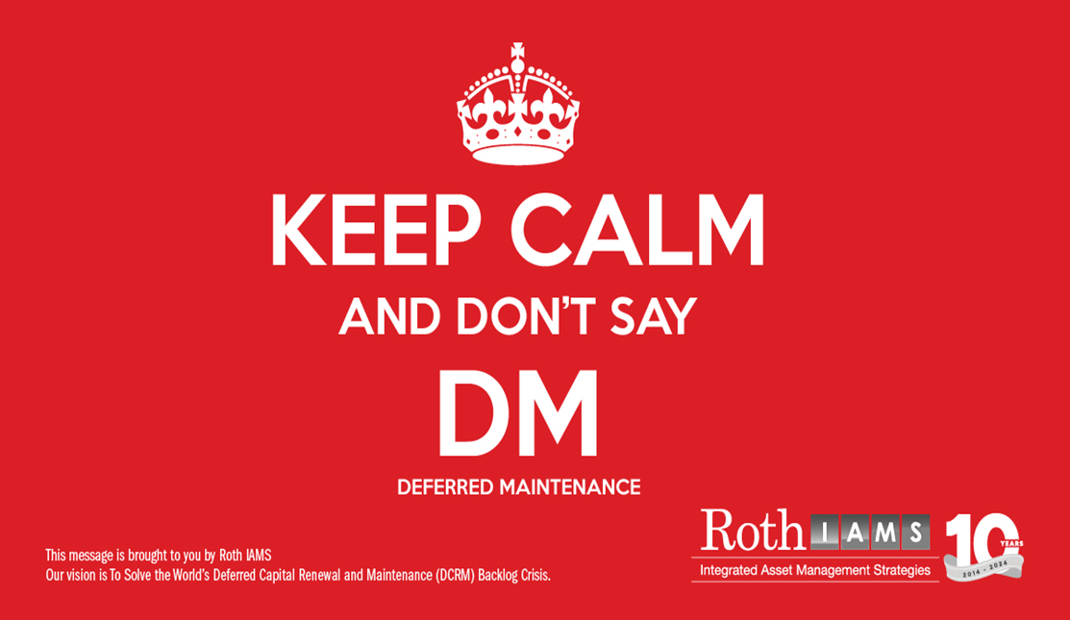
About Roth IAMS
Roth IAMS is one of the largest firms in North America that focuses exclusively on existing infrastructure asset management. We have provided services across North America for public and private sector clients since 2014. Our vision is to solve the world’s deferred capital renewal and maintenance (DCRM) backlog crisis.

Slide 3
Introductions
Andrej Culen, P.Eng.
Structural, Practice Lead
Professional structural engineer, with 25 years of experience and knowledge in structural design, evaluation/ analysis, restoration and forensics of new and existing structures in steel, concrete, wood and masonry.
Experience managing Structural Condition Assessments and Forensics for facilities and other infrastructure assets such as stadiums, post tension parking garages, retaining walls, historic wood structures.
Responsible for Roth IAMS structural methodology and leads a team of 7 structural engineers to provide efficient, time sensitive, and cost-effective design/ repair solutions.

Slide 4
Agenda
Overview – What is RAAC?
Issues – What are the problems associated with RAAC?
Do I have it? First steps - determining if my facilities may contain RAAC.
Are you at Risk? Evaluating and Maintaining RAAC elements. Next Steps, Maintenance Plans, and Extending the Service Life.
Three Phases of RAAC Management
Questions

Slide 5
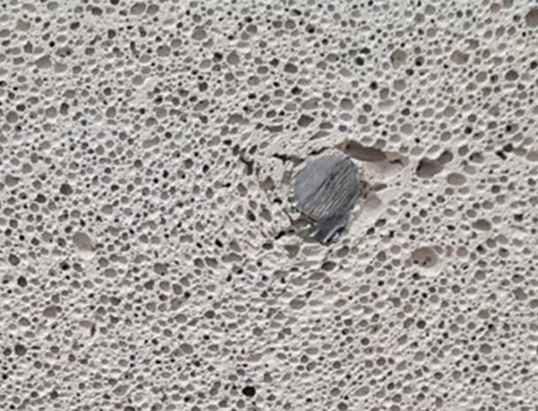
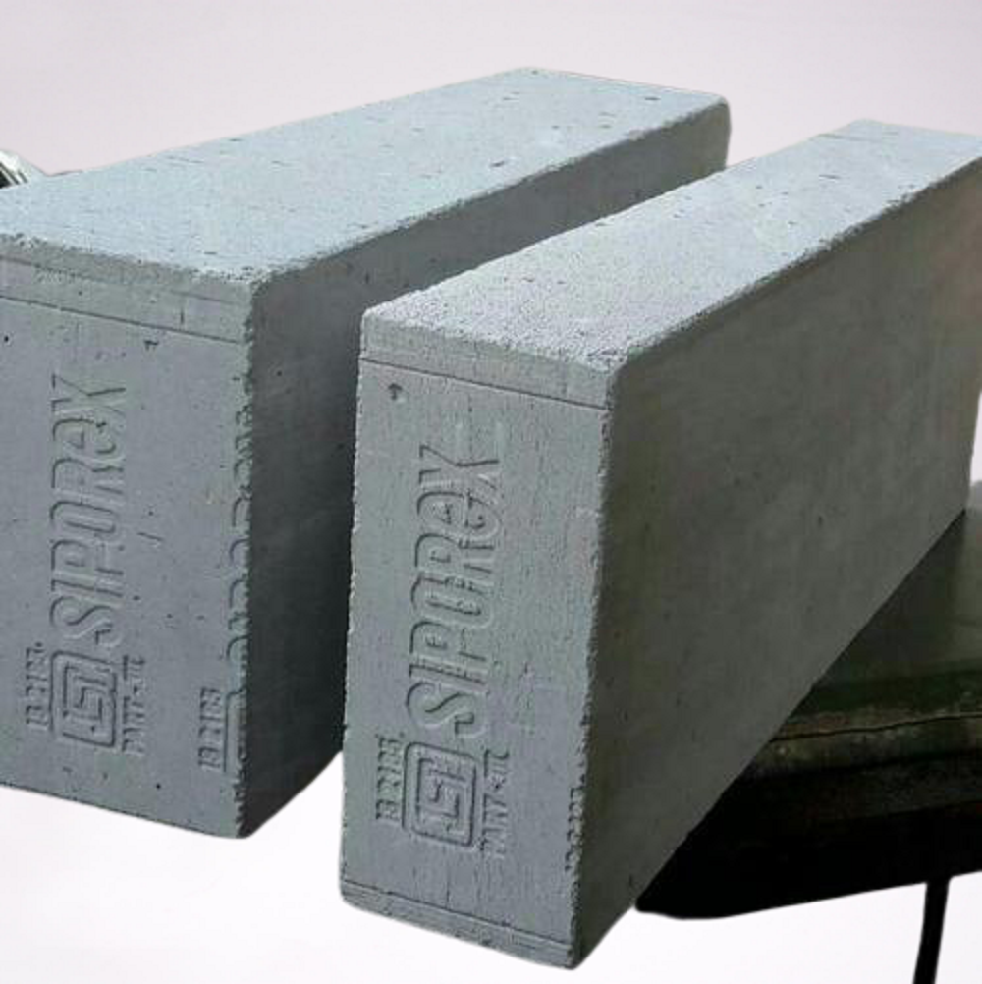
Reinforced Autoclaved Aerated Concrete(RAAC)
What is it?
Manufactured and used from the mid-1950s to the mid- 1990s.
Prefabrication process for lightweight concrete which incorporates an aeration process that creates millions of tiny hole or pores inside the concrete mix.
RAAC is mix of cement, calcium hydroxide, fine sand, and aluminum powder.
Aluminum and calcium hydroxide react to create bubbles, which make up 65% to 85% of materials volume
Brand Name - “Siporex” – East Canada.
Notes:
Manufactured and used from the mid-1950s to the mid- 1990s.
RAAC is a Prefabrication process for lightweight concrete, incorporating an aeration chemical reaction that creates millions of tiny hole or pores inside the concrete mix.
In comparison - Traditional concrete is a mix of stone aggregate, cement mix and water.
RAAC is mix of cement, calcium hydroxide, fine sand, and aluminum powder.
The chemical reaction is - Aluminum and calcium hydroxide react to create bubbles, which make up 65% to 85% of materials volume
Commonly the Brand Name - “Siporex” – Eastern Canada.

Slide 6
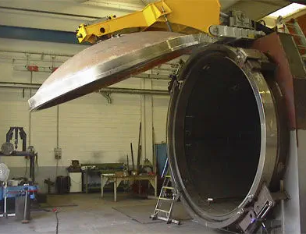
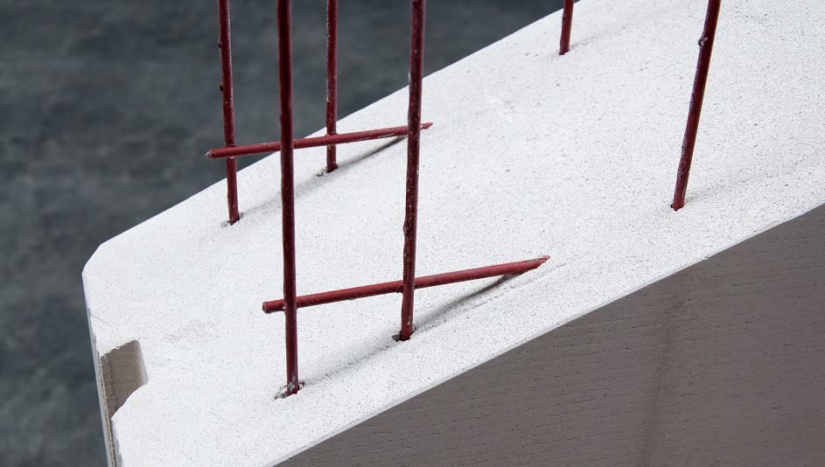
Reinforced Autoclaved Aerated Concrete (RAAC)
What is it?
The panels are cured in an autoclave, a machine used in the manufacturing process requiring elevated temperature and pressure.
The panels contain steel reinforcement for strength in tension.
Reinforcing is usually coated with waterproofing latex or bitumen for better adherence to the aerated concrete
Notes:
As part of the manufacturing process, panels are cured in an autoclave, which is a machine used to increase the temperature and pressure.
With this increased temperature and pressure, the concrete reaction aerates and expands
Typically the panel molds contain steel reinforcement for strength in tension.
The reinforcing is usually coated with waterproofing latex or bitumen for better adherence to the aerated concrete

Slide 7
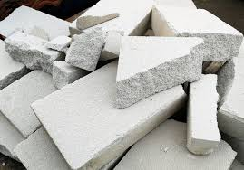
Reinforced Autoclaved Aerated Concrete(RAAC)
Materials
The material is usually light grey or off-white in colour
Easily broken or damaged with hand tools or sharp implements.
RAAC planks are rectangular in cross-section
Typically, planks vary in width from 300mm – 750mm (12”- 30”) and spans up to 6m (20’) were used. A thickness of 100 – 250mm (4”- 10”) is common.
RAAC is not the same as reinforced concrete and behaves in a different way. It has a much higher elastic modulus than reinforced concrete
Notes:
The material is usually light grey or off-white in colour, and it is easily broken or damaged with hand tools or sharp implements.
RAAC planks are rectangular in cross-section
Sometimes the cellular structure is also shaped with chamfered edges that have a V-shaped groove appearance on installation.
Typically, planks vary in width from 300mm – 750mm (12”- 30”) and spans up to 6m (20’) were used. A thickness of 100 – 250mm (4”- 10”) is common.
RAAC is not the same as reinforced concrete and behaves in a different way. It has a much higher elastic modulus than reinforced concrete, for instance, meaning that for a given load, deflection will be about ten times that for an equivalent concrete plank under similar loading conditions.

Slide 8
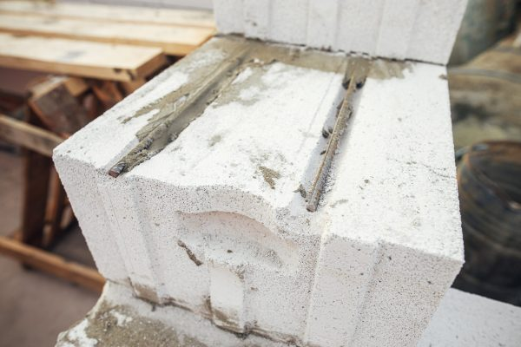
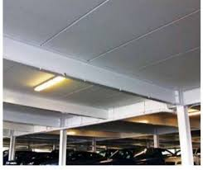
Reinforced Autoclaved Aerated Concrete (RAAC)
Why was it used?
Typically used in roof structure, but also used in floors, walls, and eaves as structural components.
The ideal benefits in the design at the time were:
Lightweight (1/3 of the weight of regular concrete)
Fire Safety – fire resistant properties
Insulation properties – heat and sound properties
Flexibility in use, easy to cut and form into blocks/ panels for walls
Cost
Notes:
Why was it used?
Typically used in roof structure, but also used in floors, walls, and eaves as structural components.
The ideal benefits in the design at the time were:
Lightweight (1/3 of the weight of regular concrete)
The lightweight prefabricated panels made it easier to install during construction, could span longer lengths, required less robust foundation systems due to reduction in overall structure weight.
Benefits for Fire Safety – higher fire resistant properties
Benefits for Insulation properties – providing higher heat and sound retention values
Flexibility in use, easy to cut and form into blocks/ panels for walls
Ultimatley – the biggest benefit was Cost

Slide 9
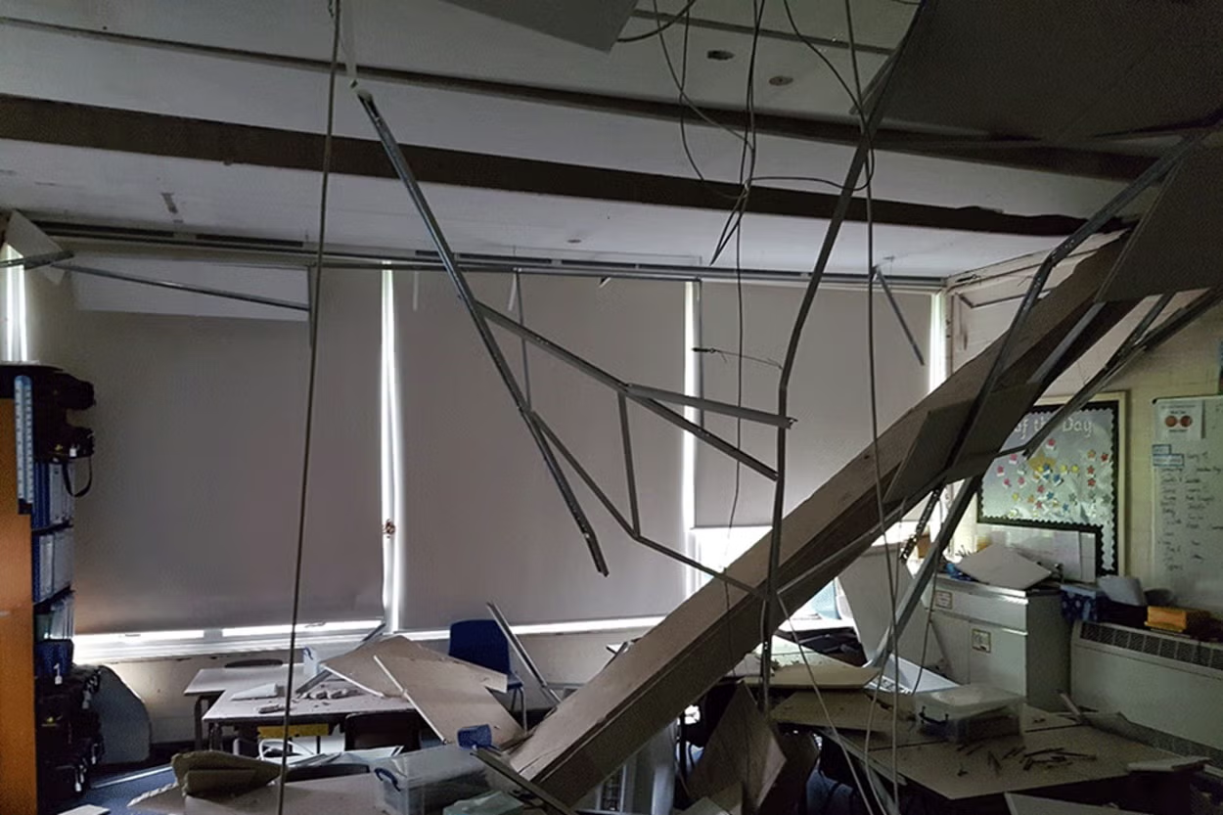
Recent Issues with RAAC - UK
2017 – UK Standing Committee on Structural Safety asked to investigate the suitability of material after a roof collapse. (Luckily, collapse was early morning, no injuries. School name not indicated)
2018 – Another roof collapse at Singlewell Primary School in Kent. Fortunately, this was on the weekend, above staff room. Again, luckily no injuries.
In both cases, RAAC panels failed, without warning.
Structural engineering investigations began – looking at frequently encountered RAAC planks installed before 1980 that were not fit for purpose.
Investigation and testing found RAAC planks become “more defective with time”
Government published guidance for schools to have adequate contingencies in case buildings need to be vacated at short notice

Slide 10
Recent Issues with RAAC - UK
Information for schools applying for grants for construction improvement funding said “not all RAAC is dangerous”.
One Scottish MP indicated, surprisingly, that RAAC used in Scotland is not an issue. (While both England and Scotland utilized the same manufacturers and suppliers of RAAC panels.)
In the summer of 2023, shortly before the Autumn term, 3 UK schools experienced sudden roof collapses. Government is now “less confident” buildings with RAAC should remain open without safety measures
January 2024 – The Department for Education advised all education settings to close areas with RAAC. Currently close to 150 affected. Approximately 100 require urgent action. A small minority of the schools have to close.
27 Health Care Facilities are being reviewed.
The Institution of Structural Engineering (ISE) – stated that the use of RAAC is not just a UK concern but has been used globally.

Slide 11
Recent Issues with RAAC- Canada
October 2023 - After 100 schools were fully or partially closed due to RAAC in the UK, the Province of Ontario began to look at RAAC in public buildings
June 2024 – After the investigation and assessment of the Ontario Science Centre (OSC) RAAC roof panels, it is closed
OSC RAAC Engineering Report – showed degradation in 16 per cent of overall roof panels examined in three separate OSC buildings rated as critical or high risk.
In some cases, spalling and other damage was apparent
Based on the engineering report, the decision was made to close the OSC by this October due to potential snow load concerns and the possibility for failing roof members.
Estimated repairs needed over 2 years costing approximately $40 M (For overall building repairs)
July 2024 – A source from Domtar, the company which manufactured the Siporex panels used in the OSC has stated – In the 1980s the Siporex brand was withdrawn from the market due to problems with the quality and durability of the panels.

Slide 12
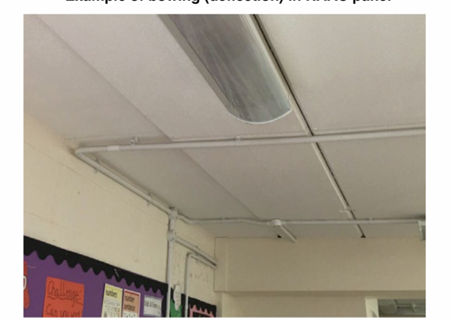
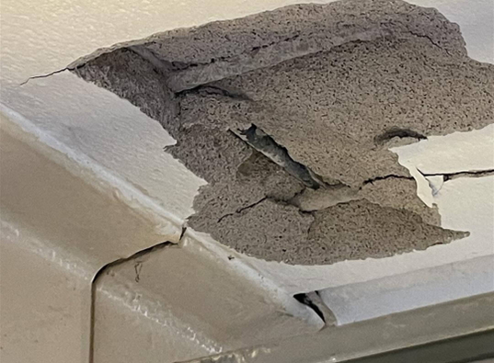
Concerns with RAAC
Water and Moisture Issues
Degradation due to water infiltration through porous structure
Higher moisture can lead to quicker corrosion of reinforcing
Higher deflection of panels from moisture absorption and weight
Due to porous nature water can infiltrate the material and reinforcing steel can corrode with little indication. Susceptible to sudden failure.
Mold growth
Note: Asbestos contamination – some older RAAC materials may contain Asbestos, or have a ceiling cover with Asbestos
Notes:
The first biggest concern with RAAC are - Water and Moisture Issues
There is Degradation in the panels due to water infiltration through the porous concrete structure
This Higher moisture in the panels can lead to quicker corrosion of reinforcing
The higher moisture also leads to Higher deflection of panels from moisture absorption and weight
Due to porous nature, water can infiltrate the material and reinforcing steel can corrode with little indication. Due to v0lume and space in the structure, this creates damaged panels which are Susceptible to sudden failure
Note: Mold can be present, as well as Asbestos contamination – some older RAAC materials may contain Asbestos, or have a ceiling cover with Asbestos

Slide 13
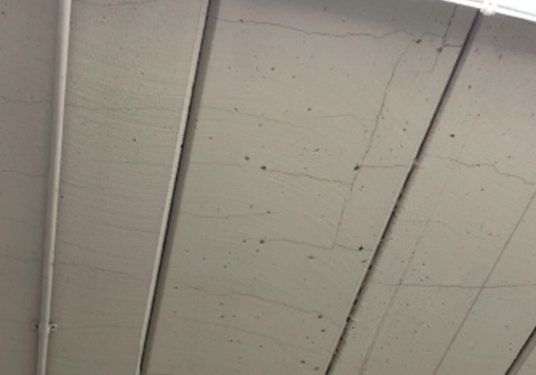
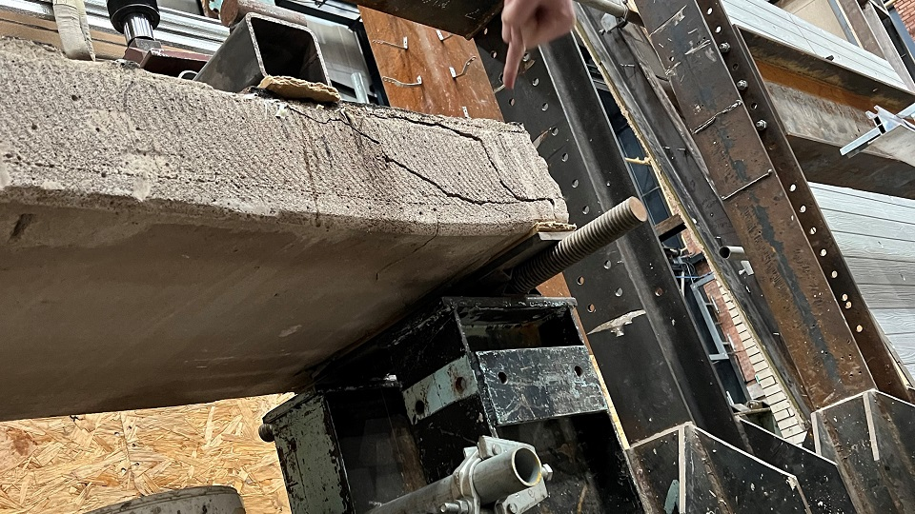
Concerns with RAAC
Strength and End Bearing
Lightweight properties came at a cost to structural strength. 20% to 30% of normal structural concrete weight
The Compressive strength of concrete is 37 N/mm² whereas autoclaved aerated concrete (AAC) might more typically have a compressive strength of 3 N/mm²
Inadequate End Bearing for panels (< 2 inches). Shear Failure
Creep (permanent displacement over time) of panels potential, reduces end bearing.
Studies of degradation in the UK, the Royal Institute of British Architects has warned RAAC roof panels only have a lifecycle of 30 years
Panels in use today in the UK and Canada are well past their Expected Useful Life.
Notes:
The second biggest concern with RAAC are Strength and End Bearing issues
Lightweight properties came at a cost to structural strength. RAAC has 20% to 30% of normal structural concrete weight
RAAC is also Less durable than standard reinforced concrete. (Flexural, shear, compressive strength values are much less) 10% to 20% of the compressive strength of everyday structural concrete. The Compressive strength of concrete is 37 N/mm2 whereas autoclaved aerated concrete (AAC) might more typically have a compressive strength of 3 N/mm2
Some panels as a result of the manufacturing process lack of quality control, may have an Inadequate End Bearing length (< 2 inches) which can create Shear Failure at the end of the panel
Another issue is Creep (or permanent displacement over time of panels. This displacement also can reduce end bearing lengths.
Studies of degradation in the UK, the Royal Institute of British Architects has warned RAAC roof panels only have a lifecycle of 30 years
Panels in use today in the UK and Canada are well past their Expected Useful Life.

Slide 14
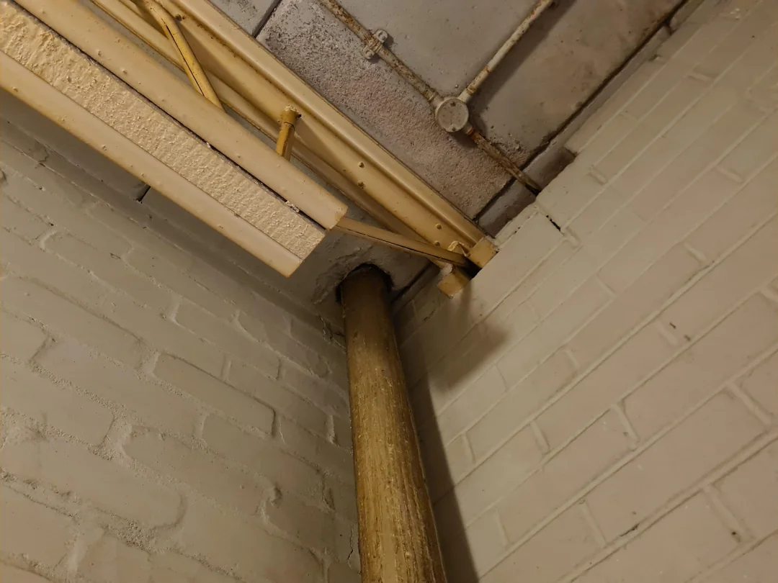
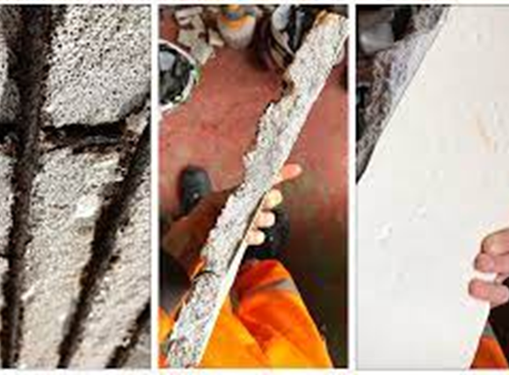
Concerns with RAAC
Warning Signs
Cracking and disruption around end bearings
Transverse cracking at midspans
Deflection can be checked and measured, with results greater than one-hundredth of the span being cause for concern.
Note: In some cases, soffits may be concealed by suspended ceilings, so it is essential to open them up to check whether there are RAAC planks and, if so, assessing their condition.
Signs of higher moisture on the underside of the panels
Externally, signs of ponding, previous or current leaks might be indications of RAAC plank failure.
Additional Loading changes or Thermal effects can contribute to deterioration
Notes:
So what are some of the Warning Signs?
Visually Cracking and disruption around the end bearing points that are observed can indicate issues
Transverse cracking at midspan or at end bearing points might indicate bearing points even less than 40mm (1.5").
Deflection can be checked and measured, with results greater than one-hundredth of the span being cause for concern.
Note In some cases, soffits may be concealing suspended ceilings, so it is essential to open them up to check whether there are RAAC planks and, if so, assessing their condition.
Signs of higher moisture on the underside of the panels can indicate quicker reinforcing corrosion may be occuring.
Externally, signs of ponding, previous or current leaks might be indications of RAAC plank failure.
Since it is thought that thermal effects can contribute to deterioration, check whether the roof has been re-covered, in particular where loading may have increased or where the surface was formerly reflective and is now black, thus absorbing more infrared light and resulting in higher temperatures within roof construction.

Slide 15
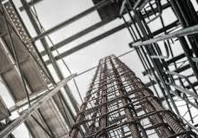
RAAC Research
Professor Phil Purnell, Professor of Materials and Structures, University of Leeds:
“The current buildings are no more dangerous than any other building that is not maintained properly. The problem here is that because roofs are not properly maintained, water gets in and corrodes the steel bars. However, the material can fail more suddenly than, for example steel, timber or normal concrete with very little warning.”
“These buildings do not necessarily need to be demolished and rebuilt. RAAC will only have been used for roofs and occasionally floors, not the main structural parts of the buildings. But the roof and floor planks/beams will need to be replaced if they are (structural) load bearing.”

Slide 16
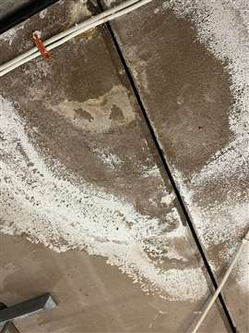
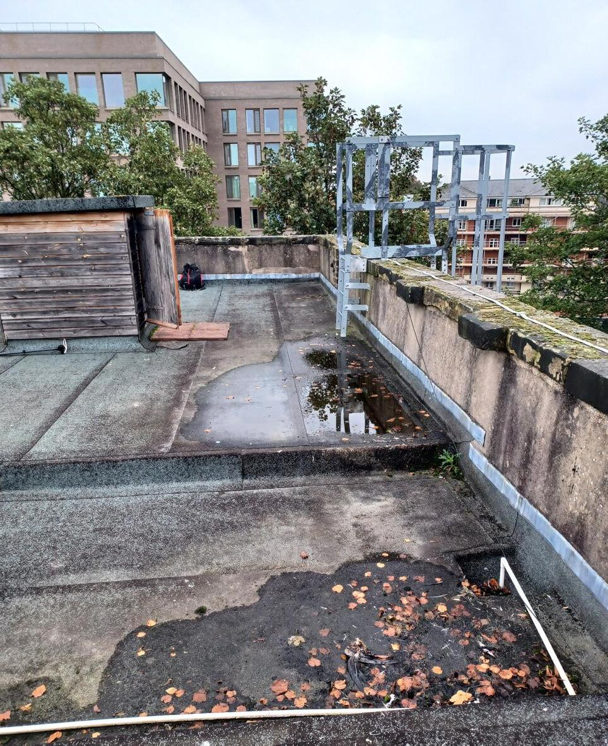
Warning Signs
As owners and operators – Questions to Ask
Has the roof recently leaked or is leaking?
Are there areas of Ponding on the roof?
These are issues that can indicate potential deflecting in the roof RAAC panels, damage to existing roof waterproofing and locations of reinforcing corrosion.
Water ingress can exacerbate failure of the RAAC planks.
Has the roof or floor had any additional load added? Exceeding design loads.
Have any new roofing waterproof layers been added. (Black instead of more reflective versions.) Increasing thermal heating.
Underside of planks – can any cracking and deflection be observed at the end of the planks or midspan?

Slide 17
It’s time for A Poll question

Slide 18
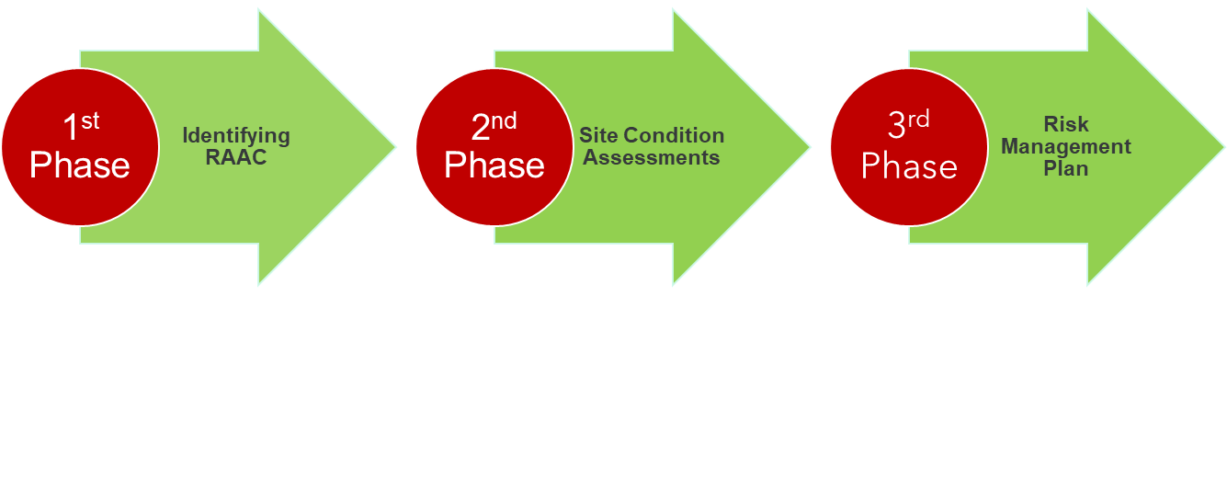
Three Phases of RAAC Management

Slide 19
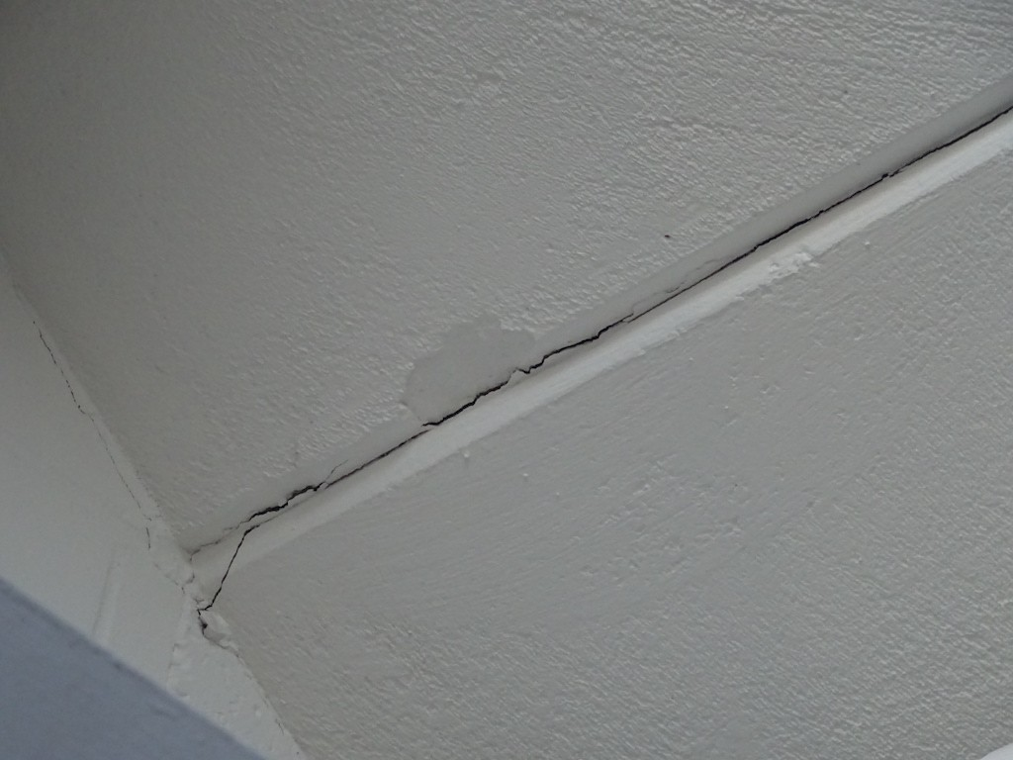
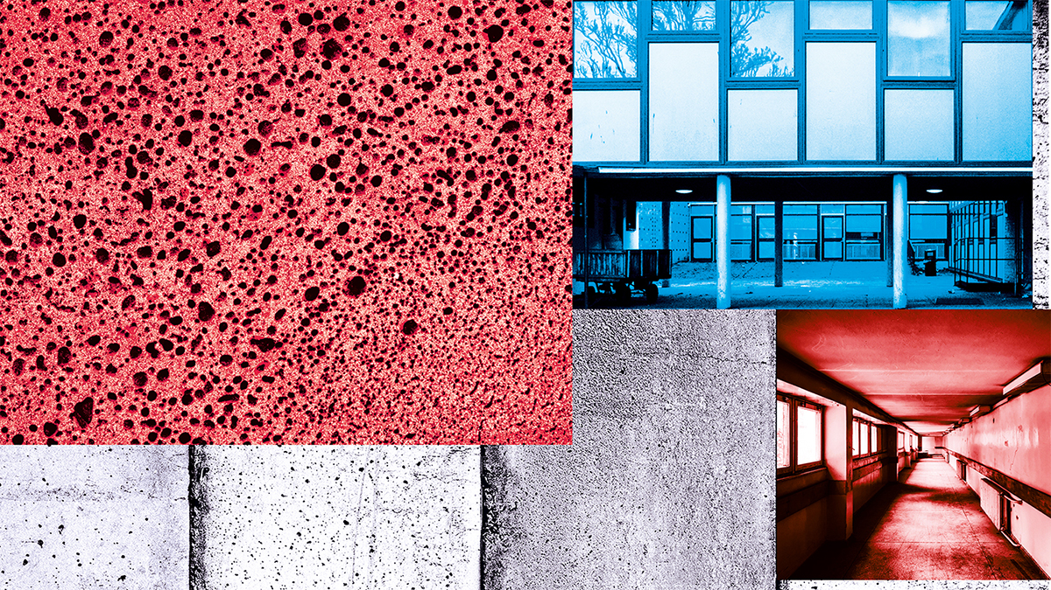
First Steps
Identifying whether you have RAAC – Desktop Investigation
* Due to the potential dangers, a detailed risk assessment should be carried out by a Professional Engineer or qualified/ experienced technical expert.
A safe system of work should be planned for identification and inspection.
Clues for Facility Staff or Building Owners:
Check Year of Construction of Buildings, Original Drawings
RAAC Planks were used between mid 1950s to mid 1990s. Construction before or after this period is unlikely to be affected
Enquire whether similar buildings/ schools in the local area are known to have used RAAC members.
Check records, plans, maintenance reports of any reference to RAAC.

Slide 20
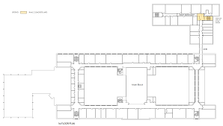
First Steps
Identifying whether you have RAAC – Desktop Investigation
Note: drawings may not mention RAAC or product brand names for RAAC. They may list “precast concrete” or "lightweight concrete panels" on drawings.
Certain product names that may be seen are:
- Siporex (Canada)
- Durox, Celcon, Hebel, Thermalite and Ytong. (UK)
* If you do not know the construction type of a roof, and whether RAAC planks are used, a Professional Engineer or qualified/ experienced technical expert should inspect the building system.
After the inspection and identification, a plan for managing the risk is to be put into place.

Slide 21
It’s time for A Poll question

Slide 22
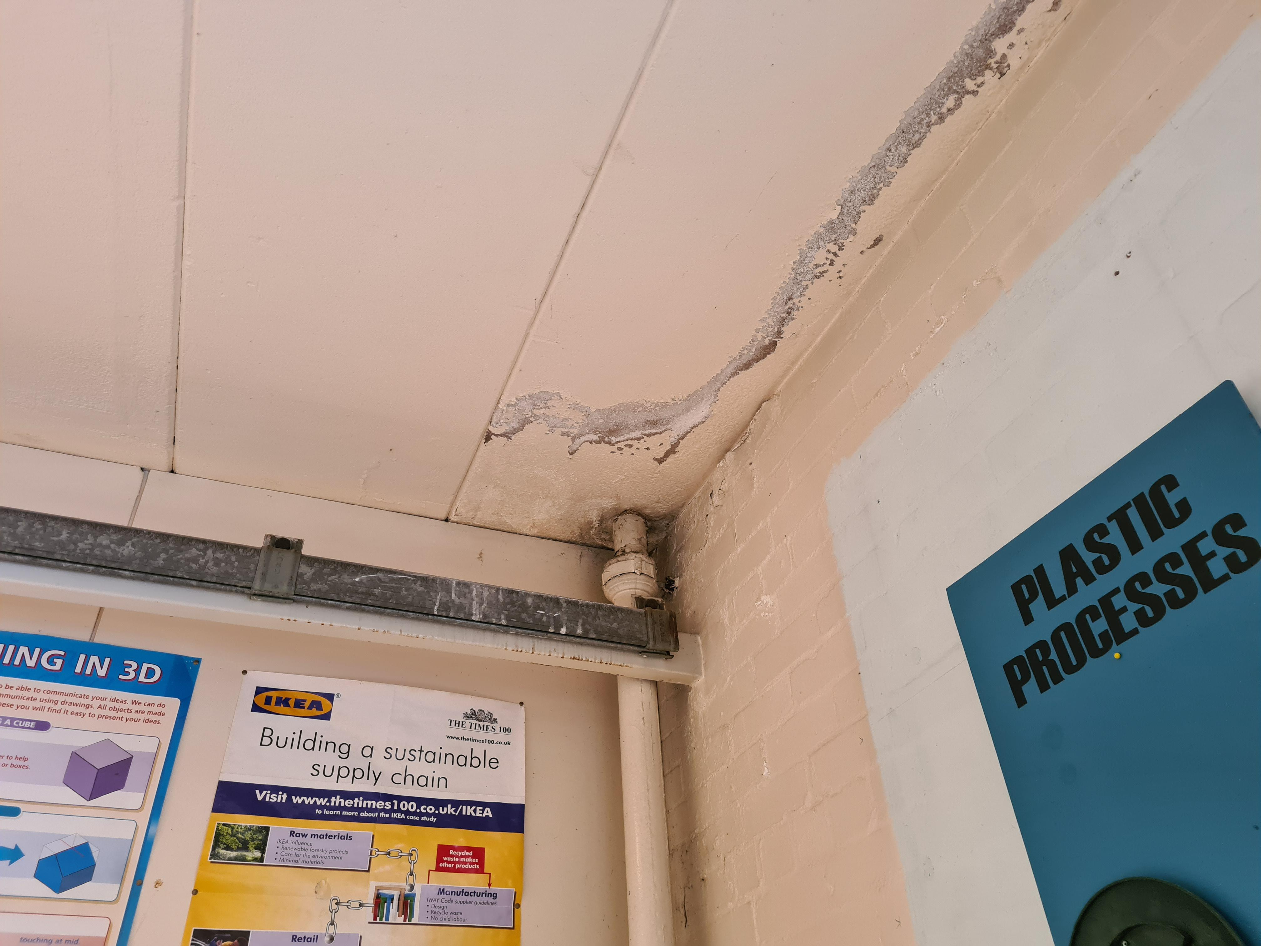
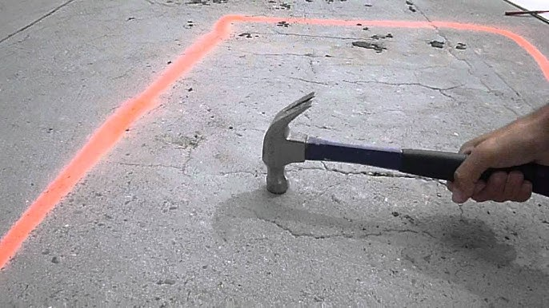
RAAC Site Assessments
Visual Site Assessment and Panel Condition Documentation
Initial Visual Inspections – crack and defect recording.
Detailed, Repeatable Surveys (Annually) – vertical deflection measurement and condition assessments of the panels.
Surveys should be done for each panel and include:
Photographic records and comparison of cracking types
Records of crack patterns or delamination
Recording any evidence of water leaks
Hammer tap sounding for debonding concrete, full length and supports
Make a record of signs of cut panels that may have occurred after manufacturing
Also record alterations or penetrations after construction

Slide 23
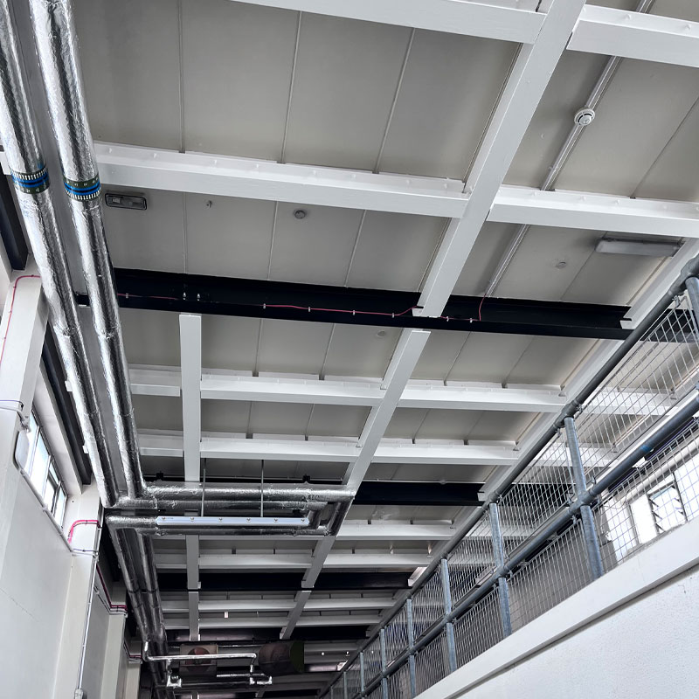
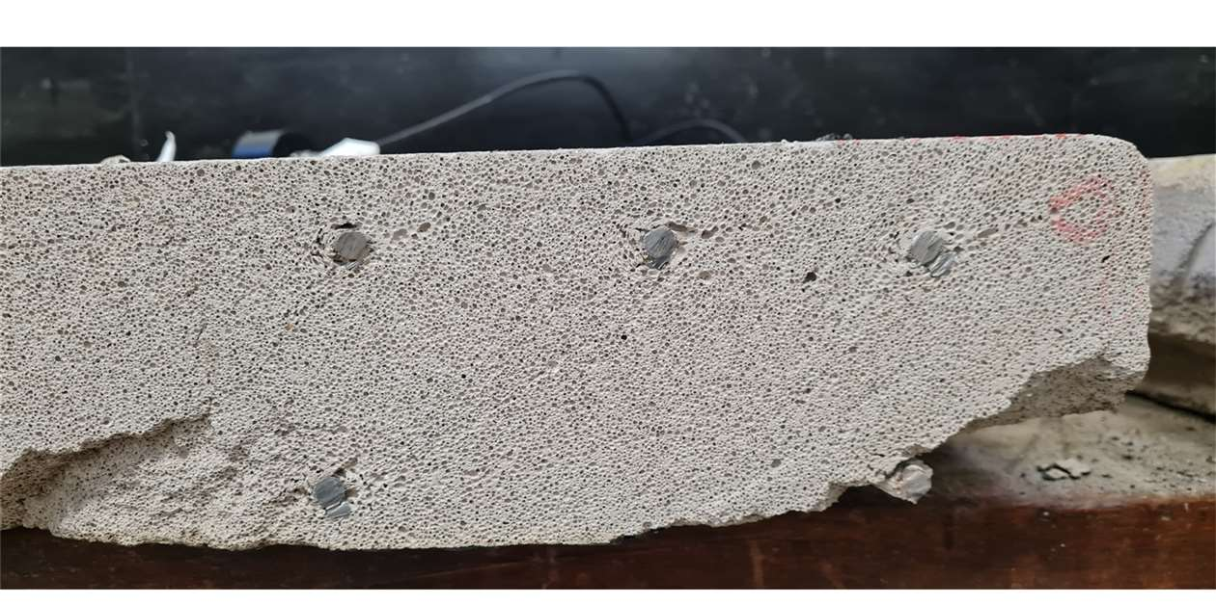
RAAC Site Assessments
Notes for Testing Limitations
Note: testing methods used for traditional concrete to check for reinforcement condition (carbonation testing and chloride ion concentration of concrete mix) are not appropriate to be used on RAAC construction.
Resistivity and half-cell testing for reinforcing require non-traditional and careful interpretation and use different assessment criteria. Research is underway for these testing methods to be used on RAAC.
Experienced and knowledgeable Technicians would be required for:
Non-destructive testing – using cover meter and radar techniques to determine reinforcement location or reinforcement positioning.
Intrusive surveys – verification of reinforcement position at panel bearings, exposure of reinforcement to identify corrosion, or electrochemical testing for reinforcement corrosion.
Note: the extremely brittle nature of RAAC makes Intrusive investigation more challenging.

Slide 24
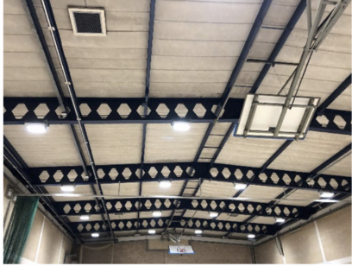
Risk Assessment
The Institution of Structural Engineers (ISE) based out of the UK is the leading association with past knowledge and ongoing research on RAAC history and use globally.
Their RAAC Study Group has published the following Resource: RAAC Investigation and Assessment – Further Guidance, 17 April 2023
In this resource they emphasize that assessments of buildings with RAAC panels are recommended to include a balance of risks for the continued use of the building against the benefit of strengthening or replacement of the panels.
The assessment should include a robust risk assessment and include consideration to the on-going monitoring and future management of the RAAC panels.

Slide 25
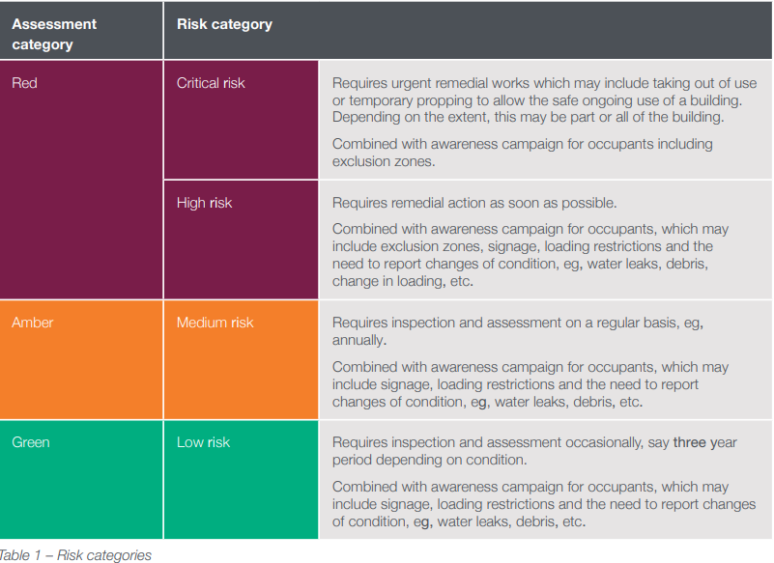
Risk Assessment Plan
Survey and assessment information should be used to create a risk classification for the panels and overall building. The proposed method is with a Red, Amber, and Green risk rating approach as in Table 1 (ISE).
Red – split into Critical and High Risk
Amber – Medium Risk
Green – Low Risk
The use of the building may be a factor in the Assessment.
*Qualified and experienced engineering judgement is required to assess when a Critical risk exists.
Critical Risk areas may need immediate action.
The final selection and urgency of mitigation measures are to be determined and discussed with the building owner for the ultimate safety of the occupants and future of the building.

Slide 26
Risk Assessment Plan
Critical Risk (Blue) Panels
- Immediate Installation of shoring until replacement or remediation
High Risk (Amber) Panels
Replacement or reinforcement prior to October 31, 2024 (Recommended Timeframe.)
Snow Loading and Rainwater Management Plan
Medium Risk (Yellow) Panels
Monitor and re-assess annually
Low Risk (Green) Panels
Monitor and re-assess at three-year intervals
From the recent engineering report for the Ontario Science Centre:
“In order to mitigate all risks associated with RAAC it is recommended that all RAAC roof panels be replaced in their entirety with new steel deck in alignment with the next roofing assembly renewal.”
Since not all roof areas required immediate renewal, a risk management plan was created.
Notes:
Critical Risk –Blue Panels –
Immediate installation of shoring (reinforcement) for all critical risk panels. These panel locations were identified immediately to the client and the work for shoring was completed following a few days.
Shoring is to remain in place until panel remediation is completed.
High Risk – Amber Panels
Setting a date - Replacement or reinforcement prior to October 31, 2024 as the recommended timeframe
as well as – a Snow Loading and Rainwater Management Plan
If remediation cannot be completed within the recommended time frame, then one of three options would be done:
1. Restricted Access or full closure to prevent persons walking in areas where high risk panels are present
2. Installation of temporary shoring to the underside of RAAC panels
3. If shoring not possible, installation of horizontal rigid hoarding near the underside of the hard ceiling or other interferences (ie sprinklers)
Medium Risk – Yellow Panels
Monitor and re-assess annually
Low Risk – Green Panels
Monitor and re-assess at three-year intervals

Slide 27
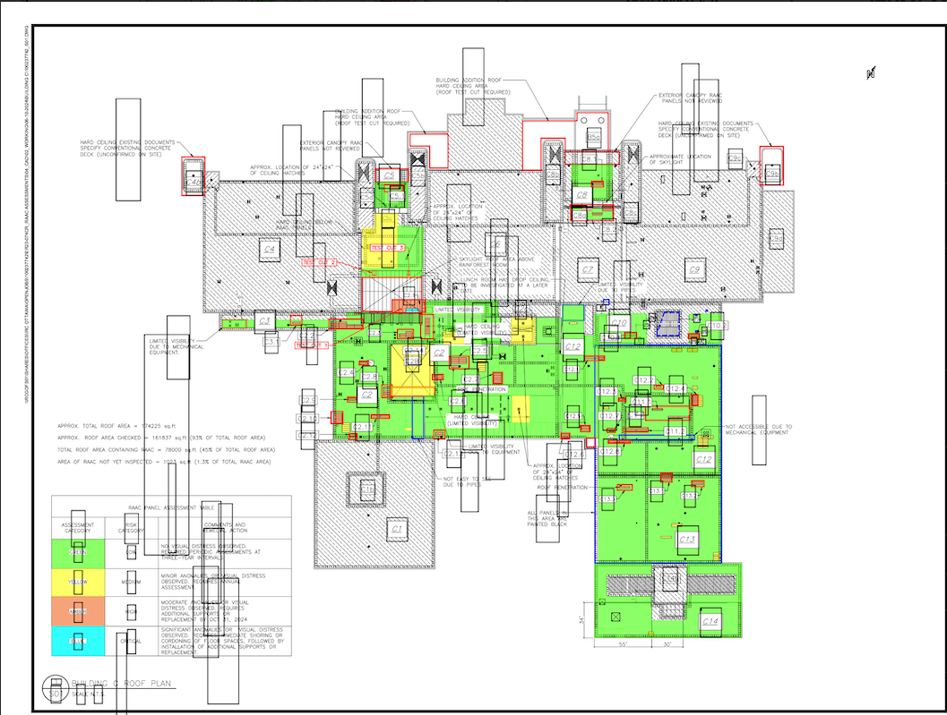
Risk Assessment Plan – Panel Classification

Slide 28
It’s time for A Poll question

Slide 29
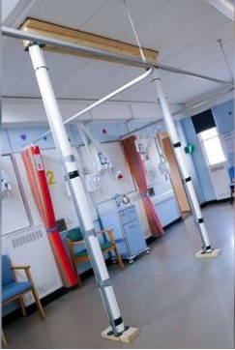
Post Assessment Recommendations
The results of assessment surveys from the UK and Canada had similar outcomes. Either:
►Remediation in place
►Strengthening
►Replacement
►Emergency propping – if panels are in severe condition

Slide 30
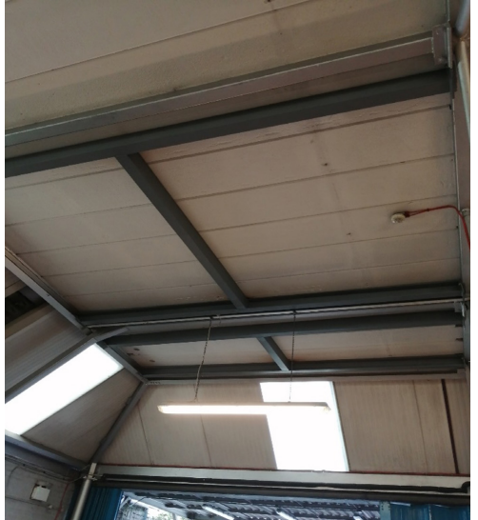
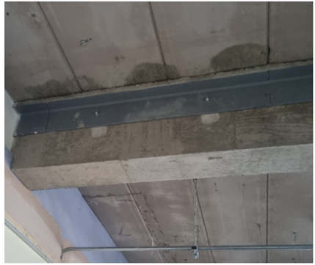
Post Assessment Recommendations
Repair and Remediation
►Positive remedial supports – to actively take the loading off panels
►Passive, fail safe supports – to mitigate catastrophic failure of panels – scaffold system
►Enhanced end bearing – to mitigate against known deficiencies, or unknown/ unproven end bearing conditions.

Slide 31
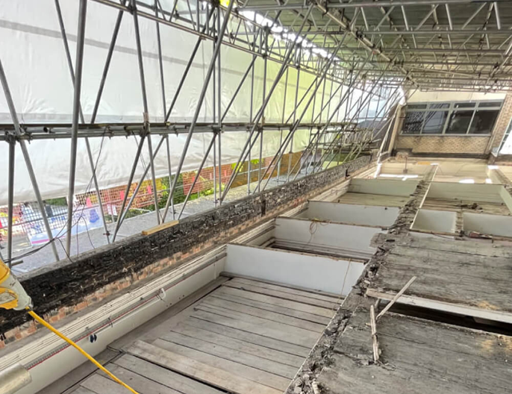
Post Assessment Recommendations
Replacement – Individual Panels or Full Roof
►Removal of individual panels and replacement with a lightweight alternative such as steel deck
►Entire roof replacement to remove ongoing management liabilities

Slide 32
Budgets
Budgetary Example
*RAAC Assessment, Remediation and Management – Ontario Science Centre
Current Year – Localized RAAC Panel reinforcement and shoring. (Critical and High) $165,000
Yearly - Assessments and Monitoring (Yellow) $10,000
Three-Year - Overall RAAC Panel Assessment and Monitoring (Yellow+Green) $45,000
Current Year – Roof Maintenance/ Assembly and RAAC Replacement = $3,864,600
Year Five to Ten - Roof Maintenance/ Assembly and RAAC Replacement = $1,955,400
*Results taken from the OSC RAAC Assessment and Management Report

Slide 33
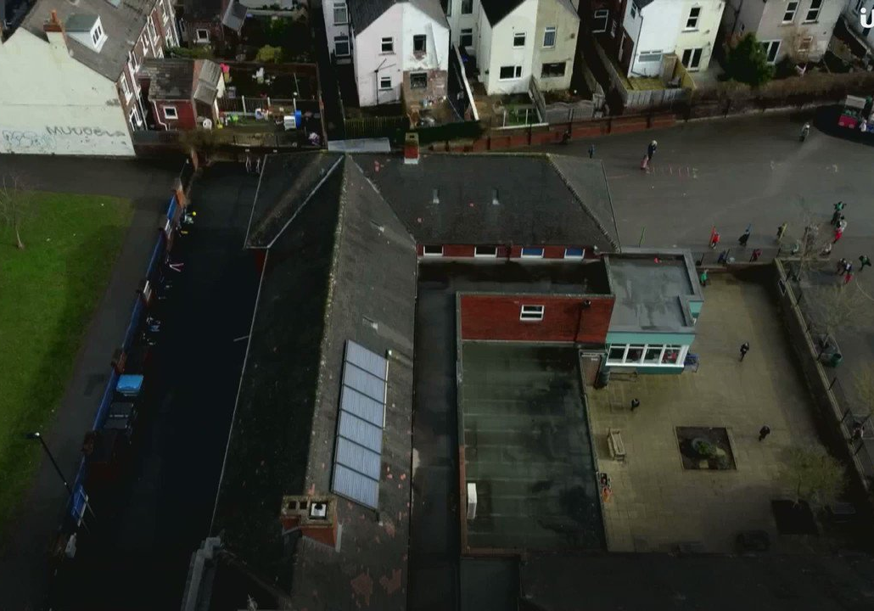
RAAC Research
Speaking about their leading work in RAAC testing, Professor Chris Goodier from Loughborough University:
“It is important that the concerns around RAAC are not overstated. There is nothing from our research to indicate that RAAC fails immediately after 30 years, or that it is a dangerous material. What our research does show is that RAAC that has been poorly manufactured, installed or maintained is at greater risk of failing.”
It is essential that owners and facility managers of buildings that utilize RAAC understand this unique construction material and its challenges.
Periodic monitoring along with a Risk Management Plan of RAAC panels are needed for their remaining service life along with their supported roofing systems.

Slide 34
Questions?
Visit our website at rothiams.com
Follow us on LinkedIn
Connect with us directly through email at structural@rothiams.com
Visit our Thought Leadership
page

