Slide 1
Cooperative Procurement Webinar: Tracking the Cost of an RFP
Purpose of this webinar: This webinar will provide valuable insights into the often-overlooked financial impacts of the RFP process and will help attendees understand how to streamline procurement practices for better outcomes.

Slide 2
Introductions
Tammy Rimes MPA
Executive Director, National Cooperative Procurement Partners
Focused on educational content, legislative advocacy, and cooperative procurement support.
Served as the Purchasing Agent for the City of San Diego
Background in sales and marketing she brings diverse experience from corporate, government, and entrepreneurial sectors.

Slide 3
North America’s Premier Association for Cooperative Procurement
360 membership of Cooperative organizations, Strategic Suppliers with a cooperative contract and public procurement and government employees
Goals are three-fold: Educational Outreach, Legislative Advocacy and Collaboration
Who is the National Cooperative Procurement Partners (NCPP)

Slide 4
What is Cooperative Procurement?
A group of entities combine their specifications into a single solicitation that can be used by all who contribute and participate.
OR
A cooperative organization or government entity issues a solicitation where the resulting contact can be “piggybacked” upon by other agencies.

Slide 5
Why Do Buyers Choose Cooperative?
Source: GovWin’s Survey of Government Contractor Sales Expectations, GovWin’s Survey of Government Procurement Professionals

Slide 6
79% of the Purchases from National Co-ops Fall into 4 out of 12 Industry Groups
Major Industry Group | Share of Co-op Purchases
Architecture and Engineering | 0.50%
Construction & Equipment | 22.40%
Education Products and Services | 7.60%
Environmental Services | 1.20%
Financial Services and Insurance | 0.30%
Healthcare | 2.60%
Operations and Maintenance | 21.90%
Professional Business Services | 4.50%
Public Safety | 3.10%
Technology and Telecom | 19.90%
Transportation/Vehicles | 15.10%
Water and Energy | 1.00%
Source: GovWin database of 3,100 purchases made through national co-ops in last two years

Slide 7
RFP Tracking Project

Slide 8
3 Stages of Procurement Process
Notes:
When reviewing the three phases outlined in Figure 1, projects require on average 43.9 hours (50%) in their Initial Stages and Publication phase, 32.7 hours (38%) in the Open Solicitation phase, and 10.5 hours (12%) in the Negotiation and Award phase. The difference between complex projects and non-complex projects is very evident in phase one, where on average, complex projects take 77.4 hours and non-complex projects only take 15 hours. Therefore, complex projects take 5 times as long as non-complex projects to complete the Initial Stages and Publication phase. During the Open Solicitation phase, complex projects take about twice as long as non-complex

Slide 9
Step by Step Process

Slide 10
Personnel Hours
Notes:
While procurement served as the lead for each of the tracked projects, the highest number of combined personnel hours for high complexity projects were attributed to the category of Customer Lead/SME. This relates directly to the first part of specification development, where content is generally provided by the user department as well as other subject matter experts. For low complexity projects, procurement often takes the lead and performs most duties, so Procurement Lead hours rank highest for those projects.

Slide 11
Costs
Position | Complex | Non-Complex
Procurement Manager | $1,082 | $455
Procurement Lead | $4,800 | $563
Admin Support | $46 | $57
Customer/SME/Evaluation | $7,705 | $436
Counsel | $1,290 | $30
Management | $2,496 | $141
Average hourly costs across all spreadsheets* | $17,419 | $1,682
Notes:
The project with the least number of recorded hours (48 hours) was for a re-bid construction project – the initial solicitation resulted in no bids, so the solicitation was re-issued. There was very little time recorded for many steps, since that work was already done in the initial solicitation (which was not submitted).
A few entities submitted projects with no hours within some of the stages. When asked about the lack of hours for those steps, they indicated it was due to procurement having authorization to proceed without management/Board approval or simply awarded to the lowest bid, with no negotiation. Pre-determined and approved templates eliminated any time having to consult with assigned counsel.
The project with the highest number of hours (4,619 hours) was for an RFP for transportation equipment with supporting services.
For the non-complex projects, many entities had little to no hours recorded for the final stage of Negotiation and Award. One entity submitted five non-complex projects with zero recorded hours in those fields. Since those submissions make up 28% of the spreadsheets, it may have skewed the costs downwards for that category.

Slide 12
Case Study – Orange County, CA
COST YEAR 1-3 | $ 51,084.54
COST YEAR 4 | $ 17,524.74
COST YEAR 5 | $ 17,524.74
TOTAL COST | $ 86,134.01

Slide 13
Report Conclusions
Time Intensive Steps, particularly for Specification Development
Cost to Procure – Does it Outweigh the Actual Cost of the Item?
Advertising Costs

Slide 14
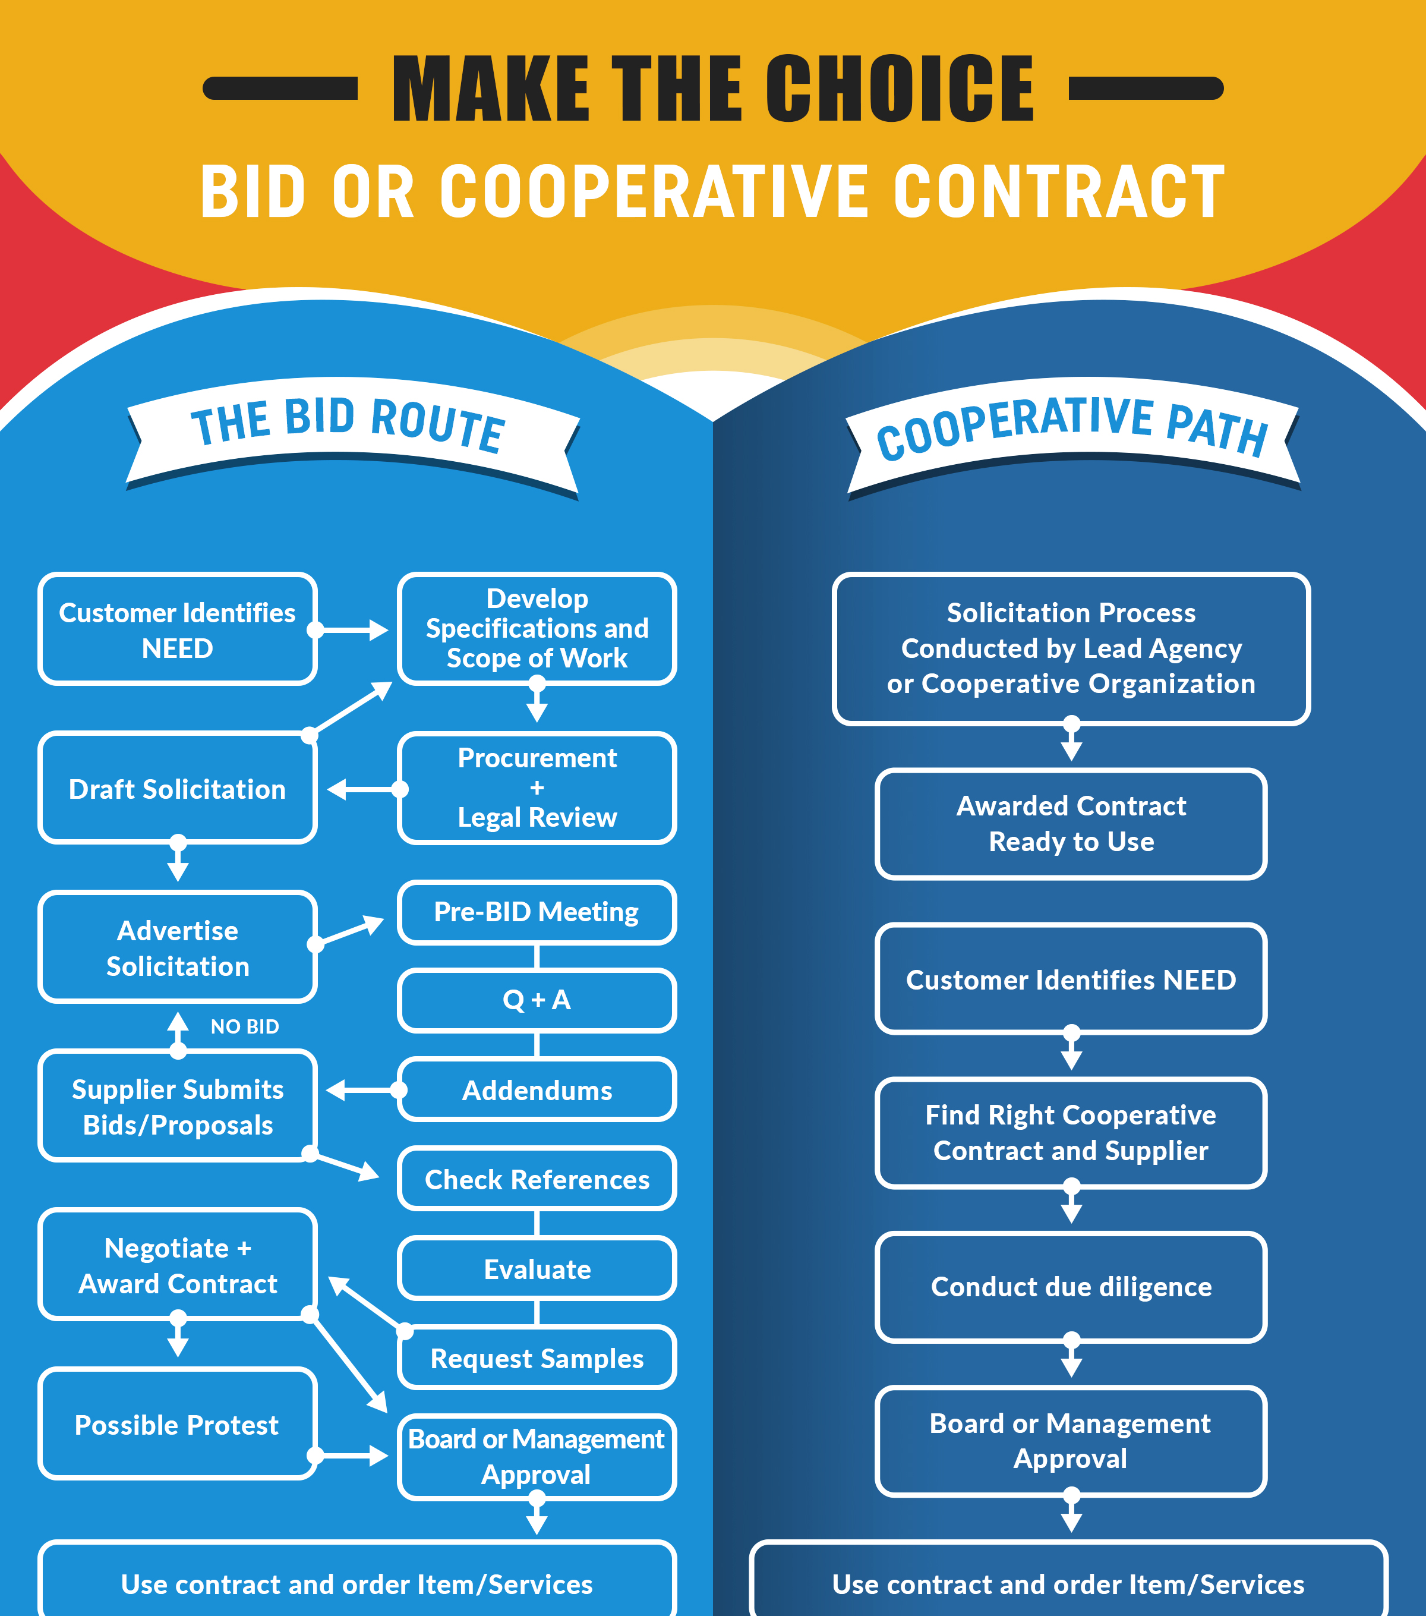
What’s Next?
Cost to Procure Calculator
Track Your Own Solicitation Costs

Slide 15
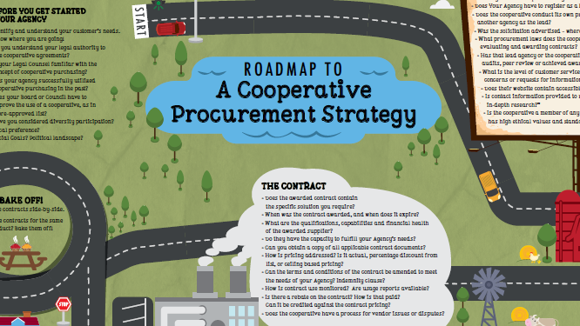
Resource #1

Slide 16
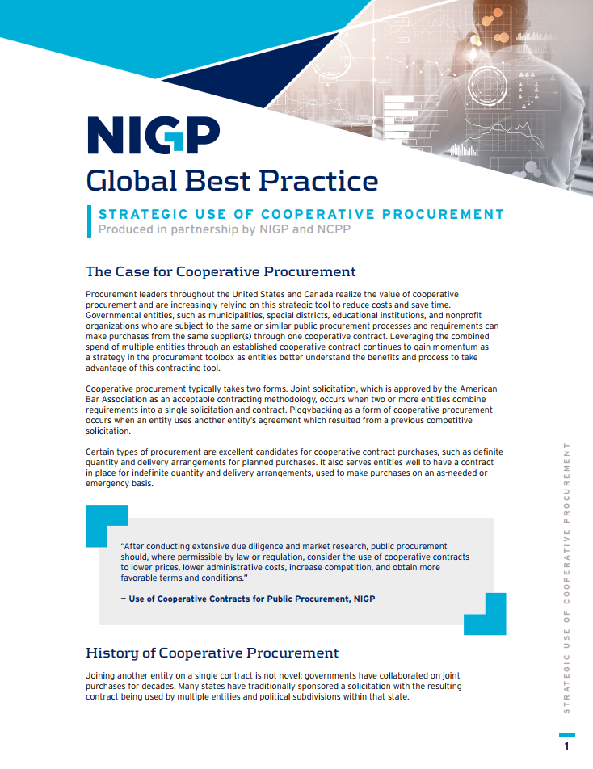
Resource #2
NIGP's Global Best Practices – Cooperative Procurement
Provide useful, applicable, and timely guidance for public procurement professionals
Result from collaborative efforts with content experts
Six Guidance Principles

Slide 17
Resource #3

Slide 18
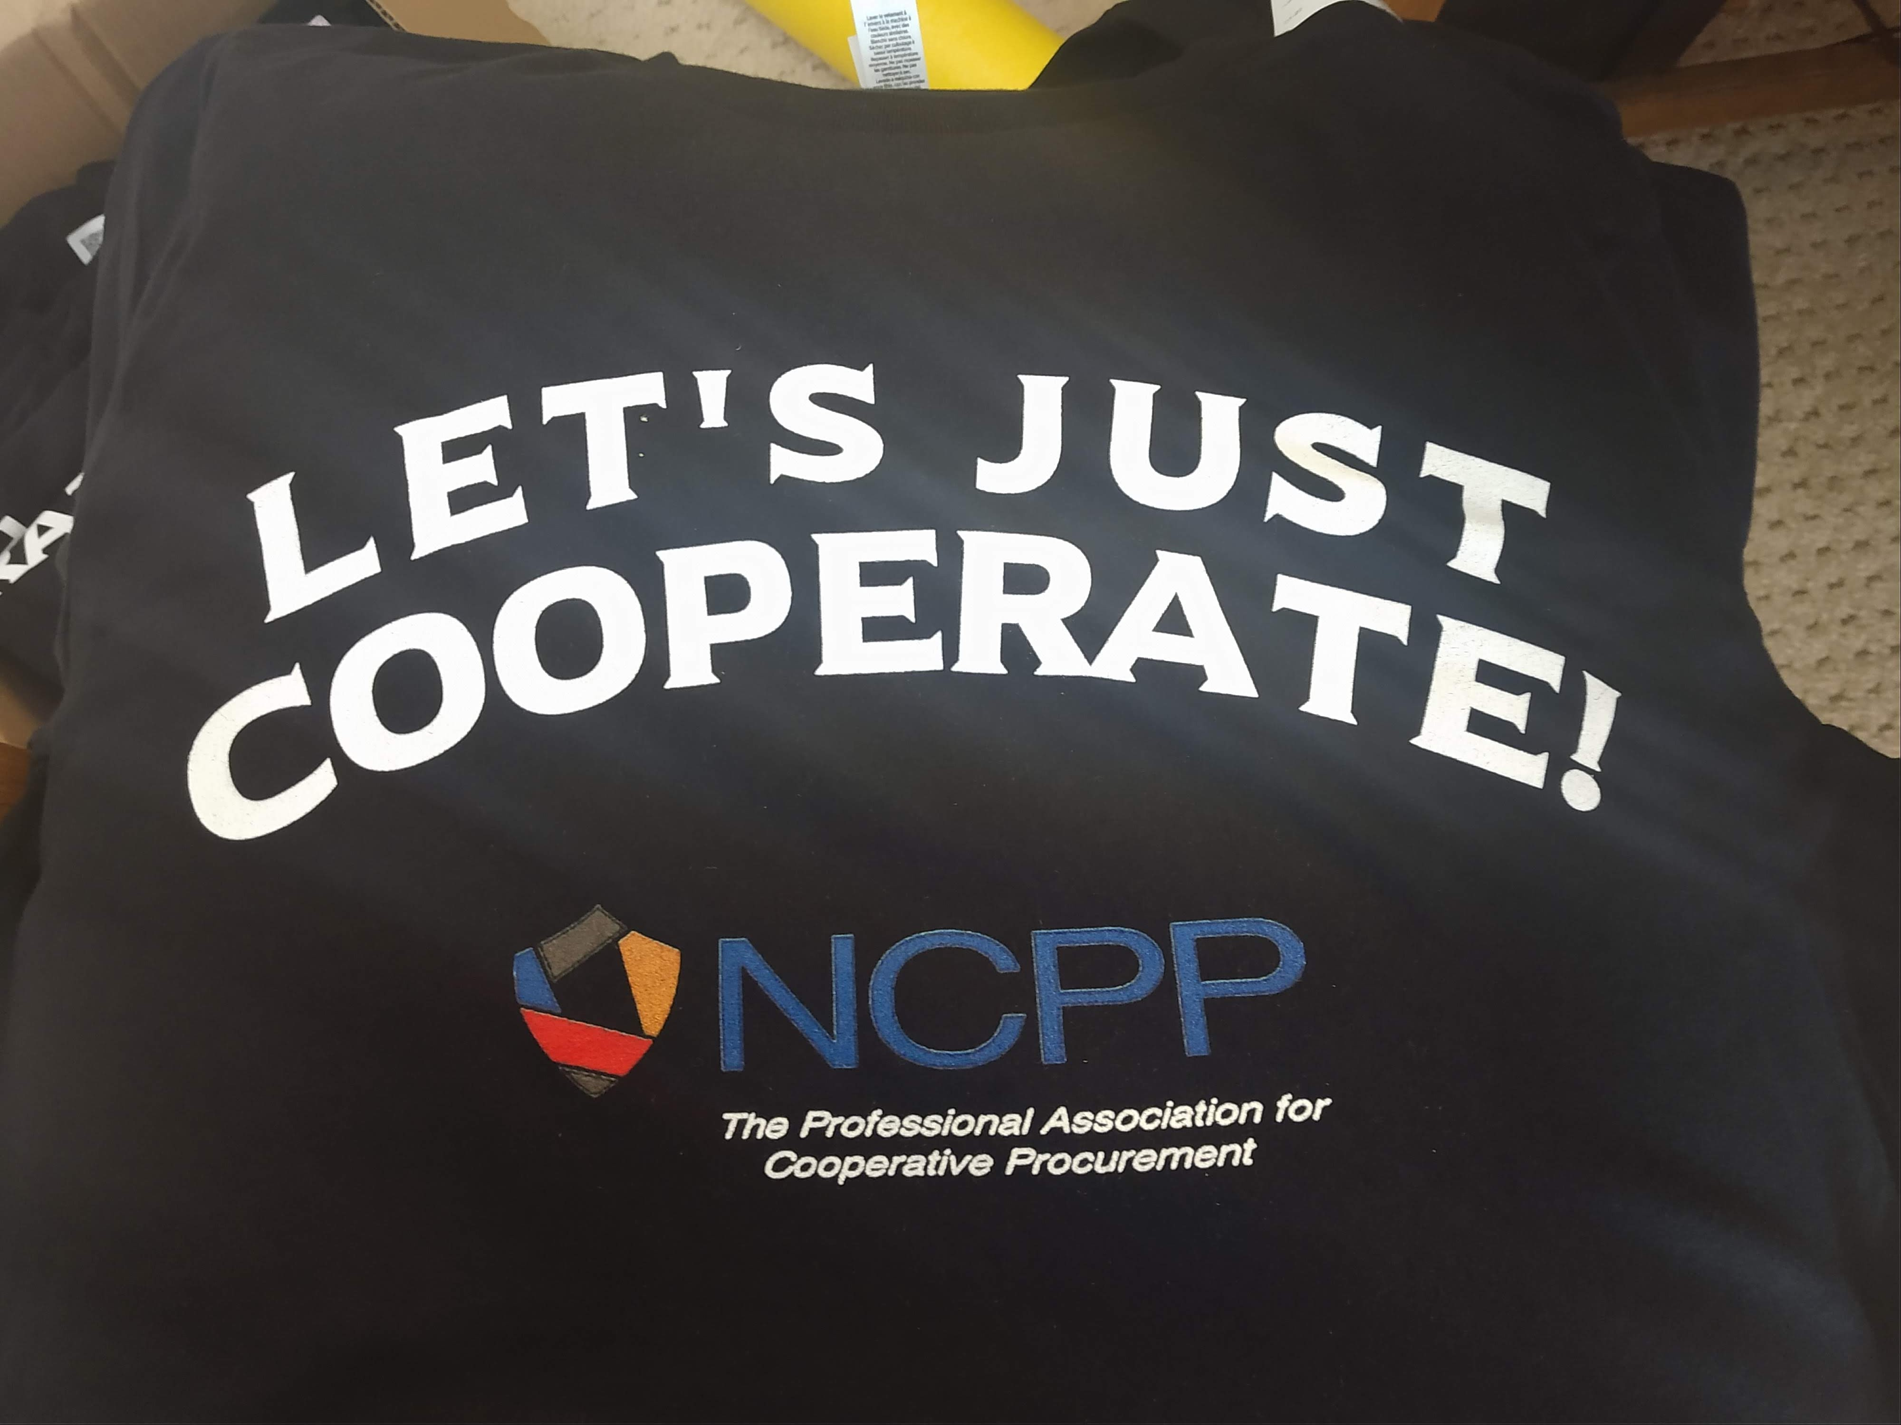
NCPPAssociation.org

Slide 19
Q & A

Slide 20
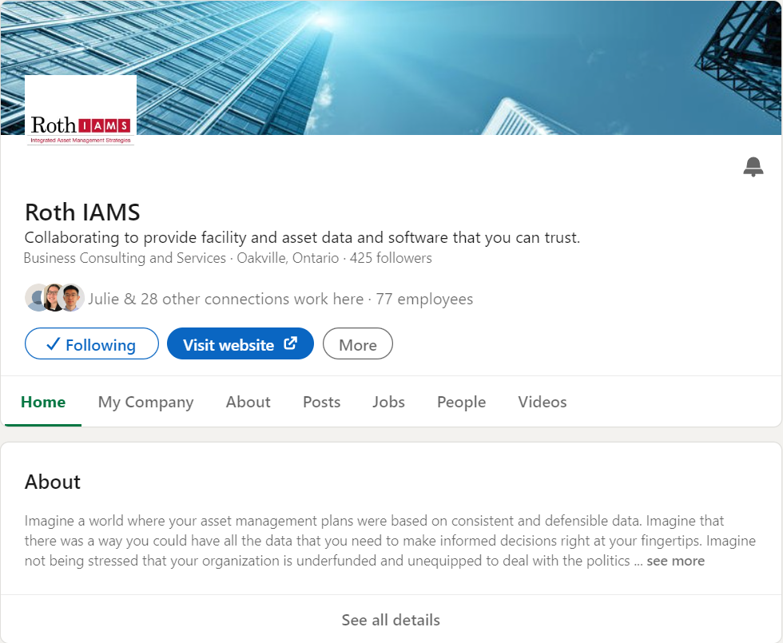
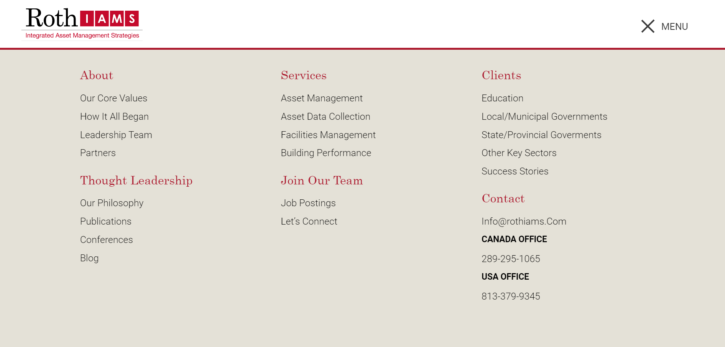
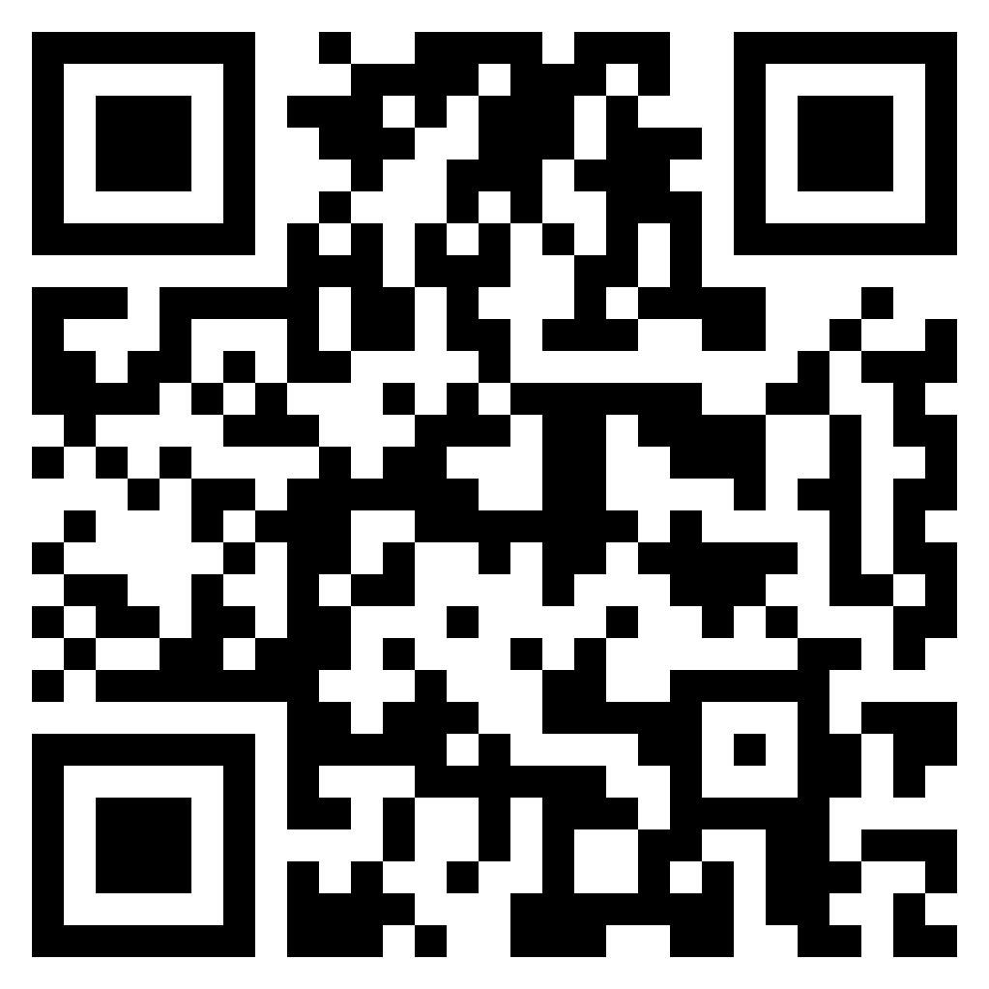
THANK YOU FOR ATTENDING
Visit our website at rothiams.com
Follow us on LinkedIn
Connect with us directly through email at bill.roth@rothiams.com or call (727) 247-9419
Dive Into Our Thought Leadership

