Slide 1
My cmms sucks
What can I do about it?

Slide 2
AGENDA
Introduction
Setting the Table
What We Hear
Getting the Data Right, First
What Does Not Suck Look Like for You?
What To Do Right Now?
Q&A

Slide 3
Introductions
Bill Roth
President & CEO of Roth IAMS
Co-Founder of SLAM Technologies
Nearly 30 years of experience collaborating with clients across North America on all aspects of facility and infrastructure asset management
Active member of APPA at the national, regional and local levels
Bob Anderson
Manager, Facility Management Consulting
Over 25 years of experience in designing and implementing facility management strategies.
Expertise across multiple markets: Education, Healthcare, Senior Services, Commercial, and Industrial.
Known for developing a unique approach to maximizing ROI on facility investments by aligning strategies with market-specific needs.

Slide 4
Introduction

Slide 6
What we hear

Slide 8
What We Hear
It doesn’t do what I want it to do
I am used to using instead
The system is out of date/obsolete
I can’t get my team to use it
It is too complicated
It wasn’t setup properly

Slide 9
The Key question
Is it the tool, the data in the tool or the users, or a bit of all three?

Slide 10
Getting the data right, first

Slide 11
Getting the Data right, First

Slide 12
Why Start with Data
The “best” CMMS system in the world will be useless unless you have the right data populated into it.
Part of the decision-making process of what CMMS to use should include the data that you want to manage
A CMMS Platform is a dynamic tool. The data should be constantly updated with every new PM Task.
Ownership of the data

Slide 13
Your Desired Dataset
Key Points on how to pick your best dataset:
Where do you invest to get the system where it needs to be
What do you need to do your first PM with the system
Inteligent Naming Conventions
Critical Task Checklists
Validation Pictures

Slide 14
What Does Not Suck Look Like for You?

Slide 16
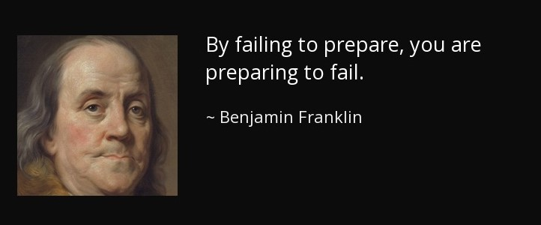
What are Your goals?

Slide 17
What are Your goals?
What do you want your CMMS to do?
Manage Work Orders?
Communicate with the organization?
Track Your Preventative Maintenance Program?
Optimize your staffing resources?
Track Technician Productivity?
Track Technician Training?
Align Skillset / training to tasks?
Validate the value of subcontractors?

Slide 18
Turning Goals into Requirements
Translate your goals into a easy-to-understand list of CMMS to meet those goals
Must Haves
Want to Haves
Nice to Haves
Becomes the “Scorecard” you use to evaluate CMMS

Slide 19
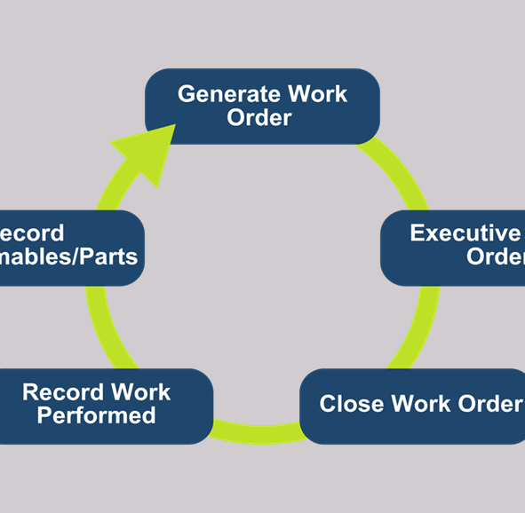
What to do Right Now Down to basics

Slide 20
Now What?
Don’t throw the baby out with the bath water!
Changing CMMS software is disruptive and shouldn’t be done lightly
If you didn’t know what you wanted when you acquired it, it may (or may not) be the right system now.

Slide 21
Now What?
Compare your current system to your requirements document to see how it stacks up
If it truly is the wrong system for you, then go to market for an alternative now that you have a clear vision of what you want to achieve with the software
If it fits, then reevaluate the implementation and how the system is used
Define success for your organization
Implement measurement tools to track progress to success

Slide 22
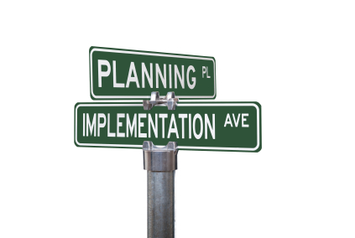
One(Ok 2) Final Note(s)
Whether you change your CMMS or just change the way you are using your current system, remember the hardest part is going to be changing the behavior of your staff
Make sure you have a plan to engage the staff throughout the process and get buy-in from all users during the evaluation and implementation phases

Slide 23
Q & A

Slide 24
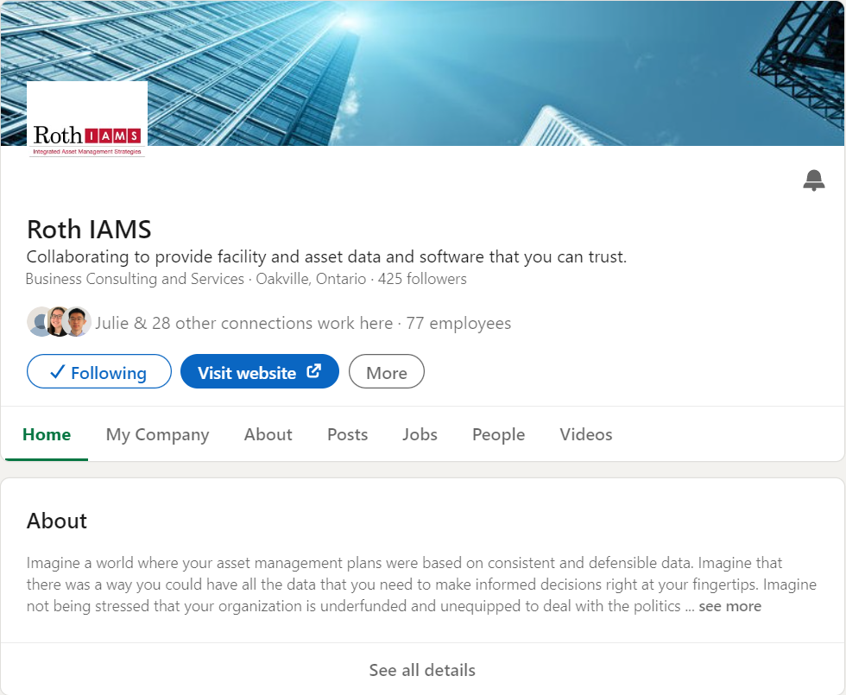
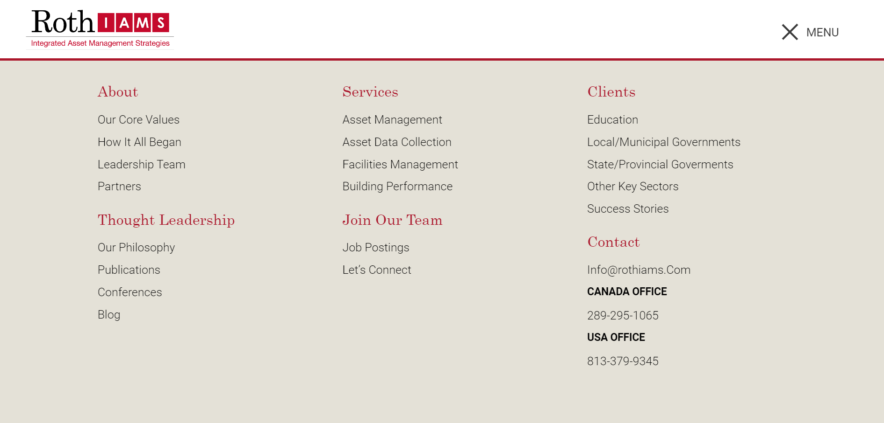
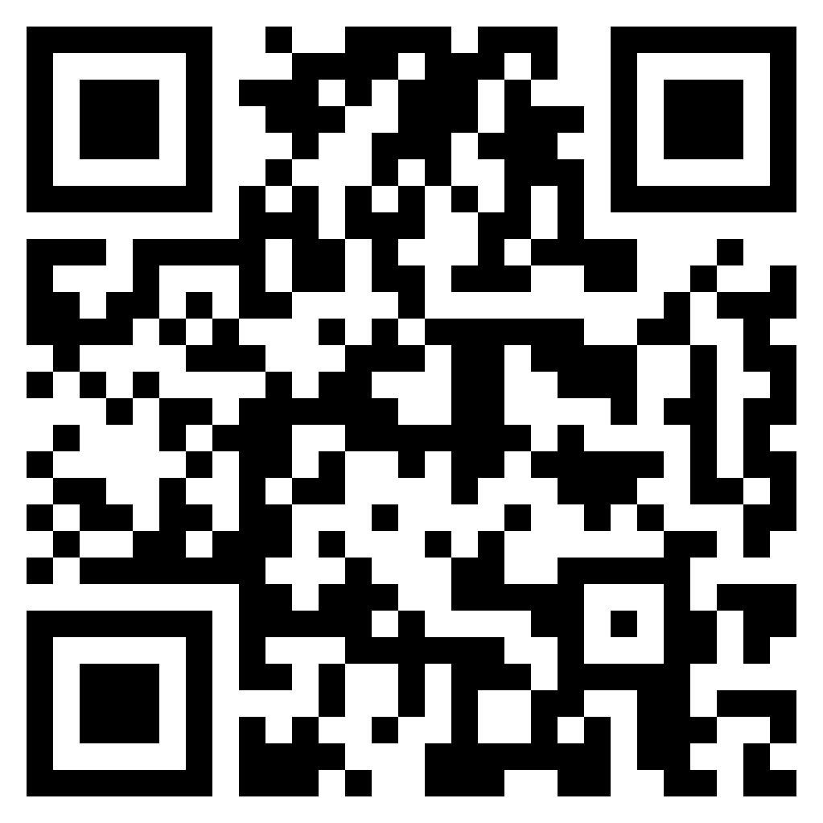
THANK YOU FOR ATTENDING
Visit our website at rothiams.com
Follow us on LinkedIn
Connect with us directly through email: bill.roth@rothiams.com or fmc@rothiams.com or call (727) 247-9419
Dive Into Our Thought Leadership

