Slide 1

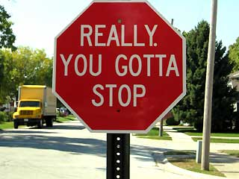
3 Things Facility and Asset Managers Should Stop Doing Right Now!

Slide 2
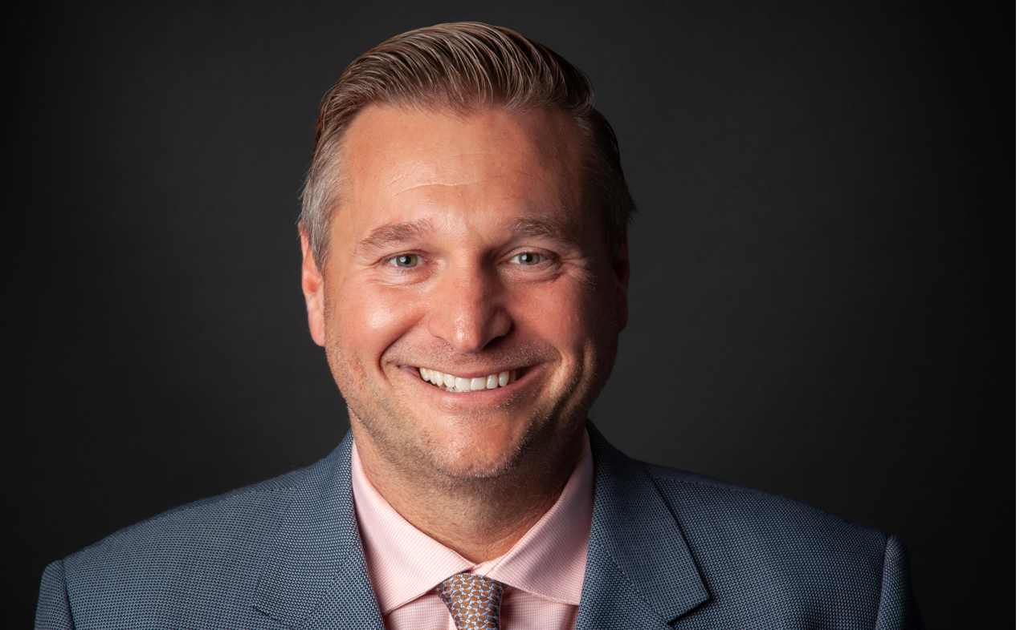
Introduction
Bill Roth
  President & CEO of Roth IAMS
  Co-Founder of SLAM Technologies
  Nearly 30 years of experience collaborating with public sector institutions across North America on all aspects of facility and infrastructure asset management
  Active member of several industry associations such as APPA (National, Regional and Local), NSPMA, NASFA, etc.

Slide 3

agenda
What is Integrated Asset Management
Thing #1
Thing #2
Thing #3
Q&A
Bonus Thing!!!

Slide 4

WHAT IS INTEGRATED ASSET MANAGEMENT?
Capital Planning Excellence
Operational Excellence
Performance Excellence

Slide 5
Thing #1
Working in Silos
Capital Planning Excellence
Operational Excellence
Performance Excellence

Slide 6


Slide 7
Why Most Organizations have Silos
Easy to have clearly defined accountabilities
Concentration of technical expertise (birds of a feather)
Creates more leadership opportunities
The way it has always been done

Slide 8

The Downside of Silos
Bad for corporate culture (Us against Them)
Left hand doesn’t know what the right hand is doing
  Opportunity to “trip over” each other and disrupt users
Lack of diversity of thoughts and ideas
Missed opportunities for synergies
Wasted money

Slide 9

What Shouldn’t We Do
Get rid of all departments and sit together and sing kumbaya

Slide 10

What Should we Do
Create a “one team” culture
  Get the most senior champion that we can find
  Get the right people in the right seats
  Manufacture opportunities to collaborate
  Create joint accountabilities across departments

Slide 11

What Should we Do
Develop joint accountabilities across departments
  Key Performance Indicators and Goals that can only be achieved through interdepartmental collaboration
    e.g. Reducing our Facility Condition Index while at the same time increasing the amount of preventative maintenance that we are doing
  Focus on the end users
    e.g. How can we limit the disruption over time to the users of a particular building or area of campus

Slide 12

What Should we Do
Build a single consolidated capital and maintenance plan for the portfolio
  I’ll show you mine if you show me yours
  Identify areas of improved performance
    e.g. What HVAC equipment needs to be replaced first, then look for more efficient options, instead of just looking at simple payback
  Address a range of issues at the same time
    Condition, Regulatory/Environmental, Functional and Sustainability

Slide 13
Thing #2
Thinking in the short Term
Capital Planning Excellence
Operational Excellence
Performance Excellence

Slide 15

Why Most Organizations think short term
Societal shift - YOLO
Highest level of certainty
It will be someone else’s problem
Too busy putting out fires – looking right in front of us
Easier to gloss over problems
Harder problems tend to take a longer time to fix
  Head in the sand

Slide 16

The Downside of Short-Term Thinking
Facilities have a 50+ Year Lifespan so
5-years is not a long time in the life of the asset
Misunderstanding of the issues by non-facilities folks
Short-Term and Long-Term Outlook can be very different
  May make bad decisions today based only on near-term data

Slide 17
What Does This Tell You?

Slide 18
What Would You do Now?
What does this tell you?
What is different now?

Slide 19
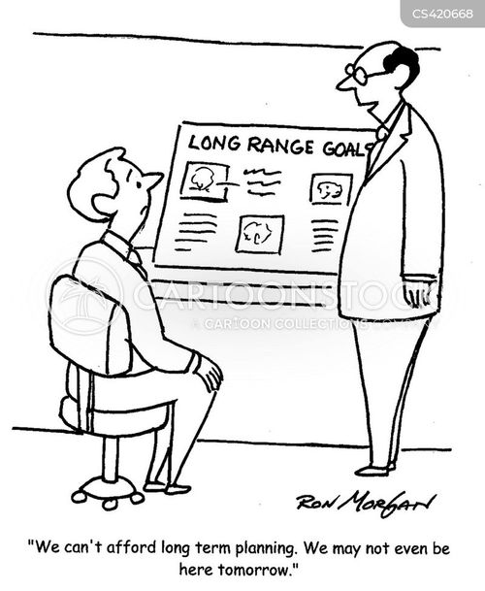
What Shouldn’t We Do
Forget about the short term and only focus on the long-term

Slide 20
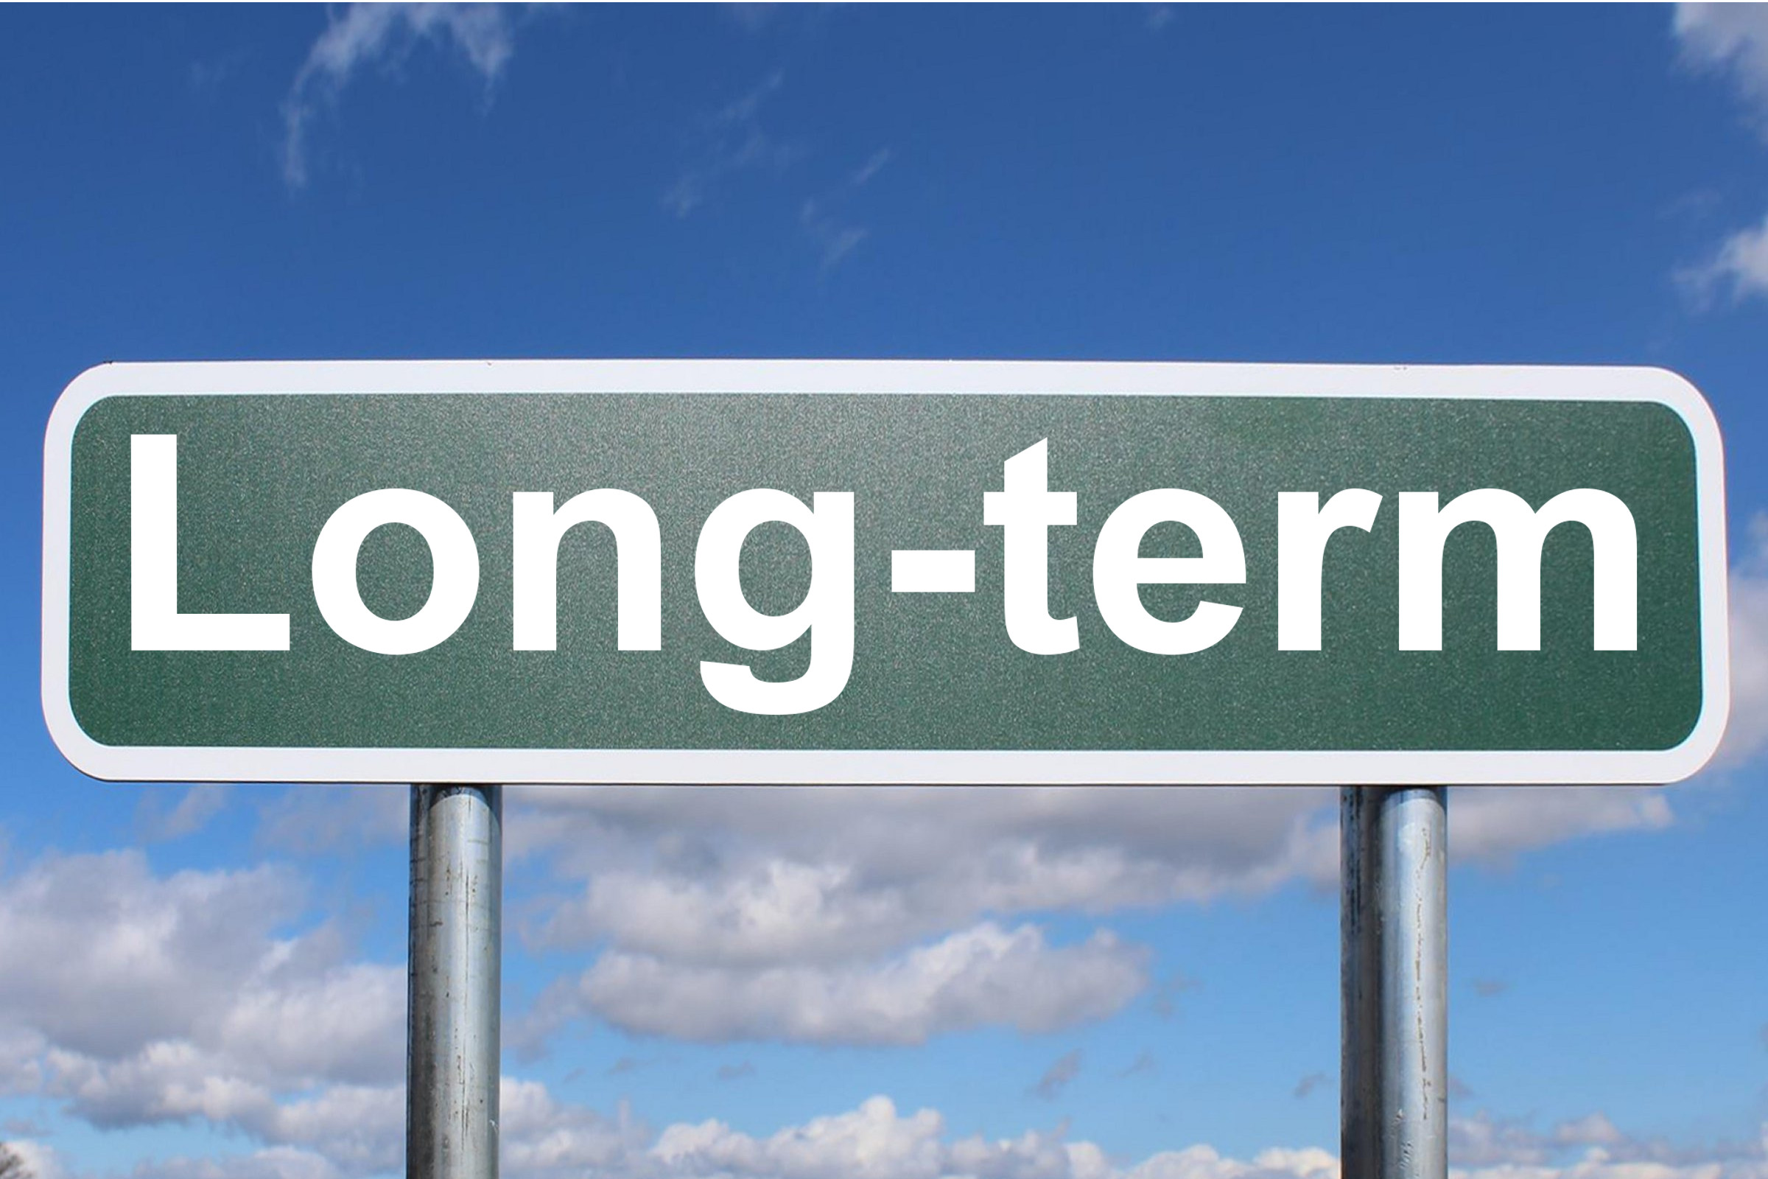
What Should we Do
Senior leadership needs to take the lead in expanding the field of view
  Take a longer-term view of your data to make more informed decisions
  Move from reactive to preventative maintenance
    Short-term pain for long-term gain
    Will reduce Deferred Capital Renewal and Maintenance in the long run
  Accept that “Less Worse” may be the best that we can do

Slide 21
Thing #3
Focusing on the data
Capital Planning Excellence
Operational Excellence
Performance Excellence

Slide 22

Why Most Organizations Focus on the Data
We are facilities folks, we love data (well most of us!)
  We understand it
  When you trust it, data has a certainty to it
  We have lots of it

Slide 23
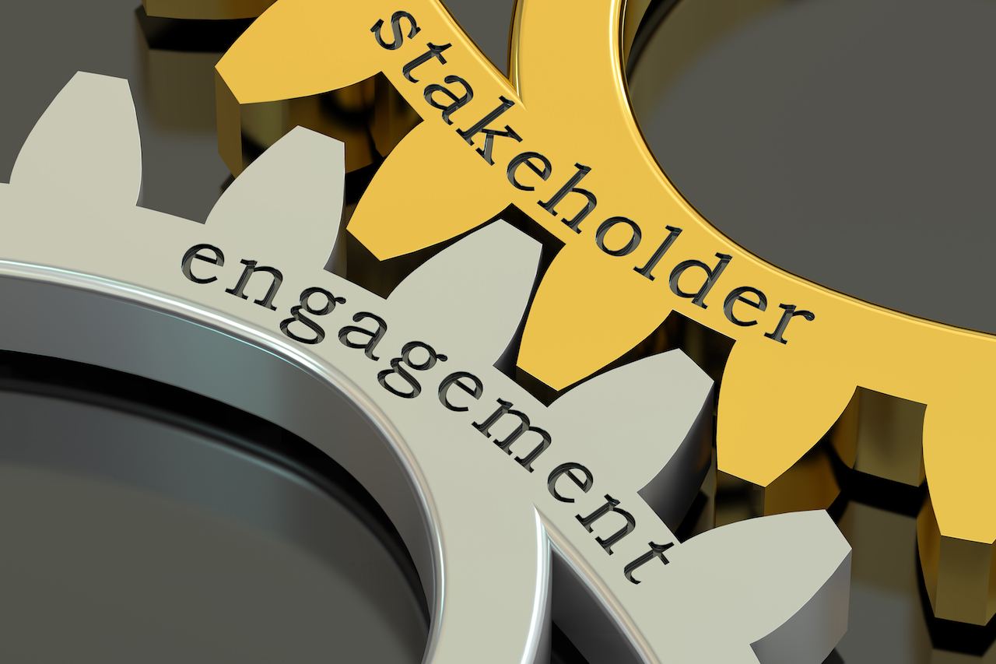
The Downside of Focusing on Data too Much
Most of our stakeholders are non-facilities people
  Finance
  Educators
  Students and Parents
  General Public

Slide 24

What Shouldn’t We Do
Throw the data out with the bathwater

Slide 25

What Should we Do
Use the data as the basis for a story that we tell our stakeholders
Tailor the story to our audience
  How you tell finance a story is going to be different than how you tell the general public
  Speak their language
A picture isn’t worth a thousand words, it can be worth a Million Dollars if you use it to tell your story effectively

Slide 27
Which Tells A Better Story?
10-Year Facility Needs Forecast
Year | DCRM
2024 | $500,000.00
2025 | $3,000,000.00
2026 | $2,000,000.00
2027 | $750,000.00
2028 | $850,000.00
2029 | $400,000.00
2030 | $900,000.00
2031 | $1,200,000.00
2032 | $825,000.00
2033 | $275,000.00

Slide 28
Bonus thing!!!!
Capital Planning Excellence
Operational Excellence
Performance Excellence

Slide 29
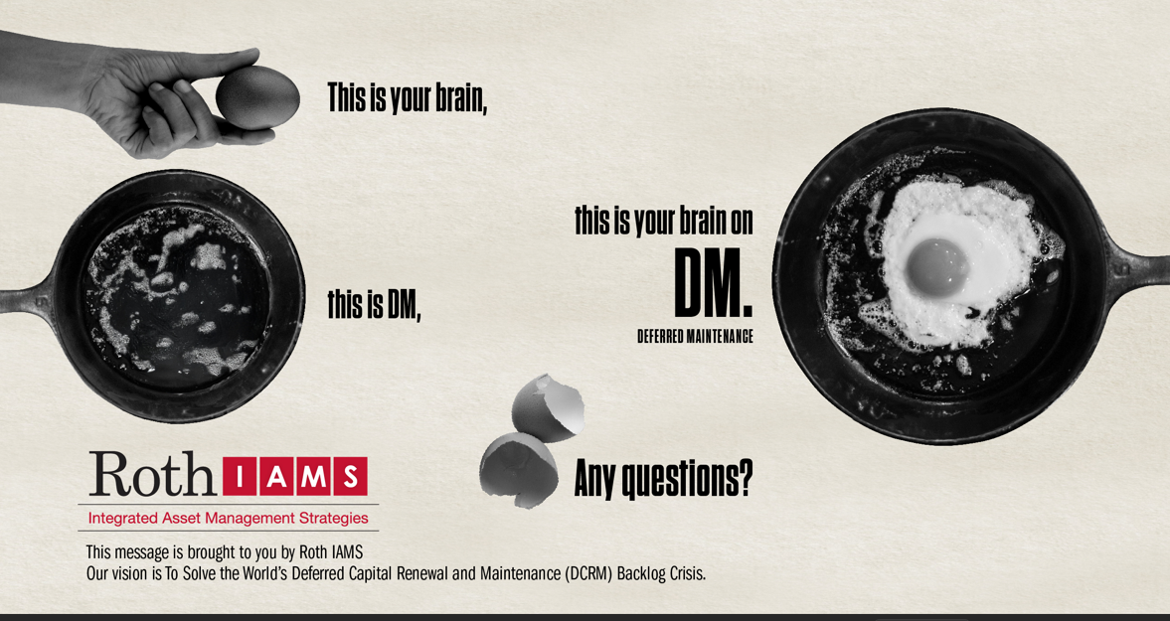

Slide 30
In Summary
Stop working in silos and collaborate across your entire team
Stop looking only 5-Years (of less) into the future and take a longer-term view of your portfolio
Stop throwing data at people and start telling them a story
DON’T SAY DEFERRED MAINTENANCE!!!!

Slide 31

Q & A

Slide 32
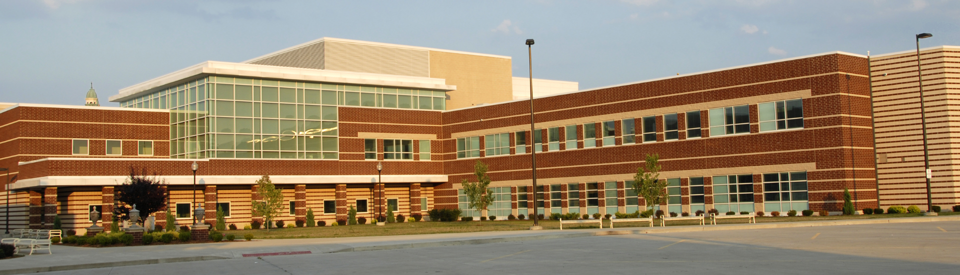

For More Thought Leadership
Scan the QR Code!

Slide 33
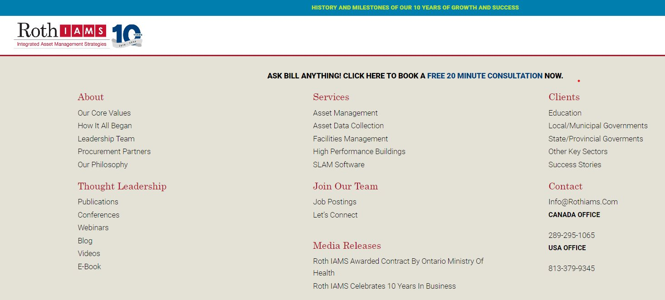
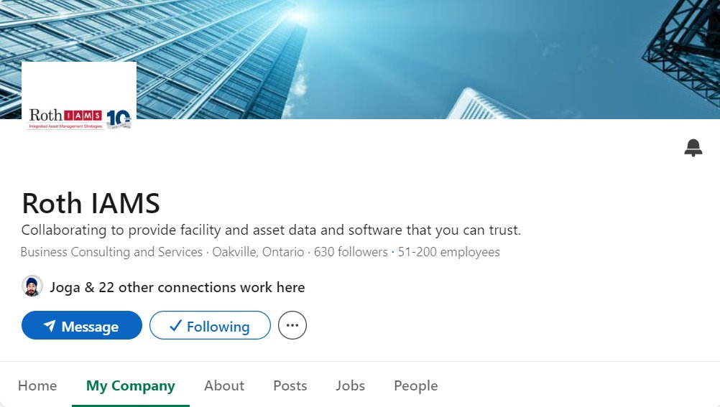
THANK YOU FOR ATTENDING
WE HOPE WE ADDED VALUE TO YOUR DAY!!!
Connect with me directly
  bill.roth@rothiams.com
  US - (727) 247-9419
  CA – (416)-700-6678
Visit our website at rothiams.com
Follow us on LinkedIn

