Slide 1
Solving the Current Replacement Value (CRV) Riddle

Slide 2
Introductions

Slide 3
Introductions
Bill Roth
President & CEO of Roth IAMS
Co-Founder of SLAM Technologies
Nearly 30 years of experience collaborating with public sector institutions across North America on all aspects of facility and infrastructure asset management
Active member of several industry associations such as APPA (National, Regional and Local), NSPMA, NASFA, etc.

Slide 4
Introductions
Ayden Townsend Practice Leader, Data Management, Roth IAMS
30 Years of Expertise – Extensive experience in architecture, construction, training, and data analytics across public and private sectors.
Facility Management Leader – Led CAD standards, accessibility studies, CMMS selection, and facility condition assessments at TVDSB.
Strategic Capital Planner – Helps clients prioritize deferred maintenance and develop long-term capital plans.
SLAM Champion – Manages Customer Success Coordinators and drives platform improvements based on user needs.

Slide 5
AGENDA
Introductions
Why CRV Matters
Four Common Methods to Calculate CRV
Special Considerations
Q & A
Picking What’s Right For You

Slide 6
Setting the Table Why CRV Matters

Slide 7
Why CRV Matters
Without CRV you cannot calculate your Facility Condition Index (FCI)
FCI = Sum of Deferred Capital Renewal Needs for a Defined Period of Time x100
Current Replacement Value
FCI is the industry standard for benchmarking your buildings across your portfolio
Foundational piece of integrated asset management
Millions of dollars are spent getting the Deferred Capital Renewal Need, yet CRV is often an afterthought
Many organizations have struggled to get numbers they can trust

Slide 8
Why CRV Matters
“Internal” consistency is more important than accuracy
If your CRV is too high, your FCI values will be artificially low
If your CRV is too low, your FCI values will be artificially high
A stable CRV (one that doesn’t change too much over time) provides more reliable data for decision-making

Slide 9
It’s time for A Poll question

Slide 10
Four common methods for calculating crv

Slide 11
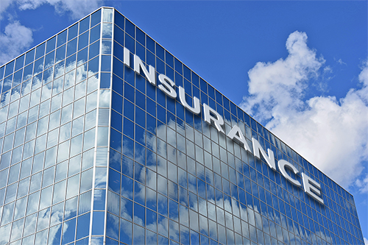
Insurable Value
When securing insurance on a building, your insurance company will ask for an Insurable Value, which is used as the basis of a “total loss” in the underwriting
Generally calculated using an industry-standard cost guide based on the construction of the building (e.g. Marshall & Swift)
Can be very detailed and building-specific
If your organization already has them and is using them in other areas of your operations, they can be easy and “free” to secure

Slide 12
Insurable Value
CHALLENGES
How were the numbers originally calculated?
Many of these values are legacy values where the people who developed them are no longer around
Was the same methodology used for buildings over time
How have they been increased/inflated over the years?
Have they been updated based on upgrades or additions to the building?
May not be available for all asset types
e.g. Surface and subsurface infrastructure

Slide 13
Insurable Value
WHEN TO USE IT
When you have the numbers
When you know how they were calculated originally
When you know that the numbers have been updated

Slide 14
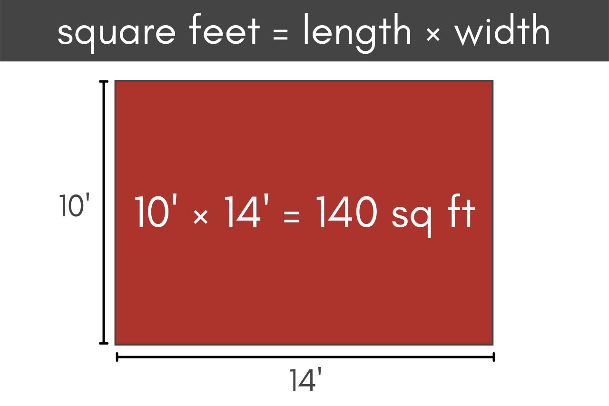
Simple Square Footage
Develop a single or categorical cost/sq.ft. for each building type
Apply it based on the size of the building
Easy to consistently apply across the portfolio
Simple and easy to explain to non-facilities stakeholders

Slide 15
Simple Square Footage
Simple Square Footage Example
Building Type | Unit Cost ($/sq.ft.) | Building Size (sq.ft.) | CRV
Elementary School A | $250 | 50,000 | $12,500,000
Elementary School B | $250 | 65,000 | $16,250,000
Secondary School C | $400 | 150,000 | $60,000,000
Administrative Building | $550 | 75,000 | $41,250,000

Slide 16
Simple Square Footage
CHALLENGES
Simplicity starts to fall away if you have too many different types of buildings
Need to have accurate building sizes
Less accurate if you have diverse design and construction standards across similar asset types
If buildings were calculated over the course of decades, standards and codes, and likely even elements present will vary
Need to have confidence in the unit costs and how they were developed
Can’t just pull them out of the air or “spit ball” them

Slide 17
Simple Square Footage
WHEN TO USE IT
A few unique types of buildings within your portfolio
Similar design and construction standards
Buildings located within a smaller geographic area
Municipalities, school districts, housing

Slide 18
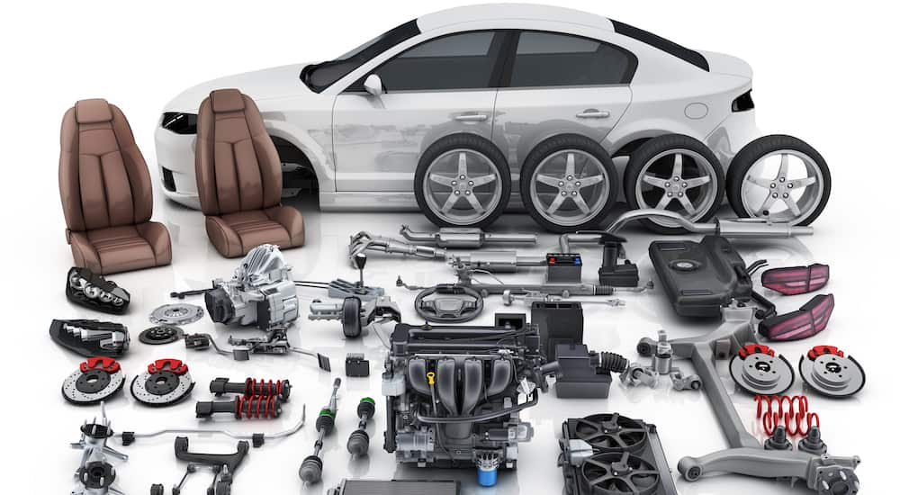
Sum of the Parts
CRV = Sum of All Element Replacement Values (ERVs)
Like building your car from parts
Based on the real-world elements within each building
Integrated within many Capital Asset Management Systems
It’s just math!
Relatively easy to explain to non-facility stakeholders

Slide 19
Sum of the Parts
CHALLENGES
Requires a Facility Condition Assessment (FCA) to get ERVs
Dependant upon the quality and depth of your FCA
Were all elements captured, or just those that need attention within the short term
Was anything missed?
Can fluctuate greatly when you do a new FCA (if things that were missed or were out-of-scope previously are picked up)
Causes big swings in FCI before and after a new FCA

Slide 20
Sum of the Parts
WHEN TO USE IT
High level of trust in your FCAs and your element costs
Senior executives understand that there may be variation over time in your FCI

Slide 21
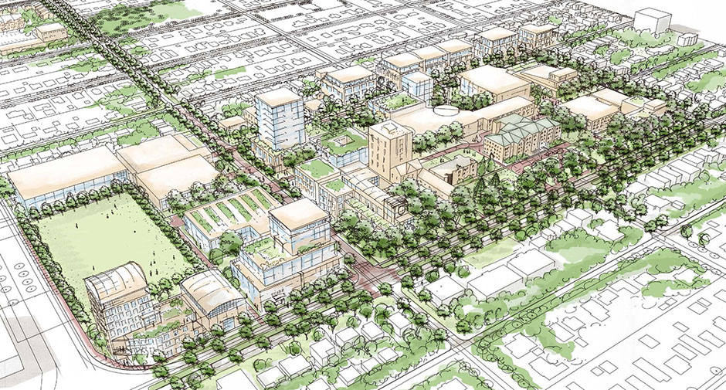
Weighted square footage
A modified version of the Simple Square Footage method used for buildings with multiple space uses
Develop unit costs for different types of space usage/program that are applied based on the area of each space

Slide 22
Weighted square footage
Weighted Cost CRV Calculation Example
Space Type | Unit Cost | Square Footage | Space Cost
Classroom | $400 | 100,000 | $40,000,000
Laboratory | $750 | 175,000 | $131,250,000
Office | $550 | 25,000 | 13,750,000
CRV |  |  | $185,000,000
Blended Cost/sq.ft. |  |  | $616.67

Slide 23
Weighted square footage
CHALLENGES
Requires an accurate space inventory
More complex and harder to explain to non-facilities stakeholders
Need to have accurate unit costs for each space type
Keeping area for each space type updated

Slide 24
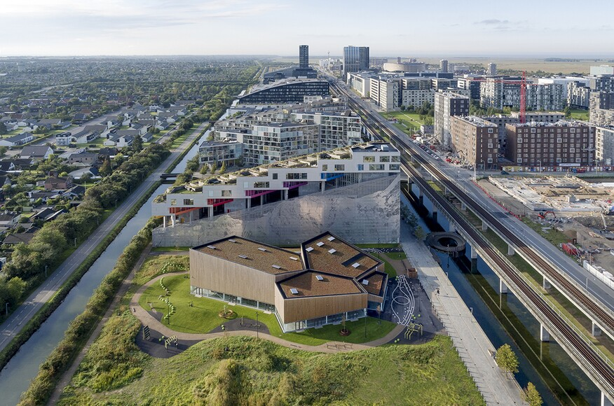
Weighted square footage
WHEN TO USE IT
Complex portfolios with many multi-use facilities
Where you have or can get up-to-date, accurate space measurements

Slide 25
It’s time for A Poll question

Slide 26
Special considerations

Slide 27
Special Consideration
Regional Factors
If you have a geographically diverse portfolio need to account for regional cost differences
Soft Costs
CRV only includes labor and materials, so you need to account for things like Project Management, Design, Contingency, etc.
Difficulty Factor
Unique circumstances that can impact costs such as heritage buildings, specialized finishes, etc.

Slide 28
Special Consideration
EXTRA SPECIAL CASE
Buildings on a campus that are connected to a Central Utility Building
Have lower HVAC costs compared to stand-alone buildings
Central Plants themselves are very complex and hard to template
Better to just develop a building-specific cost based on the actual equipment within the building

Slide 29
Picking what is right for you

Slide 30
What Way is Right for Me?
Portfolio Characteristics – Uniform vs. diverse assets.
Data Availability – Do you have up-to-date IVs or asset inventories?
Accuracy vs. Simplicity – Is ease of use more important than precision?
Consistency Over Time – Can you maintain the same methodology?

Slide 31
In Summary
CRV is an important part of your Asset Management Planning
Consistency is More Important than Accuracy
Pick the Right Method for You and Your Portfolio
DON’T SAY DEFERRED MAINTENANCE!!!!

Slide 32
One more thing

Slide 34
Q & A

Slide 35
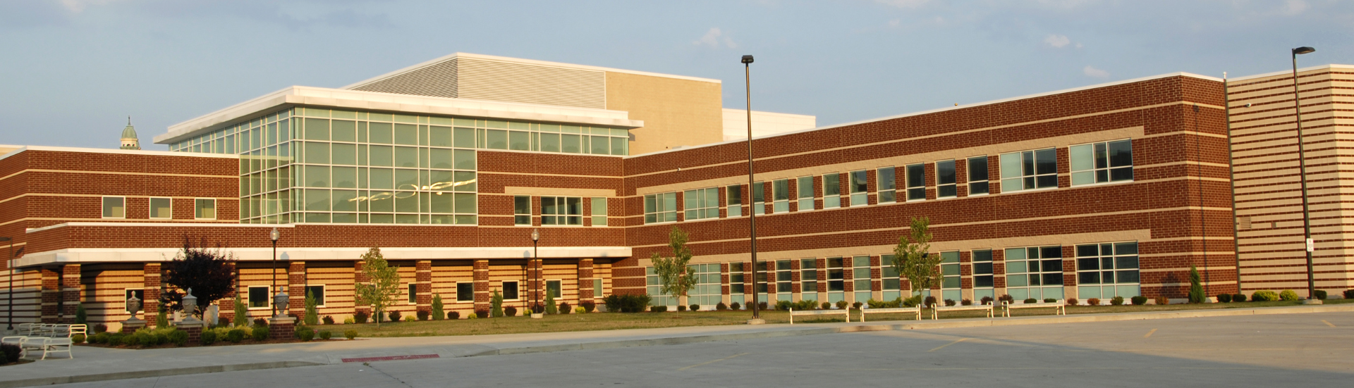
For More Thought Leadership
Scan the QR Code!

Slide 36
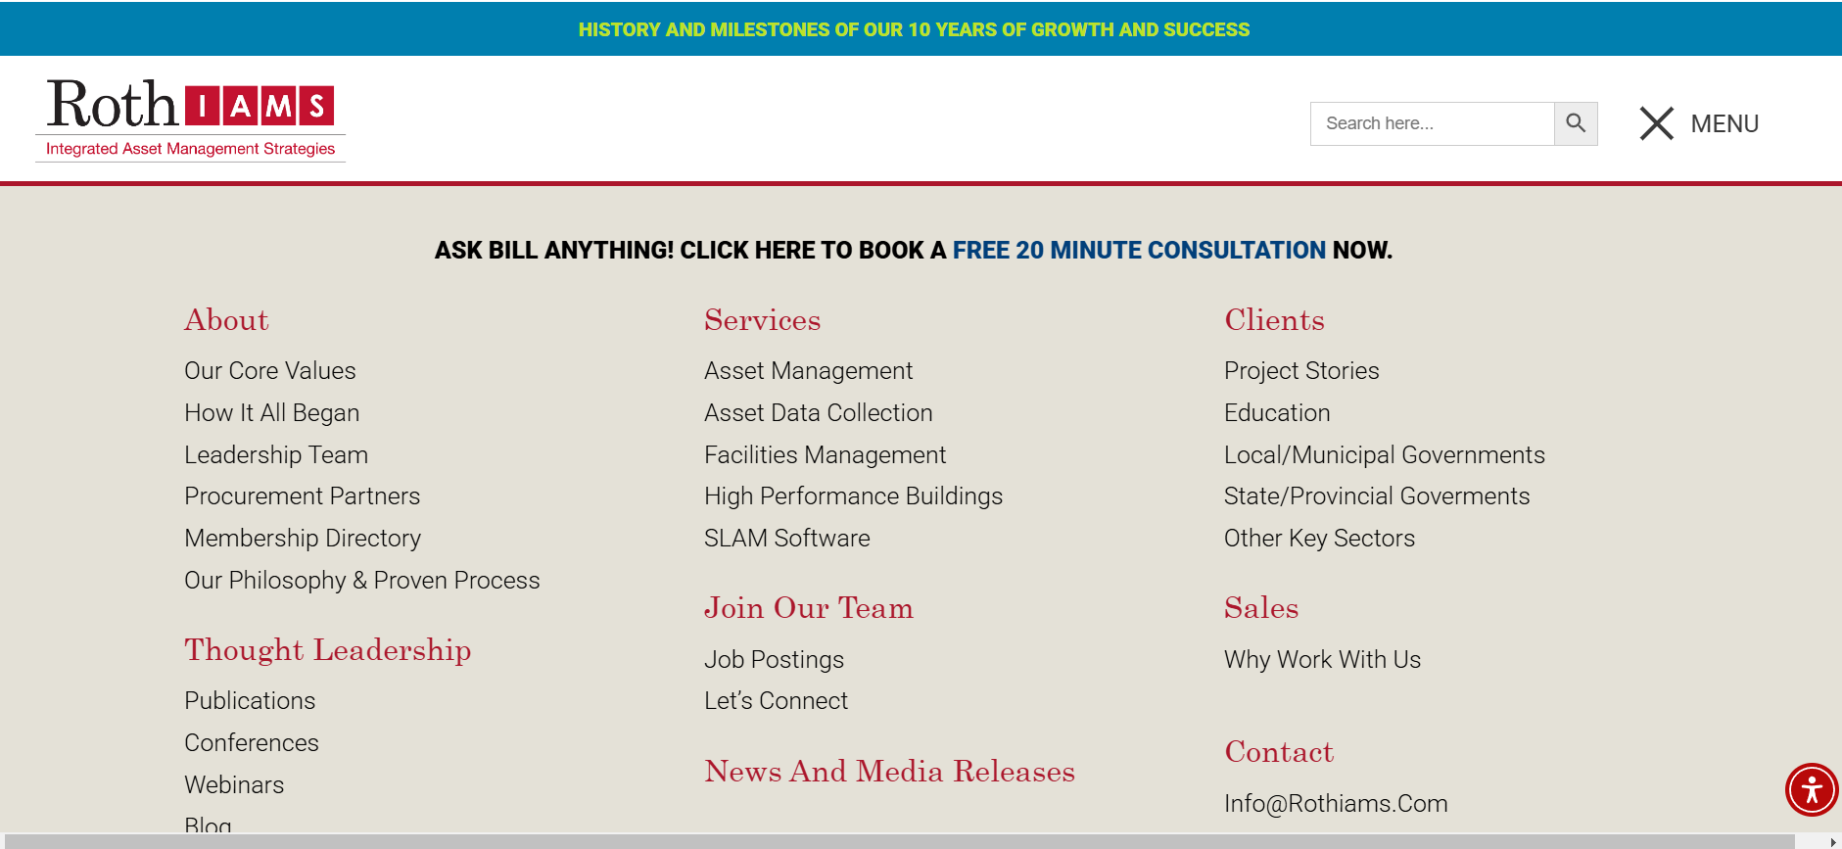
THANK YOU FOR ATTENDING
Connect with us directly
bill.roth@rothiams.com
US - (727) 247-9419
CA – (416)-700-6678
ayden.townsend@rothiams.com
Visit our website at rothiams.com
Follow us on LinkedIn

