Slide 1
MVP – Which High Is Higher Than High?

Slide 2
Introductions – Roth IAMS
Alisha McLean
National Sales Director of Roth IAMS
Alisha helps organizations with strategies, tools and solutions to help them make data informed decisions that help tell their asset management story

Slide 3
AGENDA
Introduction
Before You Get To Priority
How Do You Prioritize
What You Get – Roth IAMS MVP
What’s the Catch

Slide 4
ABOUT ROTH IAMS
Capital Planning Excellence
Operational Excellence
OUR VISION IS TO SOLVE THE WORLD’S DEFERRED CAPITAL RENEWAL AND MAINTENANCE (DCRM) BACKLOG CRISIS.
Performance Excellence
100+ Staff
59+ Municipalities
17+ District School Boards
191+ Hospitals
68+ Colleges & Universities

Slide 5
how do you decide what Deferred Capital Renewal and Maintenance (DCRM) issues you are going to address?

Slide 6
BEFORE YOU GET TO PRIORITY
Understand how much money you are going to have, or you assume you are going to have
What “comes off the top” for Allowances?
What Non-Condition Related Needs are you going to address?
Divestment/demolition
Renovations
Others?
Notes:
Draw down considerations so that you are not over allocating your funds

Slide 7
GETTING DOWN TO CONDITION
Building Condition Assessments
Element inventory
Condition rating
Costing guidelines
List of Needs
Not a Capital Plan
Notes:
None of this will work if you don’t have an effective strategy in place to acquire, manage and update consistent and defensible asset data on a regular basis

Slide 8
It’s time for A Poll question
Notes:
How is your organization currently choosing what work to do? 1. Whoever is the loudest gets their work done 2. We use a risk based matrix 3. We fix things as they break 4. Whoever has the most influence gets their work done 5. none of the above

Slide 9
PICKING WHAT GETS DONE?
Most organizations use categorical priority
e.g., Urgent, High, Medium Low
What happens when you run out of money in the middle of a category?
Which High Priority is Higher than High?
Next stage of evolution is typically Risk-Based
Notes:
Categorical priority only considers condition rating

Slide 10
TRADITIONAL RISK MANAGEMENT

Slide 11
It’s time for A Poll question
Notes:
What are some considerations beyond risk that impact your organizations decisions over what work to complete?

Slide 12
BEYOND JUST RISK MANAGEMENT
More than just Risk to consider in Capital Planning
What other factors do you consider?
Impact to Users
Asset Criticality (firehall vs. library)
Sustainability/Energy Efficiency
Code Compliance
Community Needs
Others?
Notes:
A community center needs to be inviting aesthetically

Slide 13
MULTIVARIABLE PRIORITIZATION(MVP)
How to do it?
SLAM Cap Software or Excel
Roth IAMS lead workshop
Half-Day Workshop
Include as wide a range of stakeholders as possible
Facilities, Finance, Administration, Users, etc.
Notes:
They get an in depth understanding of how decisions get made. Part of this process is getting everyone to agree before they leave the room. Can be done virtually but strongly recommend in person

Slide 14
MULTIVARIABLE PRIORITIZATION (MVP)
5-7 categories for prioritization
Weightings & scorings for each category
Buy in amongst stakeholders
Scoring 1-100 against recommendations
Capital planning tool
Decision making support
Slam Cap
Excel
Uniformat ll
Alignment amongst stakeholders
Transparency
Defensible Data
Notes:
4-7 categories 4 is 2 risk management categories which leaves 1 element category and 1 asset category, Brainstorm all categories, score them against importance & weight.

Slide 15
MULTIVARIABLE PRIORITIZATION (MVP)
Category Type | Category | Weighting | Subcategory | Score
Building/Asset | Public Usage | 15 | Back Office | 10
 |  |  | Counter Service | 50
 |  |  | Direct Usage Infrequent | 30
 |  |  | Direct Usage Seasonal | 70
 |  |  | Direct Usage Year Round | 100
Category Type | Cateogory | Weighting | Subcategory | Score
Element | Consequence of Failure | 30 | Fire/Life Safety | 100
 |  |  | Full Building Shut Down | 60
 |  |  | Partial Building Shut Down | 40
 |  |  | Program Interruption | 30
 |  |  | Nuisance | 10
Notes:
4-7 categories 4 is 2 risk management categories which leaves 1 element category and 1 asset category, Brainstorm all categories, score them against importance & weight.
Energy savings potential
Accessibility
Component condition
Future use potential

Slide 16
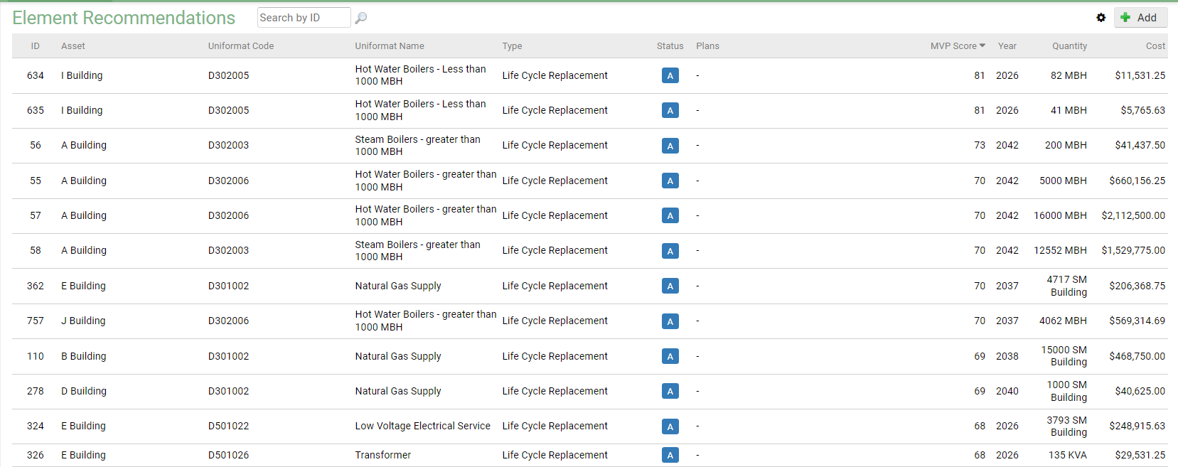
WHAT YOU GET?
Notes:
Numerical value between 0 and 100 that will allow you to compare projects relative importance to the organization against each other
If I only had $1, where is the best place for me to invest that $1 to address my DCRM Backlog

Slide 17
WHAT’S THE CATCH?
None of this will work if you don’t have an effective strategy in place to acquire, manage and update consistent and defensible asset data on a regular basis
Not a Decision Making Tool
There are always going to be reasons to override the MVP
Requires time & investment into data collection
Requires engagement of all stakeholders/departments
Notes:
Roofing programs, renovations to override MVP
Investment of both time and capital in the data collection
In order to be successful it also required engagement of all stakeholders in the process, from the decision makers, project managers, program providers, and user groups, which will all bring a different ye valid perspective on the matters. This may have to be undertaken across multiple departments.

Slide 18
One more thing…

Slide 19
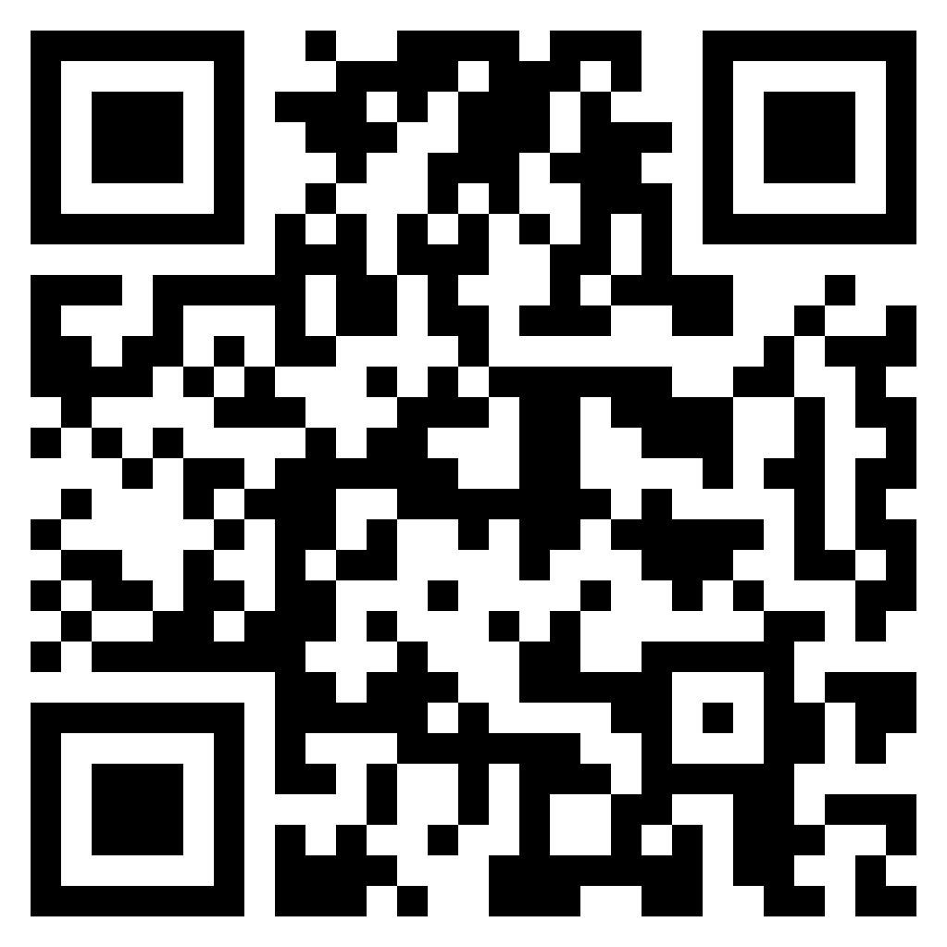
THANK YOU FOR ATTENDING
Dive Into Our Thought Leadership
Visit our website at rothiams.com
Follow us on LinkedIn
Connect directly through email at alisha.mclean@rothiams.com or call (365)292-1476

