Slide 1
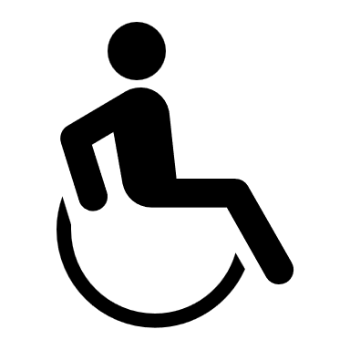
The Risks of Not Being ADA Compliant
An Introduction to the ADA
Johnny Moore - Facility Assessor, ACTCP, NCBDC, CPBD, AIBD, ASSOCIATE AIA

Slide 2

Welcome and Introductions

Slide 3

Introduction
  Johnny Morre
  Facility Assessor, Operations
  Johnny is the U.S. expert in ADA for Roth IAMS, with over 20 years of experience in ADA inspections, assessments, and compliance, as well as 10 years in facility condition assessments and accessibility audits.
  A retired U.S. Air Force engineer, he previously ran his own ADA compliance business, provided expert witness services in ADA Civil Rights cases, and holds multiple certifications in building design and accessibility.

Slide 4

AGENDA
Welcome and Introductions
History, Definition, and Purpose (the ‘Who, What, When, Where, and Why’) of ADA
Explanation of the Titles and codes governing the ADA
2010 ADA Standards for Accessible Design
Overview of ADA Applications and Procedures
Examples of ADA Issues & Concerns
ADA Fails
The Risks of Not Being ADA Compliant

Slide 5

Disclaimer
Information, materials, and/or technical assistance provided in this webinar are intended solely as informal guidance and are neither a determination of your legal rights or responsibilities under the ADA, nor binding on any agency with enforcement responsibility under the ADA.
This session is authorized by the ADA and the U.S. Access Board to provide information, materials, and technical assistance to individuals and entities that are covered by the ADA. The contents of this presentation were developed under the guidance of the U.S. Access Board and the ADA.

Slide 6
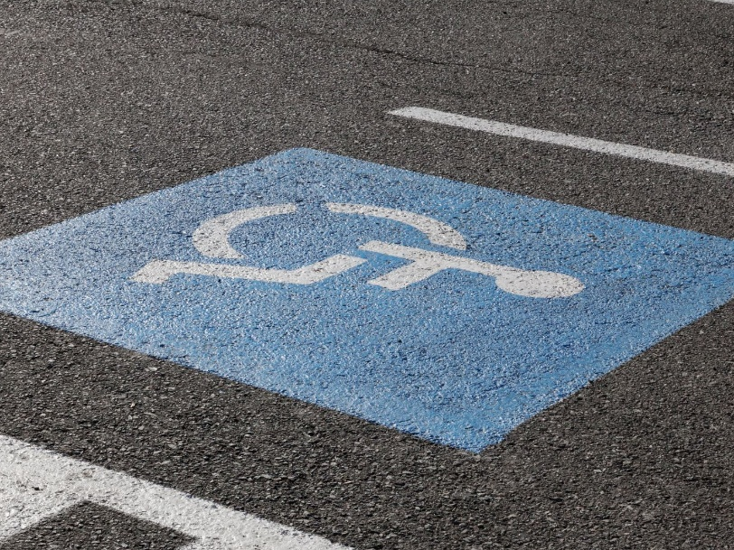
History, Definition and Purpose
(the ‘Who, What, When, Where, and Why’) of ADA

Slide 7

History and Purpose of the ADA
The Americans with Disabilities Act (ADA) which became law in 1990, is a civil rights law in the U.S. Code that prohibits discrimination against individuals with disabilities in all areas of public life, including jobs, schools, and all public and/or private areas that are open to the public.
Title II & III specifically prohibits places of public accommodation – including privately-owned, leased, or operated facilities – from discriminating against individuals with disabilities.

Slide 8
History of the ADA (cont.)
In the 1980’s, it was determined that there was a need for Civil Rights legislation for persons with disabilities
The National Council on Disabilities was developed by President Ronald Reagan to provide recommendations to himself and Congress on policies affecting people with disabilities
The NCD called for a comprehensive law to provide full opportunities and empowerment for people with disabilities
In 1988 legislation for the Americans with Disabilities Act was passed. President Ronald Reagan’s passage of the HIV/AIDS Civil Rights Law pushed the issue of having an ADA Law to the forefront of politics.
George Bush’s campaign for President included promises of pushing for a Civil Rights Law for persons with disabilities.
The Civil Rights Law for the ADA was passed in 1990

Slide 9
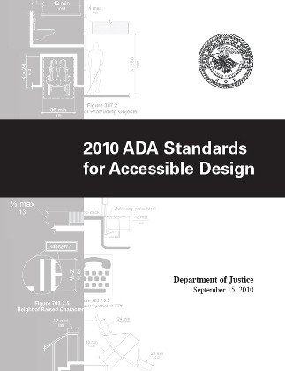
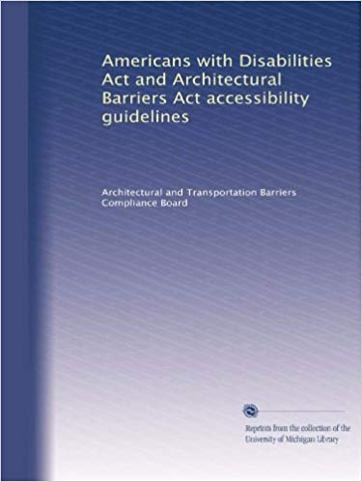
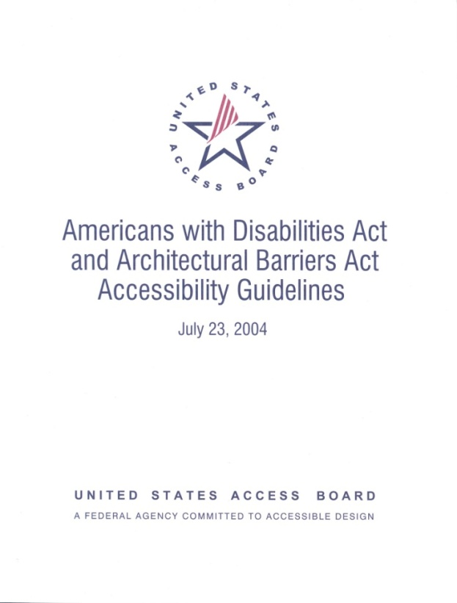
Federal regulations

Slide 10
The Justice Department Perspective
It is all about
Non-Discrimination

Slide 11
Reflective Perspectives
The Justice Department and the US Access Board first collaborated in developing the Ada Standards for Accessible Design in 1991.
They got together again in 2004 and developed the 2004 Ada Standards for Accessible Design.
They collaborated one more time in 2010 in developing and further refining the Ada Standards for Accessible Design which is what we are still using today.
The Access Board interprets the ADA Civil Rights Law into graphic standards and enforces Federal projects.
The DOJ interprets and enforces the intent and letter of this Civil Rights Act and many other laws

Slide 12
Who is protected by the ADA?
ADA Protects Qualified Individuals with Disabilities from Discrimination.
ADA Protects discrimination in your employment.
ADA Protects discrimination in access to all state and local government programs services and activities
ADA Protects access to all of society, including communications, medical care, incarceration facilities, and the internet, etc.
ADA Protects everyone in this Webinar.
It is a complete and thorough list that includes everyone.
Define a qualified individual

Slide 13
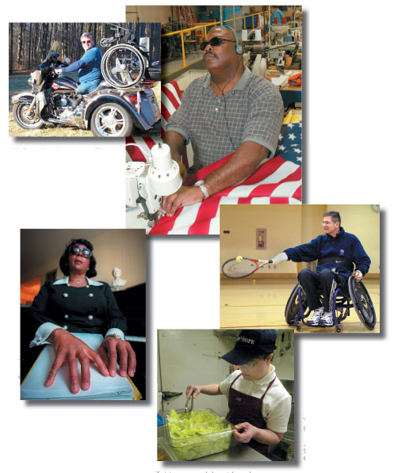
Individual with a disability: Three-part definition
1. Anyone who has a physical or mental impairment that “substantially limits” one or more major life activities.
2. Anyone who has a record of such an impairment.
3. Anyone who is regarded as having such an impairment.

Slide 14
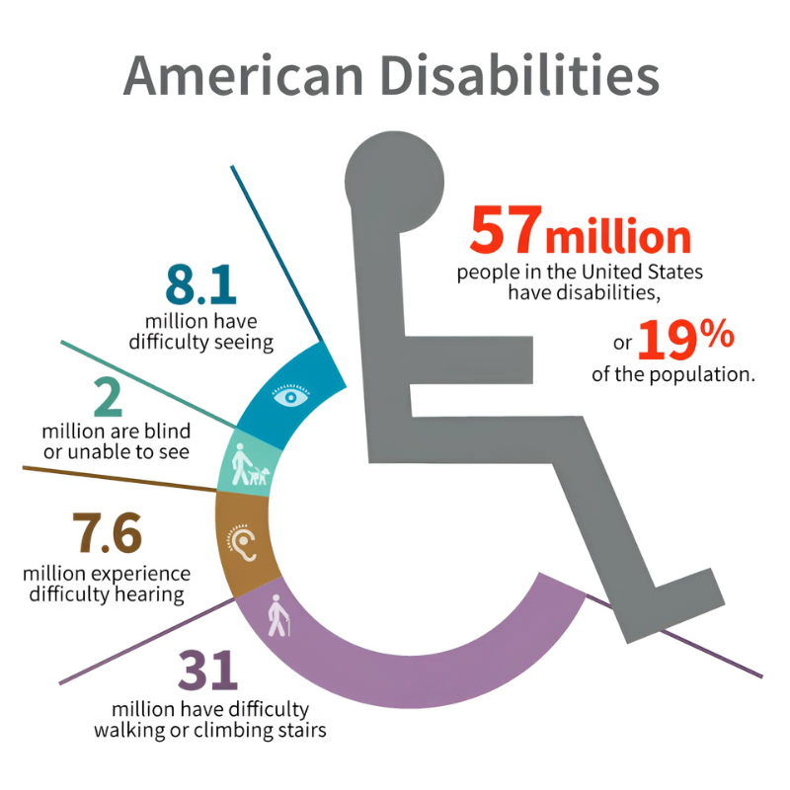
Major Life Activity
Activities that an average person can perform with little or no difficulty:
66
Walking
Speaking
Breathing
Seeing
Hearing
Learning
Sitting
Standing
Bending
Grasping
Remembering

Slide 15

United States Code
The Code of Laws of the United States of America is also referred to as the United States Code (USC). The USC is the official compilation and codification of the general and permanent federal statutes of the United States. It contains 53 titles (Titles 1–54, excepting Title 53, it being reserved). The official version of those laws not codified in the United States Code can be found in United States Statutes at Large.
The USC, as it pertains to ADA, is divided into titles, chapters, and sub-chapters that classify laws according to their subject matter. These Titles are listed as Titles I, II, III, IV and V

Slide 16
U.S. Title Codes:
TITLE I (EMPLOYMENT)
Equal Employment Opportunity for Individuals with Disabilities
This title is designed to help people with disabilities access the same employment opportunities and benefits available to people without disabilities.
TITLE II (STATE AND LOCAL GOVERNMENT)
Covers non-discrimination on the Basis of Disability in State and Local Government Services. Title II of the ADA prohibits discrimination against qualified individuals with disabilities in all programs, activities, and services of public entities.
TITLE III (PUBLIC ACCOMMODATIONS)
Nondiscrimination on the Basis of Disability by Public Accommodations and in Commercial Facilities. This title prohibits private places of public accommodation from discriminating against individuals with disabilities.
TITLE IV (TELECOMMUNICATIONS)
TITLE V (MISCELLANENEOUS PROVISIONS)
The 1991 Standards set guidelines for accessibility to places of public accommodation and commercial facilities by individuals with disabilities.

Slide 17
2010 ADA Standards for Accessible Design
“The ADA BIBLE”
CHAPTER 1:
Application and
General Scoping

Slide 18
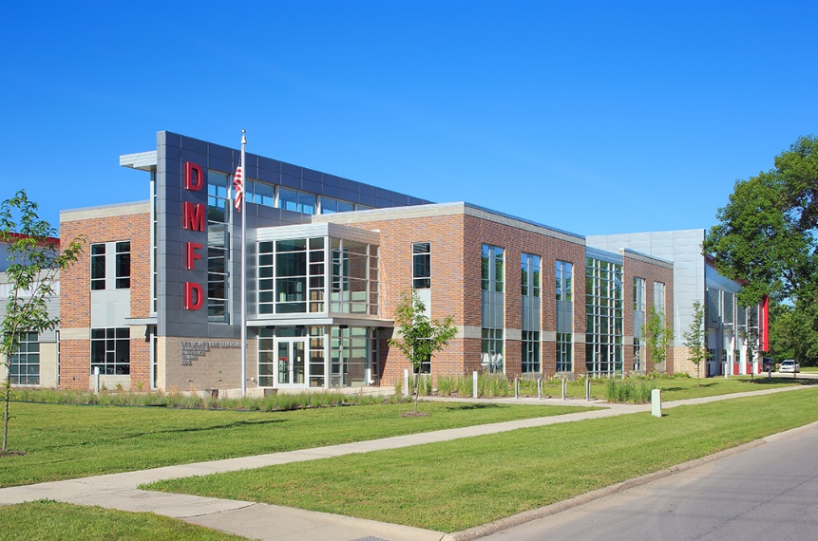

Purpose
101.1- Technical interpretation of the ADA for accessibility to
Sites
Buildings
Facilities
Elements
It defines what ‘Persons with Disabilities’ are

Slide 19
What about the ADA
“Grandfather Clause”?
There isn’t one!

Slide 20
Chapter 2 - Scoping
Tells what is included

Slide 21
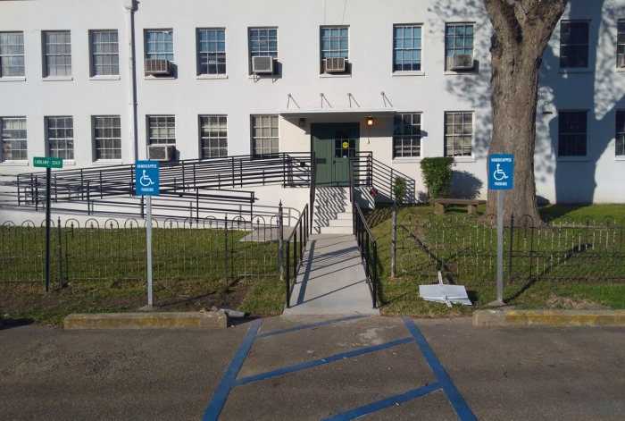
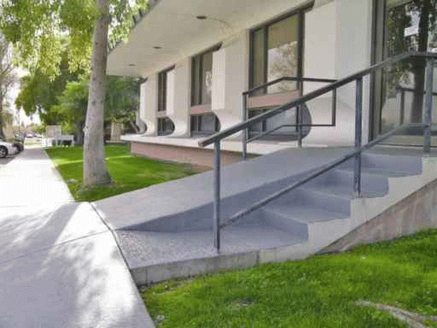
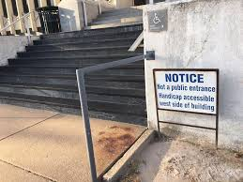
Entrances - 206.4
The Accessible Route to entrances must coincide with general circulation routes to maximum extent feasible.

Slide 22
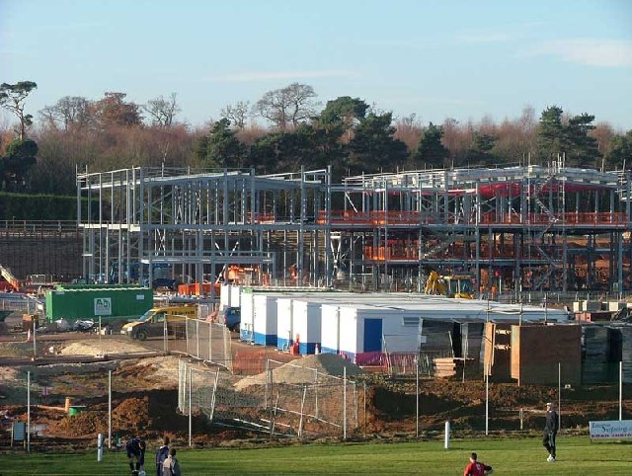
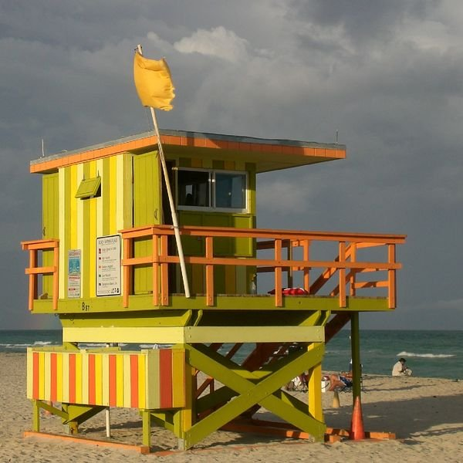
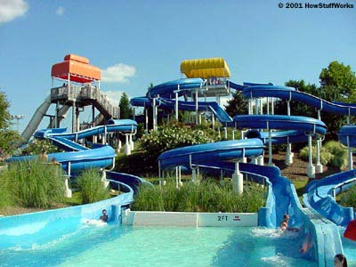
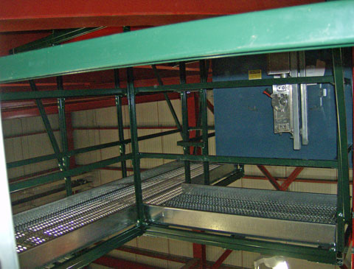
General Exceptions (203)
Exempt Sites, buildings, facilities, and elements
Construction sites
Raised areas for security, life/fire safety
Limited access spaces
Machinery spaces
Single occupant structures (e.g., toll booths)
Certain common use spaces in detention and correction facilities and residential facilities
Employee work areas
Various spaces in recreation facilities
Raised referee judging and scoring areas
Water Slides
Animal containment areas
Raised boxing, wrestling rings
Diving boards and platforms

Slide 23
Chapter 3 - Building Blocks

Slide 24
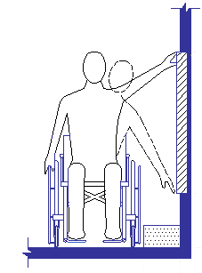
Reach Ranges (308)
Max. Reach – 48”
Min. Reach – 15”
(forward & side)

Slide 25
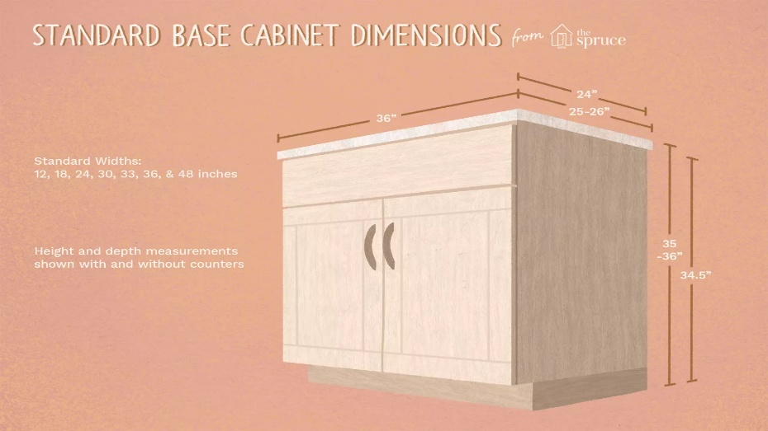
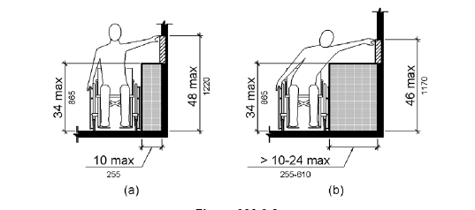
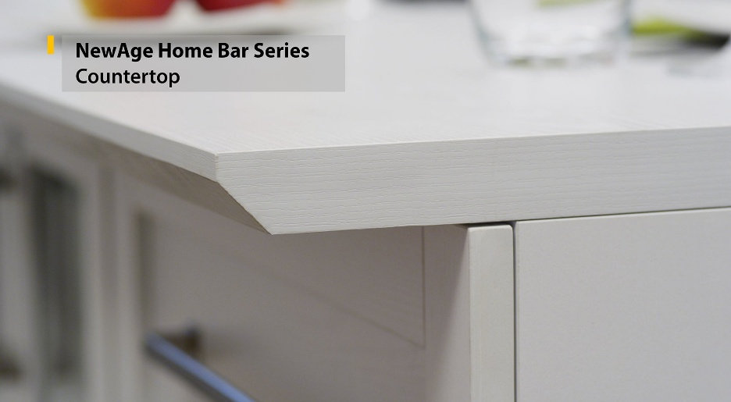
Obstructed Reach Range: Cabinets; Counters; Type B Units

Slide 26
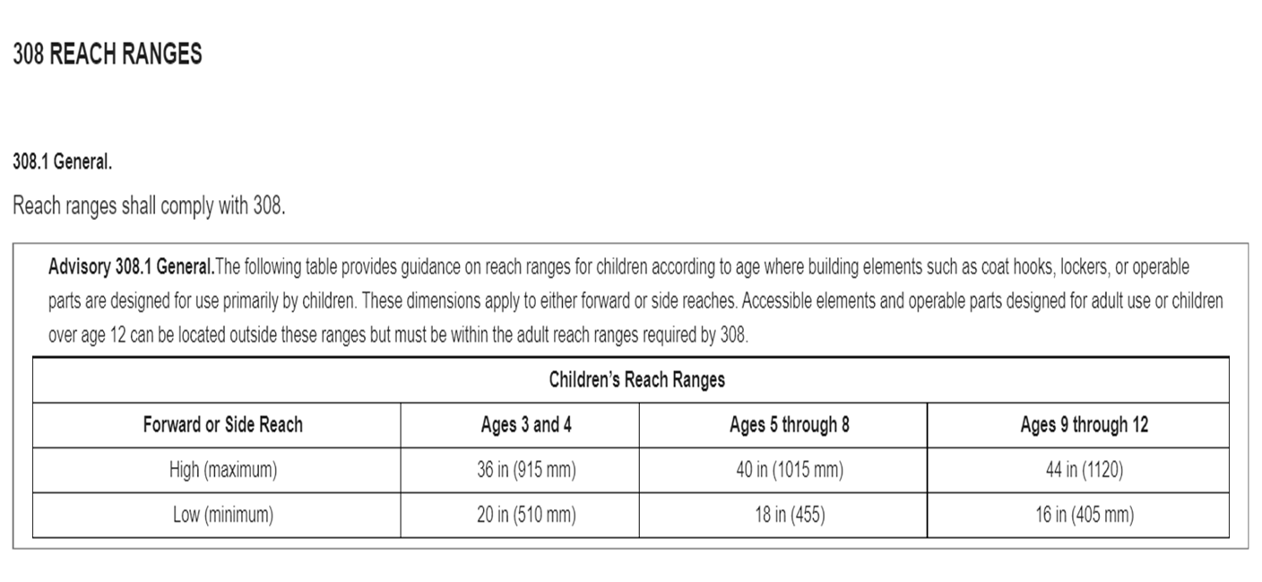
Children’s Reach Ranges

Slide 27

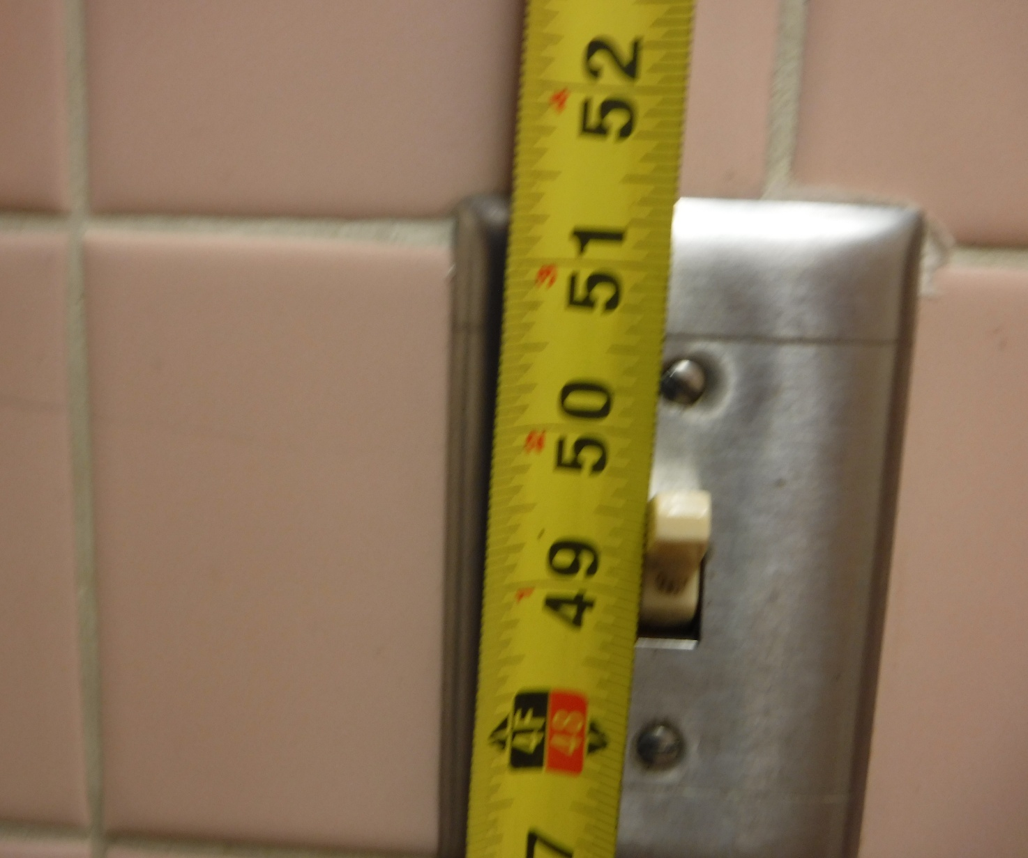
Operable Parts

Slide 28
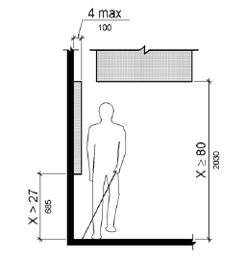
307.2 Protruding objects

Slide 29
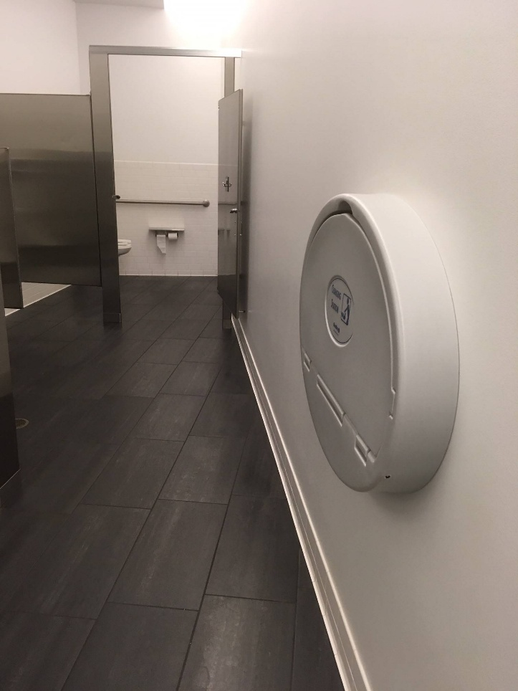
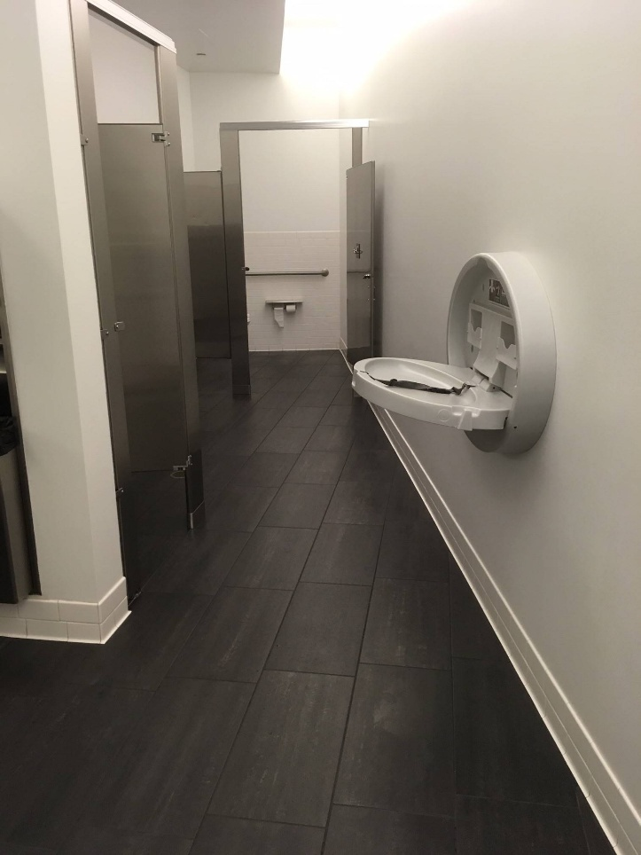
307.2 Protrusion Limits
Objects with leading edges more than 27 inches (685 mm) and not more than 80 inches (2030 mm) above the finish floor or ground shall protrude 4 inches (100 mm) maximum horizontally into the circulation path.

Slide 30
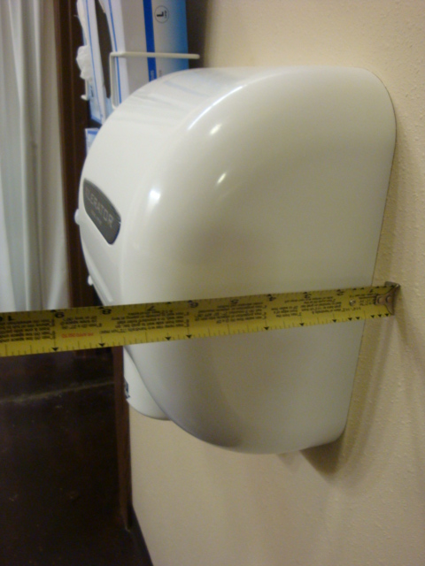
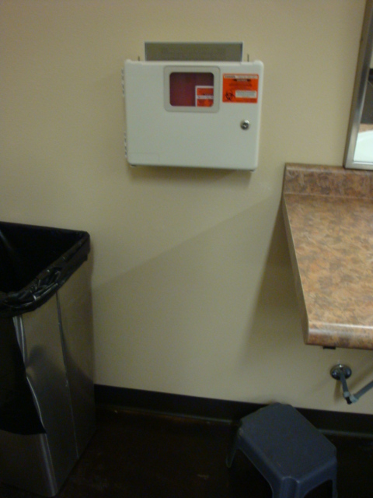
Only a protruding object when on a circulation path

Slide 31
Chapter 4 - Accessible Routes

Slide 32
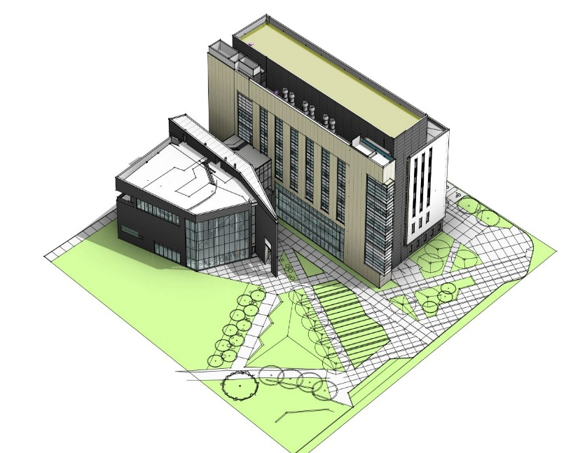
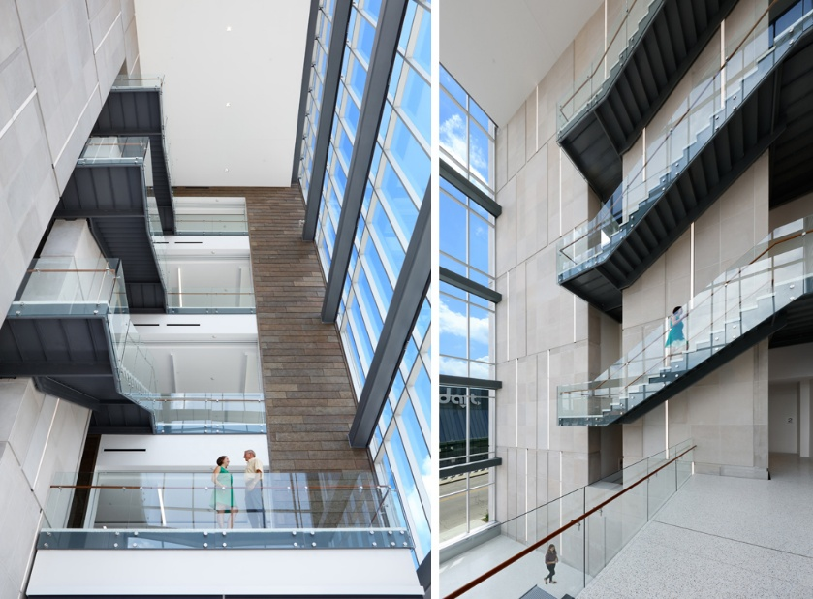
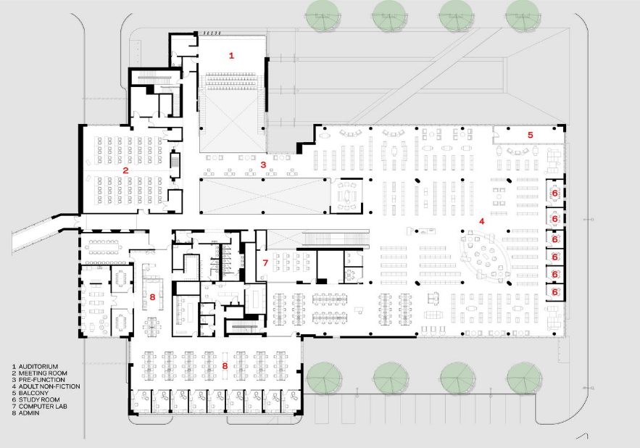
Connect all accessible areas, spaces, and elements inside, with the exterior accessible routes on the outside

Slide 33
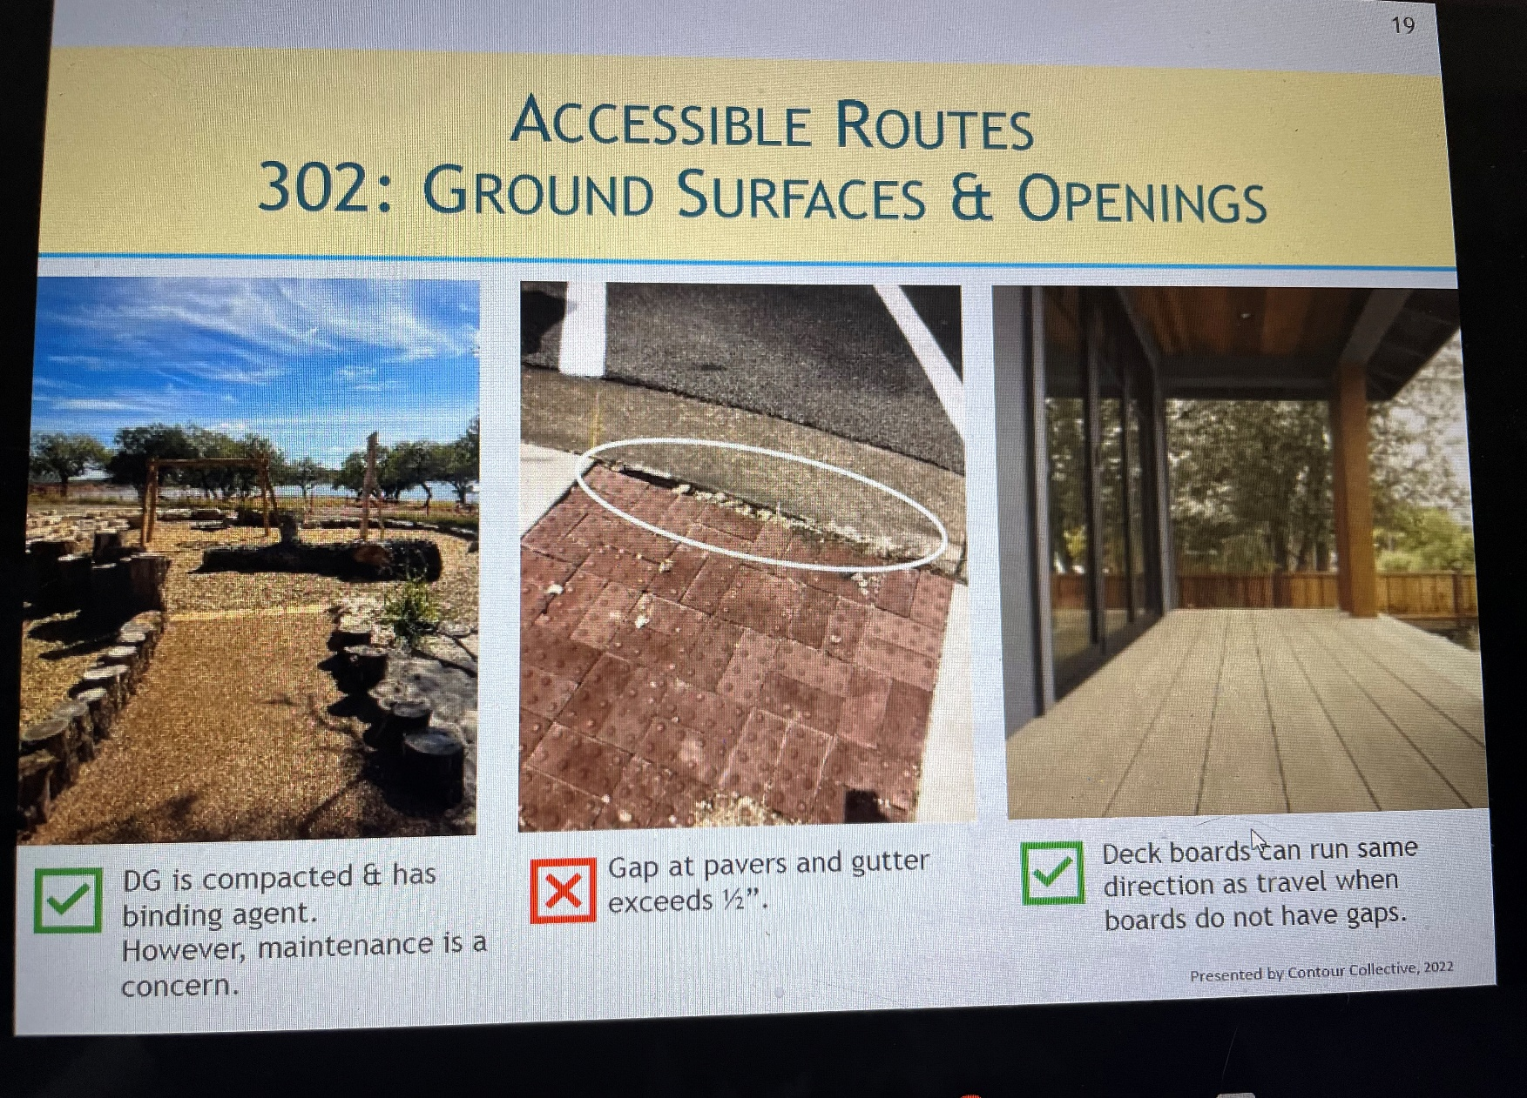

Slide 34
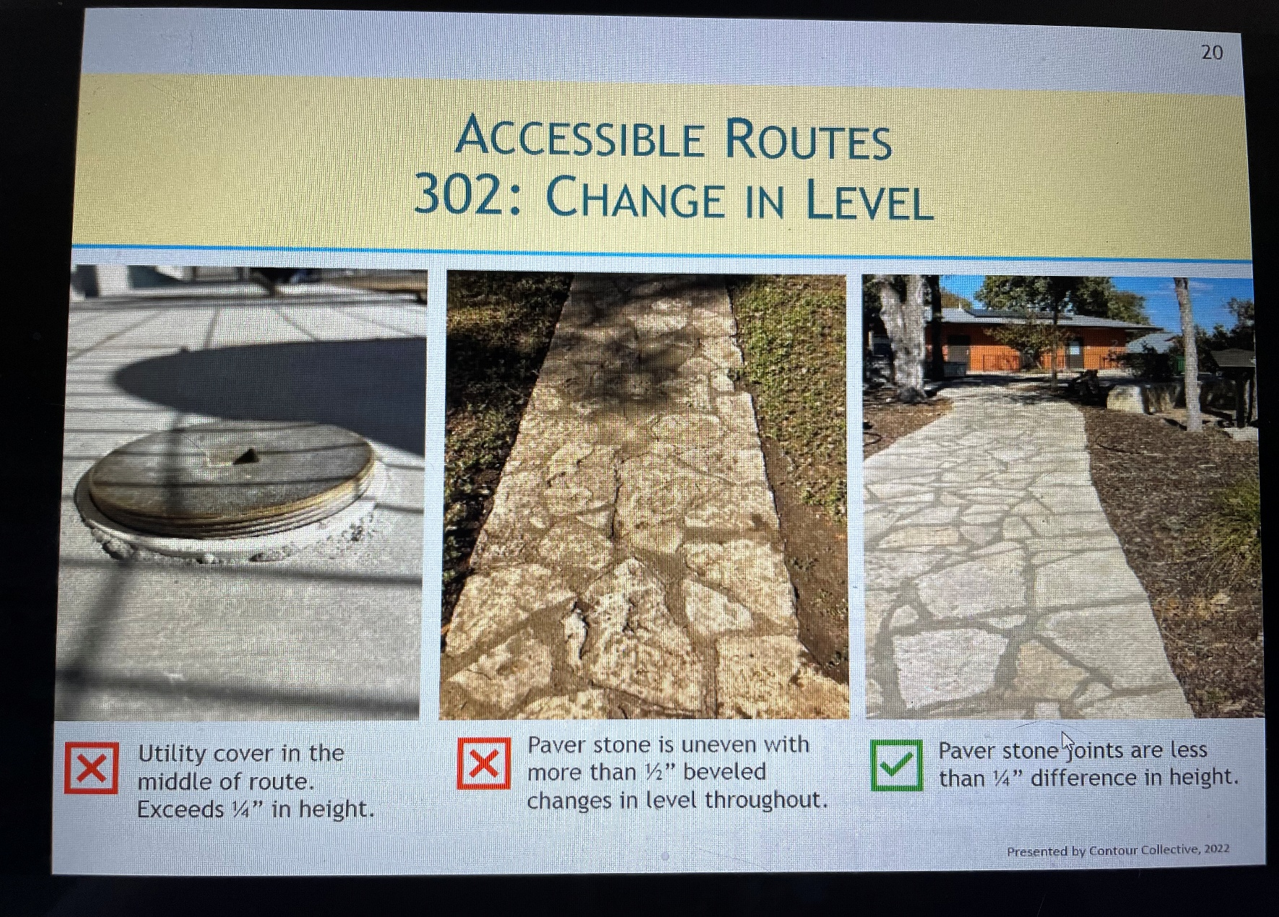

Slide 35
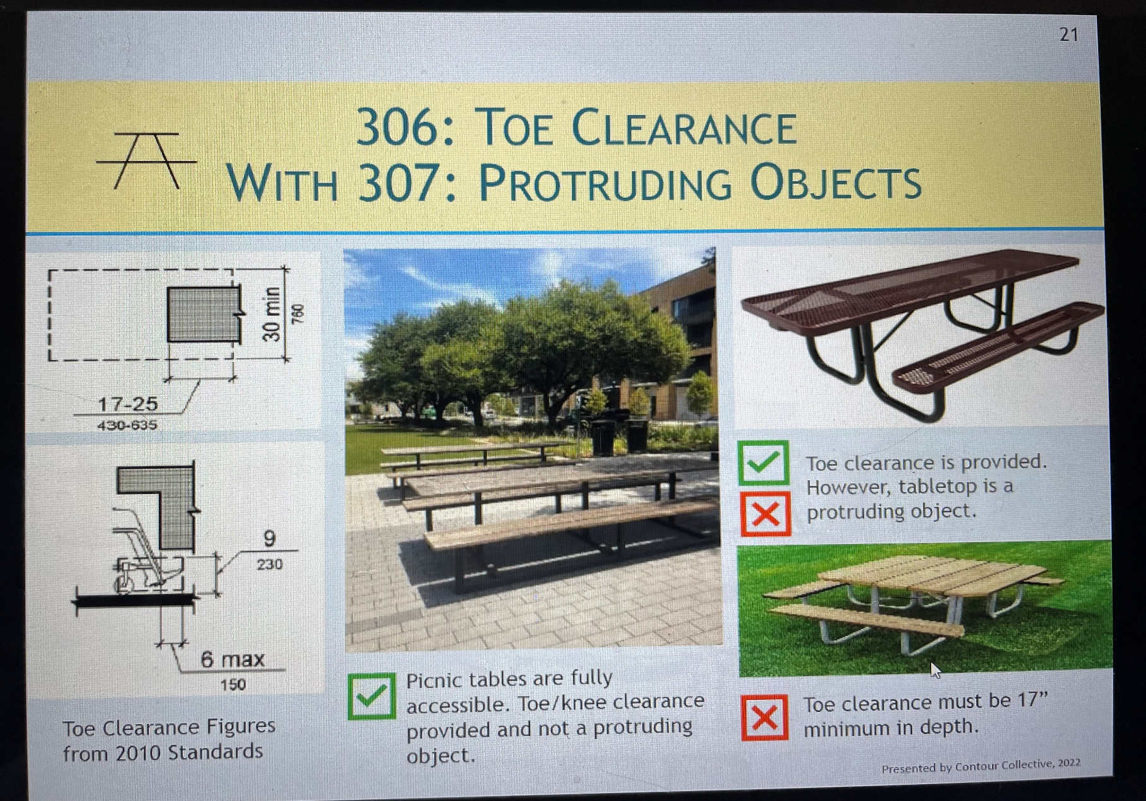

Slide 36
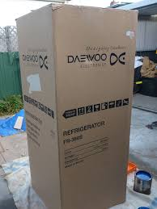
Accessible Route: The Box
Consider a large box as the wheelchair footprint of 30” X 48” by 84” high.
Start moving that box across the entire site, through each door, into bathrooms, sidewalks, parking lots.
Move the box vertically in multi-story buildings with/without elevators.
Ensure the box can use every single accessible element, fixture, space, furnishing, area, etc.

Slide 37
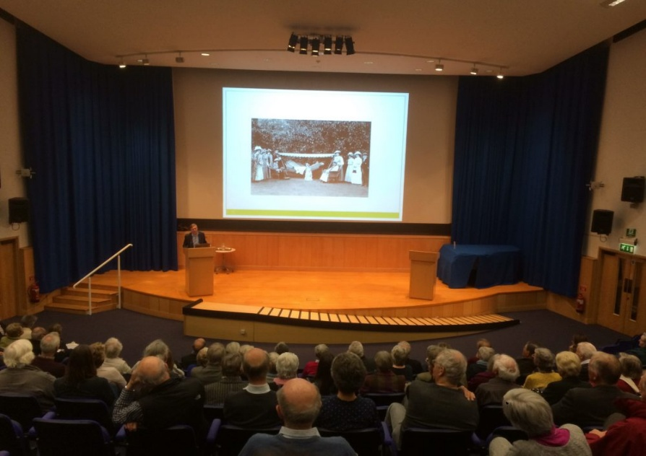
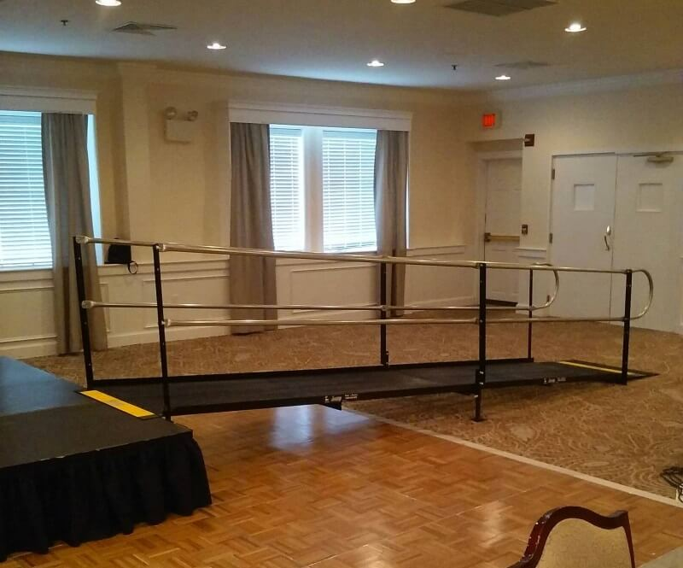
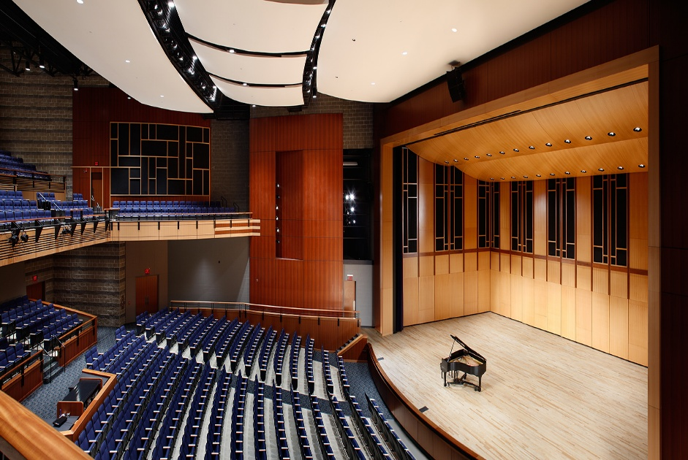
Connecting Performing and Seating Areas

Slide 38
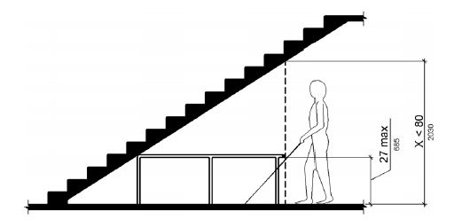
This type of guidance will prevent…
…this from happening!

Slide 39
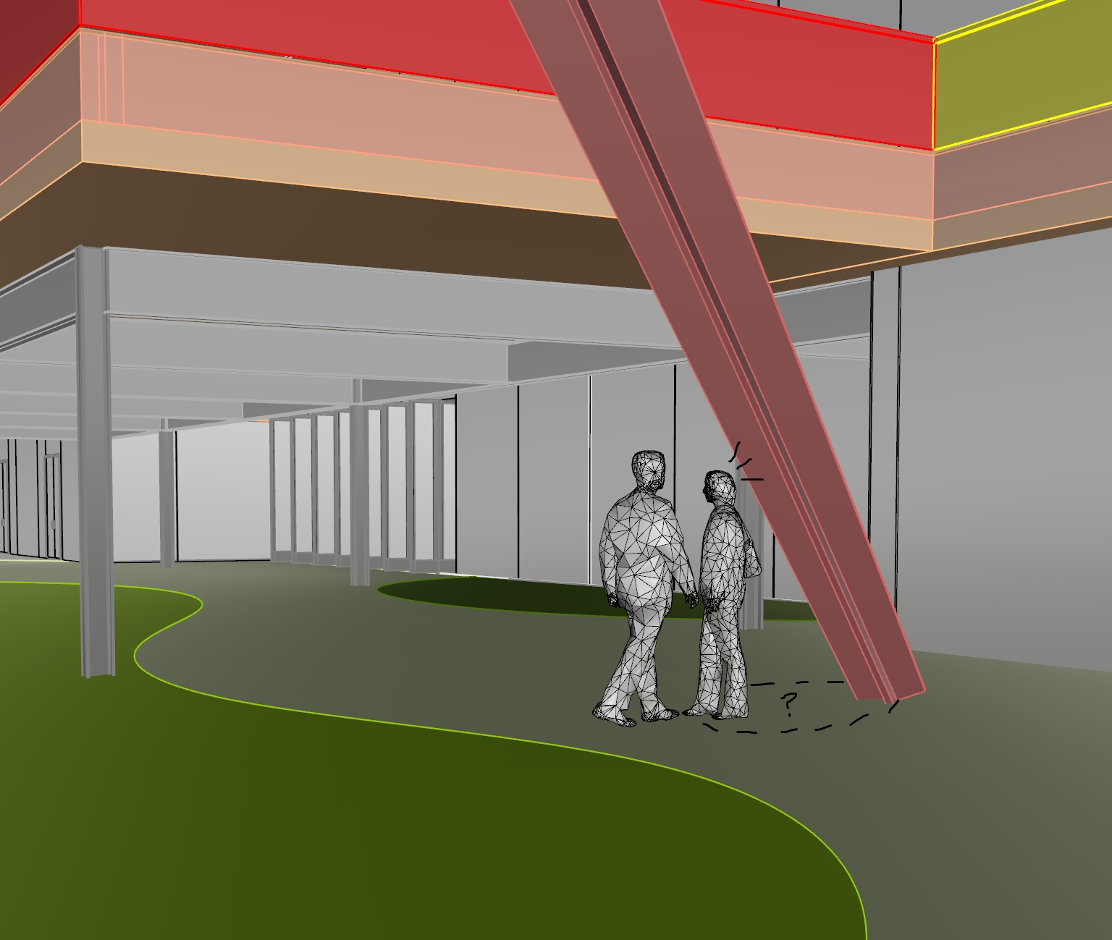

Slide 40
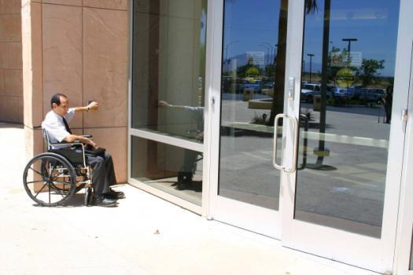
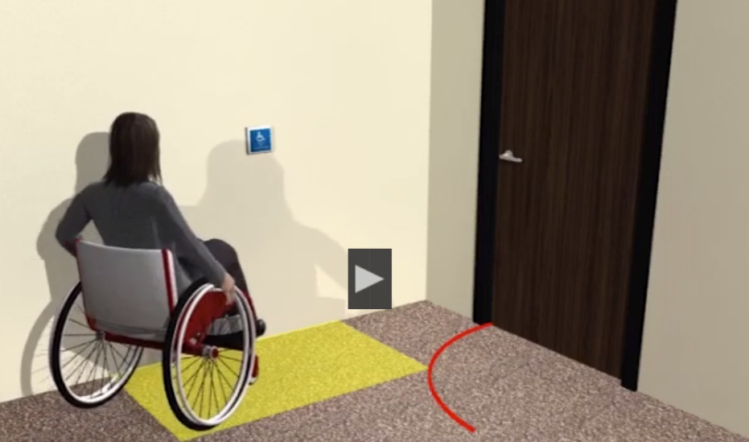
Entrances
Automated openers are recommended for exterior doors.
The most commonly requested reasonable accommodation for people with disabilities.
ONLY Required for Federal GSA buildings.
Industry standards referenced:
Full-powered: ANSI/BHMA A156.10 (1999)
Low-energy and power-assisted: ANSI/BHMA A156.19 (1997 or 2002)

Slide 41
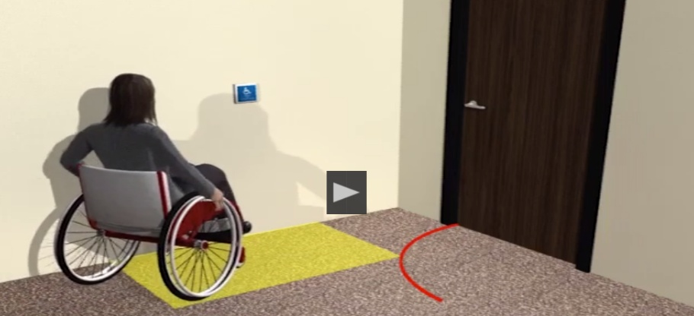
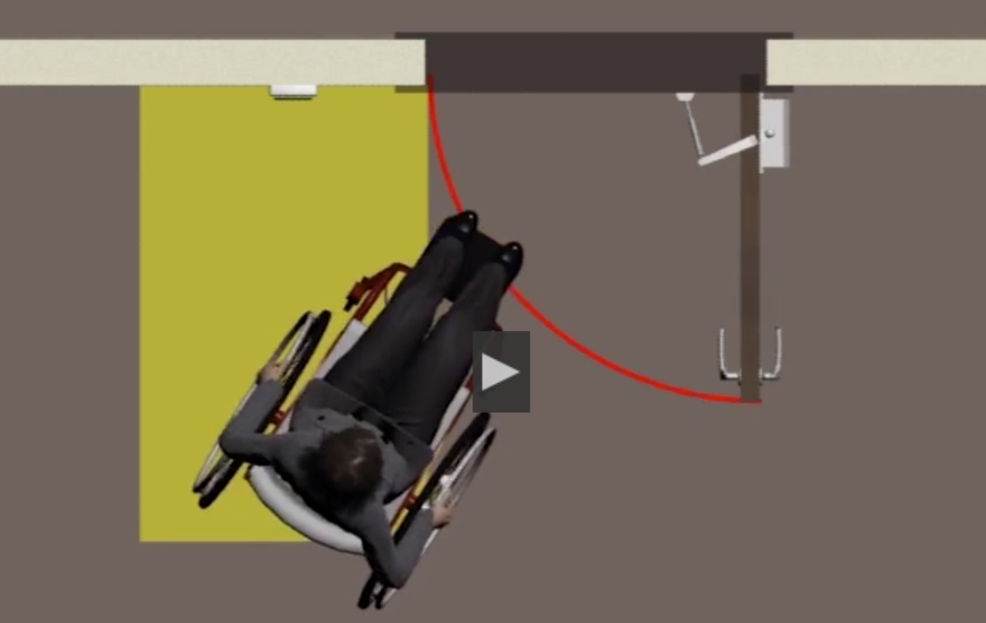
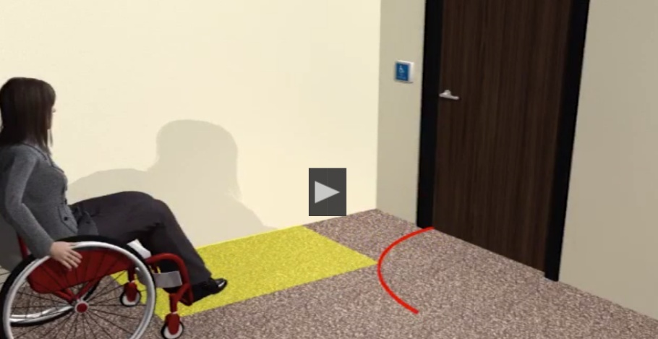
Automated Doors - Entrances
Footprint 30” X 48”
Accessible Route
Provide wheelchair space at controls outside door swing.

Slide 42
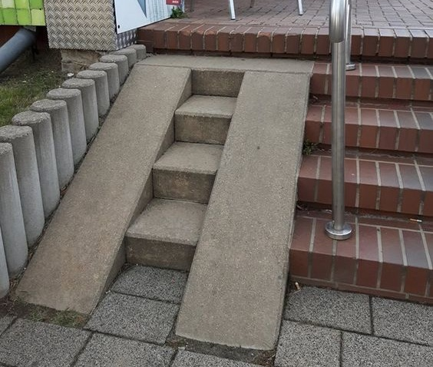
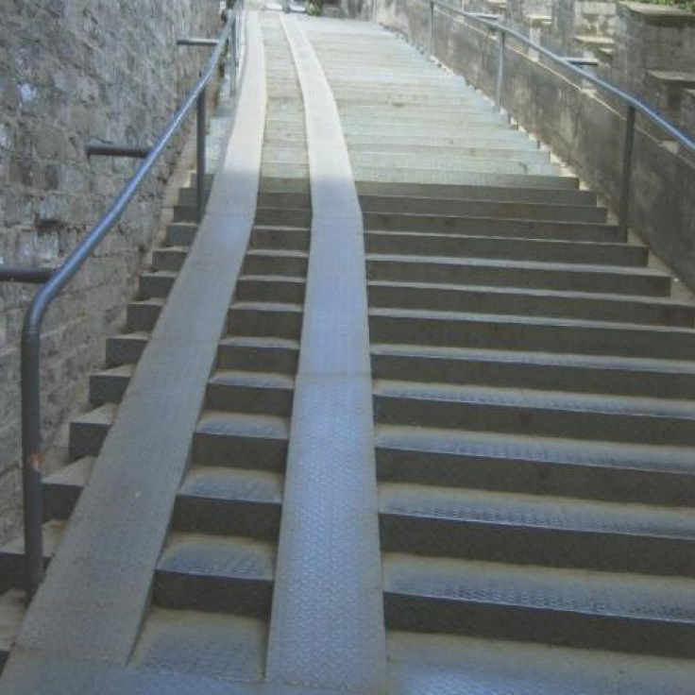
Ramp slopes 405.2
1:20 – Walking surfaces
1:12 - New Ramps
1:10 - Ramps on existing sites with maximum 6” rise
1:8 - Ramps on existing sites with maximum 3” rise
What is the impact of the ramp slope on a person with a disability?

Slide 43
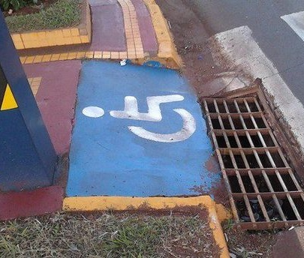
Curb Ramp
The running slope of curb ramp runs must not be steeper than 1:12 (8.33%).
2010 Standards 406.1, 405.2
Landings must be provided at the tops of curb ramps.
2010 Standards 406.4
Openings in floor surfaces must be of a size that does not permit the passage of a 1/2 inch diameter sphere.
2010 Standards 302.3

Slide 44
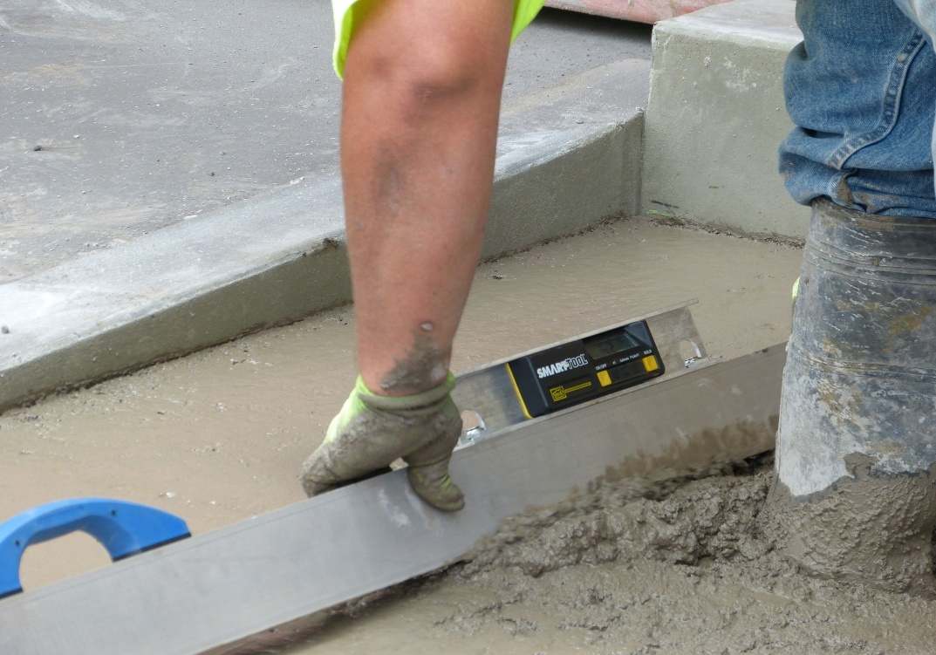
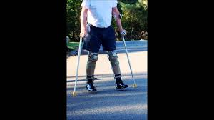
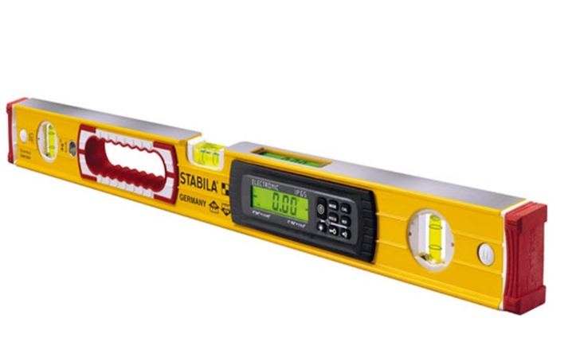
Ramps, Accessible Routes: Slopes, Cross Slope
Cross slope of ramp runs shall not be steeper than 1:48
Cross slope for landings shall not be steeper than 1:48
US Justice Department: 0.2 go-no-go
US Justice Department: 24” Digital Level

Slide 45
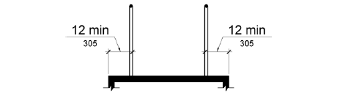

Ramps - Edge Protection
Edge protection complying with 405.9.1 or 405.9.2 shall be provided on each side of ramp runs and at each side of ramp landings.
Figure 405.9.1 Extended Floor or Ground Surface Edge Protection
405.9.1 Extended Floor or Ground Surface. The floor or ground surface of the ramp run or landing shall extend 12 inches (305 mm) minimum beyond the inside face of a handrail complying with 505.

Slide 46


Slide 47


Slide 48


Slide 49


Slide 50
Chapter 5: General Site & Building Elements

Slide 51

Van Spaces (502)
8’
Van space
Car space
Van space

Slide 52

There is a reason for marking the accessible aisle…

Slide 53



Parking
Angled van spaces –aisle can only be on the passenger side
Sign height 60” min.

Slide 54

502.3 Access Aisles
502.3 Access Aisle. Access aisles shall adjoin an accessible route.
Advisory 502.3 Access Aisle. Accessible routes must connect parking spaces to accessible entrances. Marked vehicular crossings enhance pedestrian safety, particularly for people using wheelchairs and other mobility aids. Where possible, it is preferable that the accessible route not pass behind parked vehicles.

Slide 55


Parking Spaces & Access Aisles
60” wide min
Extend full length of the parking space
No changes in level (1:48 max)
Marked to discourage parking
Not overlap the vehicular way
Placed on either side of parking space: Except for angled van parking – Use passenger side only

Slide 56


Access Aisles
What works here?
What happens if the rules, guidelines, and criteria are not followed?

Slide 57



Safety-Rules for a reason

Slide 58


Grab Bar Obstruction
The space between the grab bar and projecting objects above must be 12 inches minimum.
2010 Standards 609.3

Slide 59


Slide 60

Handrail
Objects with leading edges more than 27 inches and not more than 80 inches above the floor must not protrude more than 4 inches maximum horizontally into the circulation path.
2010 Standards 307.2
Handrail gripping surfaces must extend beyond and in the same direction of the stair flight.
2010 Standards 505.10

Slide 61

Handrail
At the top of a stair flight, handrails must extend horizontally above the landing for 12 inches minimum beginning directly above the first riser nosing. Extensions must return to a wall, guard, or the landing surface, or must be continuous to the handrail of an adjacent stair flight.
2010 Standards 505.10.2

Slide 62
Chapter 6 - Plumbing Elements & Facilities

Slide 63


Slide 64


Slide 65

Understanding the ‘T’ in ADA

Slide 66


Slide 67

211.1 “Where drinking fountains are provided…
…on an exterior site, on a floor, or within a secured area, they shall be provided in accordance with 211.

Slide 68

Drinking Fountains - 602.6 Water Flow
The spout shall provide a flow of water 4 inches high minimum and shall be located 5 inches maximum from the front of the unit.
The angle of the water stream shall be measured horizontally relative to the front face of the unit.

Slide 69

Bottle Filling Station
Where a bottle filler is provided, the bottle filler must be on an accessible route and must have accessible operable parts. The bottle filler must be able route and must have accessible operable parts. The bottle filler must be operable within the reach range.

Slide 70

Water Closet Location (604.2)
  The water closet shall be positioned with a wall or partition to the rear and to one side.
  The centerline of the water closet shall be 16 inches minimum to 18 inches maximum from the side wall or partition.
  Water closets shall be arranged for a left-hand or right-hand approach.
  For toddlers and preschoolers, the maximum toilet height should be eleven inches, and maximum height for hand sinks should be twenty-two inches.

Slide 71

604.8.1.2 Doors
Toilet compartment doors shall be self-closing.
A door pull complying with 404.2.7 shall be placed on both sides of the door near the latch.
The door must have a latch.

Slide 72


This is acceptable
This is not!

Slide 73


This is Why
Pipe wrap, Toe clearances
Necrosis:
Loss of feeling
Unaware of burn or fracture damage leading to medical complications:
  infection
  gangrene
  amputation
Altered healing ability and time
Skin grafting
Suspended healing

Slide 74
Chapter 7 - Communication Elements & Features

Slide 75




Wayfinding
Alert drivers at parking lot entrances as to which buildings or entrances are - or are not - served by that lot.
Post signs at entrances and bathrooms that are not accessible and provide wayfinding to those that are accessible.

Slide 76
Chapter 8 - Special Rooms, Spaces & Elements

Slide 77

106.2 Definitions: Transient Lodging
Transient Lodging: “A building or facility containing one or more guest rooms for sleeping that provides accommodations primarily short-term in nature.
Transient lodging does not include residential dwelling units intended to be used as a residence.

Slide 78
Chapter 9 - Built-in Elements

Slide 79

Built-In Elements Chapter 9

Slide 80

Dining & Work Surfaces
Access to at least 5%, not fewer than 1

Slide 81


Lowering surface sections option

Slide 82
Chapter 10 - Recreation Facilities

Slide 83

Safe Harbor
If elements in an existing facility have not been altered on or after March 15, 2012, and these elements comply with the specifications in the 1991 Standards, they are not required to be modified in order to comply with the requirements in the 2010 ADA Standards.

Slide 84

Chapter 10-Elements that do not benefit from Safe Harbor
Play areas
Saunas and steam rooms
Swimming pools, wading pools, and spas,
Shooting facilities with firing positions,
Miscellaneous.
Team or player seating
Accessible route to bowling lanes
Accessible route in court sports facilities

Slide 85

Swimming pools
Required means of access to the water
  Over 300 linear ft of pool wall = 2
  Less than 300 linear ft of pool wall = 1
Lift or sloped entry
Second means - lift, sloped entry, transfer wall, stairs, or transfer system

Slide 86

Play Areas (240 and 1008)
Contain play components
Designed and constructed for children
Separated by age ranges for safety

Slide 87


Slide 88


Slide 89



Ground level play components
Approached and exited at ground level

Slide 90



Elevated play components
Approached from elevated level
Attached to composite play structure
Components (counted once)

Slide 91
End of 2010 ADA Standards for Accessible Design

Slide 92
















Access Board Animations

Slide 93

ADA ‘Fails’
They are not that hard to see

Slide 94

…more ADA ‘Fails’

Slide 95


Slide 96

REACH RANGE

Slide 97



Slide 98



Slide 99

IT JUST NEVER ENDS!?!

Slide 100
Understanding the Risks
Title II and Title III specifically prohibit places of public accommodation and commercial facilities, including state and local government services and buildings, as well as privately-owned, leased, or operated facilities, from discriminating against individuals with disabilities. It sets the minimum standards of accessibility for both alterations to existing structures and new construction of facilities.
The standards are based on the ADA Accessibility Guidelines (ADAAG), which are enforced by the DOJ, DOT, and the courts, and apply nationwide (US).
When buildings are found to be ‘non-compliant’ with ADA guidelines, it is usually due to a lack of awareness of the fact that ADA compliance is a Federal Law that mandates and controls the accessibility of all buildings that provide equal access to people who are disabled. Compliance is easy to accomplish once the people in charge are made aware of what is required and how to acquire that status. But if they don’t comply…

Slide 101
Risk Associated with non-compliance.
The current greatest risk is litigation based on the violation of the civil rights of individuals with disabilities.
There are DOJ fines and penalties that are assessed for violations of ADA non-compliance, ranging from $75,000 for the first offense to $150,000 for the second and all subsequent offenses.
Missing or non-compliant signage is the number one violation found within the approach and throughout buildings. Per ADA and the DOJ, all permanent rooms within a building must be identified with appropriate and compliant signage. This is just an example of compliance with all of the ADA laws.
There were over 11,472 ADA lawsuits in the United States in 2023, which quadrupled (4X) since 2013, per the law firm of Seyfarth Shaw, most recent 2023 report. These numbers are expected to rise in the future as awareness of the Civil Rights Laws pertaining to the violation of the rights of individuals with disabilities, and the ability to access buildings, becomes more prevalent.

Slide 102
So, What Do You Do Now?
* The most important thing is to have an ADA representative assigned as your go-to person who will be responsible for obtaining all the information about ADA compliance of your building or facility.
Develop a self-evaluation assessment checklist or acquire one on-line.
Perform a self-evaluation assessment of your building to determine all the accessible barriers that exist.
Use that information to develop a Transition Plan.
Determine the priority of all your barriers, and time frame to correct them, and the funding source required to pay for them.
File the completed Transition Plan with your state. Remember that the Transition Plan is a ‘living, breathing, document.
Depending on your type of facility, you may have to post information pertaining to your proposed corrective actions in the local paper and news agencies as well as schedule town hall meetings for the public to way-in on the plan.
When all else fails, learn and use your resources…
​

Slide 103
For additional information about the ADA, you can contact the following agencies.
ADA information sources are listed below:
The U.S. Access Board
U.S. Department of Justice
U.S. Department of Transportation
U.S. Equal Employment Opportunity Commission
Internal Revenue Service
Disability and Business Technical Assistance Center
Roth IAMS can also help. The contact information is on the last slide.
800-872-2253​
800-514-0301​
888-446-4511​
800-669-4000​
800-829-3676​
800-949-4232​

Slide 104

HAPPY, SAFE, ACCESSIBLE=
ADA COMPLIANCE
SUCCESS!

Slide 105

Q & A

Slide 106


For More Thought Leadership
Scan the QR Code!

Slide 107


THANK YOU FOR ATTENDING
Visit our website at rothiams.com
Follow us on LinkedIn
Connect directly through email at accessibility@rothiams.com or call (365)292-1476

