Slide 1
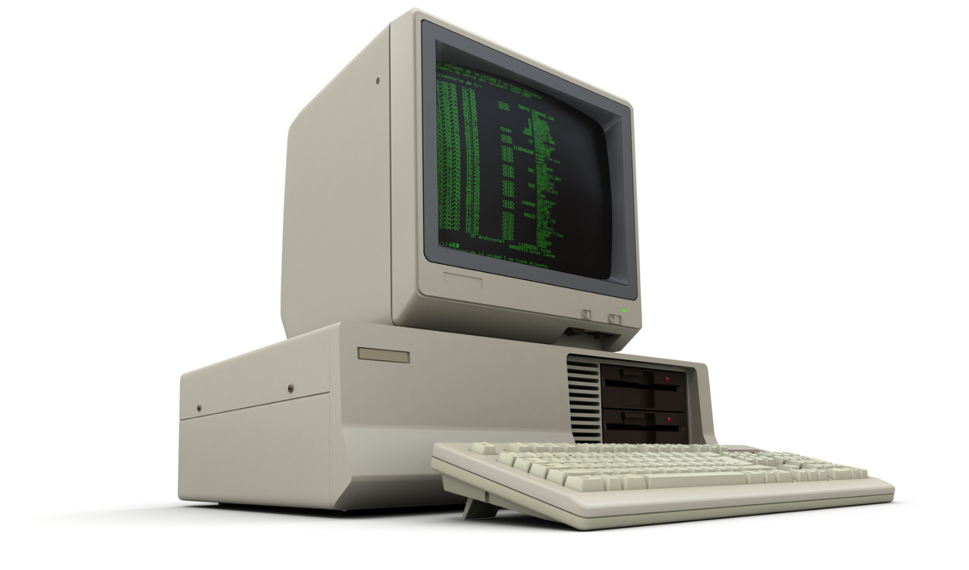
Old Data: Should It Stay or Should It Go?

Slide 2
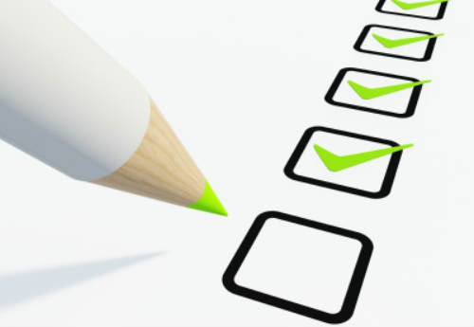
AGENDA
Introduction
Setting the Table
Defining your quality of your data
Determining whether to use the data in your capital planning
Determining the best course of action for updating your data

Slide 3

Introduction

Slide 4
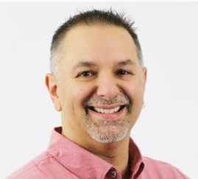
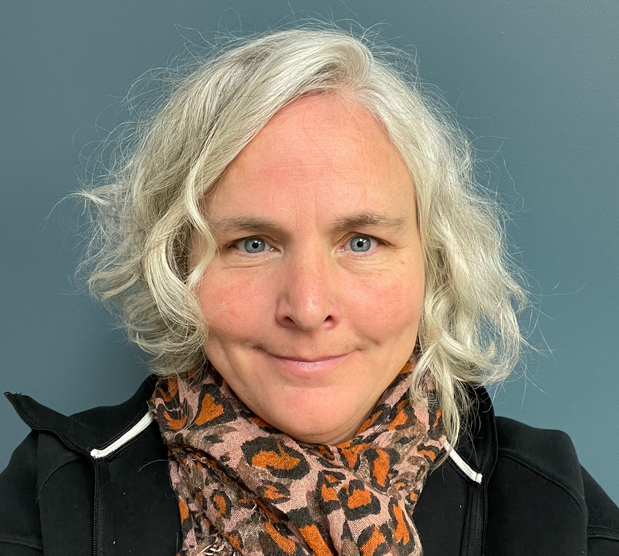
Introduction
30 Years of Expertise – Extensive experience in architecture, construction, training, and data analytics across public and private sectors.
Facility Management Leader – Led CAD standards, accessibility studies, CMMS selection, and facility condition assessments at TVDSB.
Strategic Capital Planner – Helps clients prioritize deferred maintenance and develop long-term capital plans.
  20 years of expertise –Public sector facilities management, primarily in post-secondary institutions.
  Her focus in the last decade has been on deferred capital renewal and maintenance; developing prioritization schemes, creating and managing multi-year capital plans.
  Ayden Townsend
  Practice Leader, Data Management
  Lynley Swanson
  Team Lead – Data Management

Slide 5

Setting the Table

Slide 6
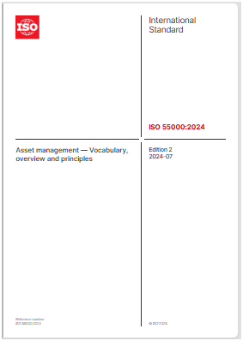
WHAT IS old data?
ISO55000: 2024 definitions
    Documented Information
      information required to be controlled and maintained by an organization and the medium on which it is contained
    Information
      meaningful result of organizing and processing data
    Data
      facts about an object
        (SOURCE: ISO 9000:2015, 3.8.1)
    Object
      anything perceivable or conceivable
Image source:
https://www.iso.org/standard/83053.html

Slide 7
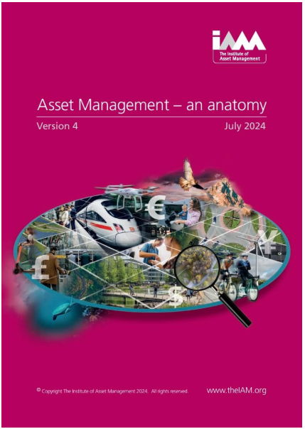
WHAT IS old data?
The Institute of Asset Management states:
  Data and Information should be managed within an Asset Management System to achieve both asset management and organizational objectives.
  It further states that:
  Where it is not possible for an organization to achieve these data requirements, it is important that direction and guidance is provided as appropriate. As an example, poor data quality, in some instances, is unavoidable. Where this scenario occurs this should be identified, and users informed how much the data can be relied upon to enable informed decision-making.
Image source:
https://www.theiam.org/knowledge-library/asset-management-an-anatomy/

Slide 8

WHAT IS old data?
  Anything older than 5 years
  Complete capital work not reconciled
  Inflationary factors not included
  Has there been major renovations since last audit?

Slide 9
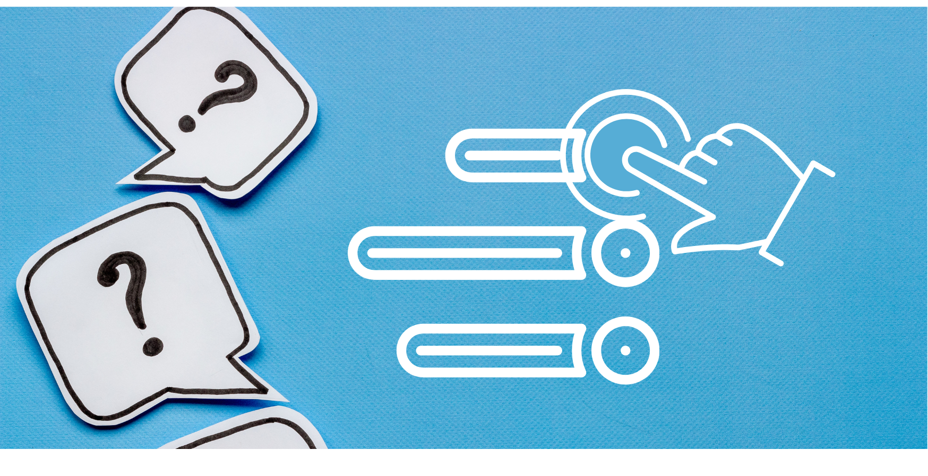
It’s time for A Poll question
Notes:
What are some considerations beyond risk that impact your organizations decisions over what work to complete?

Slide 10
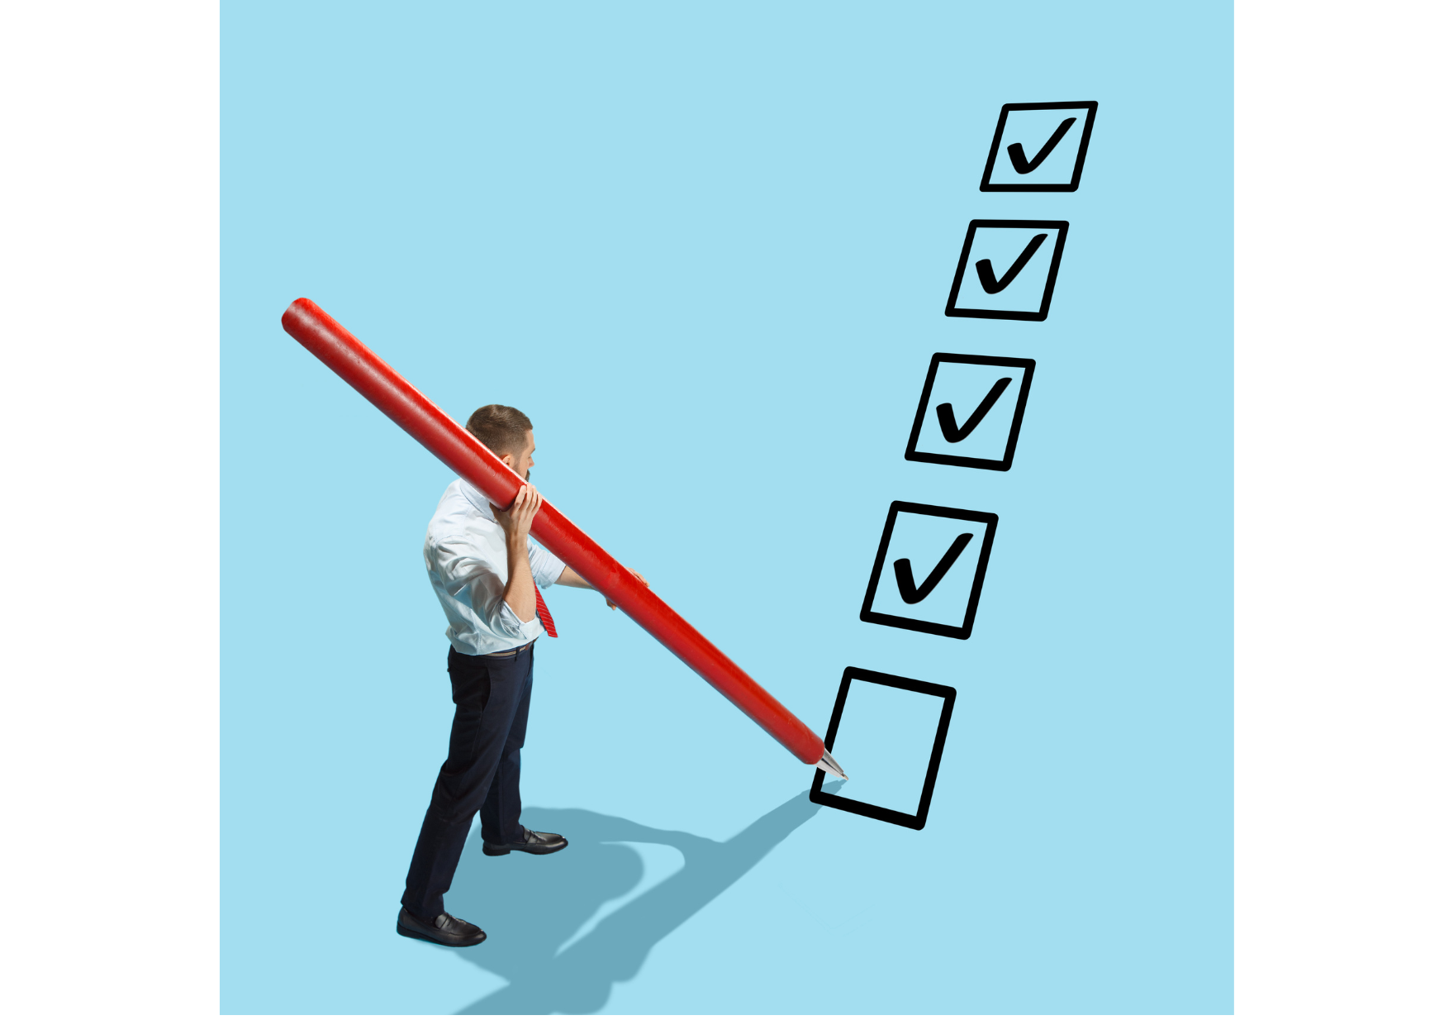
Defining your quality of your data
Verify sources
QA/QC of data
Different assessment methodology
Structure
Source of costing
Consistency of data points
Has your portfolio changed

Slide 11

DETERMINING WHETHER OR NOT TO USE THE DATA IN YOUR CAPITAL PLANNING
Completed work not reconciled and used again
  Quality and consistency of data
  Is costing accurate

Slide 12
It’s time for A Poll question
Notes:
What are some considerations beyond risk that impact your organizations decisions over what work to complete?

Slide 13
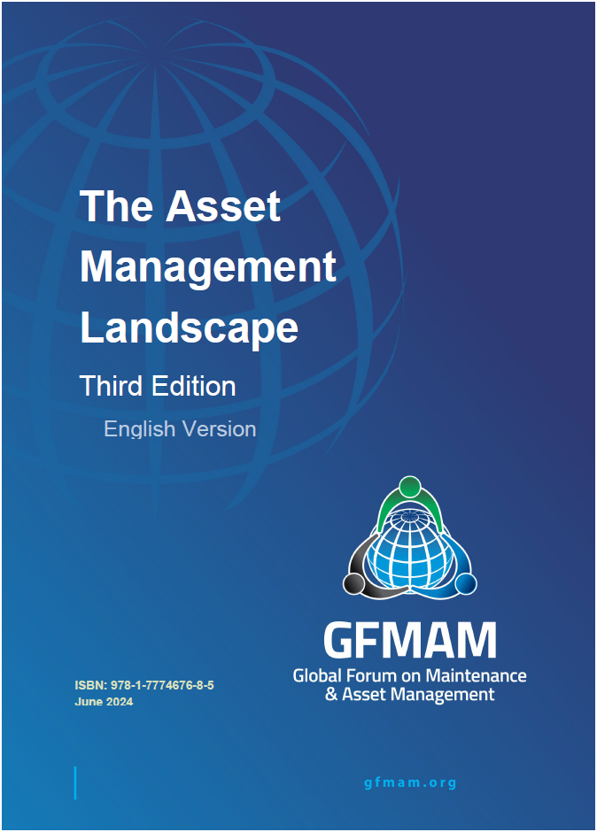
Determining the best course of action for updating your data
GFMAM defines Management of Change as:
  the systematic approach to an organization's processes for the identification, assessment, implementation, and communication of changes to processes and assets informed decision-making.

Slide 14
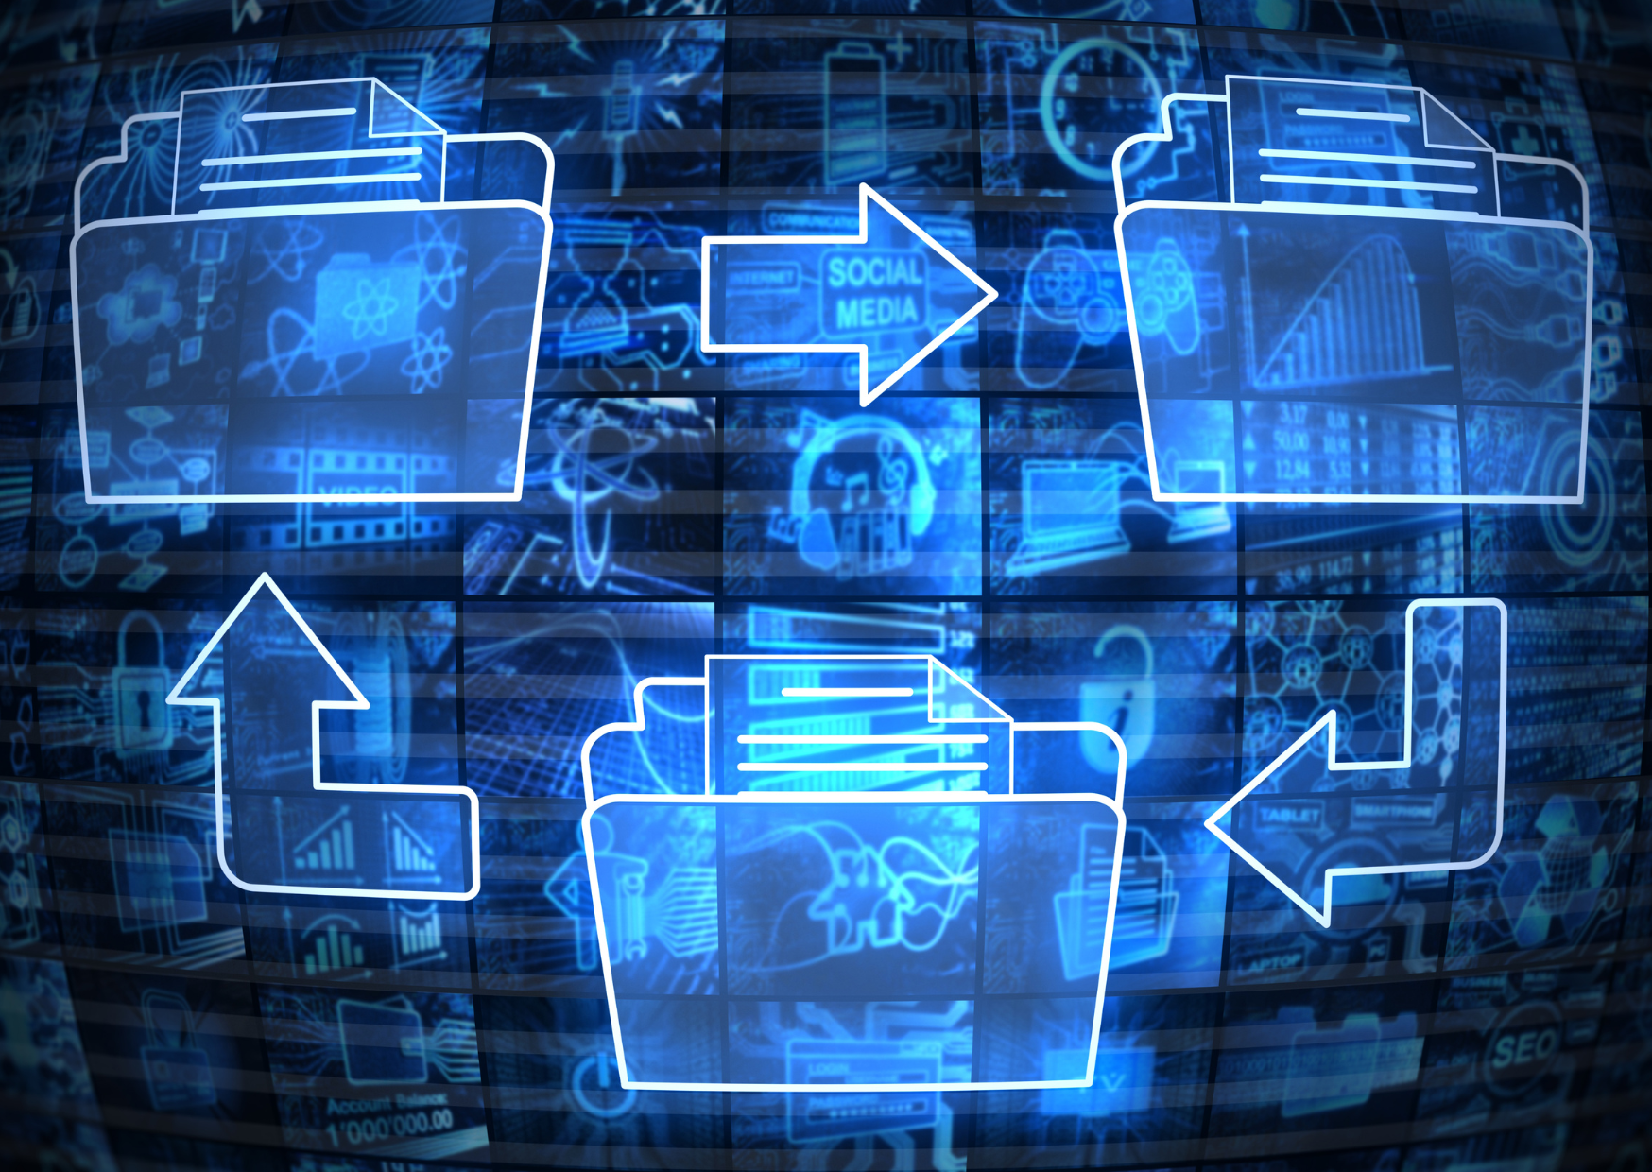
Determining the best course of action for updating your data
Is it just doing another FCA using existing data as a start point?
Is it reconciling past work in your current data set?
Is it abandoning old data and starting over?
Is it just doing a thorough QA/QC on your existing? data

Slide 15

pros and cons of using old data

Slide 16
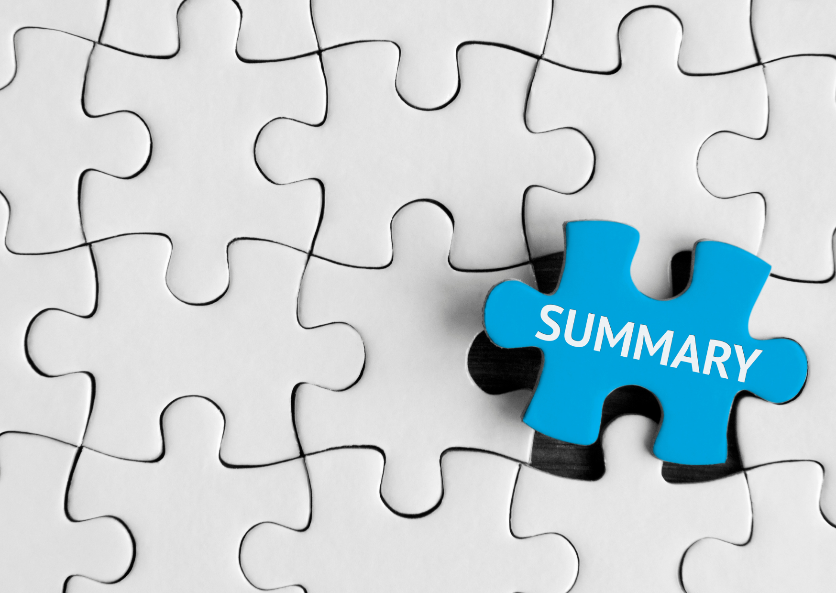
Summary
Know what you have in front of you
Own your data and the value it has
Choose to use or update your data
If you are going to update, how will you do it?

Slide 17


Q & A

Slide 18
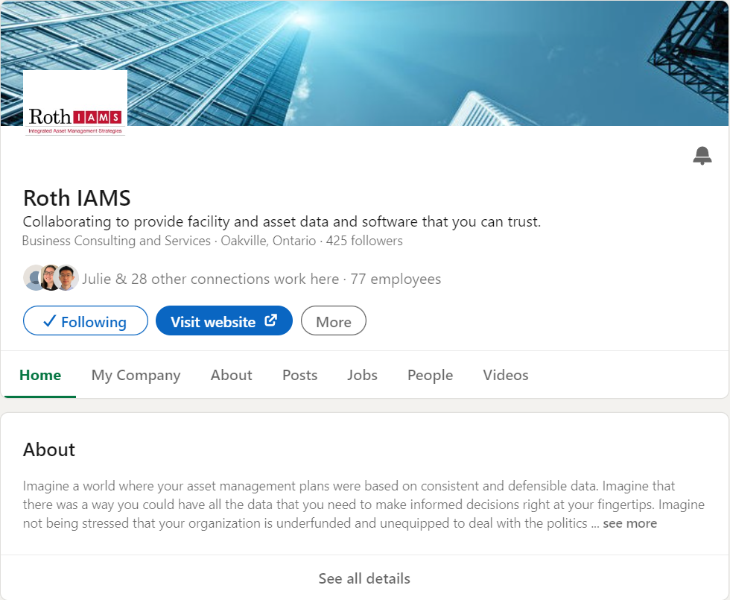
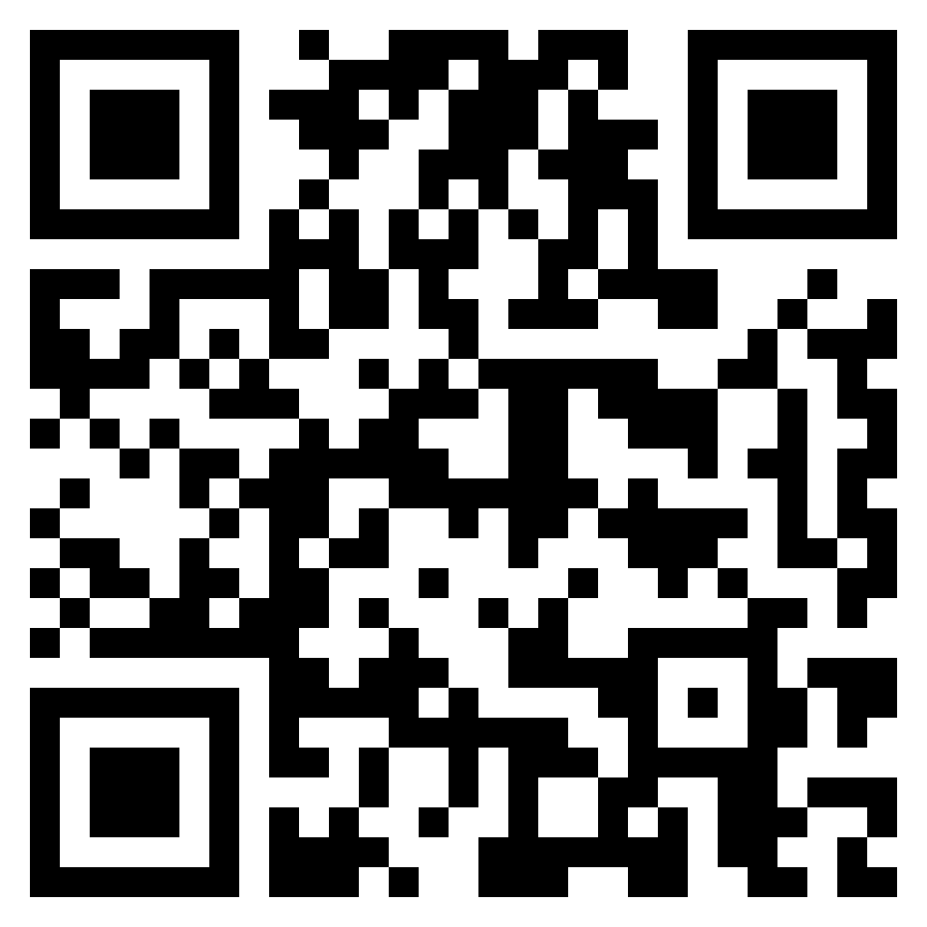
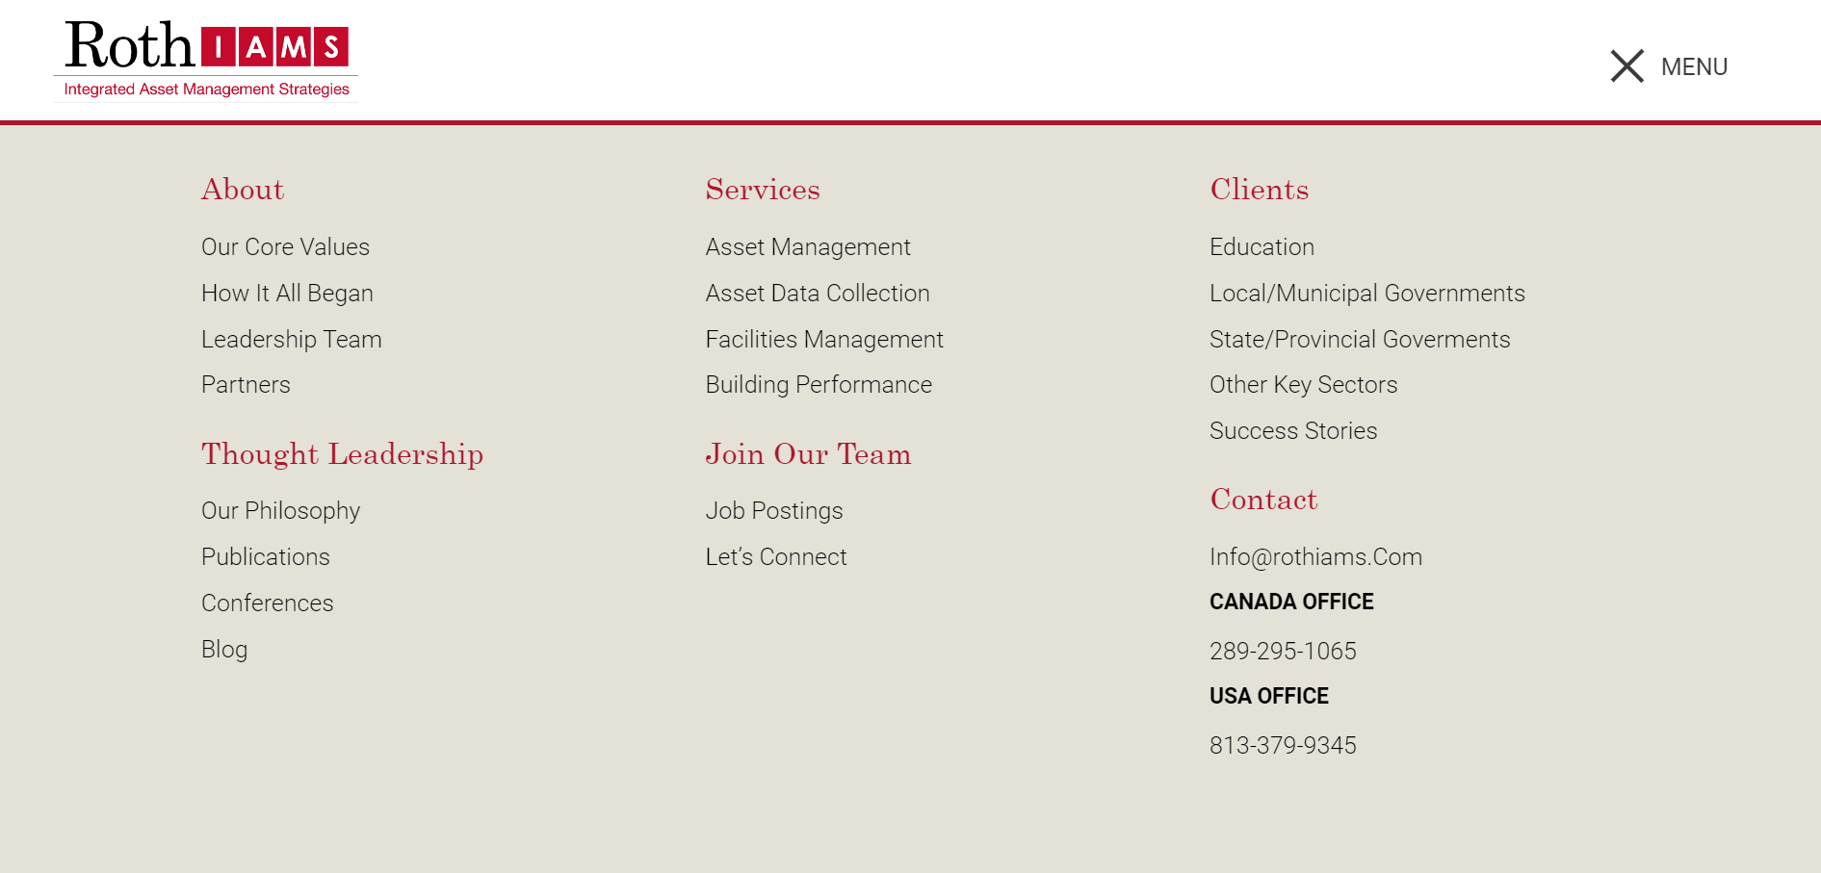
THANK YOU FOR ATTENDING
Visit our website at rothiams.com
Follow us on LinkedIn
Connect with us directly through email at ayden.townsend@rothiams.com or call (647) 355-0034
Dive Into
Our Thought Leadership

