Slide 1
I Don’t Have Facility Condition Data to Meet the July 1 Deadline for my Asset Management Plan

Slide 2
AGENDA
Introduction
Setting The Table – Getting Started
What To Do Now and After July
What To Do With The Data
Q&A

Slide 3
Introduction

Slide 4
Introductions – Roth IAMS
Bill Roth
President & CEO of Roth IAMS
Co-Founder of SLAM Technologies
Over 28 years of experience collaborating with public sector institutions across North America on all aspects of facility and infrastructure asset management

Slide 5
ABOUT ROTH IAMS
Capital Planning Excellence
Operational Excellence
OUR VISION IS TO SOLVE THE WORLD’S DEFERRED CAPITAL RENEWAL AND MAINTENANCE (DCRM) BACKLOG CRISIS.
Performance Excellence
100+ Staff
59+ Municipalities
17+ District School Boards
191+ Hospitals
68+ Colleges & Universities

Slide 6
Setting the Table

Slide 8
Today’s Focus within Integrated Asset Management
Capital Planning Excellence
Operational Excellence
Performance Excellence

Slide 9
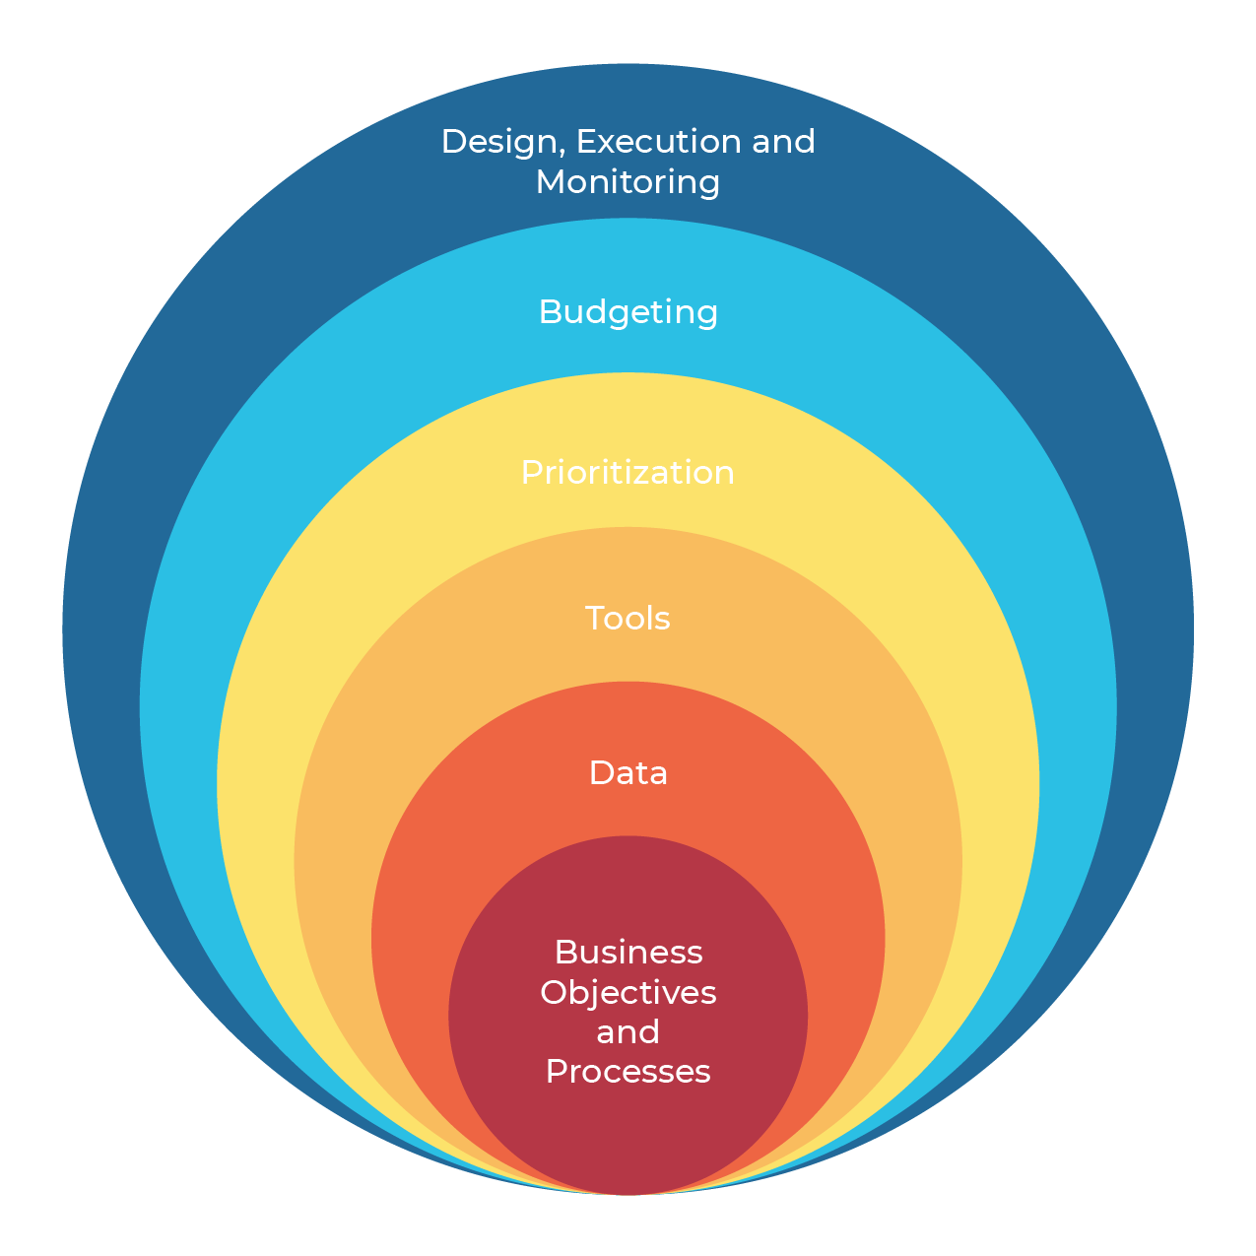
The IAM Framework – “The Onion”
As with everything related to Asset Management, we recommend that you start with gaining clarity of your Business Objectives and Processes
Base your data decisions on the clarity gained about your business objectives and processes, considering both your current and future definitions of success.

Slide 10
Questions to Ask Yourself
Beyond supporting our AMP, what else are we trying to achieve?
What types of Levels of Service do we want to develop for our AMP?
What other data do we have?
What other data do we want to collect?
Where is the data going to go?
Who is going to be responsible for the data going forward?

Slide 11
What to do Now

Slide 12
First Things First – Procurement
Do you have any standing offer agreements?
Fast-tracked RFP
Sole-Sourced Agreement
Cooperative Procurement Contracts

Slide 13
How Much Time Do You Have?
Work with your team that is doing the AMP to figure out when they need the FCA data
Need time to integrate it into the AMP
May be too late already, but that doesn’t mean you shouldn’t proceed
Demonstrating that you are doing something is better than doing nothing

Slide 14
Let’s Be Realistic
Unless your portfolio is very small, you likely won’t be able to get a detailed FCA done in time to integrate with your AMP

Slide 15
What are my options?
Modeled/Lifecycle Data
Three Main Types
of Data
Time-Limited Forecast
of Needs​
Element-Level Inventory​

Slide 16
Modeled Datasets
Building-Type Models
Three Types Modeled Datasets
Client-Informed Models
Validated Models

Slide 17
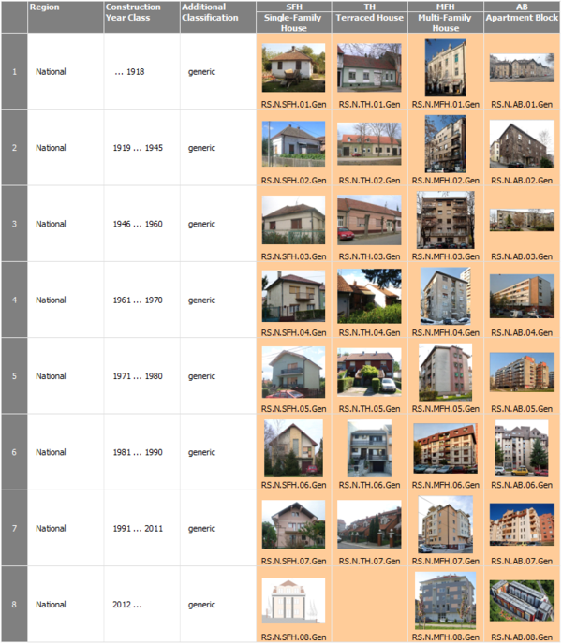
Building Type Models
Categorize your portfolio into building types (use, construction type, etc.)
Develop a high-level list of elements within a typical building or each type, with unit costs and Expected Useful Lives (EULs)
Use the date(s) of construction and/or major renovation of the building as the baseline
Create a lifecycle model for the theoretical elements within each building

Slide 18
Building Type Models – Sample Data

Slide 19
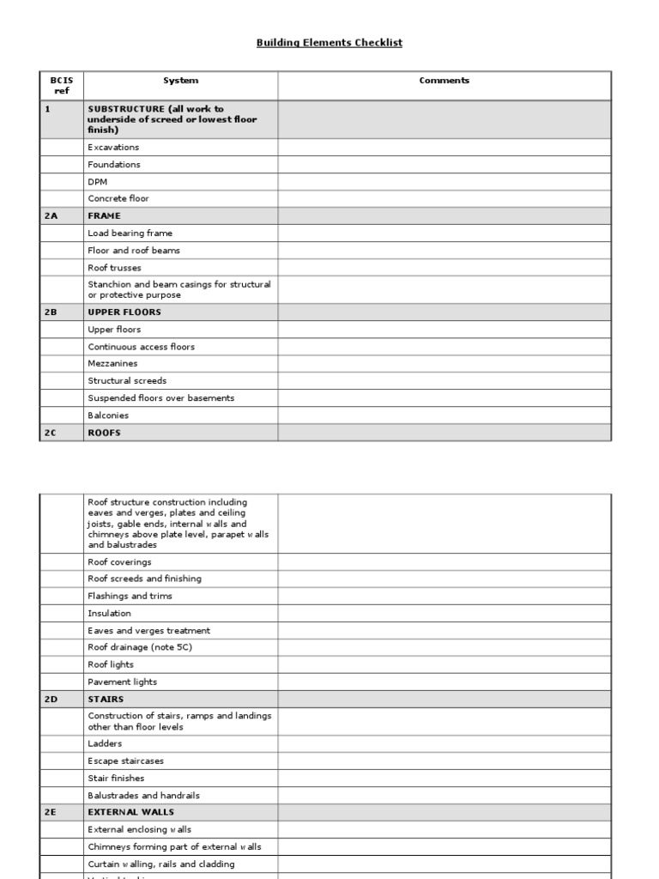
Client-Informed Model
Standard list of elements is reviewed by knowledgeable staff within a client organization
Actual elements present are confirmed and those not present are eliminated
Confirmation and expansion on specific types of certain elements (Roof, Walls, Finishes)
Date of Installation/Construction are updated at the element-level.

Slide 20
Client-Informed Model– Sample Data
Building-Type

Slide 21
Validated Model
Limited on-site assessment to adjust the modeled data
Adjusted replacement values
Condition rating
Typically validates short-term modeled needs (5-Years) and leave the rest as purely modeled data
Can include photos of elements, but not always

Slide 22
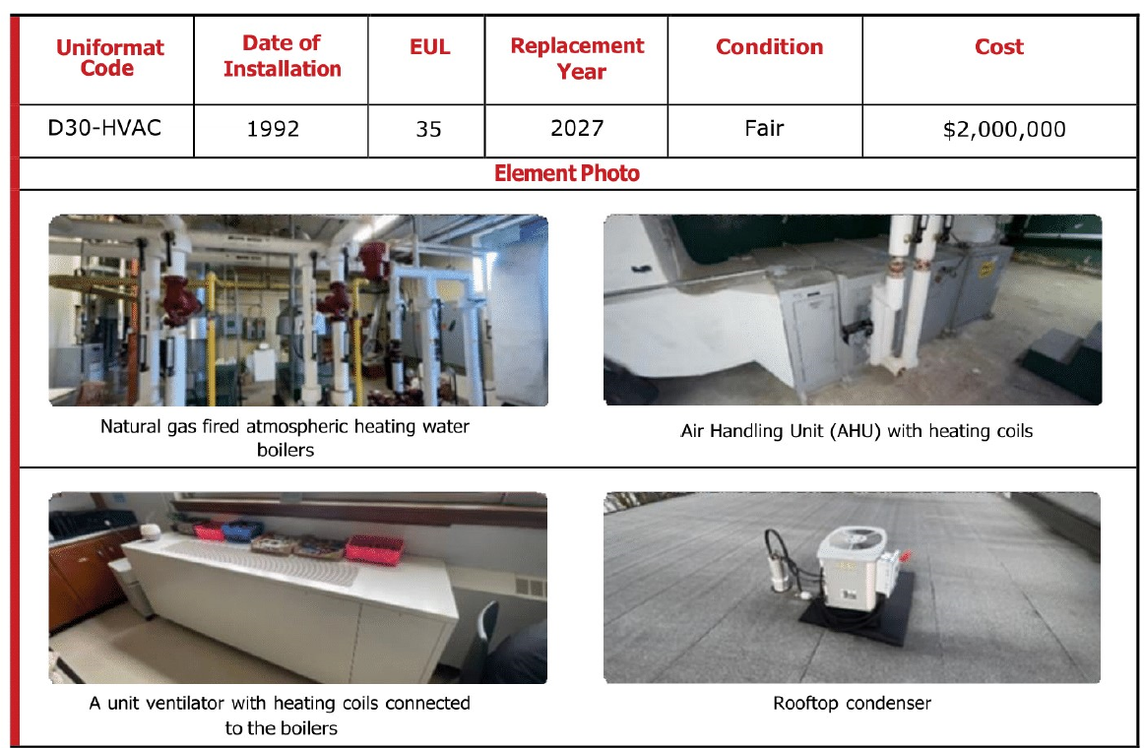
Client-Informed Model– Sample Data

Slide 23
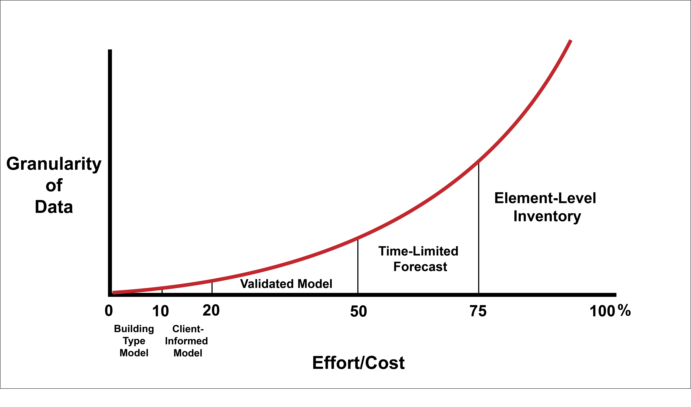
The Condition Continuum

Slide 24
A Note on Current Replacement Value
If you want a Facility Condition Index, you are going to need CRVs for each building
What method will work best for you?
Insurable Value
Simple Square Footage
Sum of the Parts
Weighted Square Footage

Slide 26
What to do after july

Slide 27
Element-Level Inventory
Gather detailed information on all elements within the building, regardless of remaining useful life
Capture photographs
Can include gathering of additional data (Make, Model Serial Number) on some elements
Can include cyclical renewals
Future additional replacement of certain elements with shorter Expected Useful Lives
Most advanced condition dataset which supports Asset Management Planning

Slide 28
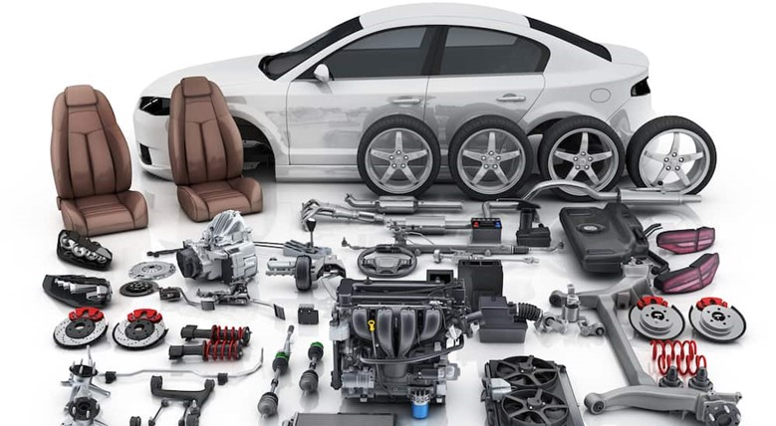
Benefits of ELI
Ability to plan for the entire lifecycle of a building
Longer-term FCI trends
Unlimited forecasting period
Detailed data that can easily integrate with Operations and Maintenance Planning (CMMS Integration)
Reassessments require reduced effort
Assuming the data is kept up-to-date based on completed capital renewal projects
Supports CRV calculation (Sum of the Parts and Other methodologies)

Slide 29
Element-Level Inventory – Sample Data

Slide 30
Minimize Cost and Maximize Value
If you are a small municipality, your costs per building may be higher due to lower economies of scale
Project Management, mobilization and other costs are shared over a smaller number of buildings
If you can find proximate peer municipalities that face the same challenge, bundle a procurement to reduce overall costs
Find a lead group to manage your consultant
Requires a standardized scope for all
Can reduce overall costs for all groups involved

Slide 31
What Many People Forget….
Now you have to keep the data up-to-date:
Reconciling completed capital projects
Removing data for buildings that are demolished or sold
Add newly constructed or acquired buildings

Slide 32
What Many People Forget….
Process to support how and when data will be updated
Who is going to provide inputs?
Who is making what decisions
Who is going to be responsible for it?
Existing staff member
New hire
Third Party

Slide 33
ONE FINAL THOUGHT

Slide 34
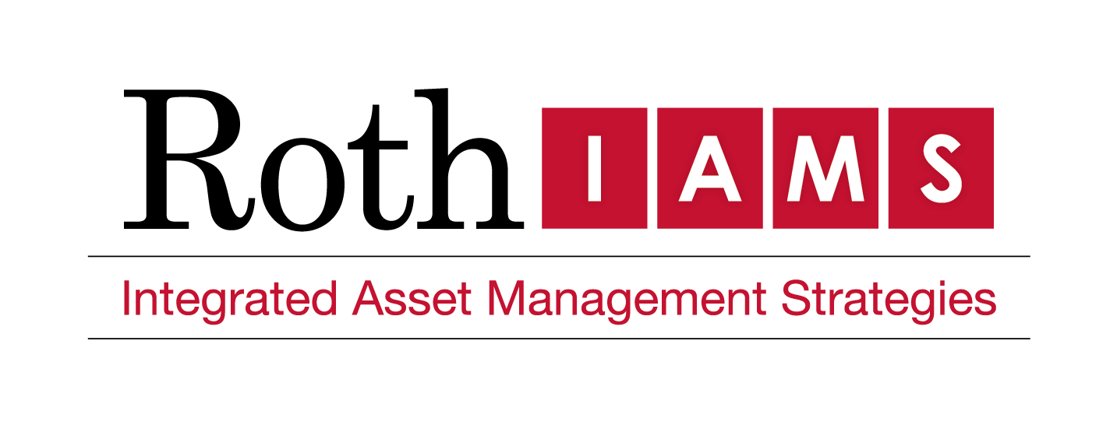
Q & A

Slide 35
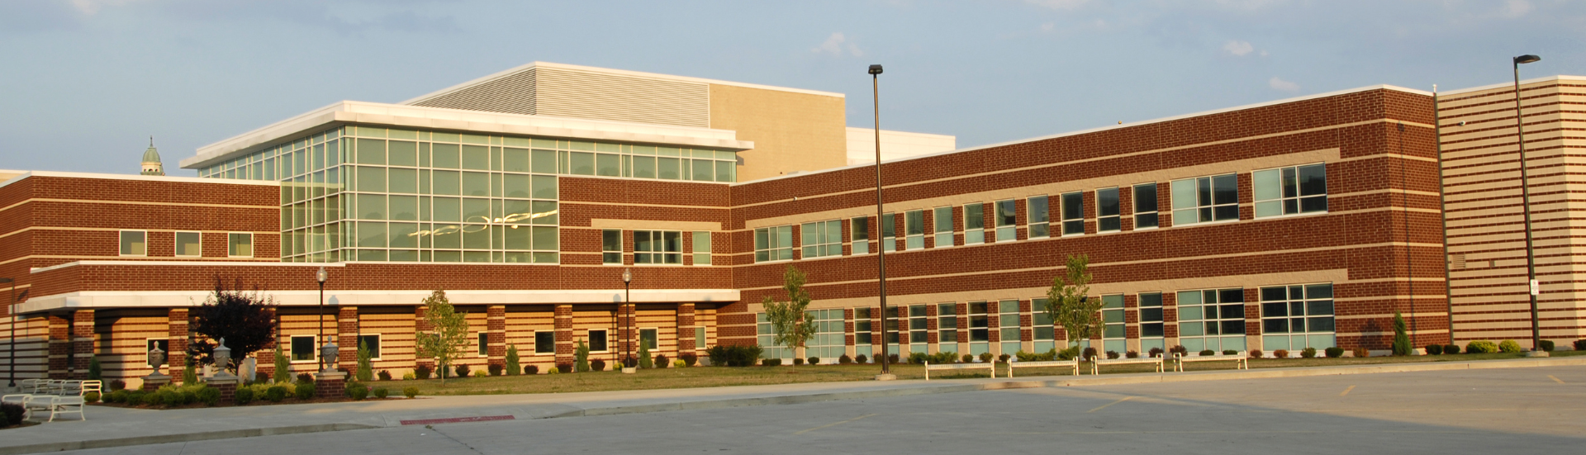
For More Thought Leadership
Scan the QR Code!

Slide 36
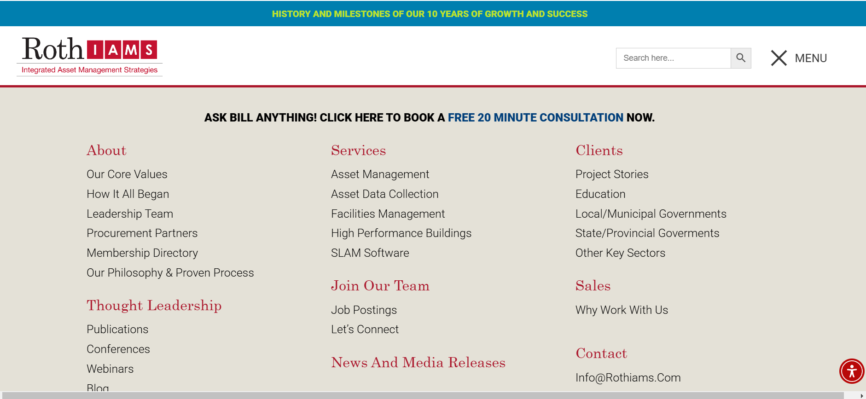
THANK YOU FOR ATTENDING
Connect with us directly
bill.roth@rothiams.com
(416)-700-6678
Visit our website at rothiams.com
Follow us on LinkedIn

