Slide 1
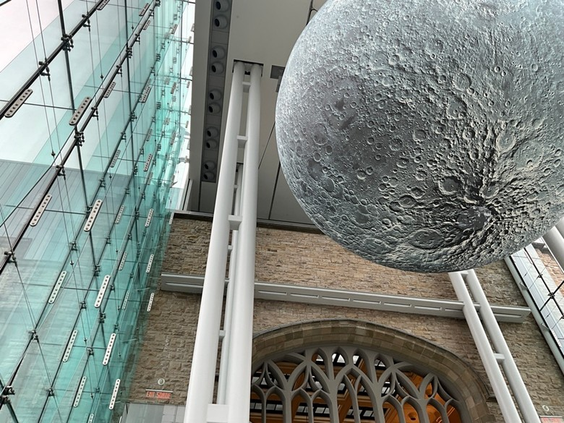
Historic Structures: The Challenges of Extending the Useful Life of Your Biggest Asset
April 24, 2025

Slide 2
Introductions
Andrej Culen, P.Eng.
Structural, Practice Lead
Professional structural engineer, with 25 years of experience and knowledge in structural design, evaluation/ analysis, restoration and forensics of new and existing structures in steel, concrete, wood and masonry.
Experience managing Structural Condition Assessments and Forensics for facilities and other infrastructure assets such as stadiums, post tension parking garages, retaining walls, historic wood structures.
Responsible for Roth IAMS structural methodology and leads a team of 7 structural engineers to provide efficient, time sensitive, and cost-effective design/ repair solutions.

Slide 3
Agenda
Overview – Why our Historic Structures Matter
Conservation
Uniqueness – Structures, Materials, Design Features
Challenges in Operations and Maintenance
Planning for the Future
Specialized Preservation
Questions

Slide 4
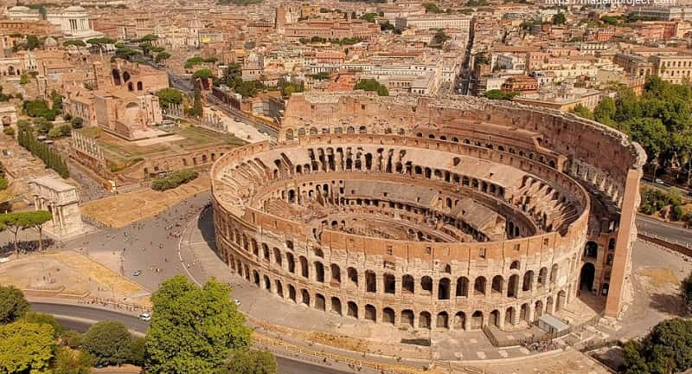
WHY OUR Historic structures matter
What are Historic Structures?
The built environment which gives a sense of wonder.
They are structures which make us want to know more about the people and culture who created them.
Have inherent value in: Architectural, Aesthetic, Documentary, Archaeological, Economic, Social, Political, Spiritual, Symbolic,
Emotional impact
If it has survived 100 years of Useful Life, good claim to be historic.

Slide 5
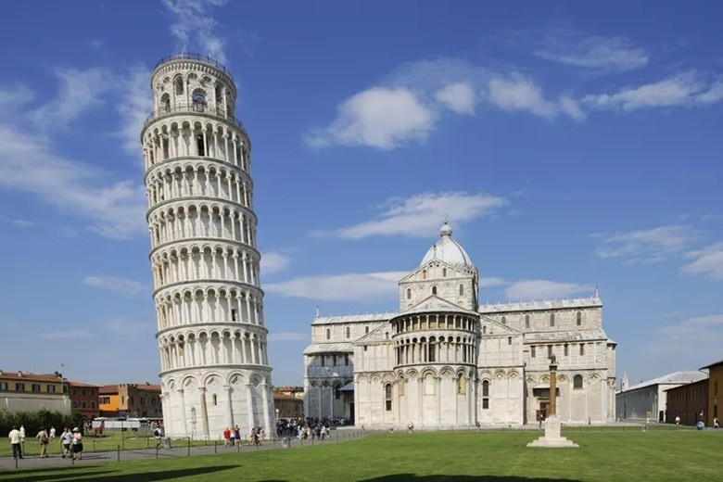
WHY OUR Historic structures matter
3 stages and 177 years to build
Began construction in 1173
Third floor was built in 1178, the tower bent 5 cm to the southeast
Unstable subsoil, stopping construction
Stoppage allowed for the settlement of the ground
100 years later, worked resumed
Additional floors added, inclination of the towers slowed down for centuries. With the added weight of floors benefitting.
First restoration, 835, eliminating the muddy soil with a marble base.
New tilt reaching plumbing deviation of 5.1 m in 1918
Until 1990 the tilt of the tower from 1 to 1.2 mm annually
Leaning Tower of Pisa

Slide 6
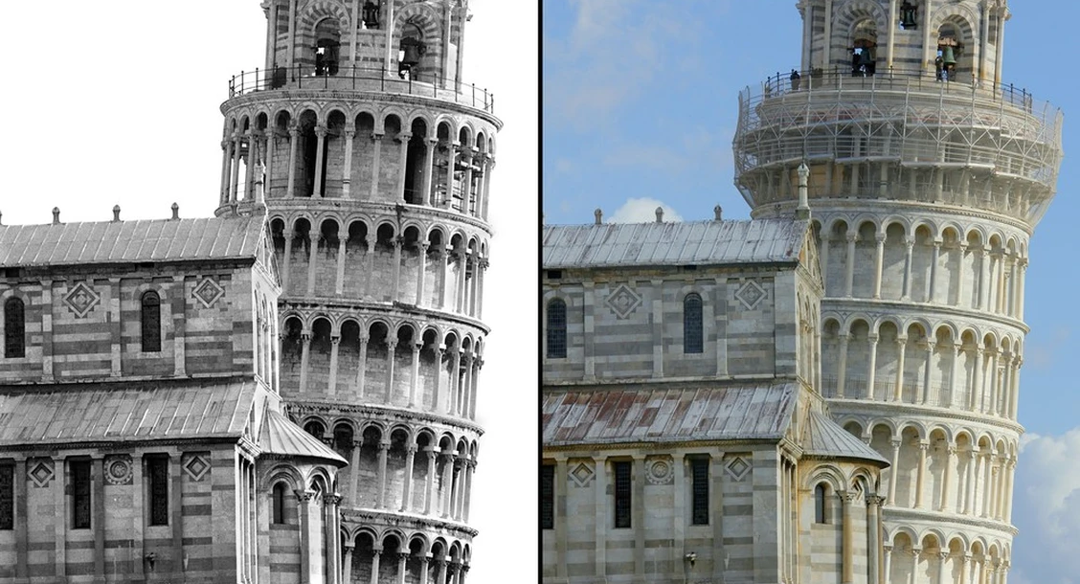
WHY OUR Historic structures matter
1990 the tower closed its doors to the public
Italian and foreign engineers planned to complete an 11-year, $27-million restoration project
Reduced its tilt by 40 cm
2010 the restoration project was successful, which involved careful soil extraction from under the “non tilting” foundation side of the Tower
Predicted - 300 years for the tower to get back to its 1990 inclination
“The Leaning Tower of Pisa is the strangest structure the world has any knowledge of” Mark Twain
Leaning Tower of Pisa
1990
2010

Slide 7
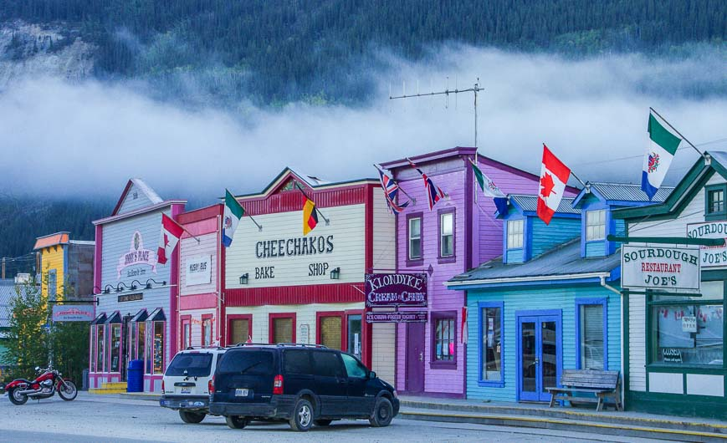
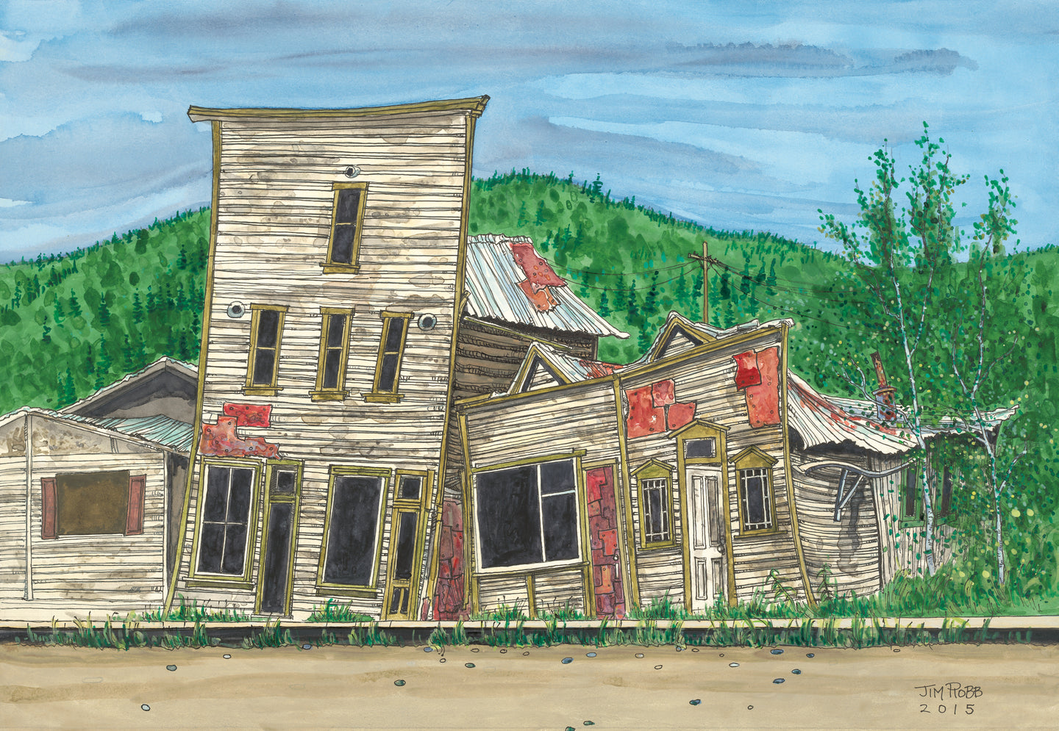
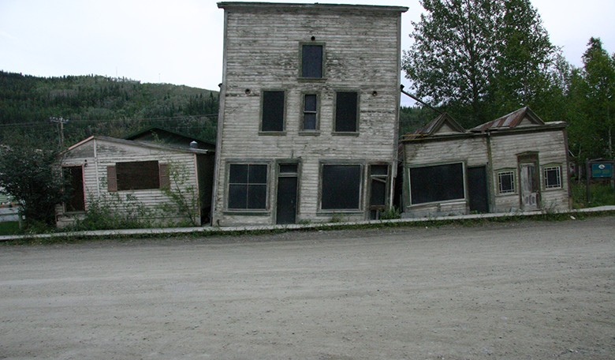
WHY OUR Historic structures matter
The “Kissing Buildings” Dawson City, Yukon, Canada
Gold Rush, Dawson City was the largest city north of Seattle and West of Winnipeg
The Dawson Historical Complex, designated National Historic Site
Capital of Yukon Territory, 1898- 1953
The two buildings fell in on each other due to changing condition and melting permafrost foundations
Abandoned “Kissing” buildings are used as part of the Gold Rush era tour of downtown Dawson City to teach about permafrost and changing climate

Slide 8
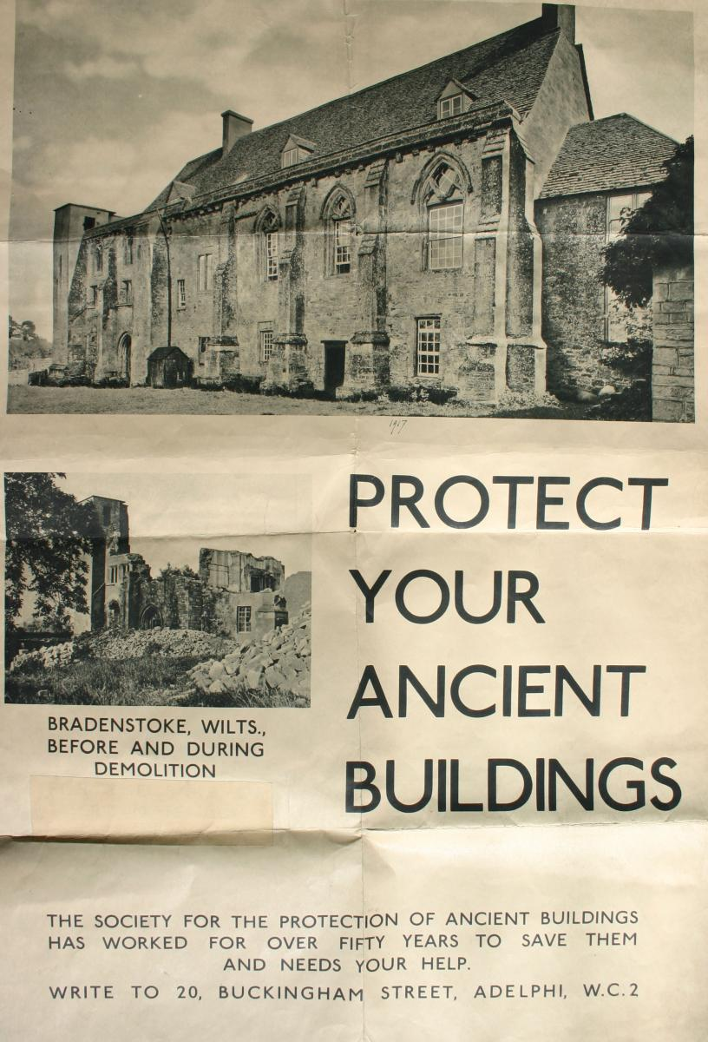
conservation
The doctrine of conservation was detailed and put forth by the International Council on Monuments and Sites (ICOMOS), in four Charters:
The Venice Charter (1964) on the basis of all modern conservation and restoration;
The Florence Charter (1981) on gardens and landscapes:
The Charter for the Conservation of Historic Towns (1987);
Then International Charter for the Archaeological Heritage Management (1990)
The first principle of these dated back to William Morris’ 1877 “Manifesto for the Society for the Protection of Ancient Buildings” (SPAB), and is still the most influential worldwide.

Slide 9
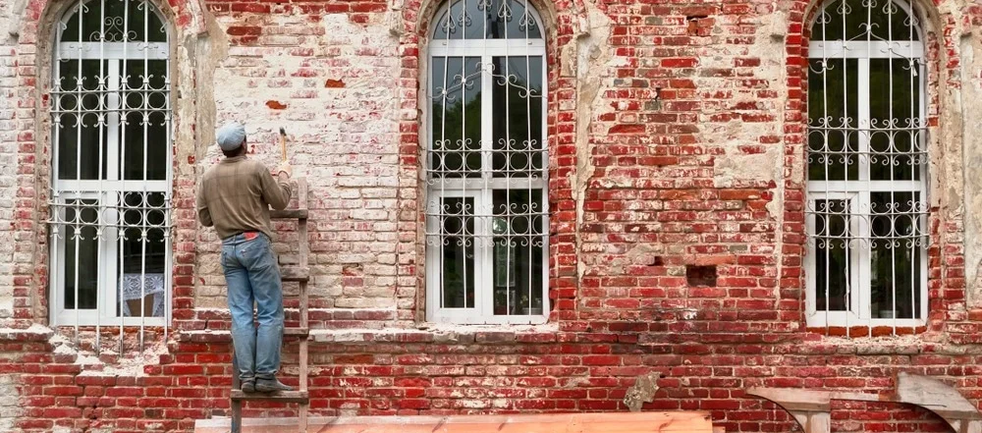
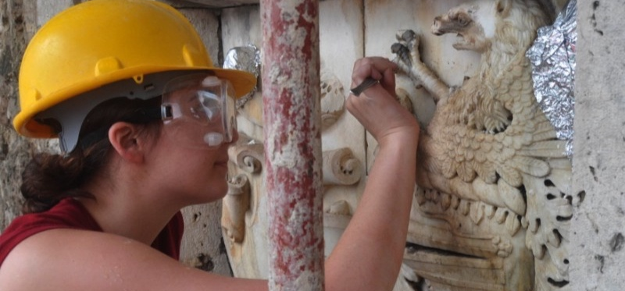
Conservation
A team of professionals make up a team involved in building restoration and conservation:
Conservation Architects
Archaeologists, building economists
Structural, Mechanical, and Electrical Engineers
Art historians, material scientists, and crafts persons for each material
Building contractors, surveyors, and town planners
Owners

Slide 10
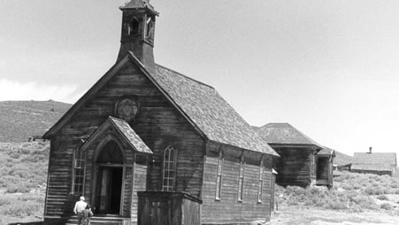
conservation
Certain ethics are mandated and should be observed by the professional team.
The Stringent Guidelines should be maintained:
the condition of the building must be fully recorded before any intervention is begun;
the materials and methods used during the treatment must be documented:
historic evidence must not be destroyed, falsified or removed;
any intervention must be the minimum necessary. It should be reversible – or at least repeatable, and not prejudice possible future interventions;
any intervention must be governed by unswerving respect for the aesthetic, historical and physical integrity of cultural property.

Slide 11
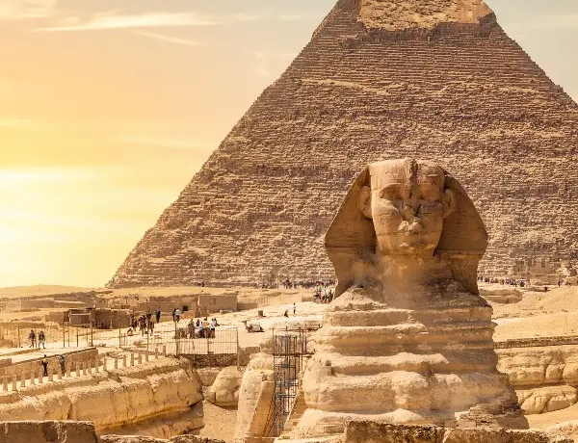
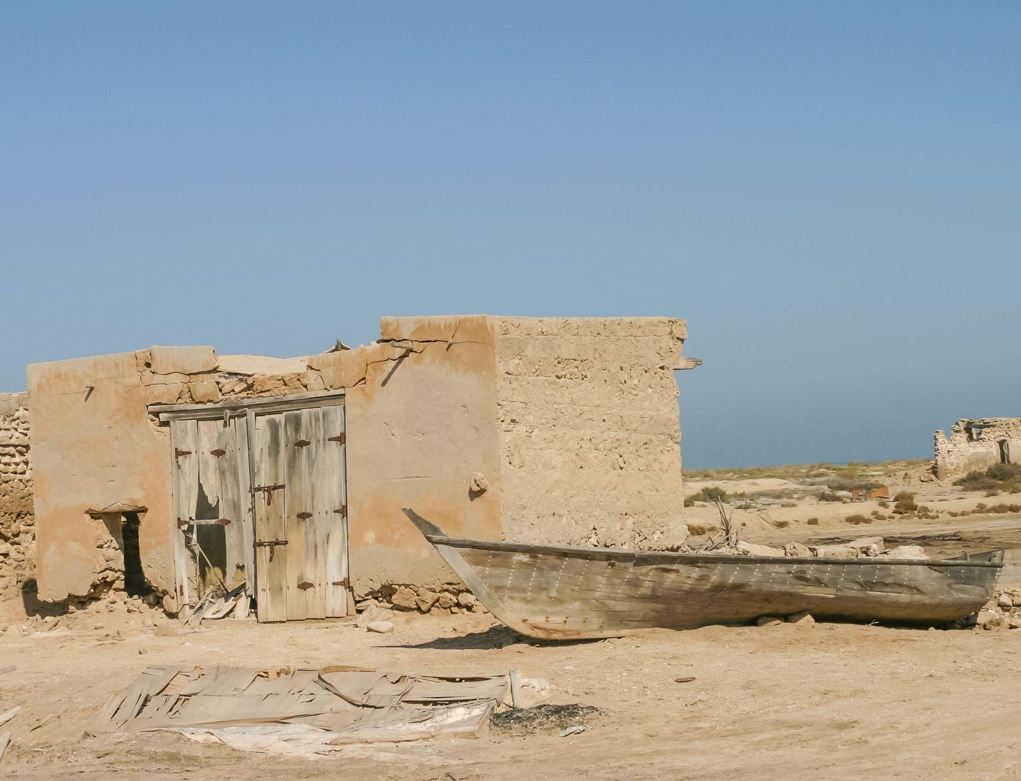
Mortality – historic structures
A building’s structure, at some point in time, will collapse if maintenance is neglected and if it is not repaired.
Luckily, many historic buildings are overdesigned with a lot of intrinsic strength, and as part of code are designed with factors of safety to allow for built in extra strength
Three Levels are always analyzed and considered:
The whole structure
Secondary structural elements (i.e. foundations, roofs, walls)
Materials and historical construction methods

Slide 12
Understanding history of Unique materials
Masonry
Stone – longest lasting masonry building materials in North America
Quarried stone - sandstone, limestone, marble, granite, basalt, coral stone
Gathered stone – fieldstone, river rock, boulders
Laid with mortar or dry stacked without mortar
Brick - Before 1870, clays were pressed into molds and often unevenly fired. Quality depended on type of clay available
By the 1870s the extrusion process was perfected, bricks became more uniform and durable
Architectural terra cotta – kiln fired clay product, popular from late 19th century until the 1030s with steel frame, high trise office buildings
Adobe – earliest building materials found in primarily Southwest, sun-dried-earthen blocks, still used today

Slide 13
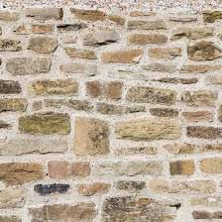
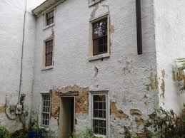
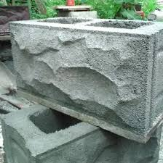
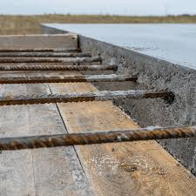
Unique materials
Mortar and Concrete
Mortar – used to bond together masonry units
Historically quite soft, consisting primarily of lime and sand, and other additives
Portland cement – first manufactured in the 1870s, but became most common in use in the early 20th century
Stucco – heavily lime based, but increased in hardness with the addition of Portland cement in the late 19th century
Concrete – long history as a construction material
Composed of sand, crushed stone, or gravel bound together with lime, and natural hydraulic cement
A variety of forms – block units, poured or cast-in-place, and precast panels
In the 20th century, as the engineering knowledge of concrete advanced – reinforced concrete was developed
Addition of steel reinforcing bars, as well as pre and post tensioning, and has become one of the most commonly used building systems today

Slide 14
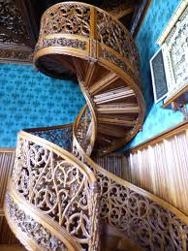
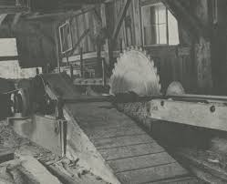
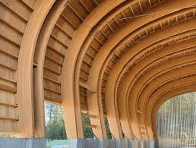
Unique materials
Wood
Most essential materials used in North American buildings
Varied attributes makes it suitable for structural members, siding, roofing, interior finishes, and decorative features
Many of the earliest settlements were built with logs
Readily available, did not require much finishing, could be quickly erected with basic tools and methods
Water-powered sawmills and mechanization increased efficient production and lowered costs
Strength benefits in both tension and compression, ease with the ability to cut and shape
Glued Laminated timber (Glulam) – Engineered wood, massive arches and trusses

Slide 15
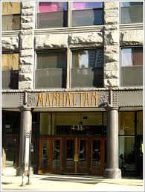
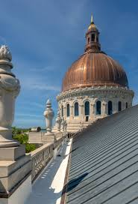
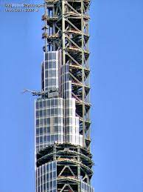
Unique materials
Steel
Wrought Iron – the form in which iron was first used in North America, architectural elements, nails, tie rods, straps and hardware
Increased in size to include balconies, railings and porches
Eventually used as structural components around the mid 19th century
Cast Iron – initially imported from England.
Structural cast – iron columns were first used in the 1820s, cast iron building fronts and decorative ornamental features followed
Metals commonly used in historic buildings – lead, tinplate, terneplate, zinc, copper, bronze, brass, Aluminum, stainless steel
16 story Manhattan Building, Chicago - at the time the tallest structure in the world (1891) - 224 ft tall
Steel – alloy of iron and usually carbon, increased in popularity as the manufacturing process and production improved
Structural steel played an important role in the development of high-rise buildings and the skyscraper
Current tallest structure in the world – Burj Khalifa 2722 ft

Slide 16
It’s time for A Poll question

Slide 17
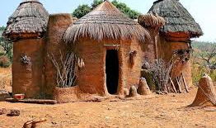
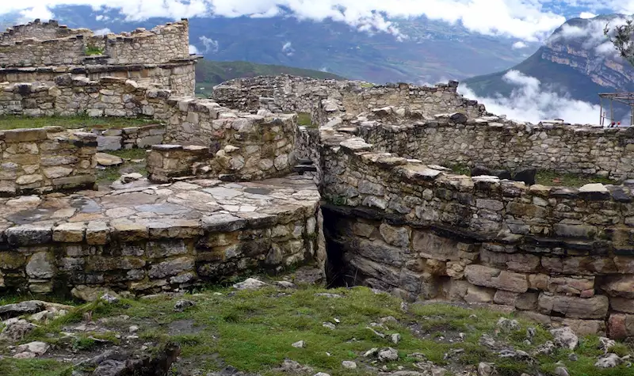
Challenges in operations and maintenance historic structures
The climate is one of the fundamental causes of deterioration on buildings
Traditional buildings, built and designed for specific geographical locations
Built using local materials and methods
Example – Traditional Adobe Hut in Africa, compared to Humid environments in Northern Peru
Over time, our climates are changing
The resistance of building materials to climatic agents of decay decreases with exposure to these elements and with age.
Conservation and preventative maintenance efforts must be more involved in order to adapt.
As our knowledge increases, our building codes are also adapted and changed.

Slide 18
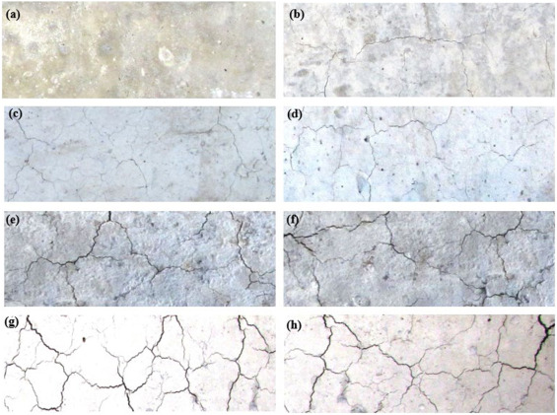
Solar radiation
Solar radiation is the prime cause of climatic conditions affecting the earth and its environment, cities, and buildings
Wavelengths (measured from peak to peak) range from:
ultraviolet (0.2 micrometers)
narrow band visible spectrum of light (0.4 – 0.9 micrometers)
infrared (8 micrometers) – greatest energy input
Different materials vary in their ability to absorb different wavelengths
Certain materials absorb a certain percentage of energy (Absorptivity)
Light, especially the ultraviolet component is very destructive, particularly to organic materials such a wood, textiles, and pigments
Solar Radiation causes fading, embrittlement in materials, and loss of substance
Unprotected wood can erode at the rate of 5-6 mm (1/4 inch) per century
due to combined attack of ultraviolet and rapid moisture exchange
“

Slide 19
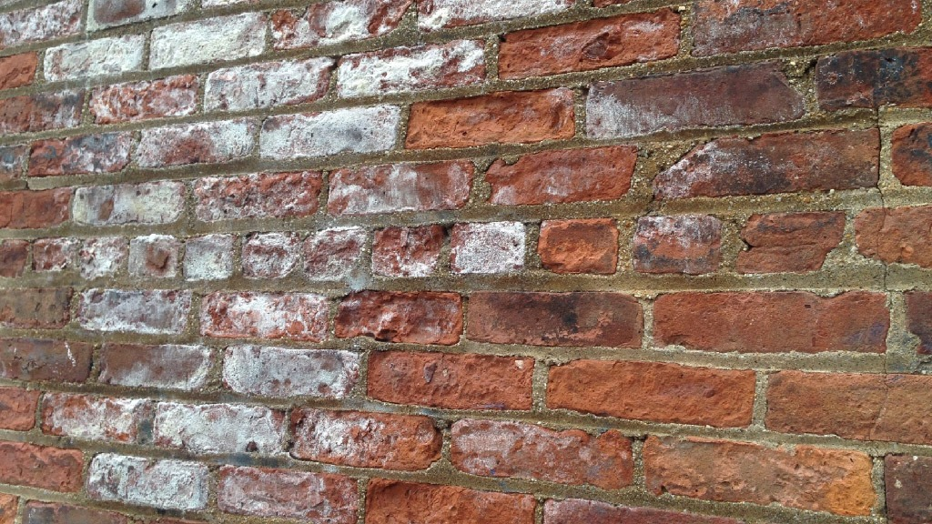
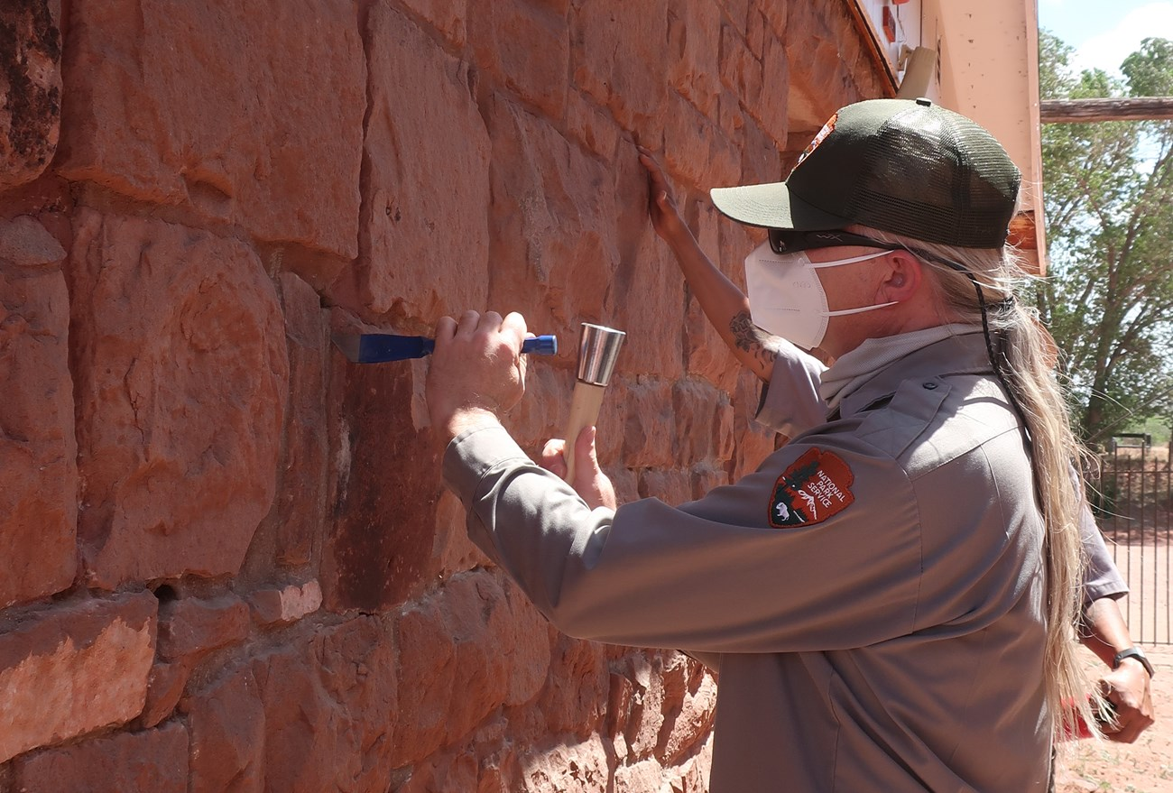
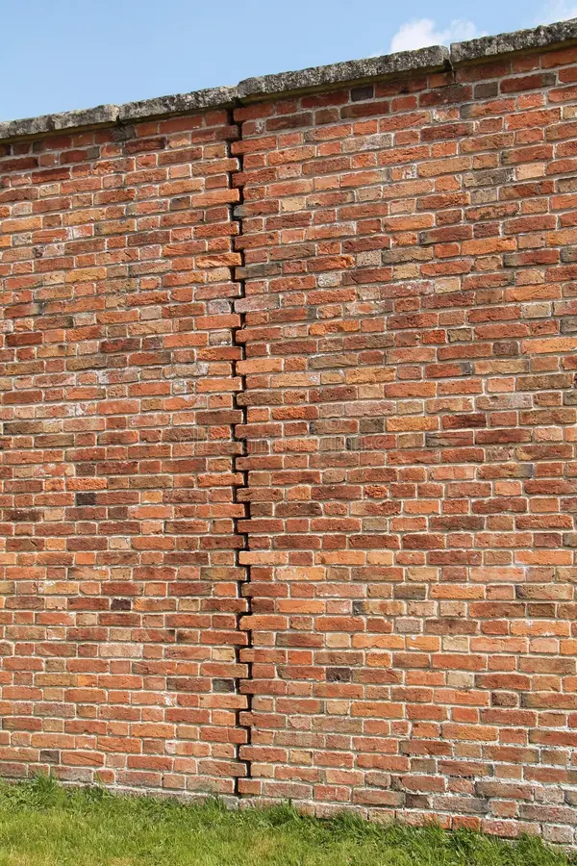
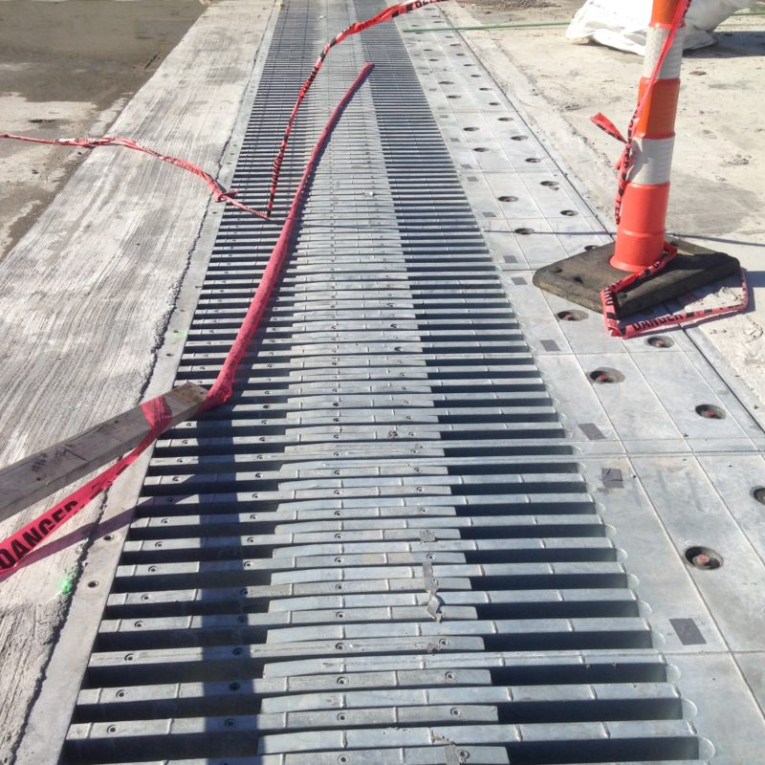
Temperature and thermal expansion
Cause of air temperature change is almost entirely through the effect of the sun
Sun heating effect (daytime) (short and long wave radiation)
Loss of heat (nighttime) (long wave radiation - convection)
Building materials expand when heated and contract when cooled
Thermal movement is a major cause of decay in buildings
Inspect, maintain, study, and repair historic mortar materials and all expansion joints on your structure

Slide 20
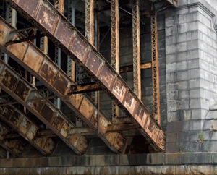
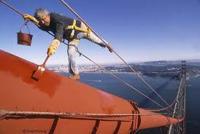
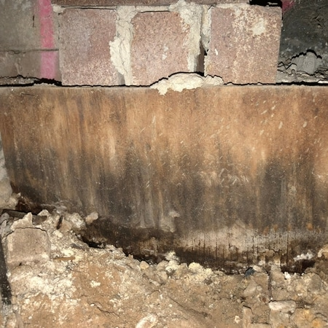
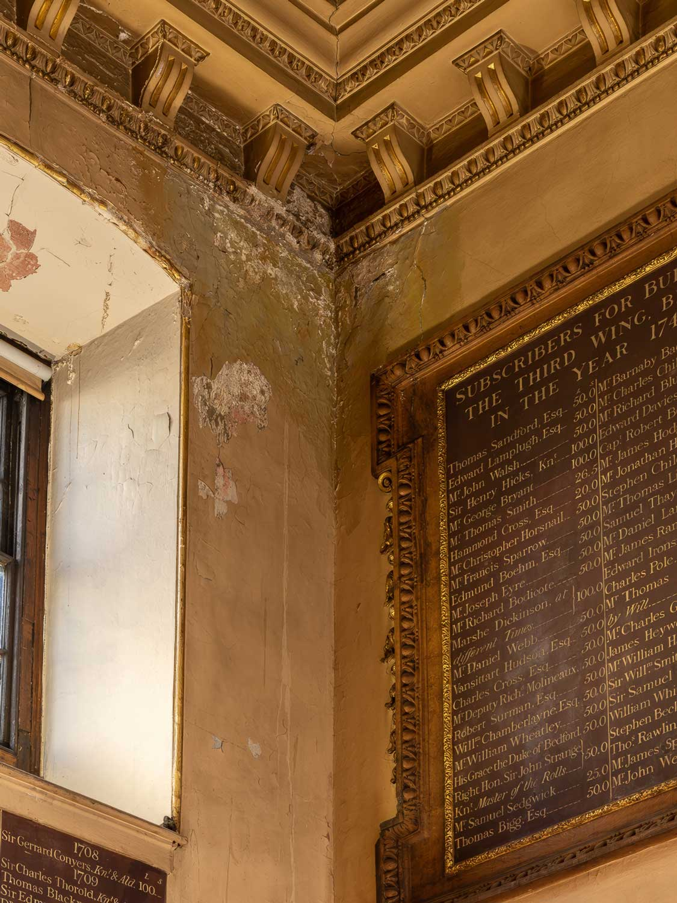
The action of moisture
The presence of water in various forms accelerates decay of most historic building materials
Corrosion is a significant threat to historic steel structures
Moisture combined with oxygen, leads to oxidation
Results in rust and structural weakening
Faulty disposal of rainwater is the most frequent cause of deterioration in ancient masonry
Capillary action at foundations can be 8 – 10 m high
Condensation of water, more dangerous than rainwater
(Stefan Effect) draws harmful particles to condensing surfaces
Particles of pollution – black carbon, iron oxides, sulphuric acid can be deposited, accelerates decay
Rainwater and moisture disposal systems and protection is vital

Slide 21
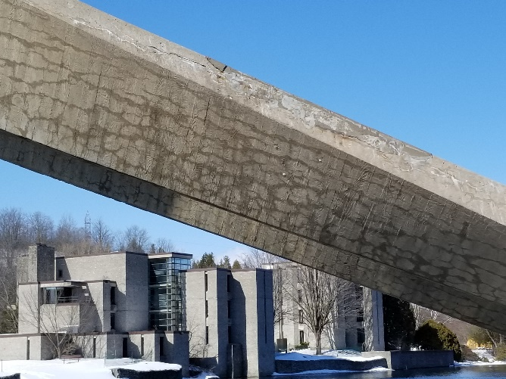
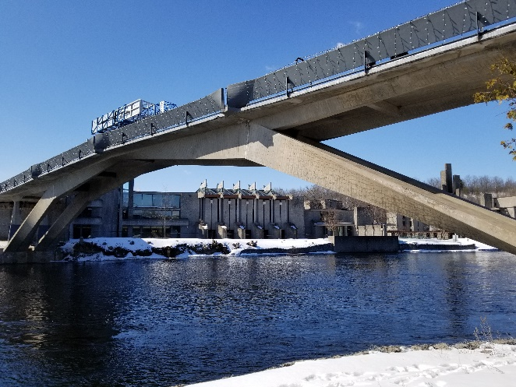
Frost and snow
It is not necessarily the extreme cold that causes damages to structures as it is the process of freezing.
Freezing and thawing, expansion of ice, is most damaging.
Freezing damages porous structural materials
Concrete Post Tensioned Faryon Bridge, Ontario
In northern climates this can especially be damaging to foundations.
Build below frost lines
In the far north – the challenge is to keep foundations in Permafrost levels
The ultimate goal – reduce number of freeze thaw cycles
Can be difficult with changing frost lines, increasing snow amounts, and melting permafrost with changing climate conditions

Slide 22
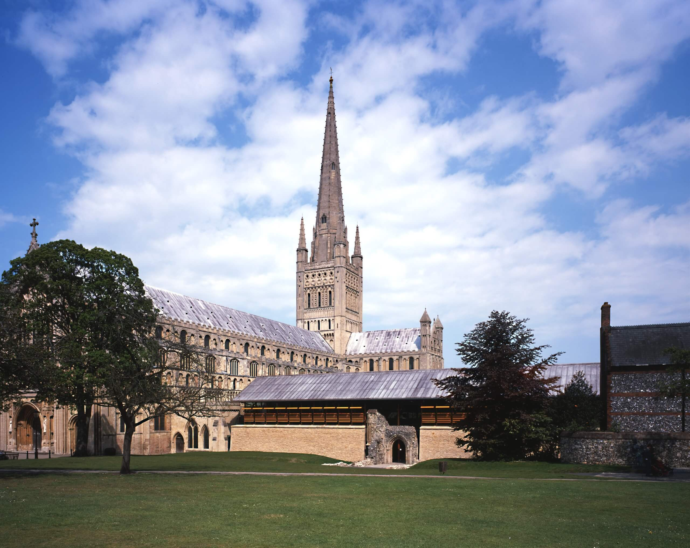
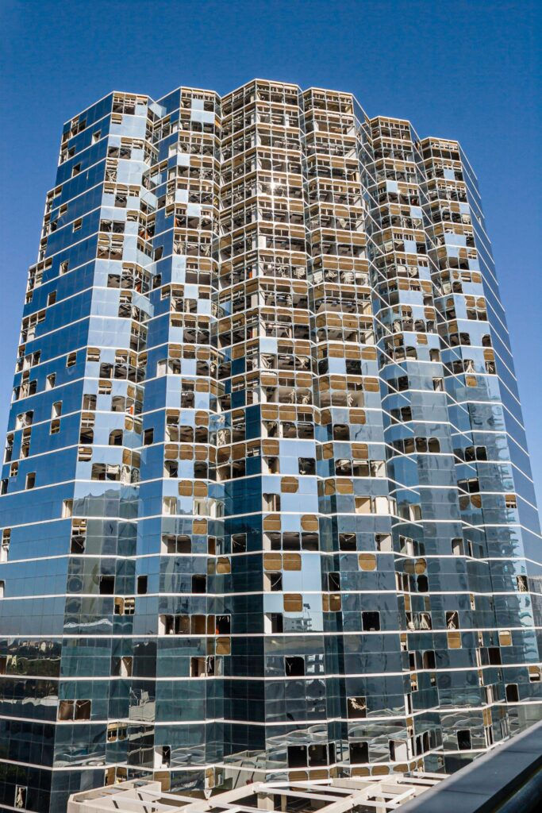
wind
Wind is the result of different atmospheric pressures in the weather system
Direction, speed, gusts, and frequency of calm, important wind loading effects
Impacts by direct damage and accelerating deterioration.
Direct Damage from wind:
Architectural roof and wall coverings - require specially designed anchorages
Damage to tall structures, church towers
Example - Norwich Cathedral, England
Accelerated deterioration:
Wind-driven rain pushes water into cracks and pores
Wind can erode surfaces, leading to loss of material
Eight of ten costliest natural catastrophes in US history wind related (Hurricanes)
For historic buildings, an expected design life of 200 years is not excessive

Slide 23
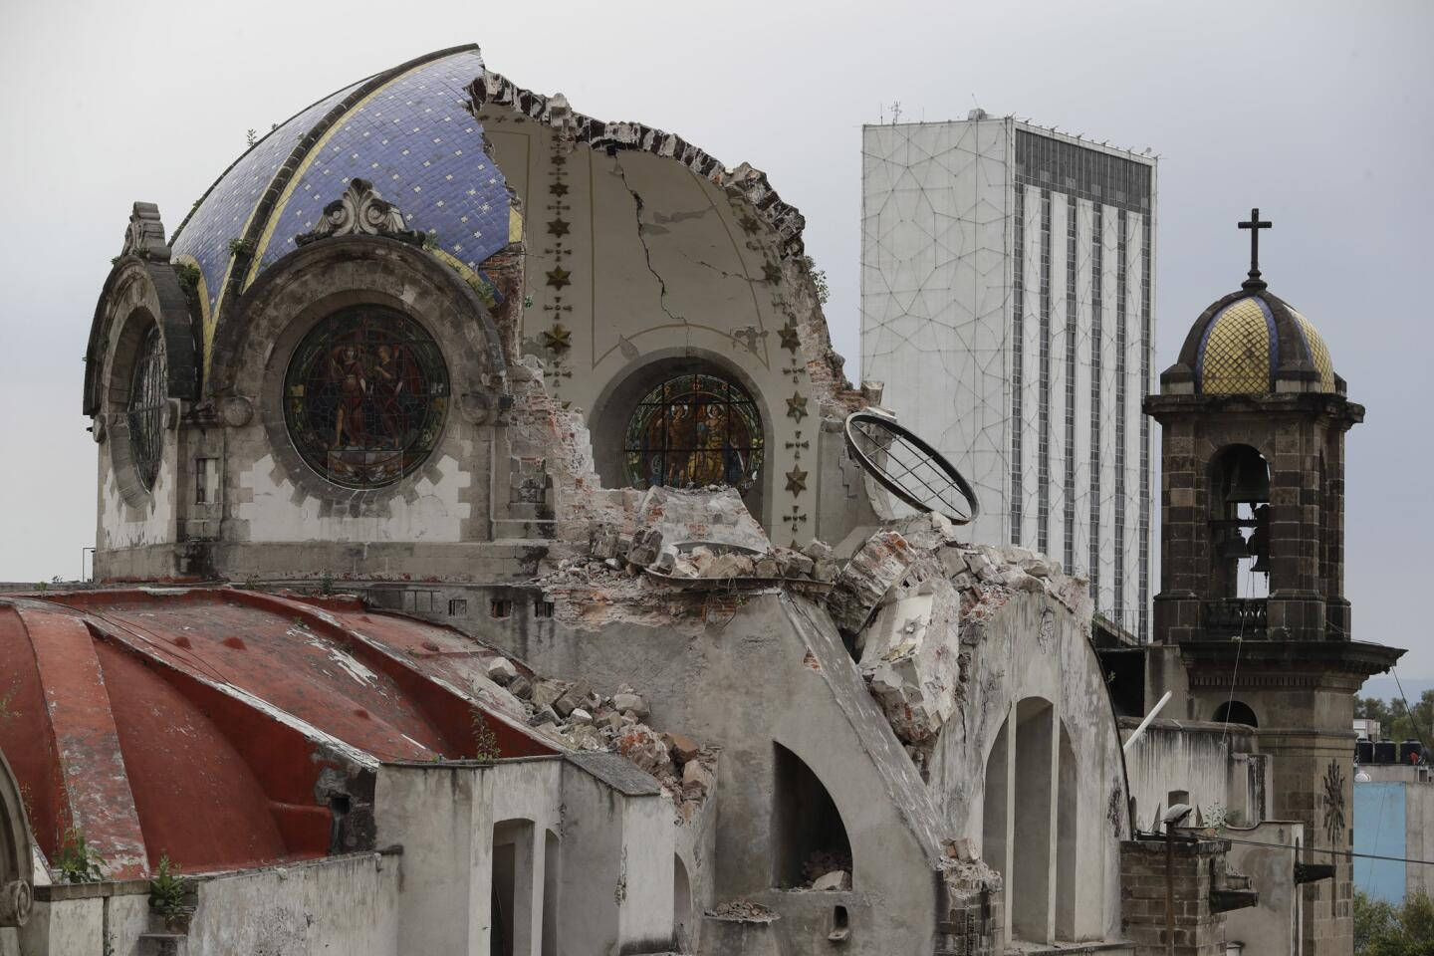
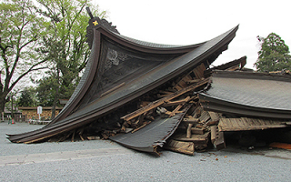
seismic
Earthquakes are different from other disasters
Capacity to destroy cultural property almost instantaneously, without warning
Preparing for and responding to earthquakes involves Local, Provincial (State), and National (or Federal) organizations
Building Design codes for seismic preparation and retro fitting essential buildings are being updated often
Seismic maps are invaluable in establishing a clear picture of the most threatened sites.
It won’t happen here, not in my lifetime

Slide 24
It’s time for A Poll question

Slide 25
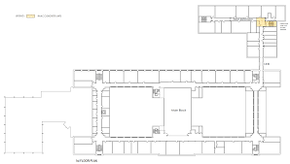
Historic assets - Planning for the future
Condition Assessments and Safe Record Data Maintenance
Preliminary Visual Assessment and Study
Assessed at regular intervals
Search of records and archives
Maintain documentation in a safe and accessible location

Slide 26
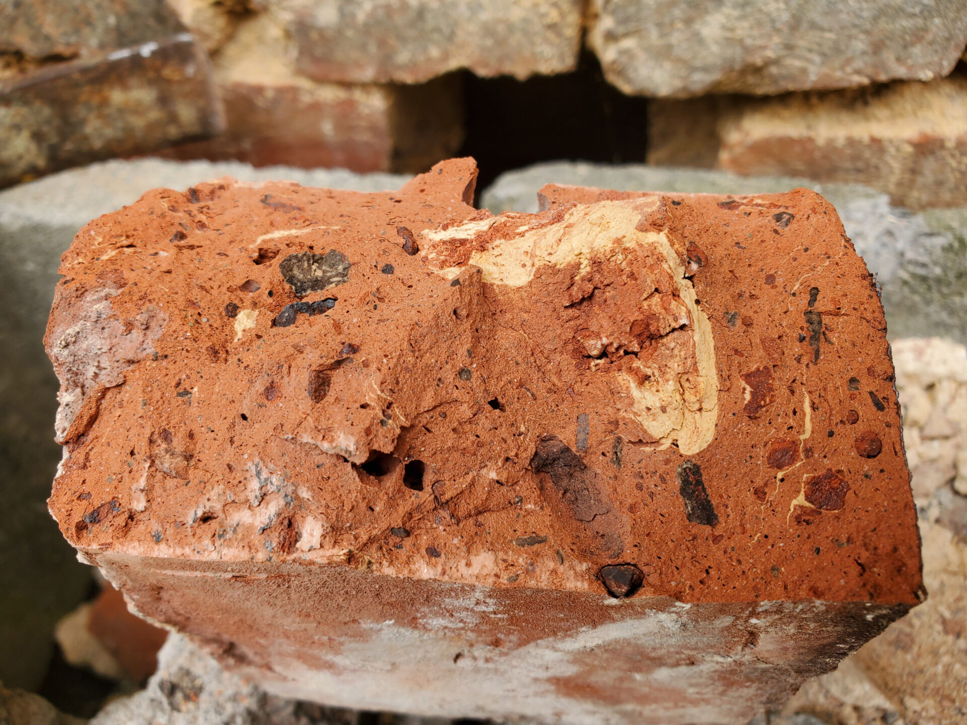
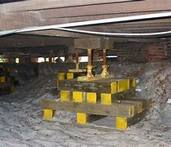
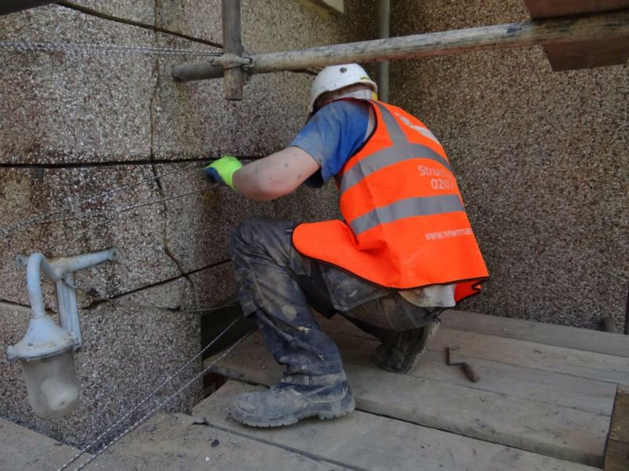
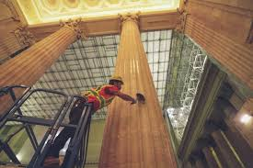
Historic assets - Planning for the future
Pre Repairs and Remediation/ Conservation Stages for Historic Structures
1. Identify, retain, and Preserve
Historic material, age, type of system, and uniqueness. (Conservation Architect)
2. Stabilize
Deteriorated or damaged main structural and secondary structural elements. (Professional Engineer)
3. Protect and Maintain
Use approved cleaning methods, preservatives and protective envelope systems. (Preservation technicians and trade experts)

Slide 27
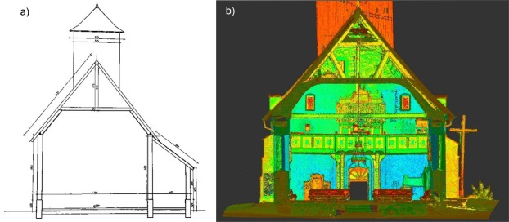
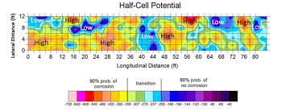
Historic assets Planning for the future
Using modern tools and technology to understand the health of historic buildings
Non-Destructive Testing
Ultrasonic Testing (UT)
Rebound Hanner Tests (Schmidt Hammer)
Ground Penetrating Radar (GPR)
Radiographic Testing (RT)
Infrared Thermography Tests

Slide 28
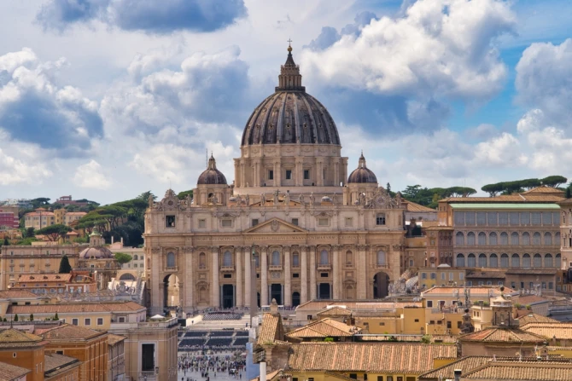
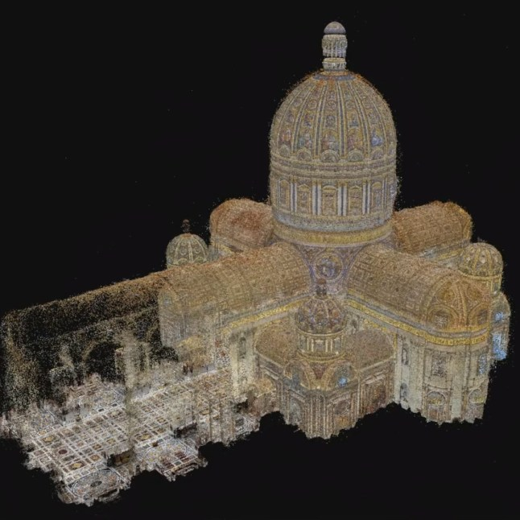
Specialized Preservation
The Future - Using Artificial Intelligence (AI) to evaluate
Vatican City
Digital twin was created of the St. Peter’s Basilica at Vatican City
Over three weeks - Involved drones, cameras and lasers used to take 400,000 detailed images
Analysis identified cracks and fissures invisible to the human eye
Developed by Microsoft, Iconem, and the Vatican
One of the most technologically advanced and sophisticated conservation projects

Slide 29
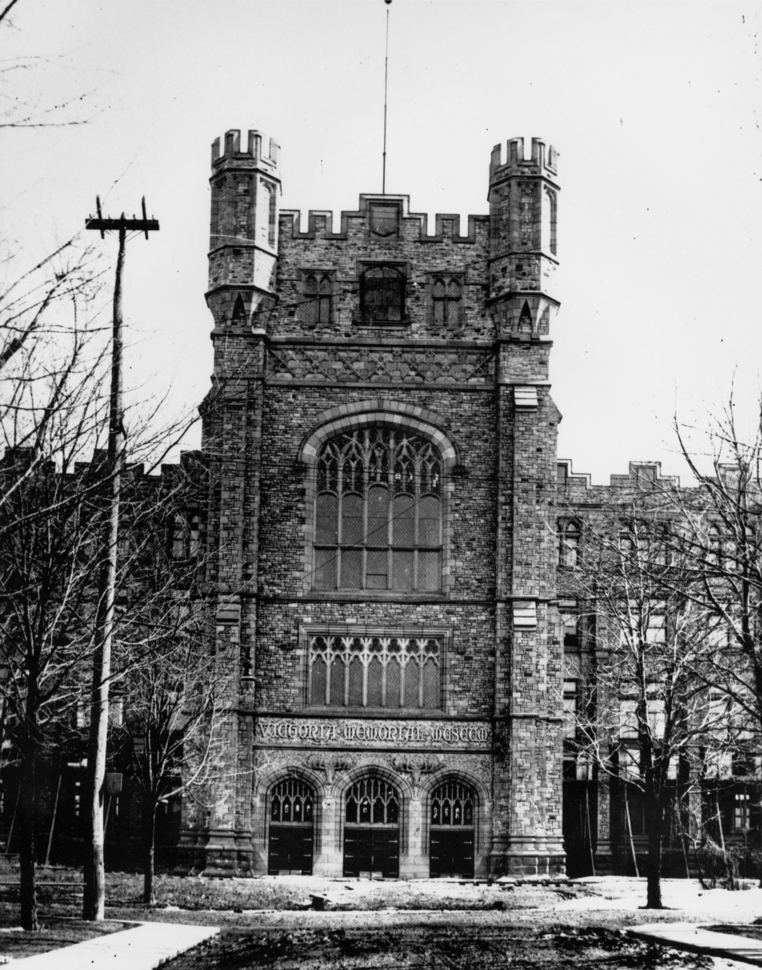
Specialized Preservation- Early Rehabilitation
Case Study - Canadian Natural Museum, Ottawa Canada
Rehabilitation and Restoration through the ages
Construction 1905 – 1911
Originally named the Victoria Memorial Museum
Architectural style – Tudor Gothic
Materials were Tyndal Stone
Original towered front entrance
Unstable soil conditions
Reduced in height five years after building opened

Slide 30
Specialized Preservation modern Rehabilitation
Case Study - Canadian Natural Museum, Ottawa Canada
Rehabilitation and Restoration through the ages
Served as the home of the Parliament of Canada 1916 – 1920
Designated a national historic site of Canada 1990
In 2004 – 2005, large scale rehabilitation
Added a new glass front entrance tower
Interior modifications to museum display areas
Seismic Upgrades
Modern lightweight materials, highlights the original

Slide 31
Specialized Preservation- Immortalized in lego
Case Study - Canadian Natural Museum, Ottawa Canada
Rehabilitation and Restoration through the ages
Took over 1,000 hours to create by a team
Over two years
The model features over 100,000 pieces
It takes over 30 hours to set up
Includes the main entrance, Grand Hall, Earth sculptures, Operating “Swimming” Octopus and Dinosaur displays, with working lights
Seismic Reinforcing?

Slide 32
references
Conservation of Historic Buildings, Feilden, M.B., Architectural Press, Third Edition (2003)
The Standards and Guidelines for the Conservation of Historic Places in Canada, Second Edition (2010) Parks Canada, Provinces and Territories of Canada
The Secretary of the Interior’s Standards for the Treatment of Historic Properties, U.S. Department of the Interior National Park Service Technical Preservation Services, (2017)
Guidelines for Preserving, Rehabilitating, Restoring and Reconstructing Historic Buildings, U.S. Department of the Interior National Park Service Technical Preservation Services, (2017)

Slide 33
Questions?
Visit our website at rothiams.com
Follow us on LinkedIn
Connect with us directly through email at structural@rothiams.com
Visit our Thought Leadership
page

