Slide 1

How Preventative Maintenance Can Improve Your Operations

Slide 2

Introduction

Slide 3

Introductions
  Bob Anderson
  Manager, Facility Management Consulting
  Over 25 years of experience in designing and implementing facility management strategies.
  Expertise across multiple markets: Education, Healthcare, Senior Services, Commercial, and Industrial.
  Known for developing a unique approach to maximizing ROI on facility investments by aligning strategies with market-specific needs.

Slide 4

AGENDA
Define Preventative Maintenance
Review of no/low-cost PM activities
Storing and utilizing historical data
Reporting and using historical data to plan repairs
Predictive maintenance take-aways

Slide 5
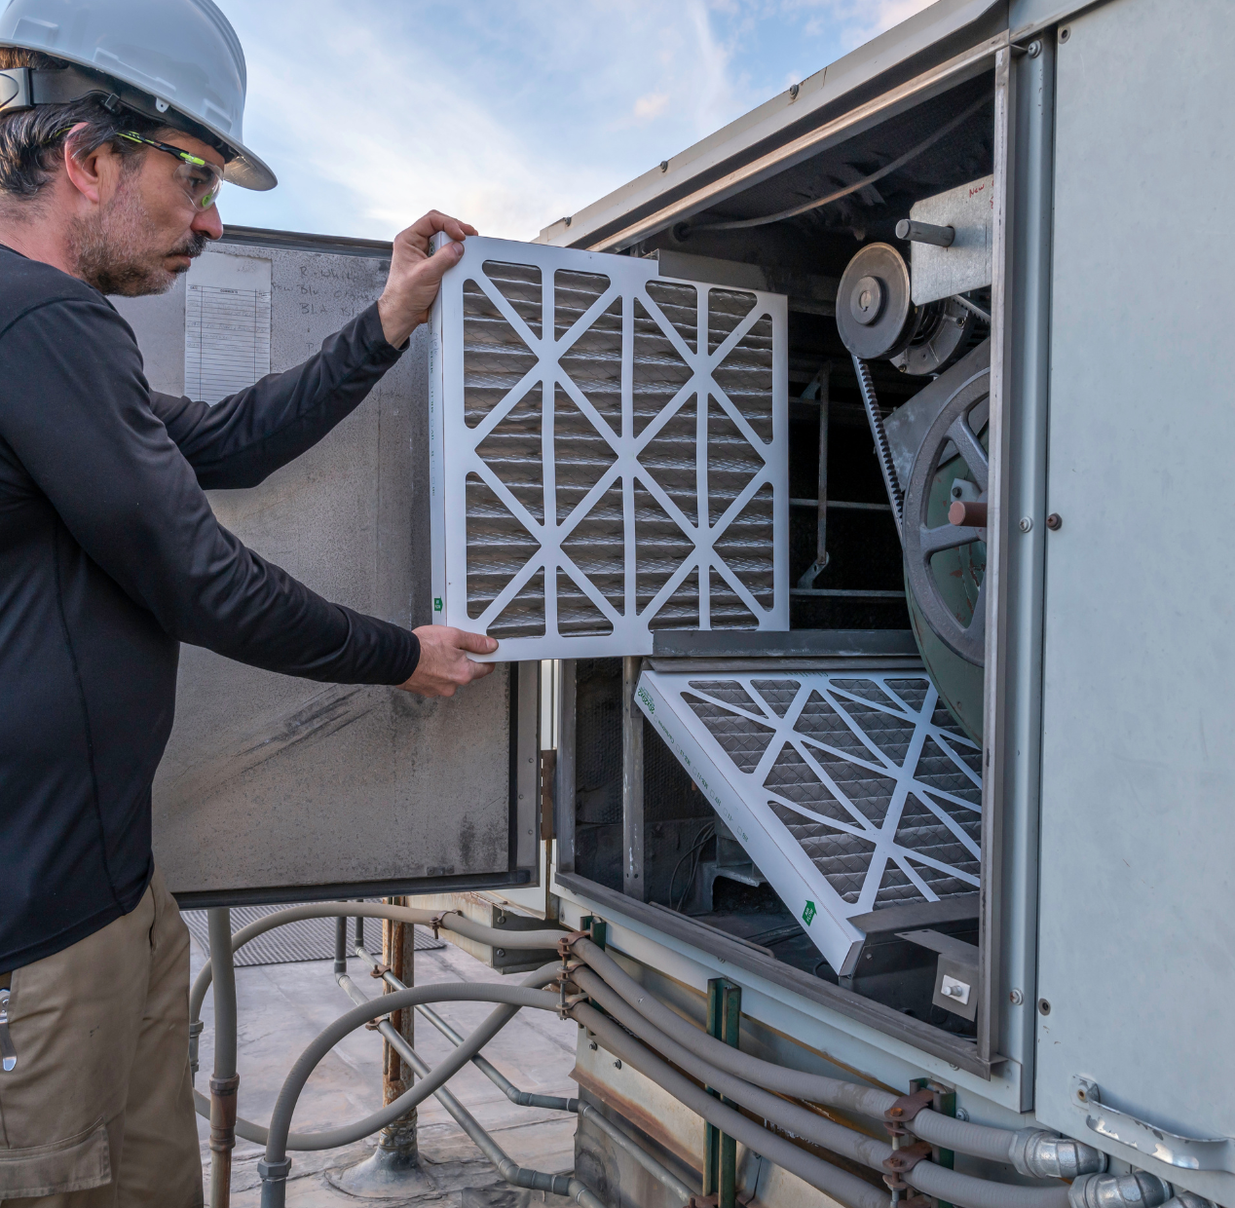
Define Preventative Maintenance

Slide 6

What is Preventative Maintenance
Tasks that you perform to:
  Prevent a potential failure
  Predict a potential failure – Predictive Maintenance
  Extend the life of equipment
  Maintain the efficiency as new
  Health and safety of building occupants
    Filter changes
    Drain Pan cleaning
Focus of today is low-cost predictive maintenance - diagnostics

Slide 7

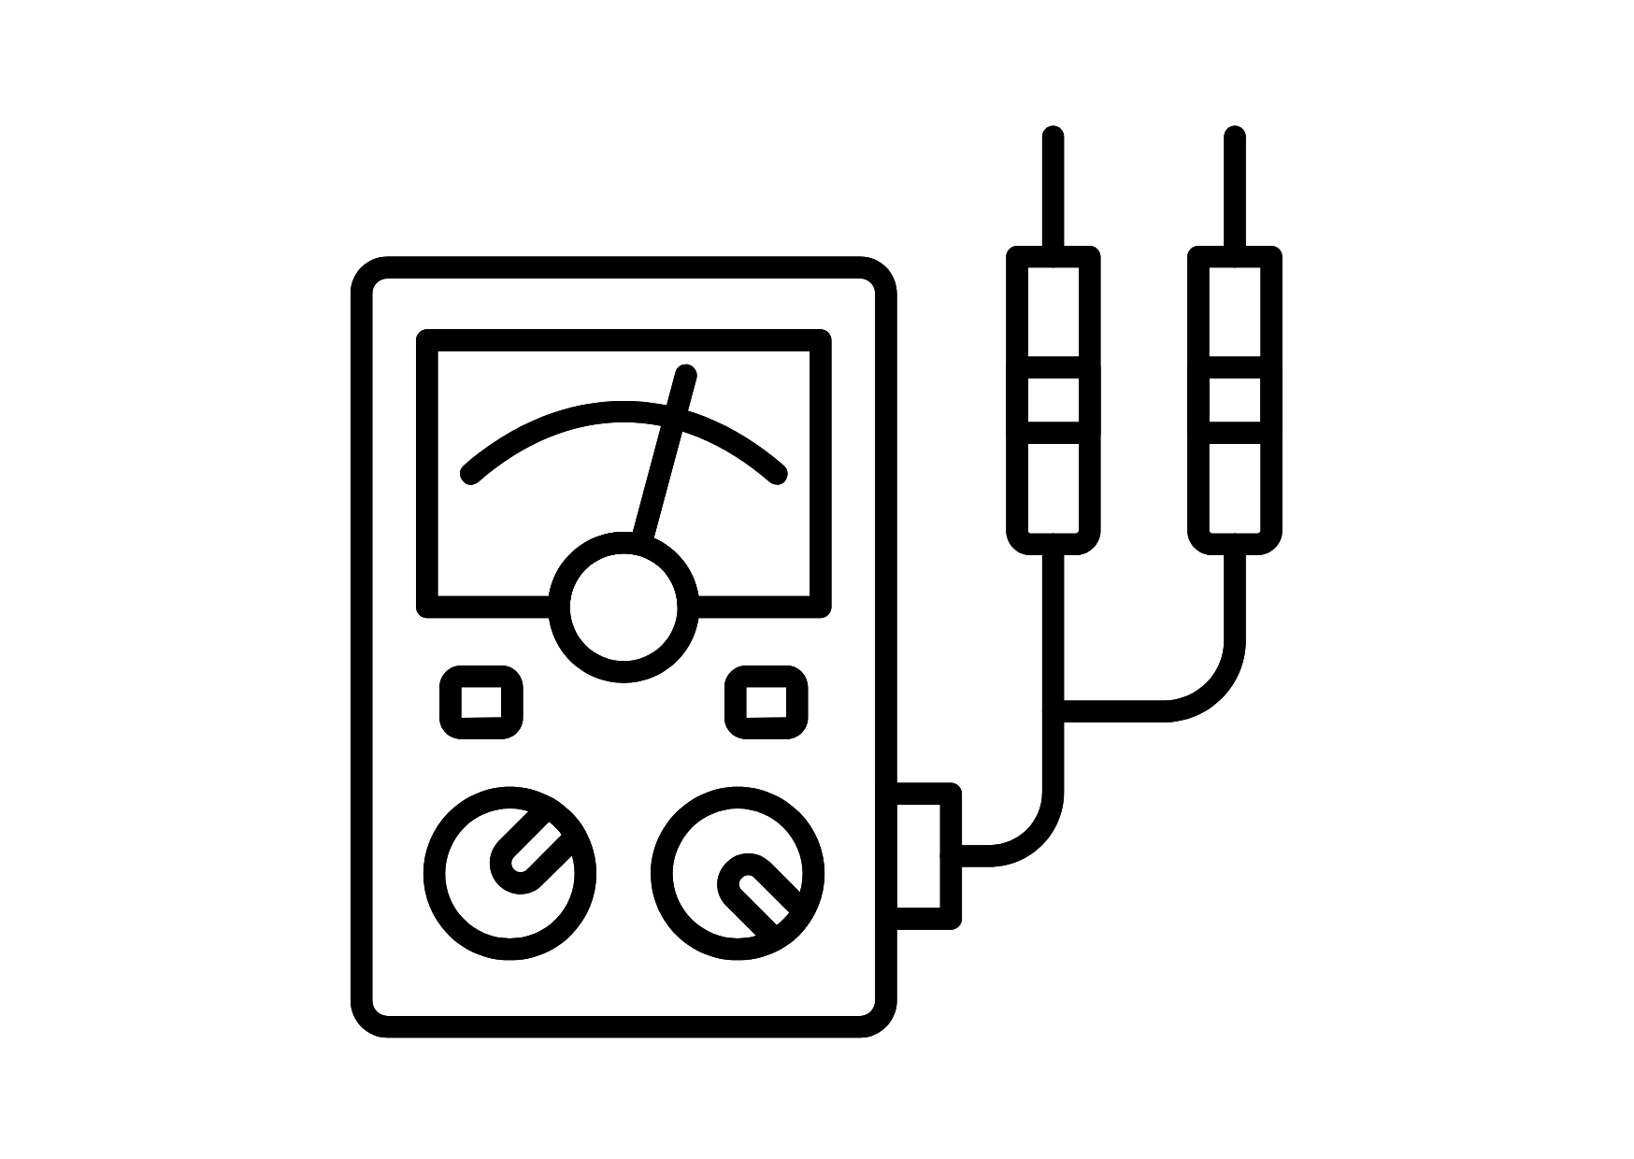

Diagnostics
Old School
  Sound
  Sight
  Feel
Instruments
  AMP/Voltage Meter
  Capacitance Meter
  Infrared Temp Gage
FM Managers Utopia
  No demand work – no chaos
  All work is planned
  No unexpected downtime

Slide 8
Review of No/Low-cost PM activities

Slide 9

It’s time for A Poll question

Slide 10

No/Low-cost PM Activities
Sound and Vibration
  Mechanical pumps
    Pump cavitation
Bearings
  High pitch
  Grinding
Contactors
  Chatter
Hard Start
  Compressors/motors
Feel
  Rise over ambient temperature
    Motors
    Blowers
    Breakers
  “Beer can cold”
  Use of thermal infrared gauge
Sight
  Clogged coils
  Leaking pump gaskets

Slide 11
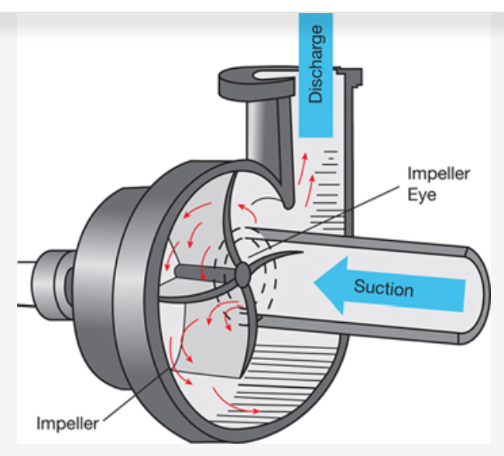
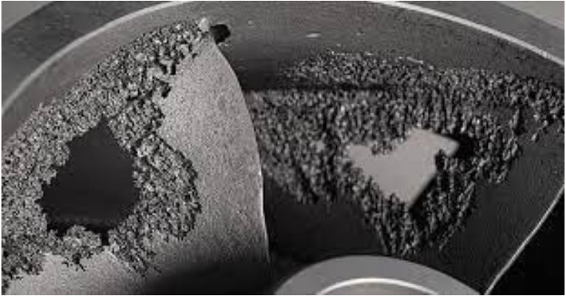
Pump Sounds
Pump Cavitation
  Liquid vaporizing
  Air leaking in on suction side of the pump

Slide 12
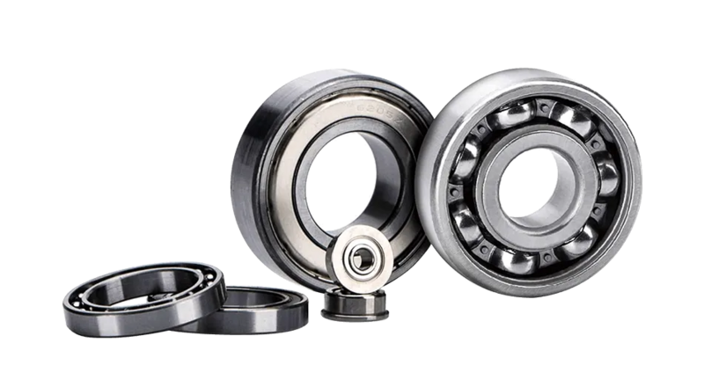
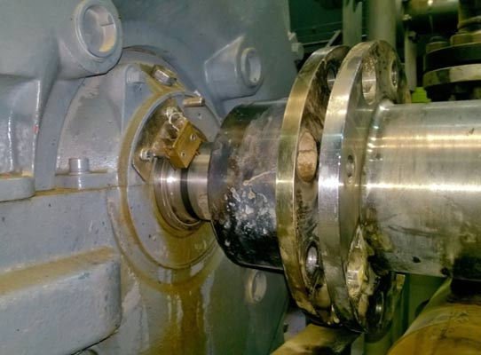
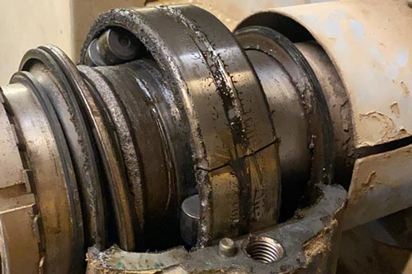
Bearing Sounds
From bearing failure $10.00 – high pitch
To housing and seal failure $300 to catastrophic $1K and up

Slide 13
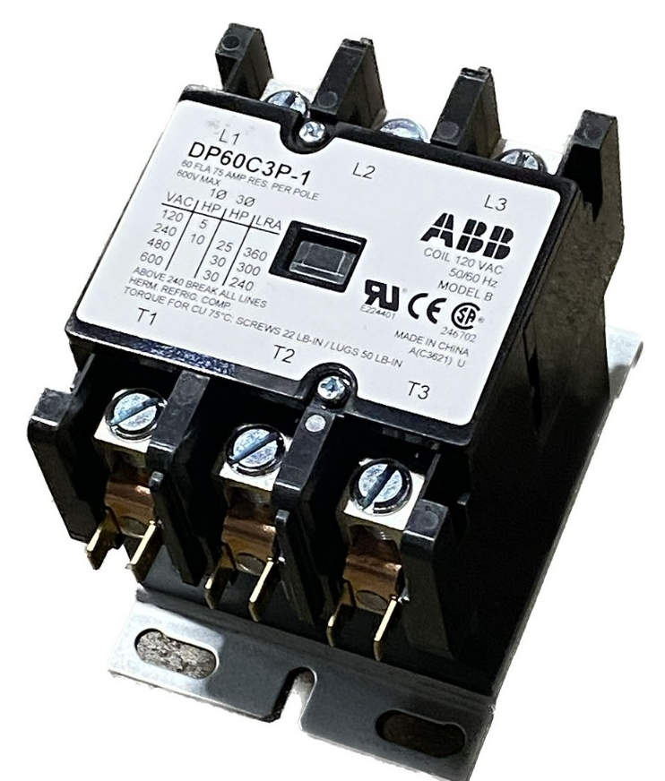
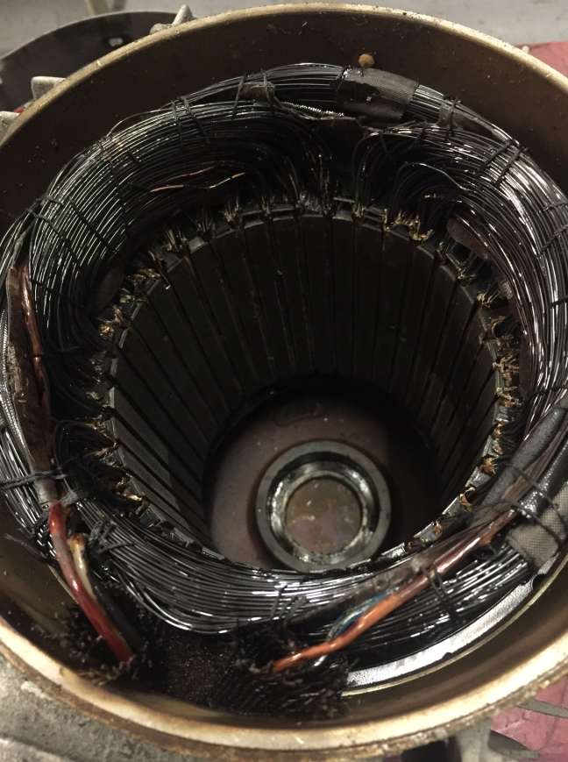
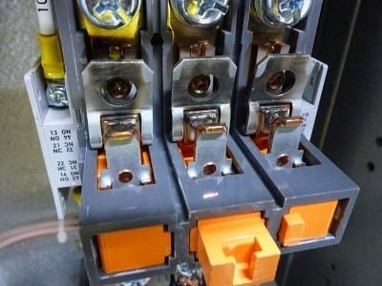
Electrical Sounds
Contactor chatter

Slide 14
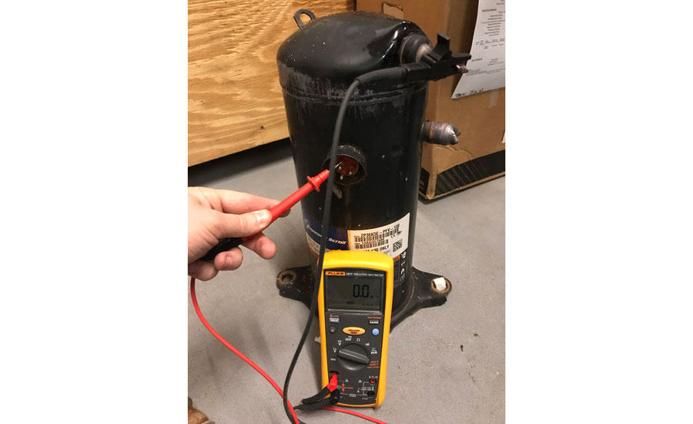
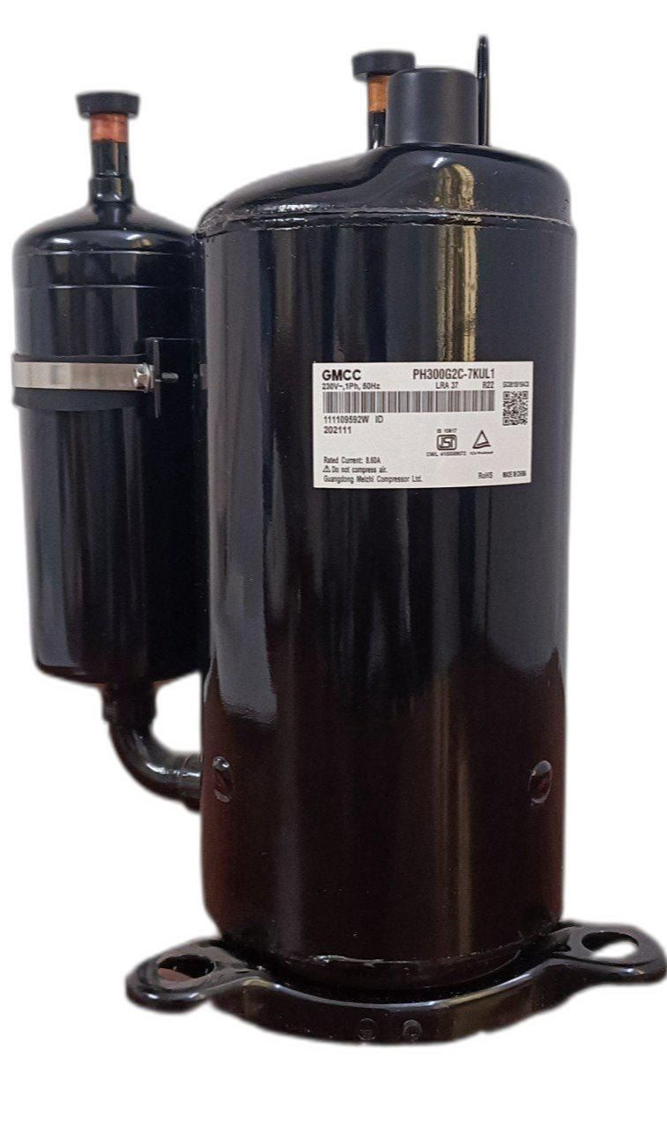
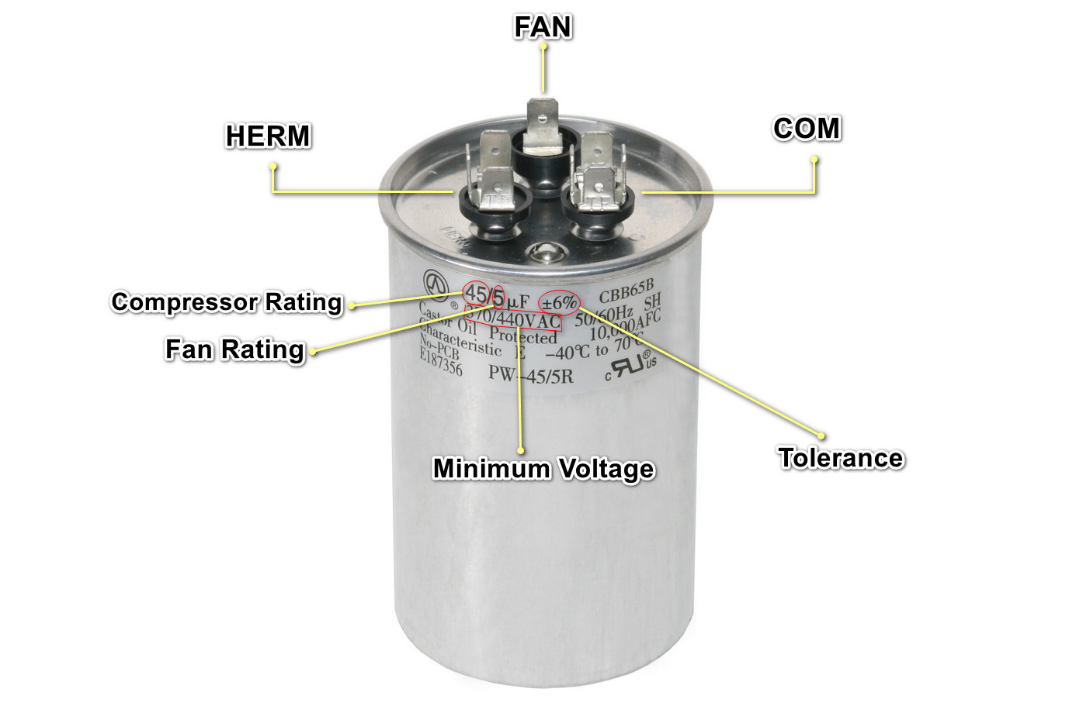
Compressor Failure Sounds
Hard start
Hunting
Stages
  Loading/unloading

Slide 15
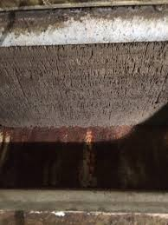
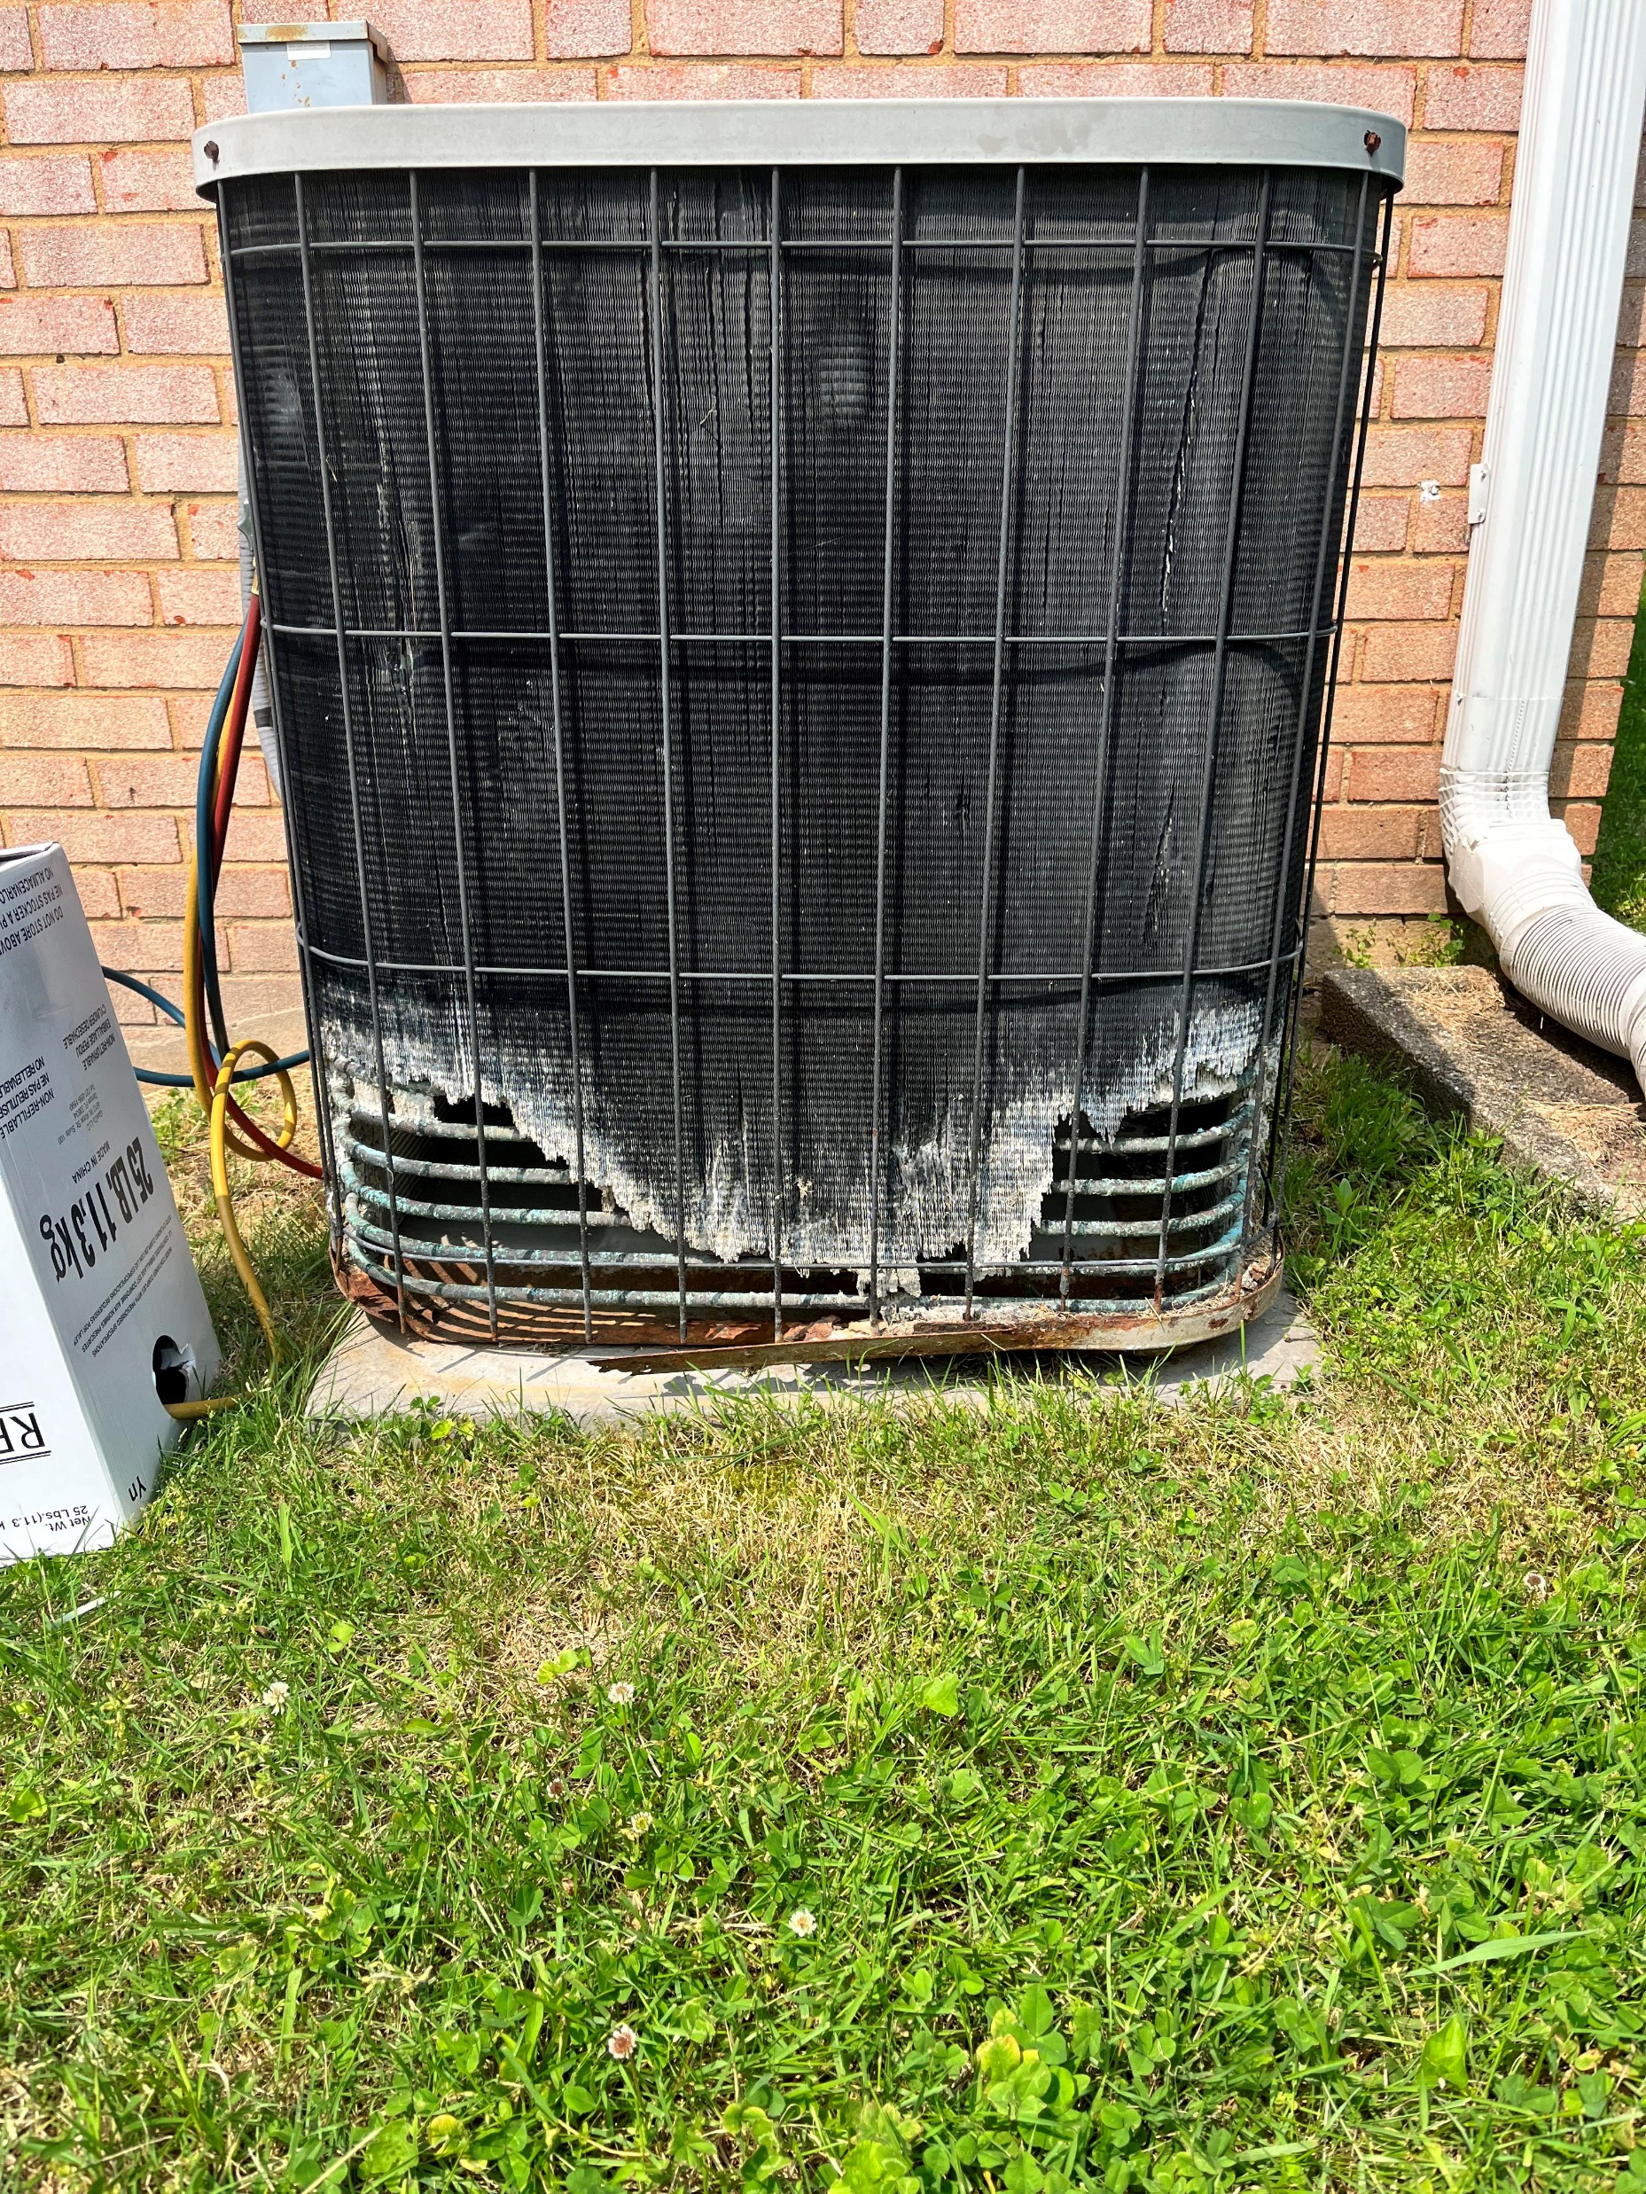
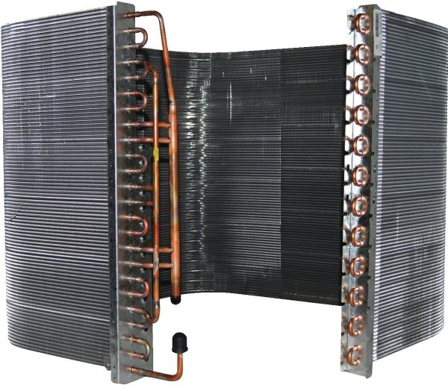
Sight – Condenser/Air Handler
Clean coil
Dirty coil
Rotted coil

Slide 16

Feel – Beer Can Cold
Temperature feel on vacuum
“Beer Can Cold”
Today’s equipment is much more critical with:
  EXV vs TXV
  Variable speed compressors

Slide 17
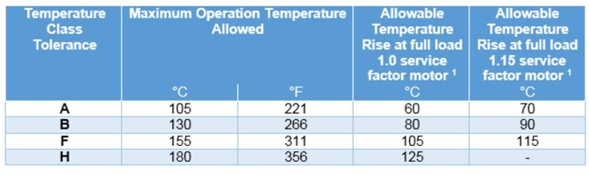
Feel – Motor Temperature
T(°F) = T(°C) + 32¹
Allowable temperature rises are based upon a reference ambient temperature of 40°C. Operation temperature is reference temperature + allowable temperature rise + allowance for “hot spot” winding.
Example. Temperature Tolerance Class F: 40°C + 105°C + 10°C = 155°C

Slide 18
It’s time for A Poll question

Slide 19

New School
AI for sound and vibration
IOT Sensors with links to your CMMS
  Temperature
  Current draw
  Pressure
  Run time vs calendar days
Almost anything you want to measure with limits can be tied to your:
  BMS integration with your CMMS
  Predictive diagnostics

Slide 20

Websites for Mechanical Noise Failures
https://www.youtube.com/watch?v=VB0c4pQFF1U
https://www.youtube.com/watch?v=X3BuTDYN9sQ
https://www.youtube.com/watch?v=lm-OgrRd3vM
https://www.youtube.com/watch?v=3sW14-QELUU
https://www.youtube.com/watch?v=DHEVTsI3dI0
https://www.youtube.com/watch?v=sp7s-V-XOCQ
https://www.youtube.com/watch?v=eMDAw0TXvUo

Slide 21

Comparisons
Run/start capacitor vs motor replacement
Gasket vs pump/impeller
Contactor vs motor/compressor
Breaker vs entire electrical panel

Slide 22
It’s time for A Poll question

Slide 23
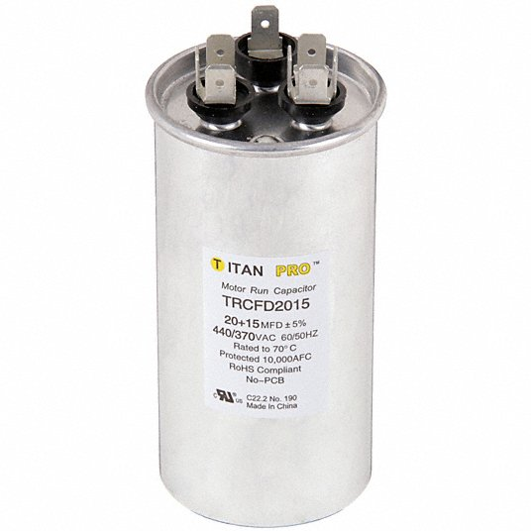
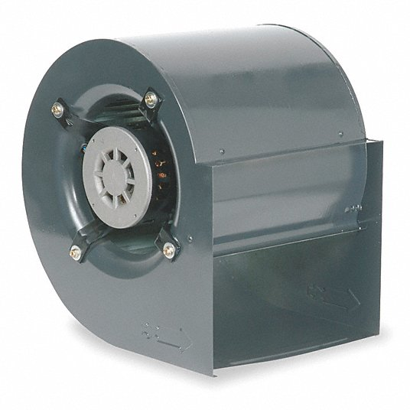
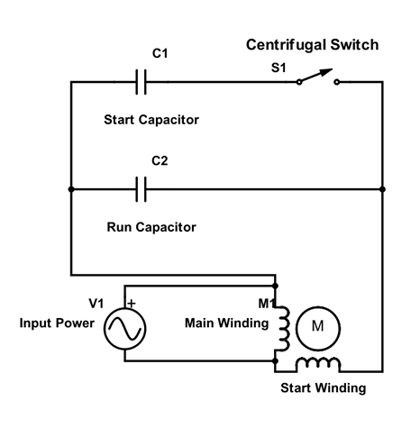
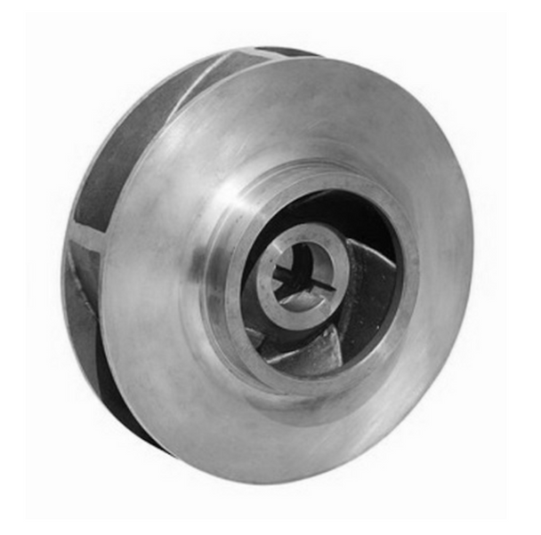
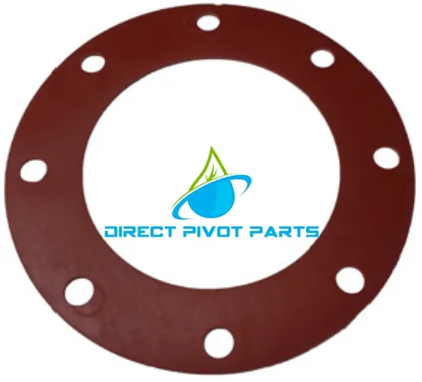
Comparison of Repair Costs
$20.00 +L Vs $850 + L
$75.00 +L Vs $570 + L

Slide 24

Storing and utilizing historical data

Slide 25

PM Data Tracking
Are you tracking data now?
Do you have trigger values/thresholds
  AMP draw
  Motor capacitor checks
  Infrared temperature recording
  Pressure gauges
  Pressure testing tools/HVAC

Slide 26

Data Trigger Points
Point where changeout is most cost-effective
Changeout is always before failure
Run till failure costs a lot more than preventative/predictive maintenance
Trigger justifies the expense

Slide 27

Reporting and using historical data to plan repairs

Slide 28

Tracking Data
CMMS
Admin Logs
Logs on the equipment

Slide 29

Predictive Maintenance Take-aways

Slide 30
Remember
Track and use the PM data to make repair plans vs. run to fail
Preventive diagnostics reduces the cost of maintaining the equipment
Know the capabilities of your CMMS – use it to manage
Schedule the must-do tasks, monitor the diagnostics, and produce a planned replacement budget – educate senior management
Know your capital repair plan and manage it!
Eliminate the daily chaos!

Slide 31

Q & A

Slide 32
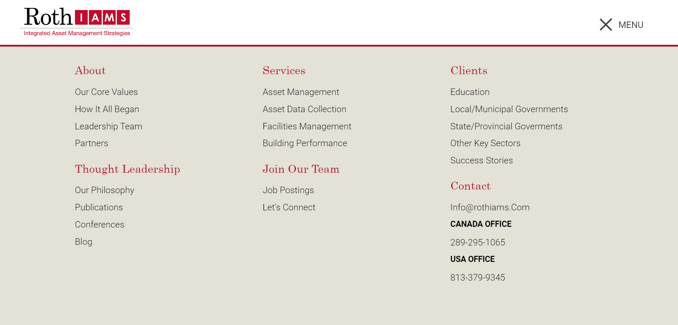

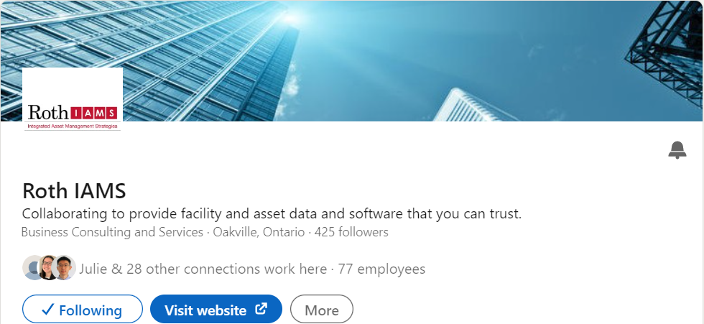
THANK YOU FOR ATTENDING!
Visit our website at rothiams.com
Follow us on LinkedIn
Connect with us directly through email at fmc@rothiams.com
Dive Into
Our Thought Leadership

