Slide 1
Understanding what you need – Accessibility Codes vs. Universal Design

Slide 2
introduction
Andrew Chow, P.Eng., M.Eng., CPI, RHFAC Professional Practice Leader - Accessibility, Senior Facility Assessor, Technical Reviewer, Roth IAMS
13 years of building condition assessment experience
10 years accessibility audit experience
Responsible for creating methodology and approach for accessibility audits at Roth IAMS
Rick Hansen Foundation Accessibility Certified
One of the primary assessors for IFAs

Slide 3
Agenda
Overview of Disabilities
Universal Design vs. Barrier -free
Design Guidelines
What do you Need
Minimum Requirements
Implementation

Slide 4
Overview of Disabilities
Image source: Pulrang, Andrew (2019). What Defines Members Of The “Disability Community?”
https://disabilitythinking.com/disabilitythinking/2019/9/15/cukmbl2x4k5eyvo2jj63lq9unifpwi

Slide 5
Overview of Disabilities
Oftentimes, we limit accessibility to wheelchair access only
We emphasize creating space for mobility
Image source: International Symbol of Access (ISA) and Modified ISA
https://en.wikipedia.org/wiki/International_Symbol_of_Access

Slide 6
Various Disabilities
Other disabilities to consider:
Vision
Hearing
Pain-related
Neurological
Image source: https://greatcareers.org/neurodiversity-in-the-workplace-and-international-day-of-persons-with-disabilities/
We must understand that there are a variety of disabilities that need to be addressed.

Slide 7
Various Disabilities
Some other “disabilities”
Injury or illness
Inconvenience
Images sources:
https://thumb.ac-illust.com/50/500adc118134e4074a7a90dbee34a771_t.jpeg
https://media.istockphoto.com/id/1332587533/vector/illustration-of-a-father-pushing-a-stroller.jpg?s=612x612&w=0&k=20&c=UrTa-QOH79XknEo_8RluSL3QjIMUuF52HI4qGI9ngLA=
Most likely, we will all be affected by a disability in our lifetime.

Slide 8
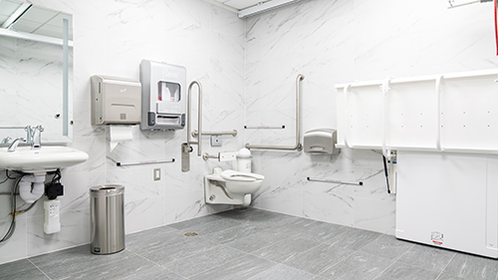
Typical Accessibility Planning
We often think that accessibility needs are limited to:
Seniors
Specific groups or requests
Image source: Hart House Universal Washroom
https://harthouse.ca/blog/hart-house-thanks-utsu-for-universal-washroom
Image source: Billable Services In THE HCS Program
https://twogetherconsulting.com/event/icaps-lons-idrcs-hcs-txhml-icf-2-3/?instance_id=2136

Slide 9
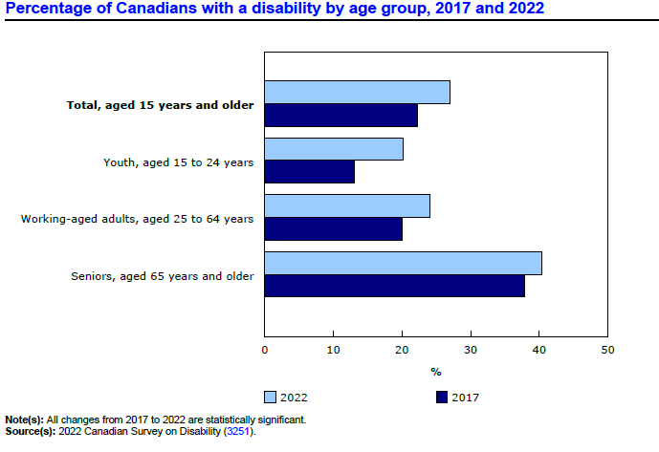
Demographics
According to Statistics Canada:
27% of Canadians have a disability (Approx. 8.0 million)¹
Youth (aged 15-24 years) experience the largest increase in disability rate (from 2017 to 2022)
A significant part of the population and a wide range of ages face challenges from disability.
1. Statistics Canada. Persons with and without disabilities aged 15 years and over, by age group and gender
https://www150.statcan.gc.ca/t1/tbl1/en/tv.action?pid=1310037401

Slide 10
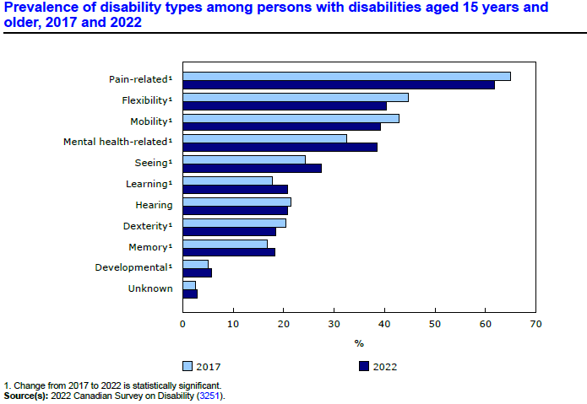
Demographics
According to Statistics Canada the
most common disabilities by age group:
Youth: Mental-health and learning
Working-age: Mental-health and pain-related
Seniors: Pain-related, mobility, and flexibility
We need a space to accommodate as many disabilities as possible.
Source: Canadian Survey on Disability, 2017 to 2022, The Daily, December 1, 2023 issue.

Slide 11
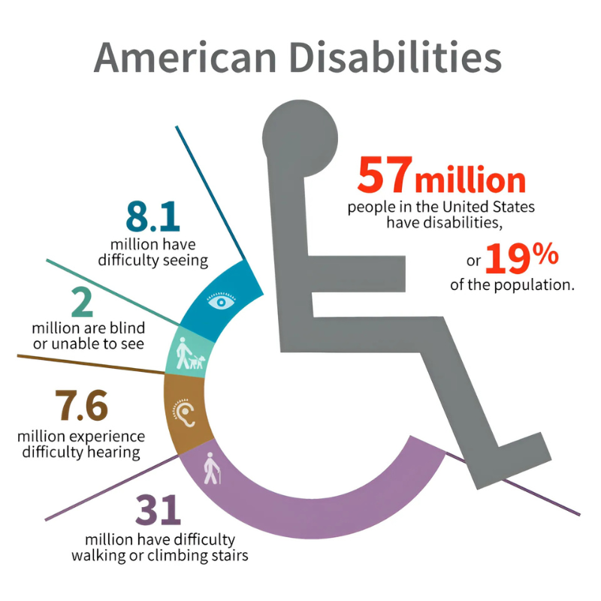
Major Life Activities that an average American can perform with little or no difficulty:
66
Walking
Speaking
Breathing
Seeing
Hearing
Learning
Sitting
Standing
Bending
Grasping
Remembering

Slide 12
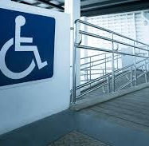
Universal Design vs. Barrier-free

Slide 13
Definitions
What is Barrier-free Access?
Dictionary
Design for those with physical or other disabilities, involving the provision of alternative means of access to steps (e.g. ramps and lifts (elevators) for those with mobility problems)
National Building Code/Ontario Building Code
Barrier-free means that a building and its facilities can be approached, entered, and used by persons with physical or sensory disabilities
Canadian Standards Association (CSA B651)
Accessible - as applied to a site, building, or other facility, possessing the necessary characteristics for it to be entered, exited, and used by people, including those with physical, sensory, or cognitive disabilities.

Slide 14
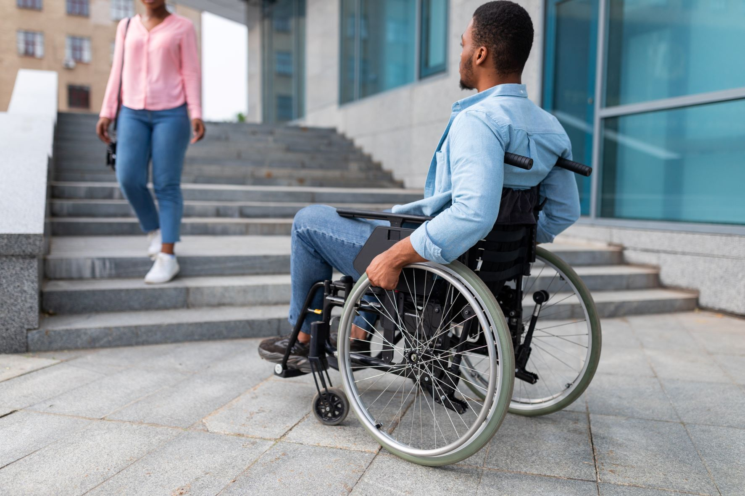
Objectives
Barrier-free
Remove barriers for people with disabilities, so that they may have access to and within a facility
ADA
Accessible Means of Egress. A continuous and unobstructed way of egress travel from any point in a building or facility that provides an accessible route to an area of refuge, a horizontal exit, or a public way.

Slide 15
Objectives
Universal Design
Universal design is defined as “the design of products and environments to be usable by all people, to the greatest extent possible, without the need for adaption or specialized design.”
(Ronald Mace, 1988).

Slide 16
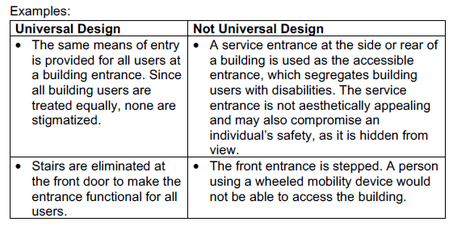
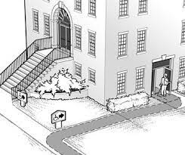
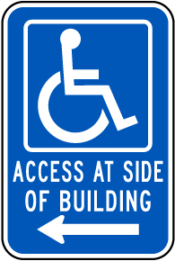
Background
Barrier-free Accessibility vs. Universal Design
Examples to Contrast “Barrier-free Accessibility” and “Universal Design”

Slide 17
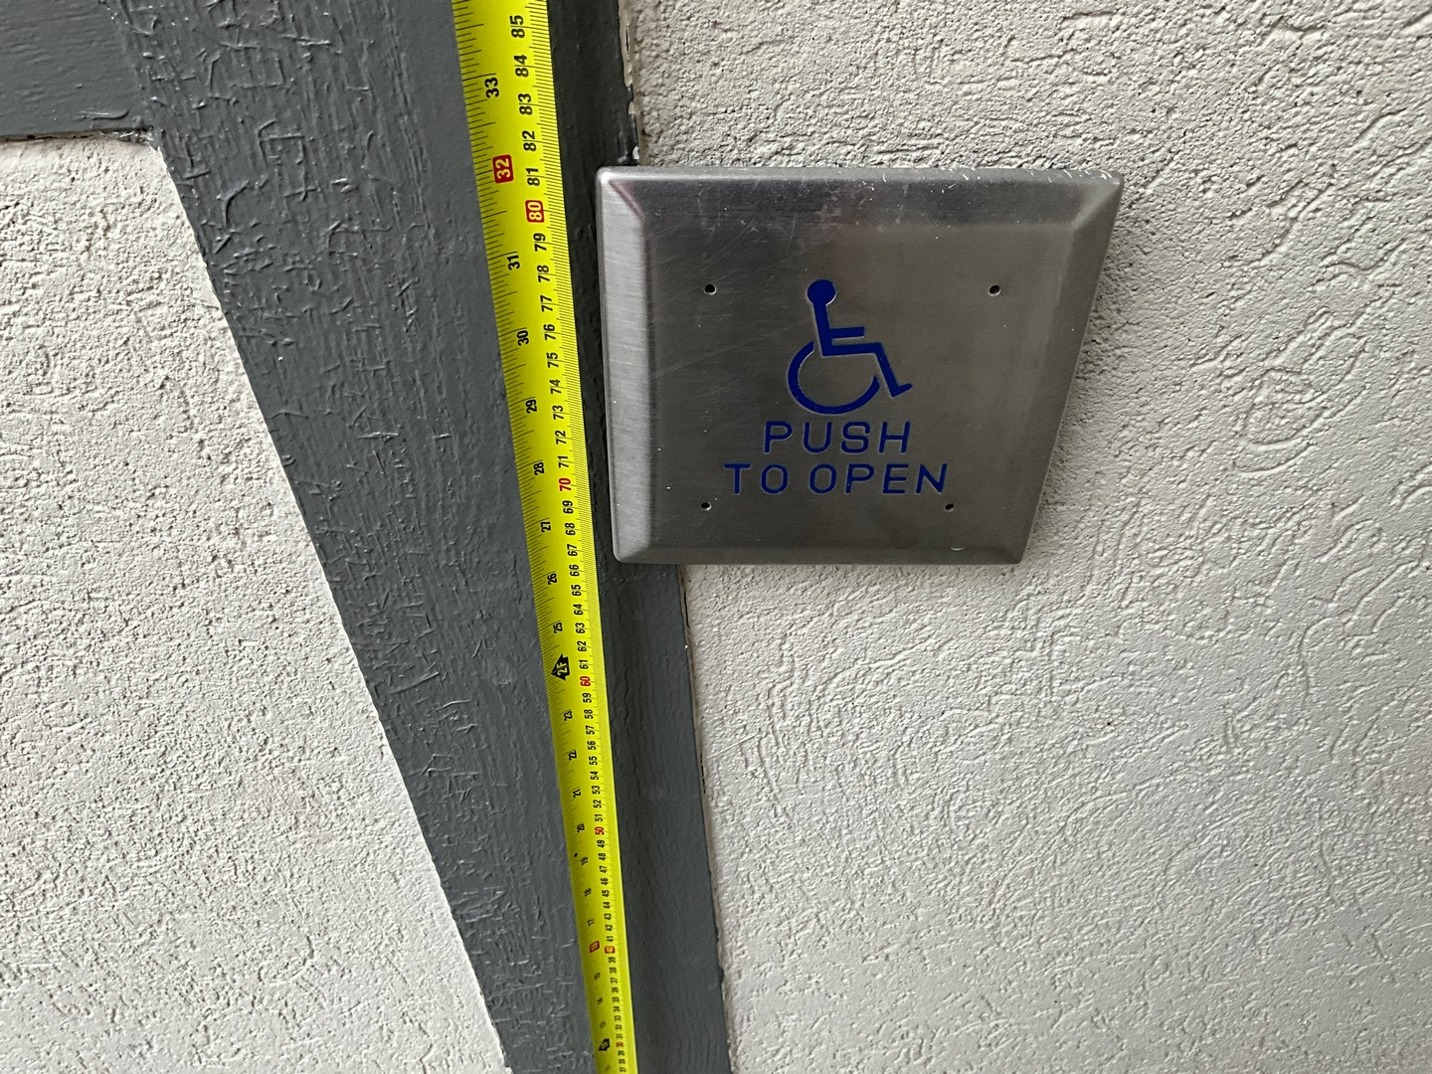
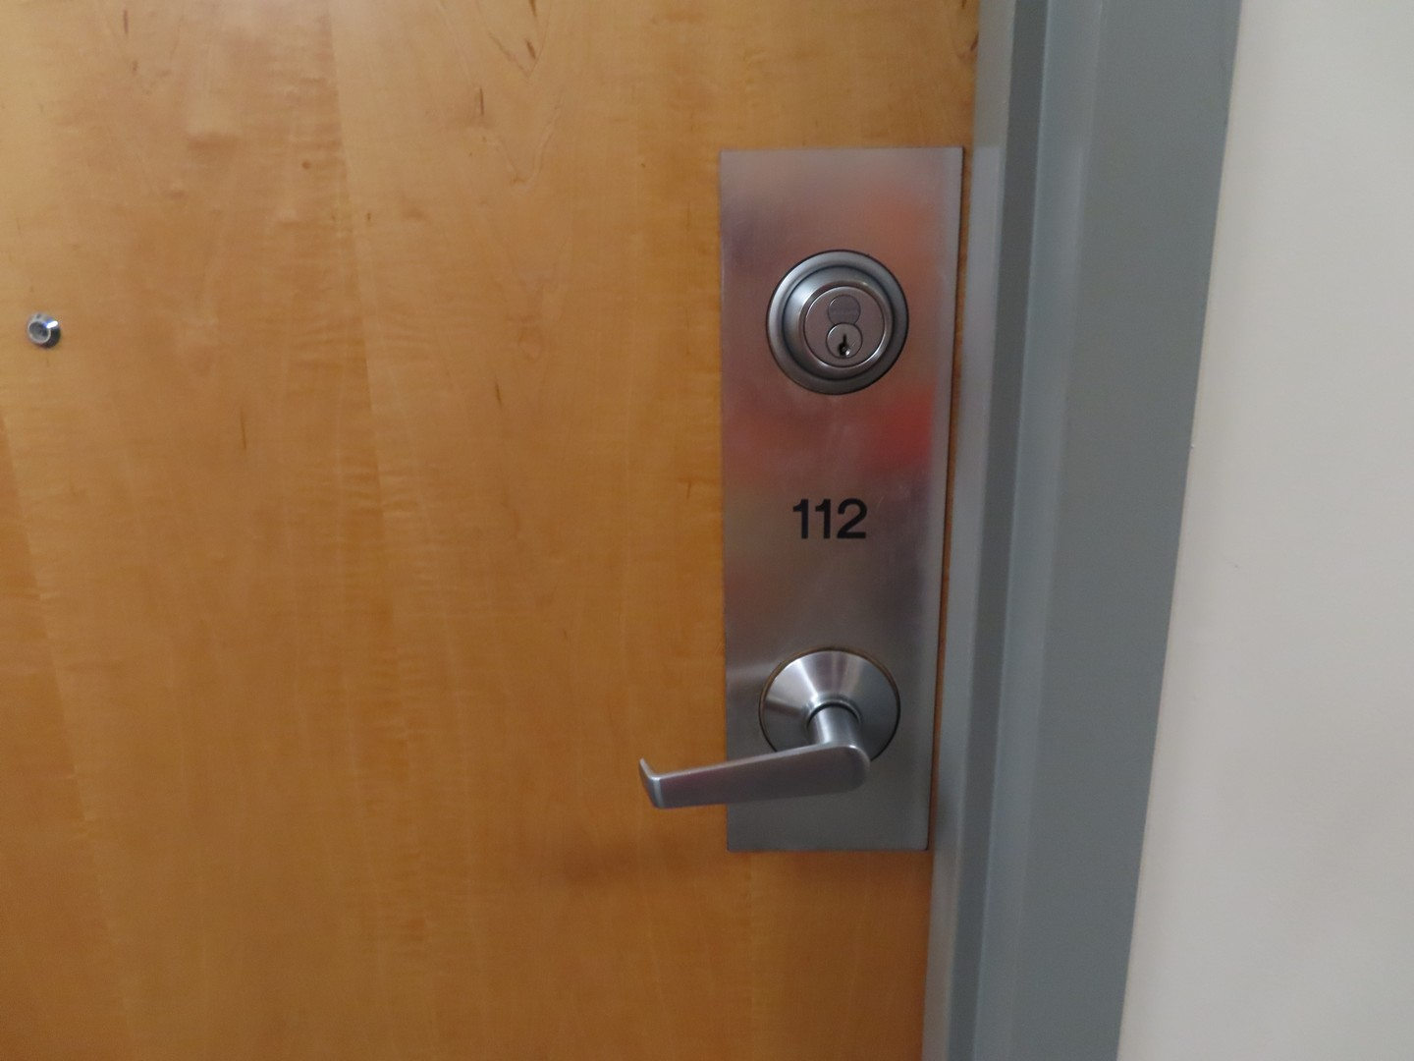
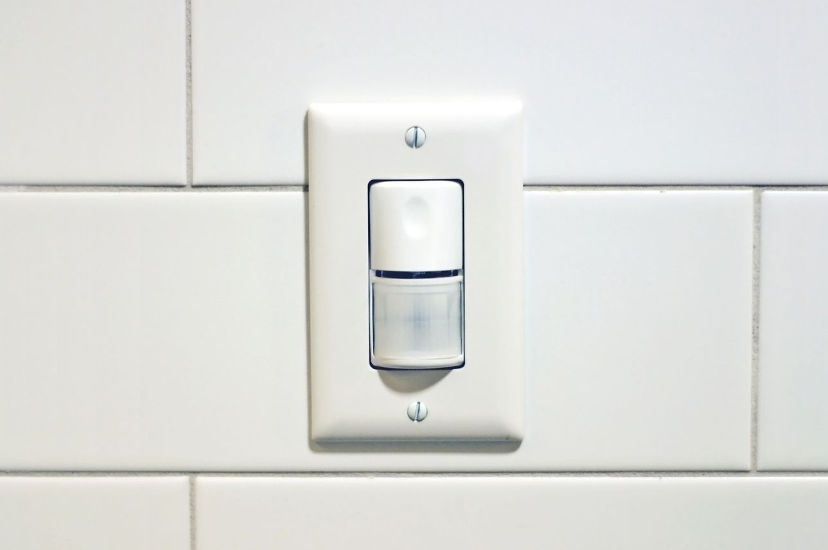
Background
Barrier-free Accessibility vs. Universal Design
Examples to Contrast “Barrier-free Accessibility” and “Universal Design”
Typical devices that all people use

Slide 18
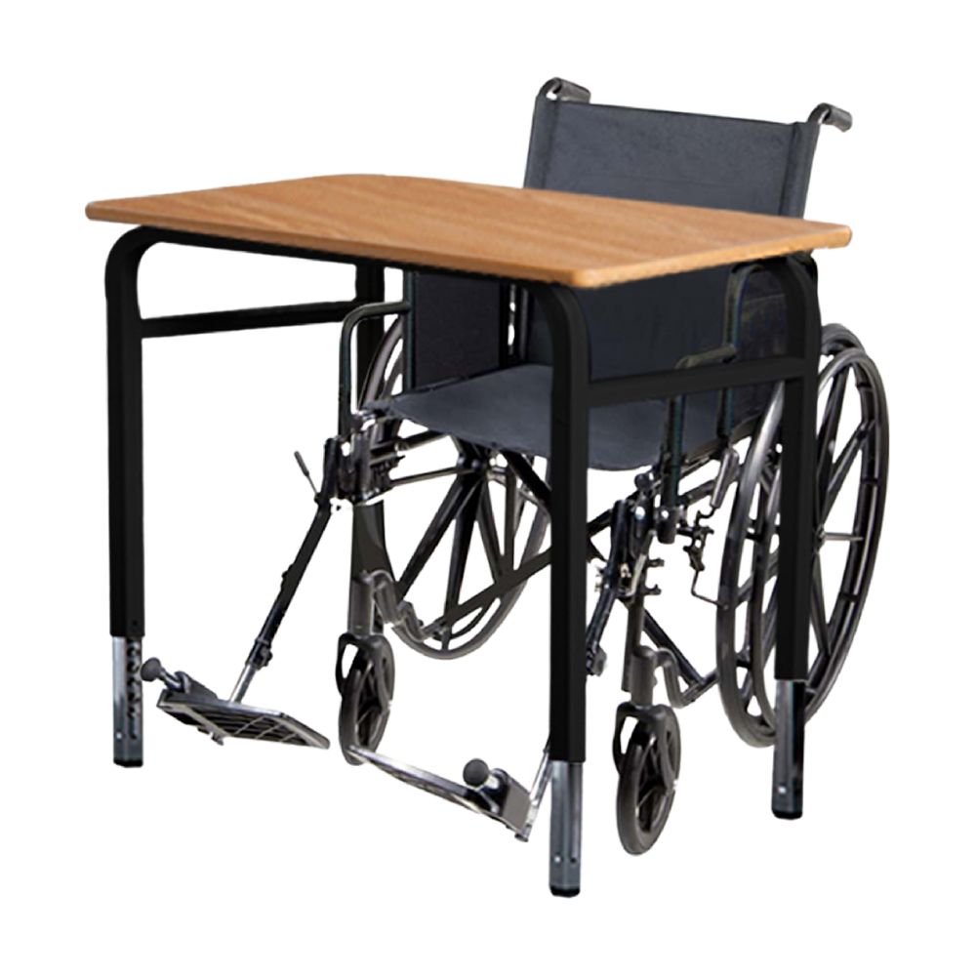
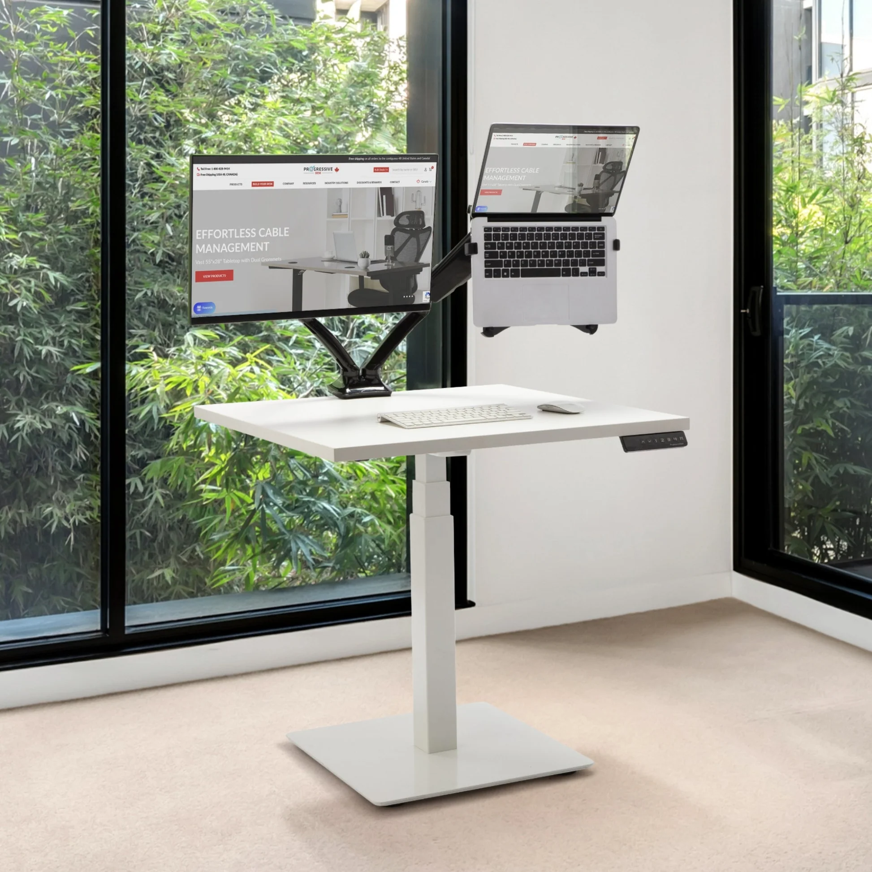
Background
Barrier-free Accessibility vs. Universal Design
Examples to Contrast “Barrier-free Accessibility” and “Universal Design”
Specifically for wheelchair users
Workstation with adjustable height

Slide 19
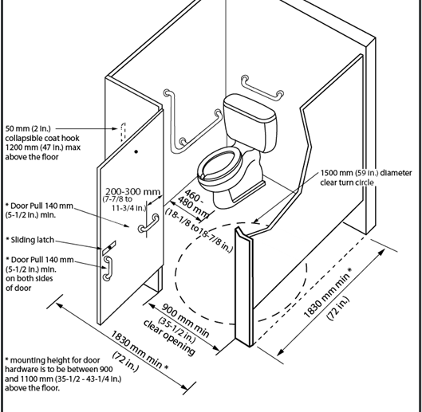
Accessibility Design Standards
Legislation & Guidelines

Slide 20
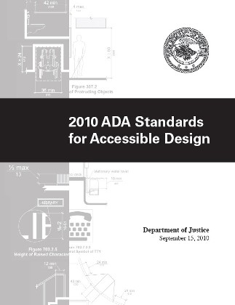
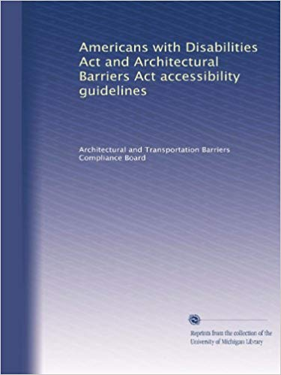
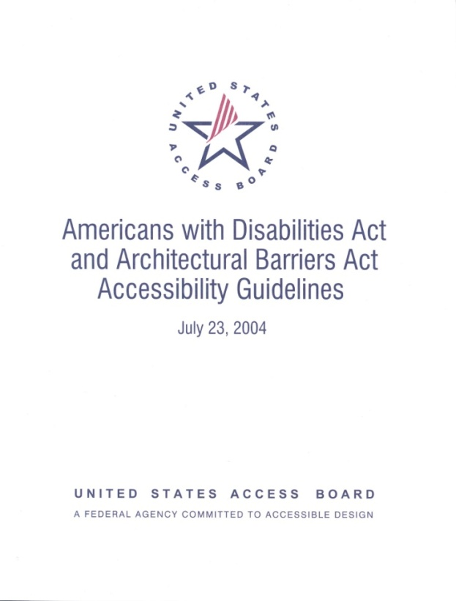
US Federal regulations

Slide 21
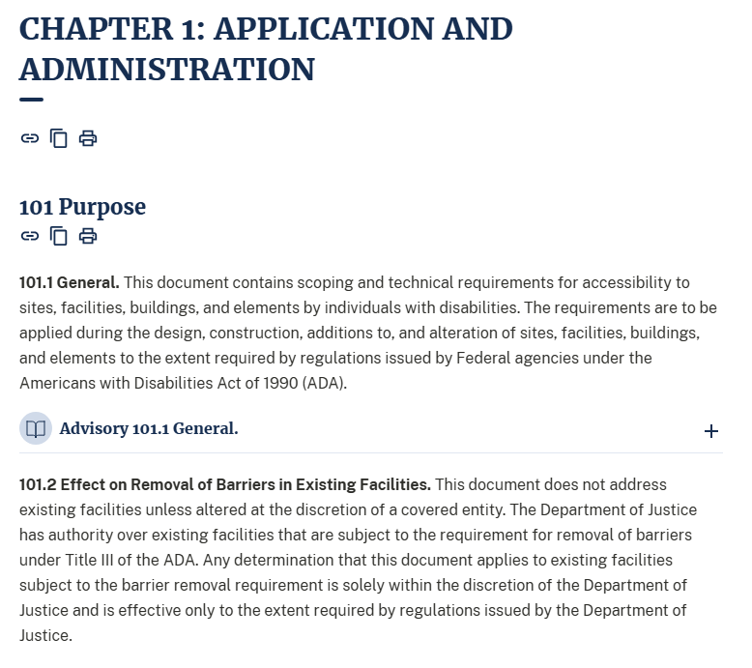
ADA Design Guidelines

Slide 22
ADA Design Guidelines

Slide 23
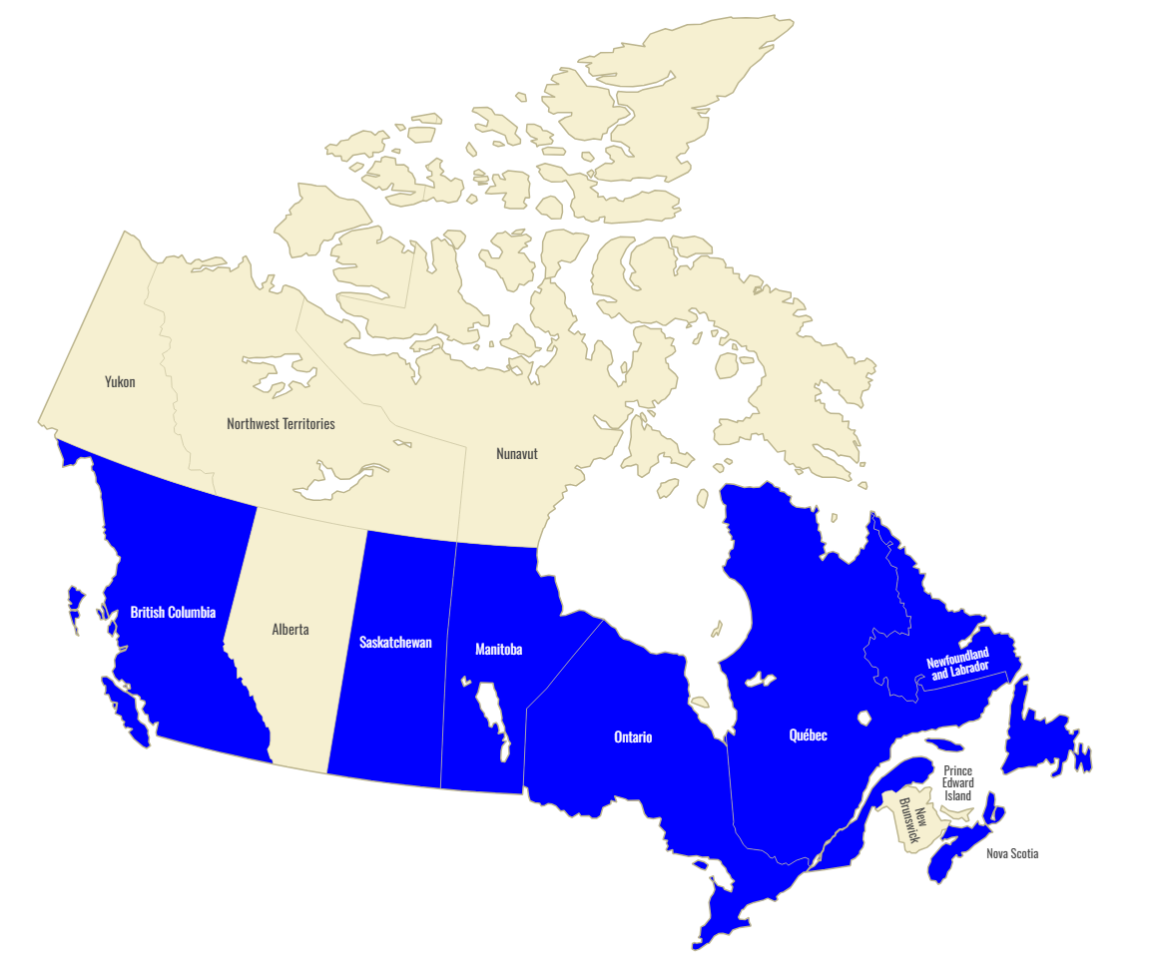
Canadian Regulations
Provinces in blue have accessibility acts
There is a federal accessibility act, but it is for federally-owned buildings

Slide 24
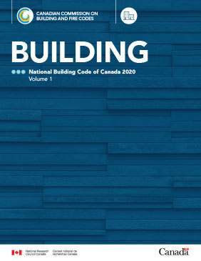
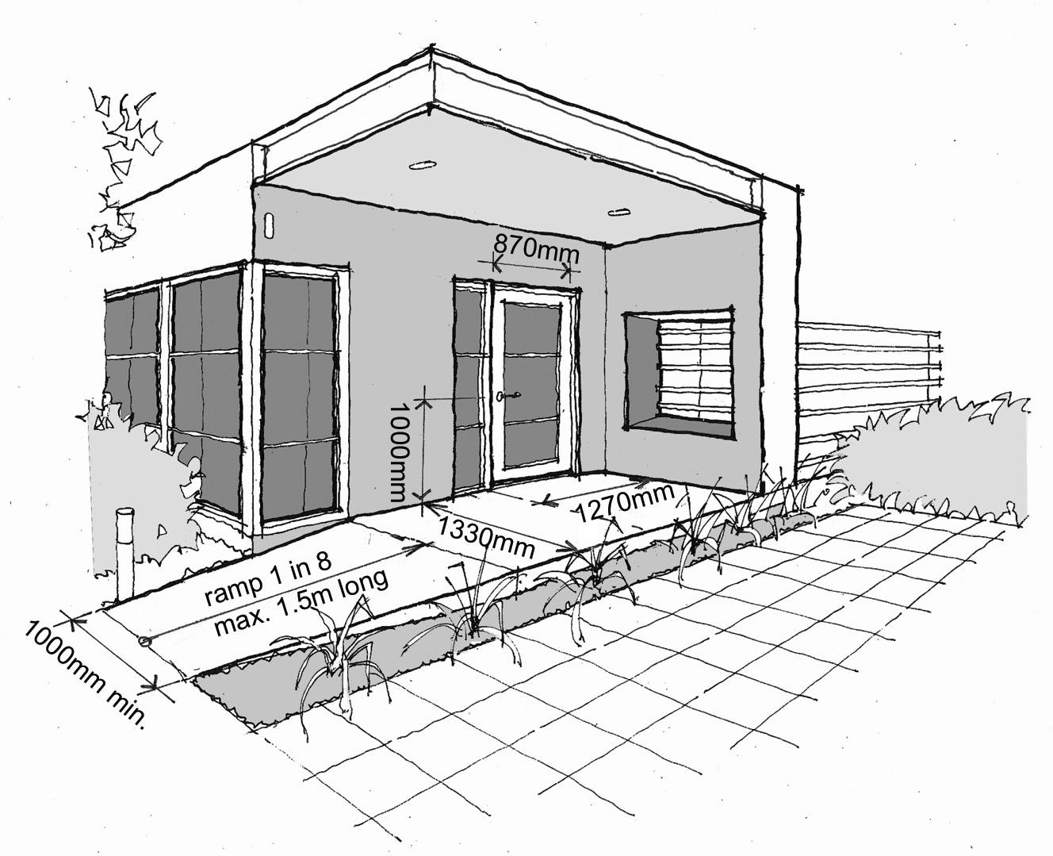
Canadian Regulations

Slide 25
Codes & Guidelines
City of London Facility Accessibility Design Standards
In 2007, the City of London published a Facility Accessibility Design Standard (FADS)
Applied to City-owned, leased, and operated buildings that were newly constructed and/or renovated
The intent of the FADS was to incorporate universal design
The FADS generally has more stringent requirements compared to the code
The scope of elements is more broader than the OBC/IASR.
Examples of elements not covered in the code, but in the FADS:
Rooms: Meeting Rooms, Cafeterias, Classrooms, etc.
Facilities: Fire Stations, Police Stations, etc.

Slide 26
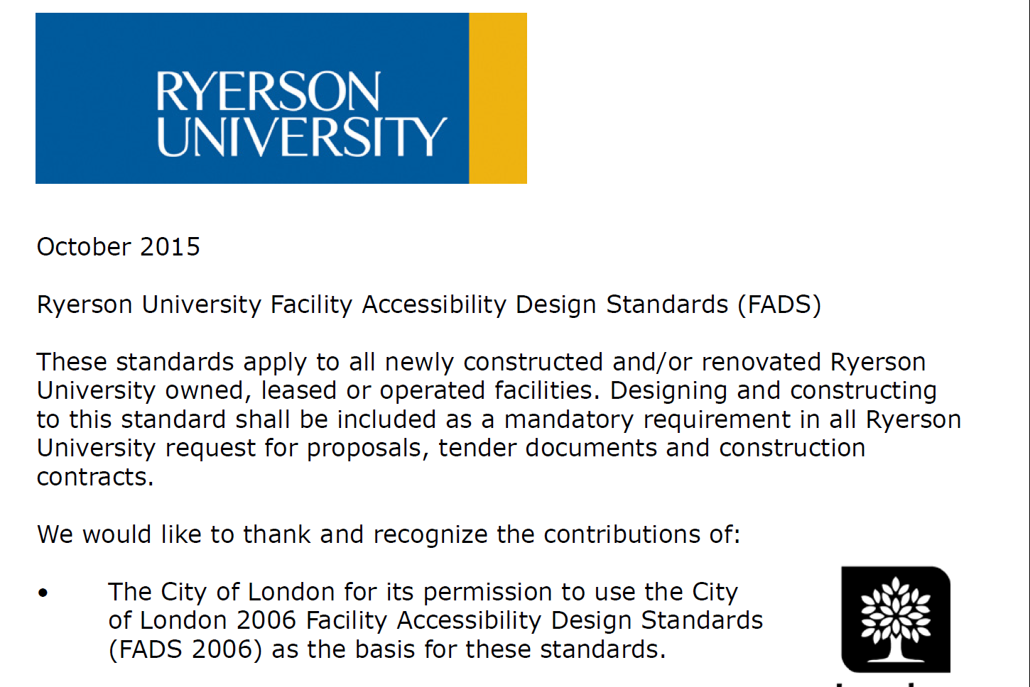
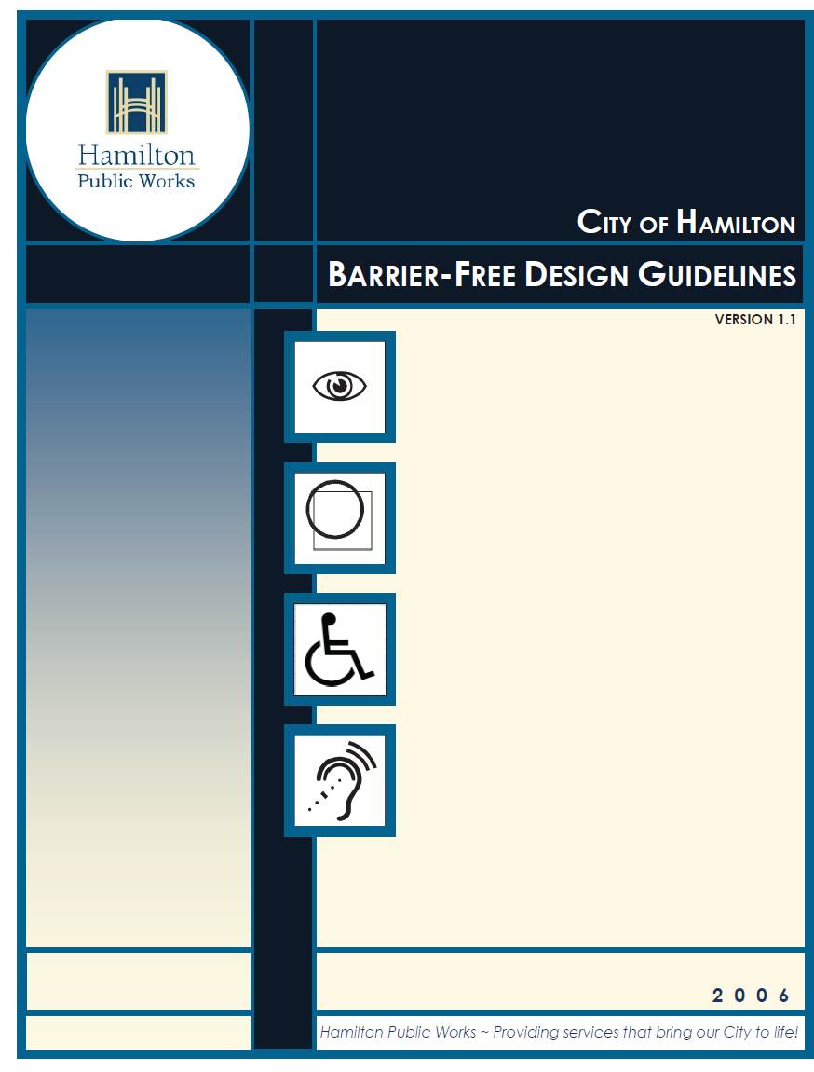
Codes & Guidelines
City of London Facility Accessibility Design Standards
Many FADS of other organizations are based on the City of London FADS. Examples:
Brock University FADS
Ryerson University FADS
City of Hamilton FADS
In recent years, it appears various municipalities and organizations have developed their own FADS
City of London recently published a new version of FADS in 2021

Slide 27
Codes & Guidelines
Canadian Standards Association
Canadian Standards Association also has a design guideline
CSA B651-23 Accessible Design for the Building Environment
CSA also generally has a broader scope than OBC
However, CSA is not necessarily more stringent than code
CSA also has standards for elevating devices (CSA B355 & CSA B44). These are referenced by the OBC
CSA is main reference document for some organizations
Rick Hansen Foundation
Canadian Mortgage & Housing Corporation (CMHC)

Slide 28
Minimum Requirements

Slide 29
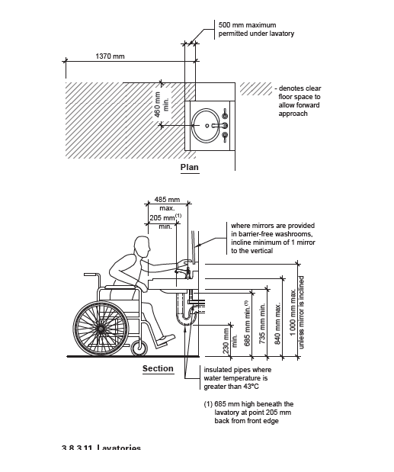
What Requirements Are to be met & How
Building codes and regulated design guidelines provide:
The building elements that need to be improved
The parameters or design specifications of the building elements
Keep in mind – Following regulations is required
Even when using design guidelines “better” than building code, ensure that building code requirements are met
Image source: Boyko, Anthony and Steven Penna (2014). Illustrated Code Series Barrier-free Requirements. Published by Orderline.

Slide 30
Understanding Legislative Requirements
Knowing the legislative requirements that apply in your jurisdiction is essential
Refer to the building codes, barrier-free design standards, etc., that are applicable under the legislation (e.g. Accessibility for Ontarians with Disabilities Act, Americans with Disabilities Act, etc.)
Before space planning, understand:
When improvements are required
What improvements are required
How improvements are to be made
Image source: Disability. Wikipedia
https://en.wikipedia.org/wiki/Disability

Slide 31
What do You need?
Determine Organizational needs

Slide 32
Organizational Needs
Objectives
Barrier-free or universal design
Standards to meet
Consider: feasibility of improvements
Demographics
Age
Roles (office workers, students, etc.)
Existing disabilities (mobility, sensory, etc.)

Slide 33
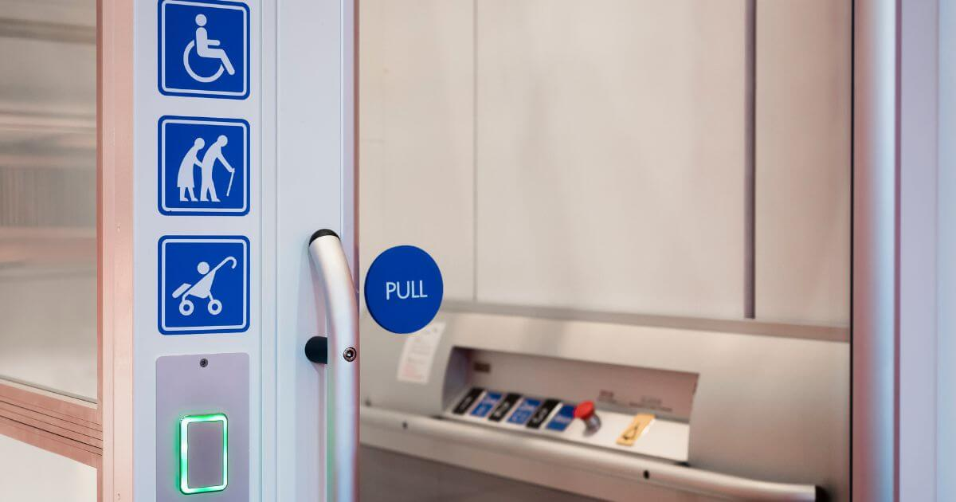
Organizational needs
Universal Design vs. Barrier-free
Universal Design approach is most inclusive and applies to a broad range of users
Universal design may not be feasible (e.g. provide accessibility at an elevated main entrance)
May not be financially or physically feasible to improve all elements in universal design

Slide 34
Organizational needs
Finance
Key hindrance in implementing improvements is the lack of funding
Some improvements are not financially feasible (e.g. improvements requiring structural changes)
May not have sufficient funding to address all universal design requirements
Need to target specific types of improvements

Slide 35
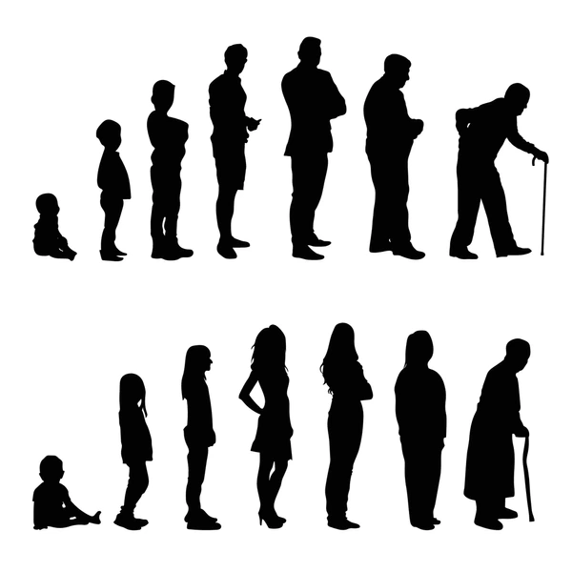
Organizational needs
Demographics
Age
If the range of facility occupants is wide, universal design may be best
If the demographics are narrow (e.g. school, seniors residence), recommend targeted improvements
(e.g. install door handles, automatic door openers)

Slide 36
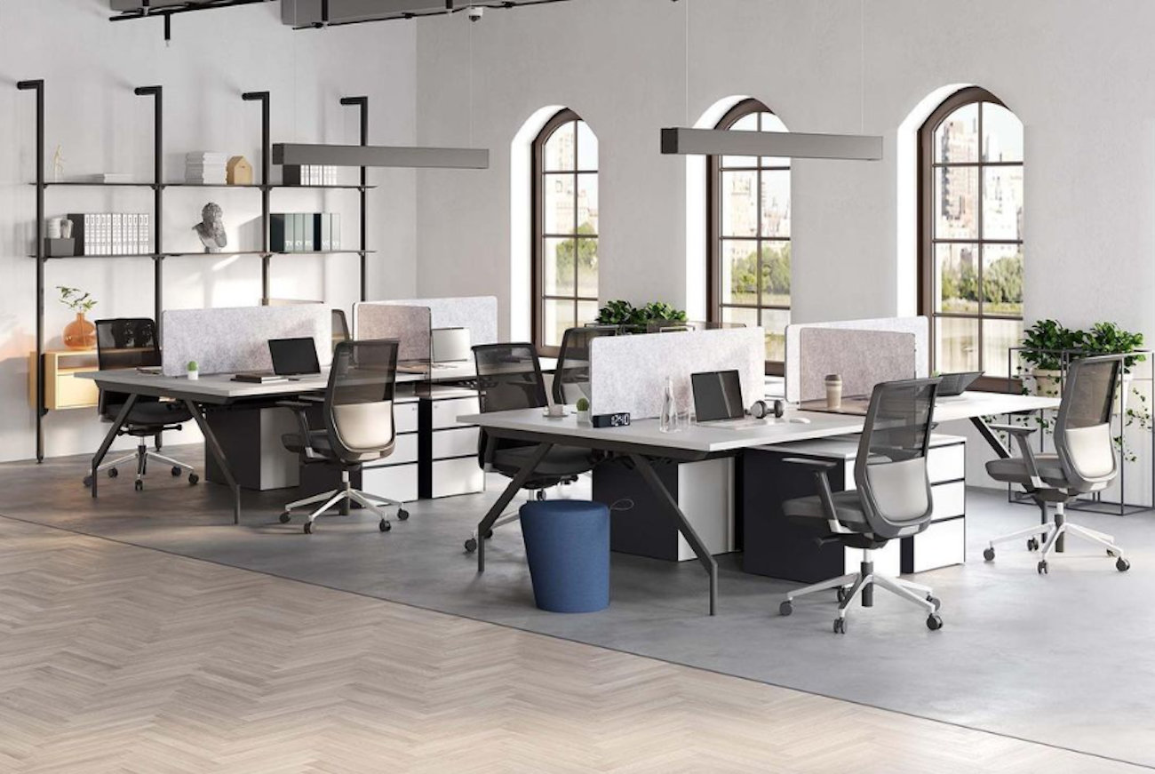
Organizational needs
Demographics
Roles
Determine what roles or positions occupy the space
Office spaces may need more adjustable workspaces, service counters, etc.
Schools may require a sensory room and accessible washrooms
Specific Disabilities
Your facility may have immediate/current needs to be addressed

Slide 37
Choosing the assessment type
Types of Assessments to evaluate your Facilities

Slide 38
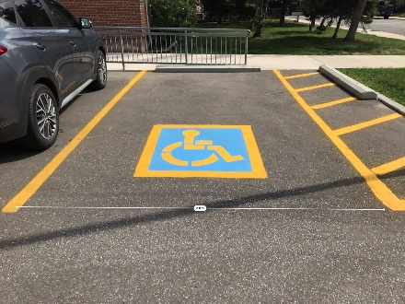
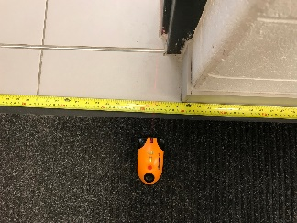
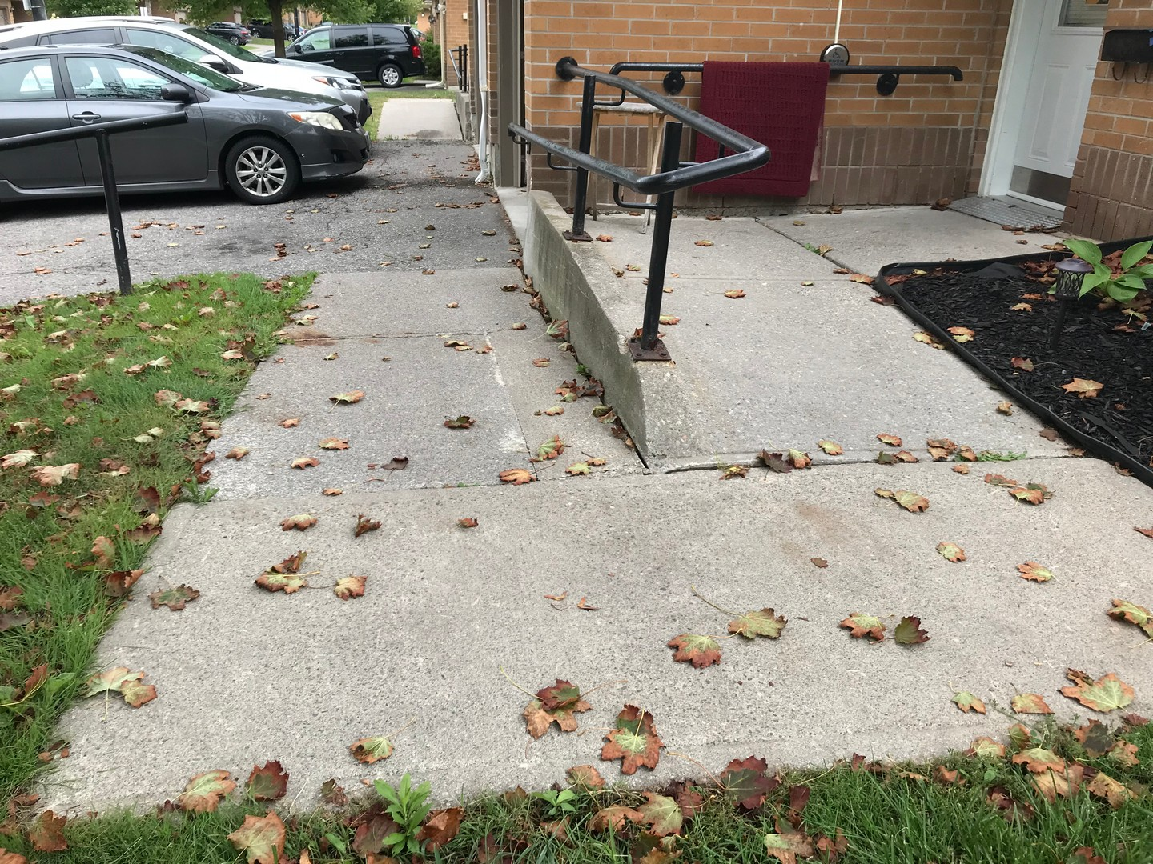
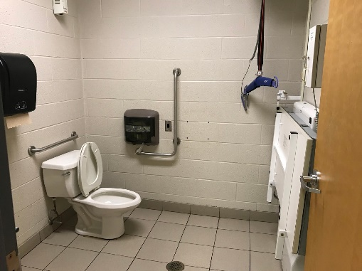
Accessibility Assessments
Barriers can be identified in several ways:
Baseline Screening Accessibility Checklist
Comprehensive Accessibility Audit
Rick Hansen Foundation Accessibility Certification Survey
Choose the audit based on your organization’s needs
Things to consider:
High-level or in-depth analysis
Number of assets
Timelines

Slide 39
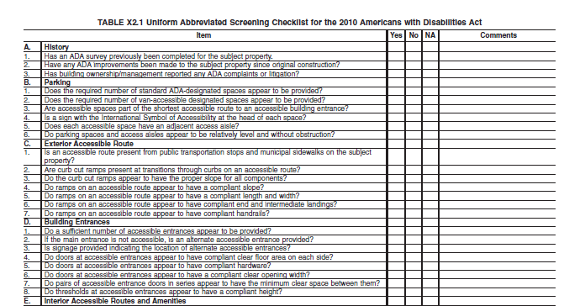
Baseline Screening Checklist
High-level checklist
Barriers evaluated mainly based on observation (i.e. no measurements)
Ideal for:
Quick evaluation of the building/site
General understanding of accessibility in a large portfolio of assets
Evaluation is not definitive or conclusive
Baseline checklist can be customized based on needs

Slide 40
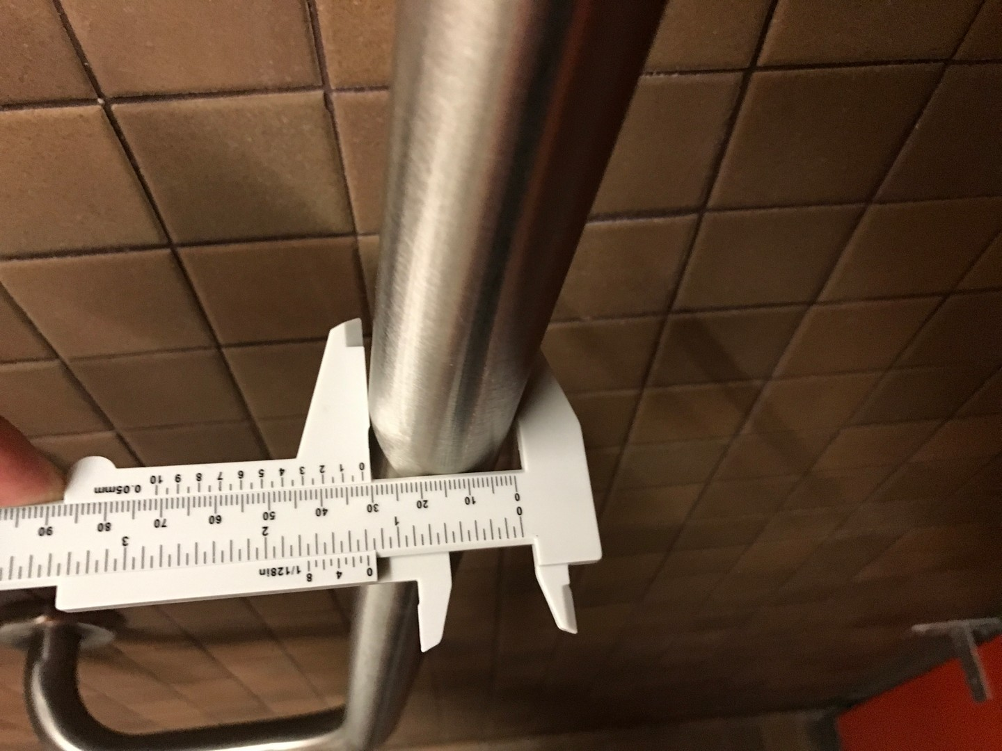
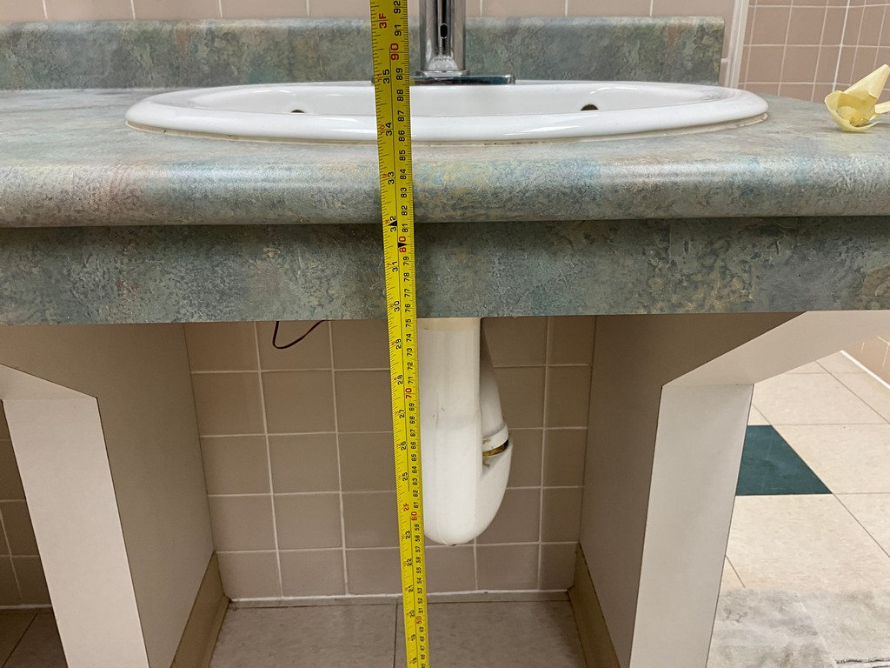
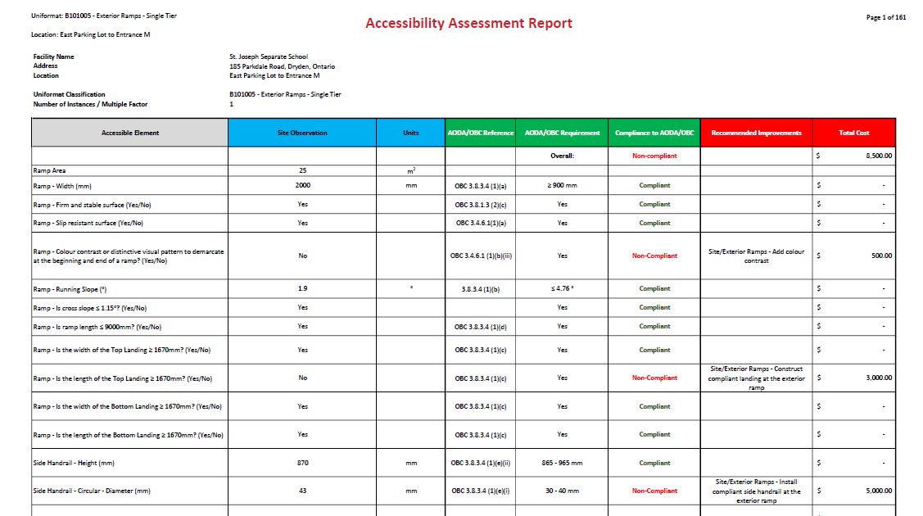
Comprehensive Accessibility Audit
Detailed audit that compares the parameters of a barrier with OBC/IASR
Optional inclusion of FADS
Comprehensive audit evaluates compliance to the code or design guideline line-by-line
Ideal for:
Confirmation of compliance to code/guideline
Identifying specific areas requiring improvement

Slide 41
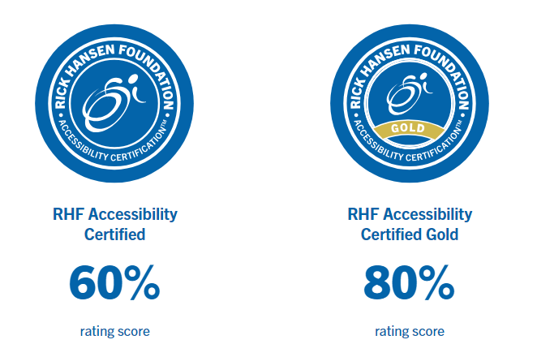
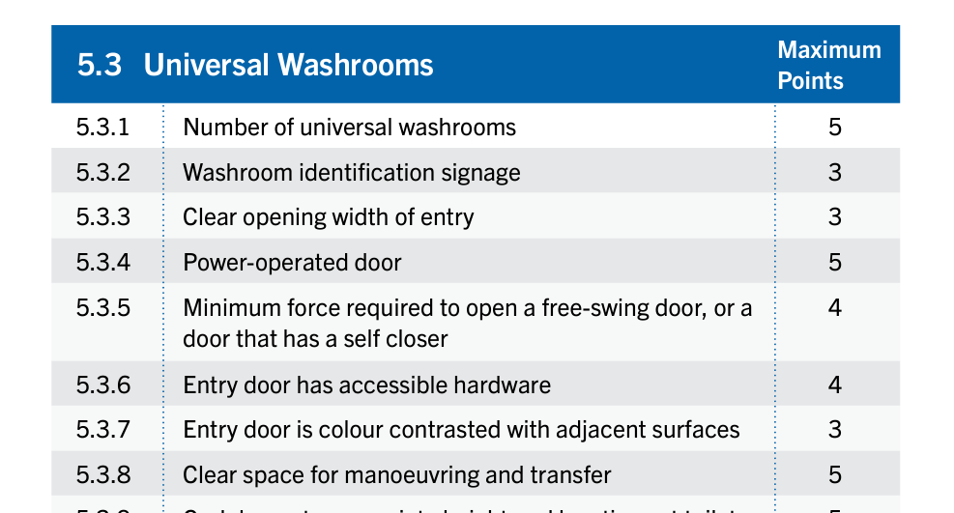
Rick Hansen Survey
Similar to a comprehensive audit, but using the Rick Hansen Rating Survey / Scoring System
Ideal for:
Promoting a particular asset (i.e. town hall)
Comparing levels of meaningful access between various assets
Note: The Survey does not specifically address guidelines based on code

Slide 42
Rick Hansen Foundation Accessibility Certification (RHFAC)
The Rick Hansen Foundation (RHF) has developed a rating system to measure a building or site’s “accessibility”
The focus is on meaningful access / universal design
Ratings are determined by meeting criteria in the Rick Hansen Survey, which is primarily based on standards developed by CSA (Canadian Standards Association)
Ratings can be showcased on the RHF’s Registry
Rating survey must be completed by a RHFAC Professional to receive certification
Reference:
https://www.rickhansen.com/become-accessible/rating-certification

Slide 43
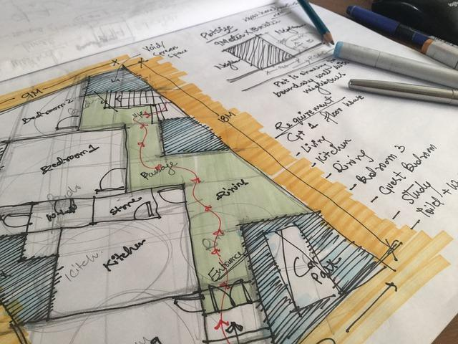
remember
Before improving your existing facilities:
Determine the objectives of your organization (universal design vs. barrier-free)
Understand the requirements of local jurisdiction (federal, provincial, municipal, organizational)
Choose a desired barrier-free design guideline including building code to evaluate the space
Assess the existing facilities (detailed assessment recommended)

Slide 44
Q & A

Slide 45
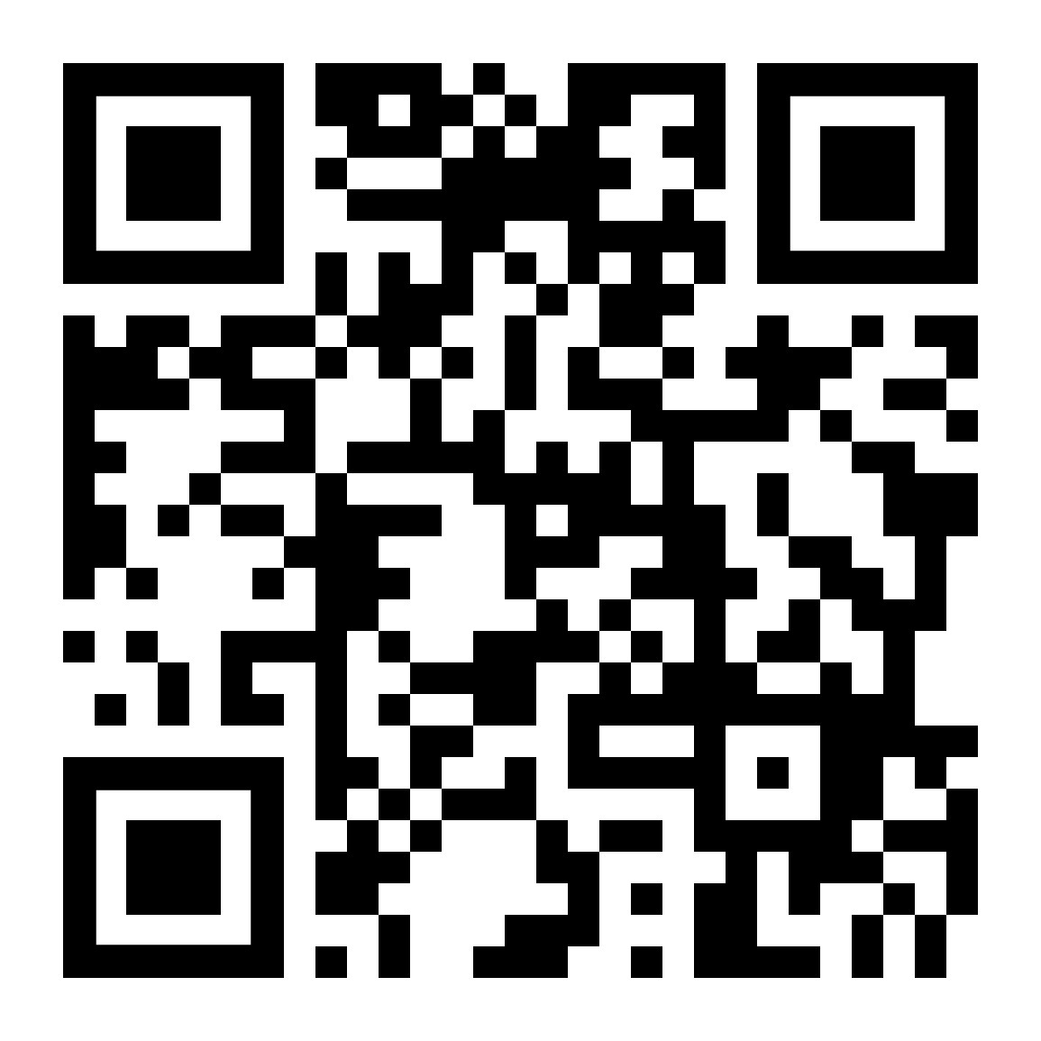
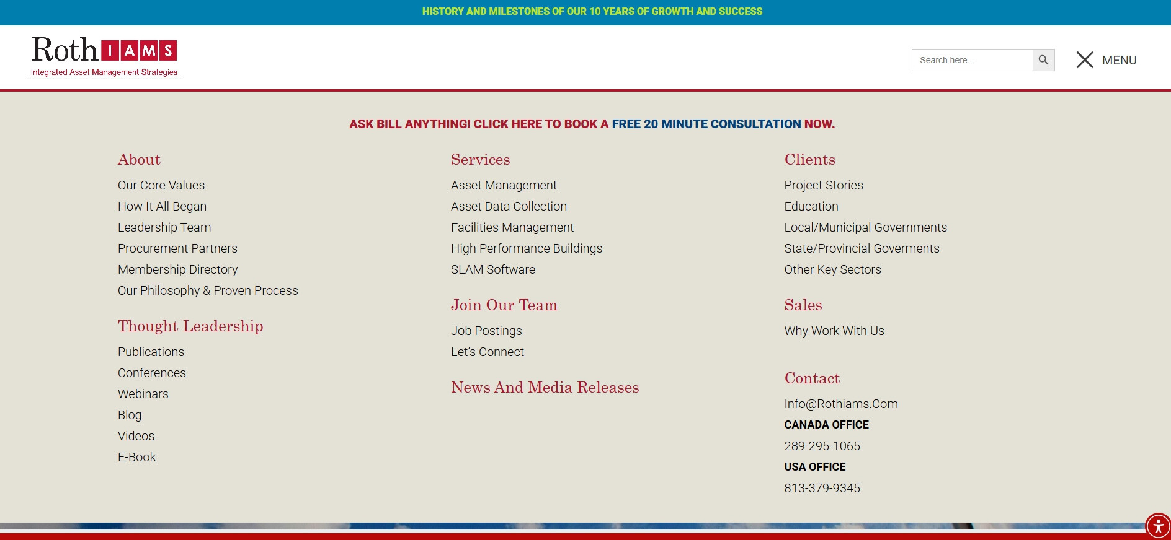
Thank you for attending
Visit our website at rothiams.com
Follow us on LinkedIn
Connect with us directly through email at andrew.chow@rothiams.com or accessibility@rothiams.com
Visit our Thought Leadership
page

