Slide 1


The Hidden Leverage: Using Cooperative Contracts to Speed Up Capital Projects
With Tammy Rimes, MPA

Slide 2
North America’s Premier Association for Cooperative Procurement
360 membership of Cooperative organizations, Strategic Suppliers with a cooperative contract and public procurement and government employees
Goals are three-fold: Educational Outreach, Legislative Advocacy and Collaboration
Who is the National Cooperative Procurement Partners (NCPP)

Slide 3
What is Cooperative Procurement?
A group of entities combine their specifications into a single solicitation that can be used by all who contribute and participate.
OR
A cooperative organization or government entity issues a solicitation where the resulting contact can be “piggybacked” upon by other agencies.

Slide 4
Why Do Buyers Choose Cooperative?
Source: GovWin’s Survey of Government Contractor Sales Expectations, GovWin’s
Survey of Government Procurement Professionals

Slide 5
Governments Making Cooperative Purchases
SLED Cooperative Purchasing Market Landscape
GovWin By Deltek Oct 2023

Slide 6
79% of the Purchases from National Co-ops Fall into 4 out of 12 Industry Groups
Major Industry Group | Share of Co-op Purchases
Architecture and Engineering | 0.50%
Construction & Equipment | 22.40%
Education Products and Services | 7.60%
Environmental Services | 1.20%
Financial Services and Insurance | 0.30%
Healthcare | 2.60%
Operations and Maintenance | 21.90%
Professional Business Services | 4.50%
Public Safety | 3.10%
Technology and Telecom | 19.90%
Transportation/Vehicles | 15.10%
Water and Energy | 1.00%
Source: GovWin database of 3,100 purchases made through national co-ops in last two years

Slide 7

RFP Tracking Project

Slide 8
3 Stages of Procurement Process
Notes:
When reviewing the three phases outlined in Figure 1, projects require on average 43.9 hours (50%) in their Initial Stages and Publication phase, 32.7 hours (38%) in the Open Solicitation phase, and 10.5 hours (12%) in the Negotiation and Award phase. The difference between complex projects and non-complex projects is very evident in phase one, where on average, complex projects take 77.4 hours and non-complex projects only take 15 hours. Therefore, complex projects take 5 times as long as non-complex projects to complete the Initial Stages and Publication phase. During the Open Solicitation phase, complex projects take about twice as long as non-complex

Slide 9
Step by Step Process

Slide 10
Personnel Hours
Notes:
While procurement served as the lead for each of the tracked projects, the highest number of combined personnel hours for high complexity projects were attributed to the category of Customer Lead/SME. This relates directly to the first part of specification development, where content is generally provided by the user department as well as other subject matter experts. For low complexity projects, procurement often takes the lead and performs most duties, so Procurement Lead hours rank highest for those projects.

Slide 11
Costs
Position | Complex | Non-Complex
Procurement Manager | $1,082 | $455
Procurement Lead | $4,800 | $563
Admin Support | $46 | $57
Customer/SME/Evaluation | $7,705 | $436
Counsel | $1,290 | $30
Management | $2,496 | $141
Average hourly costs across all spreadsheets* | $17,419 | $1,682
Notes:
The project with the least number of recorded hours (48 hours) was for a re-bid construction project – the initial solicitation resulted in no bids, so the solicitation was re-issued. There was very little time recorded for many steps, since that work was already done in the initial solicitation (which was not submitted).
A few entities submitted projects with no hours within some of the stages. When asked about the lack of hours for those steps, they indicated it was due to procurement having authorization to proceed without management/Board approval or simply awarded to the lowest bid, with no negotiation. Pre-determined and approved templates eliminated any time having to consult with assigned counsel.
The project with the highest number of hours (4,619 hours) was for an RFP for transportation equipment with supporting services.
For the non-complex projects, many entities had little to no hours recorded for the final stage of Negotiation and Award. One entity submitted five non-complex projects with zero recorded hours in those fields. Since those submissions make up 28% of the spreadsheets, it may have skewed the costs downwards for that category.

Slide 12

Case Study – Orange County, CA
COST YEAR 1-3 | $ 51,084.54
COST YEAR 4 | $ 17,524.74
COST YEAR 5 | $ 17,524.74
TOTAL COST | $ 86,134.01

Slide 13

How Does Construction and Installation Services Fit In?

Slide 14

Benefits for Construction Projects
Greater Collaboration
Advertising Costs are Less
Labor Compliance
Local contractors can be used
Consulting often included
Job Order Contracting for repairs
FAST!!!

Slide 15

Issues:
Many deferred maintenance projects
Significant maintenance of aging HVAC systems
Inconsistent Lighting
Need to reduce utility costs and water consumption
Regional Municipal Hospital
Contracted results:
Detailed facility assessment with project plan for maintenance projects
Training and presentations for staff and community stakeholders
Boiler plant upgrade with energy savings performance contract to fund upgrades
Updated lighting throughout hospital – side benefit was reduced falls and accidents

Slide 16

Coastal Beach Community
Contracted results:
Specially designed lighting and site furniture projects by the suppliers
Adequate light output for environmentally sensitive locations
Customer 270-degree “Turtle Shield” with 42-watt amber LED lights – focused directionally, especially during mating season
Issues:
Artificial light disrupts the egg-laying of local sea turtles – an endangered specials
Pedestrian lighting along stretches of public access is needed

Slide 17
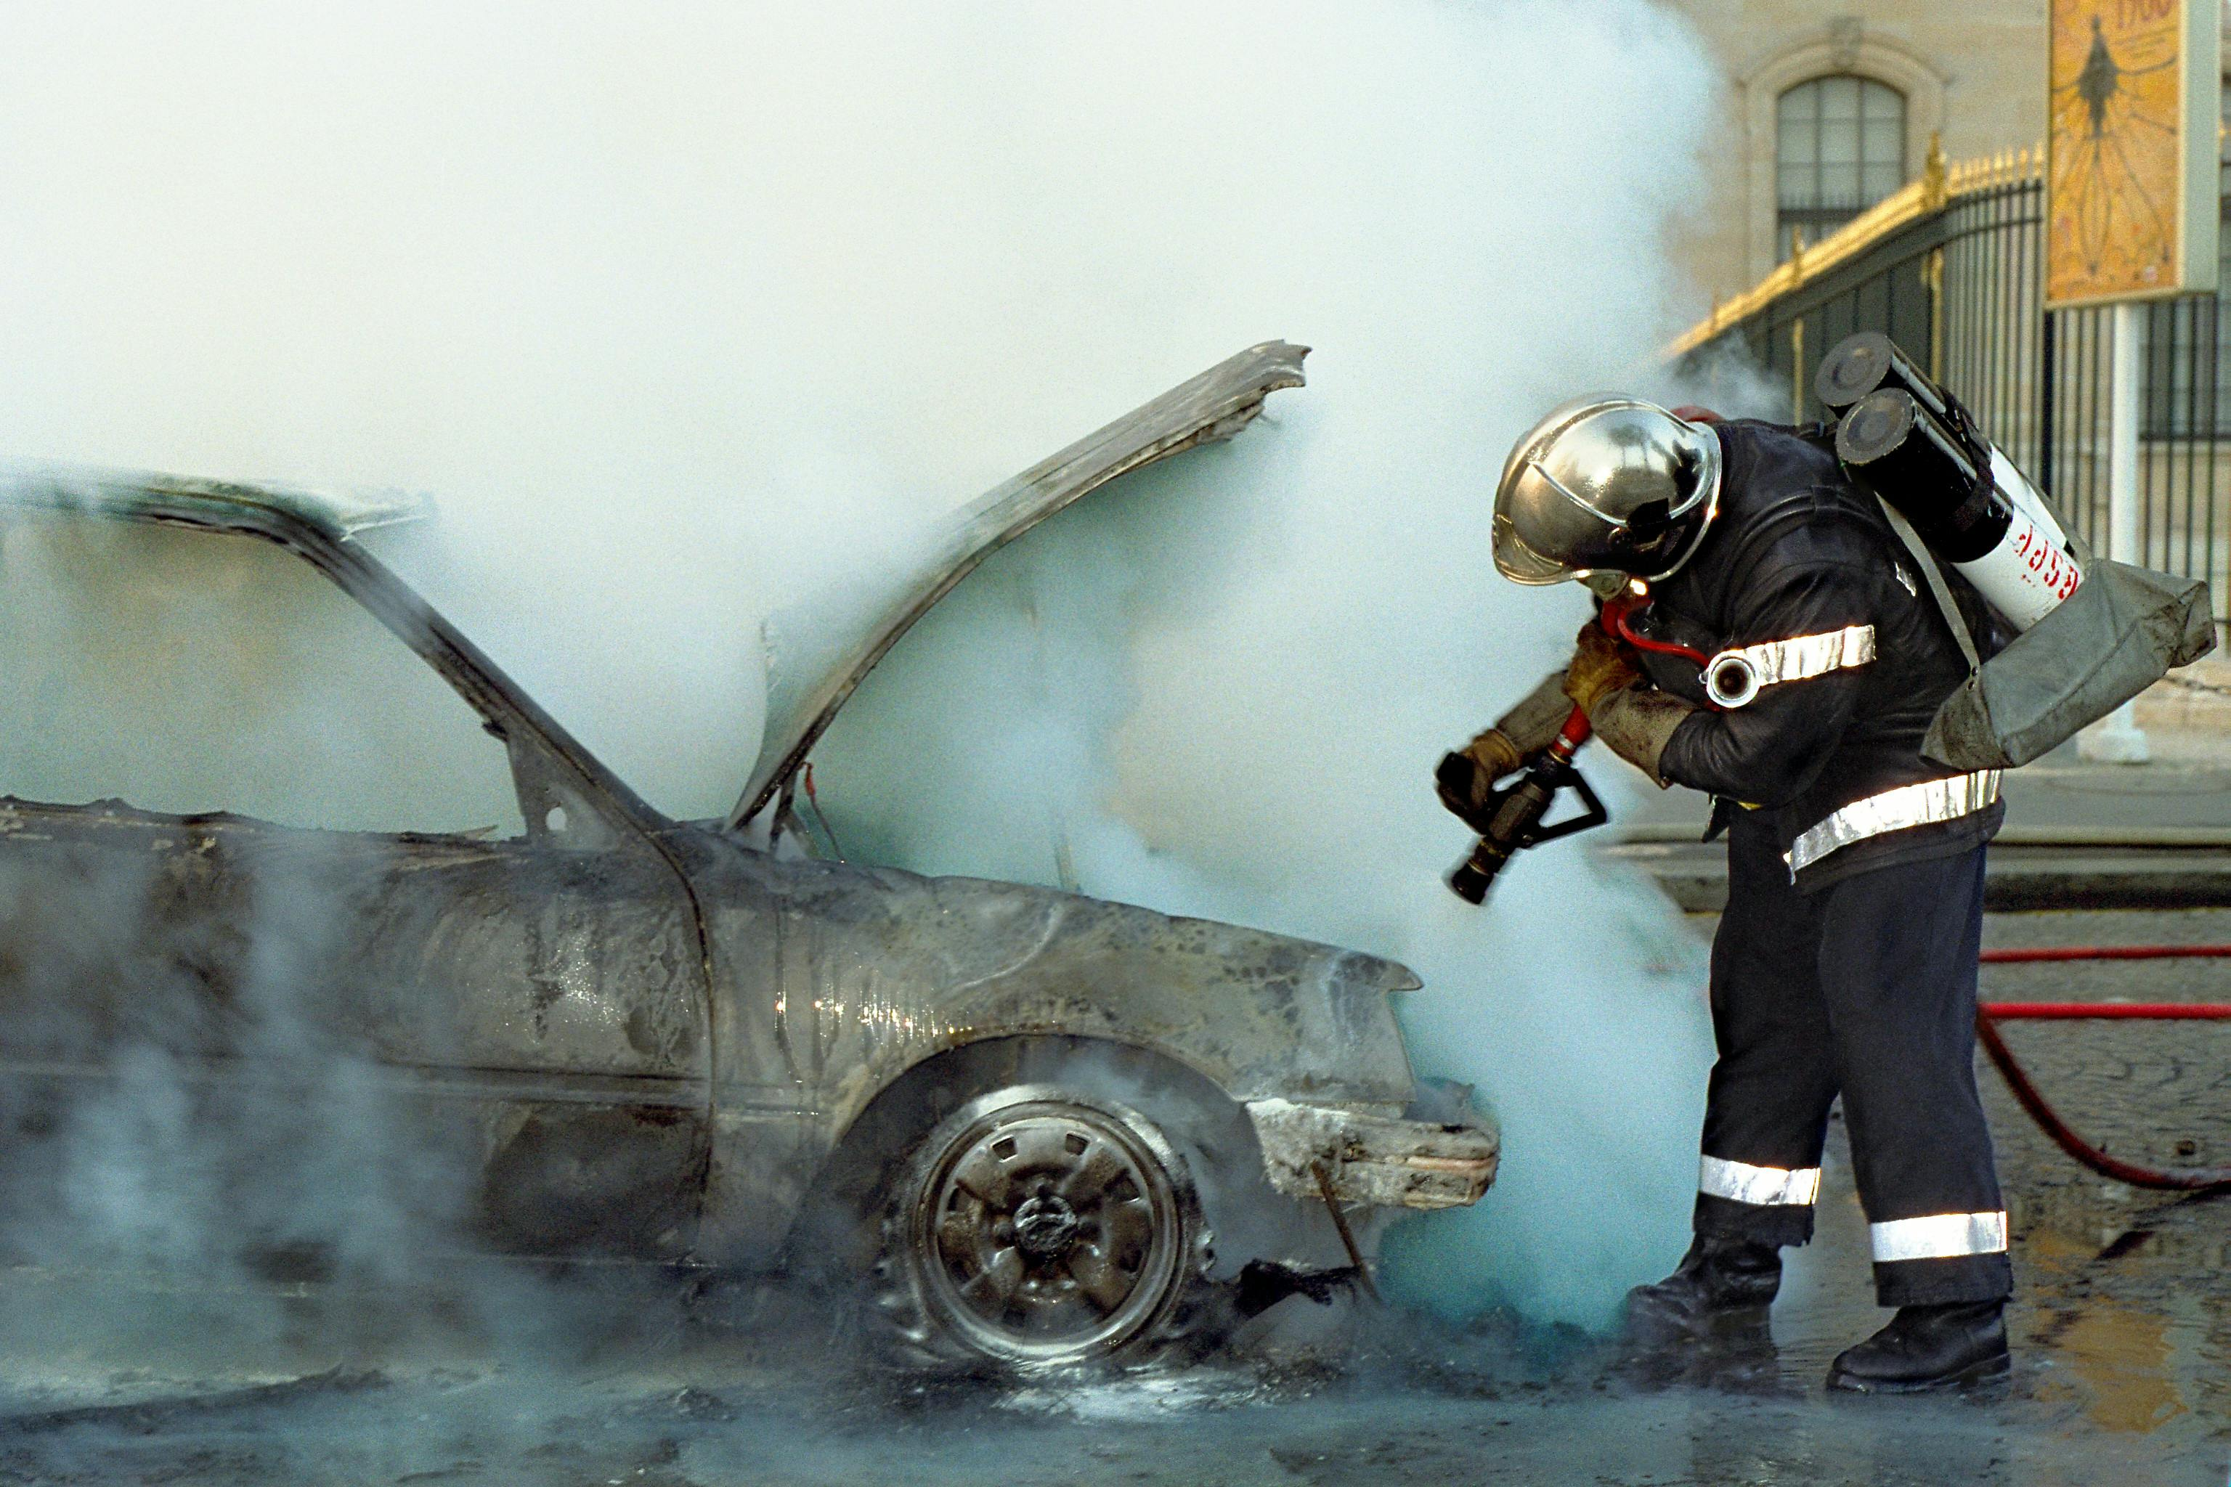
Large Urban City
Issues:
Sunday morning car accident destroyed the lobby and portion of community service center
Mayor’s office mandated that it be re-opened within the month
Contracted results:
Demolition and removal; temporary boarding
Carpentry, plumping, and lighting repairs
New office furniture – modular and stand-alone
New computers for front counter
New front doors and signage
Installed crash guard poles on intersection

Slide 18
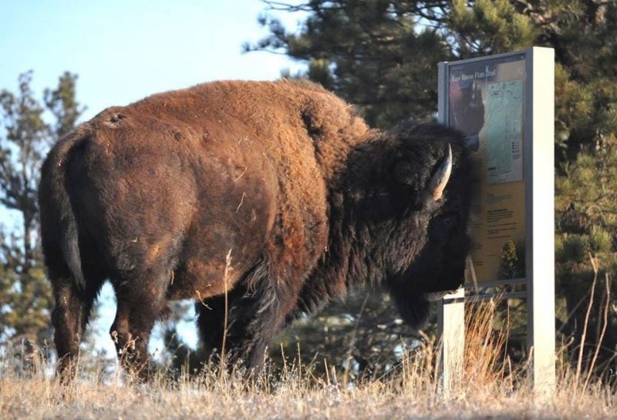
For Your Consideration

Slide 19
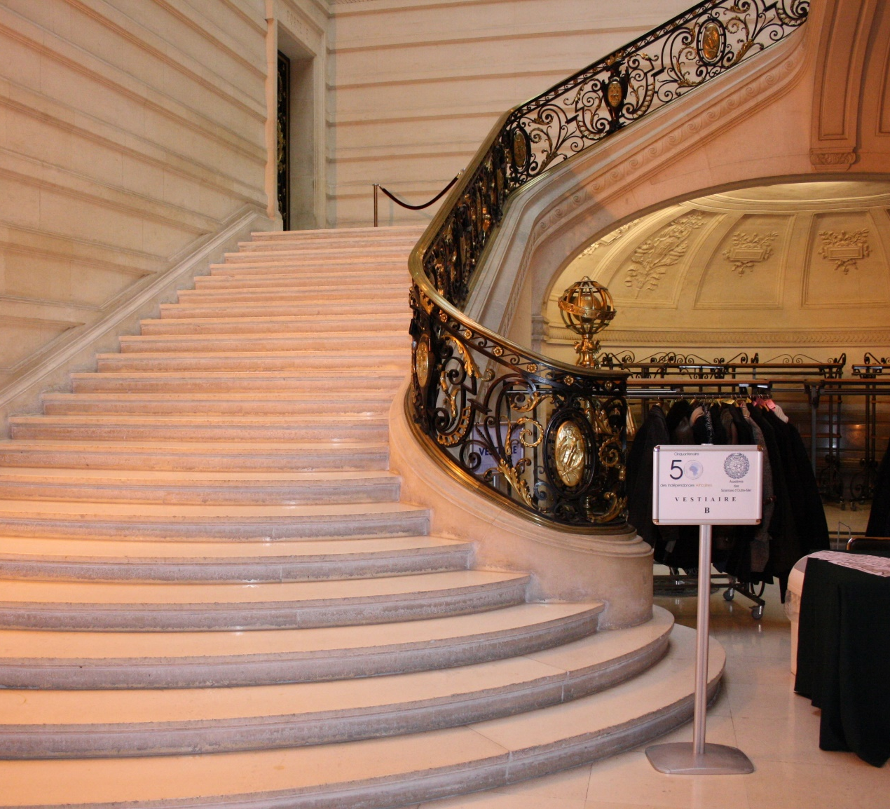
Taking the Next Step…
Expiring & Emergency Contracts
Research at least 2-3 new cooperatives yearly
Education for Departments
Ask suppliers and cooperatives about solving complex issues

Slide 20
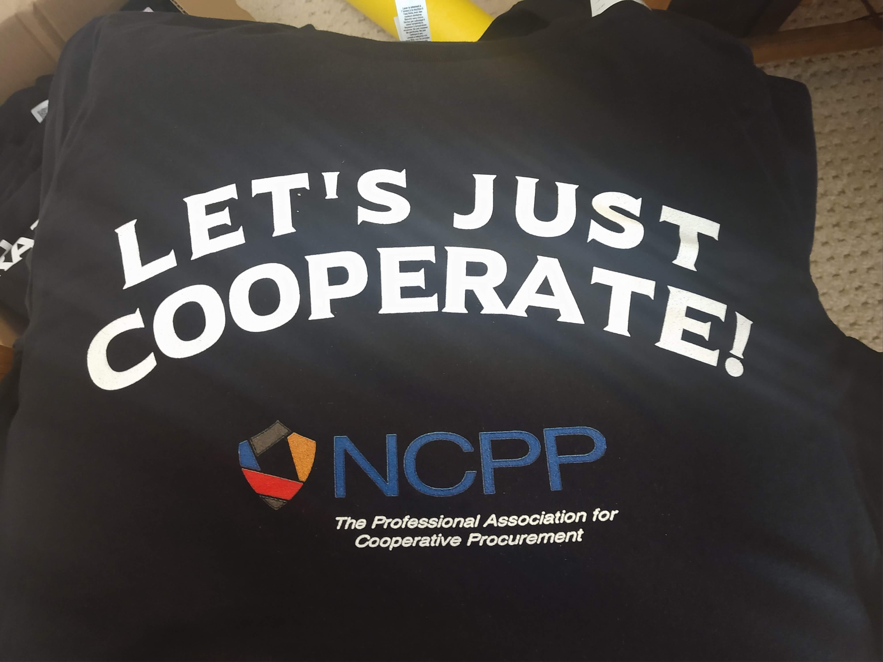

NCPPAssociation.org

