Slide 1

Beyond the buzz: ai and automation in asset management

Slide 2

AGENDA
Setting the Table
Automation vs. AI
Q & A, Resources & Next Steps
Introduction
Let’s Make AI Work for Us!
Getting Started

Slide 3

INTRODUCTION

Slide 4

Bill Roth President & CEO of Roth IAMS
Co-Founder of SLAM Technologies
Over 30 years of experience collaborating with higher education institutions across North America on all aspects of facility and infrastructure asset management
Active member of various facility industry associations such as APPA, NASFA, NSPMA, and many others

Slide 5

Setting the Table

Slide 6

AI IS EVERYWHERE & IN EVERYTHING!

Slide 7

Getting started

Slide 8

Getting Comfortable
Try something personal first
Find or create a recipe
Pick a restaurant for date night
Plan a vacation
Learn something new

Slide 9

At Work - The Mental Game
This isn't about keeping up with technology
It's about protecting your institutional knowledge
The facilities professional who documents, analyzes, and communicates faster will win the internal resource battle every time
AI is that speed multiplier

Slide 10

At Work - The Method
Identify a problem that you want solved
Consider the scale of the issue
How many people
How much time
How often
Gather the data you need
Engage your favorite AI

Slide 11
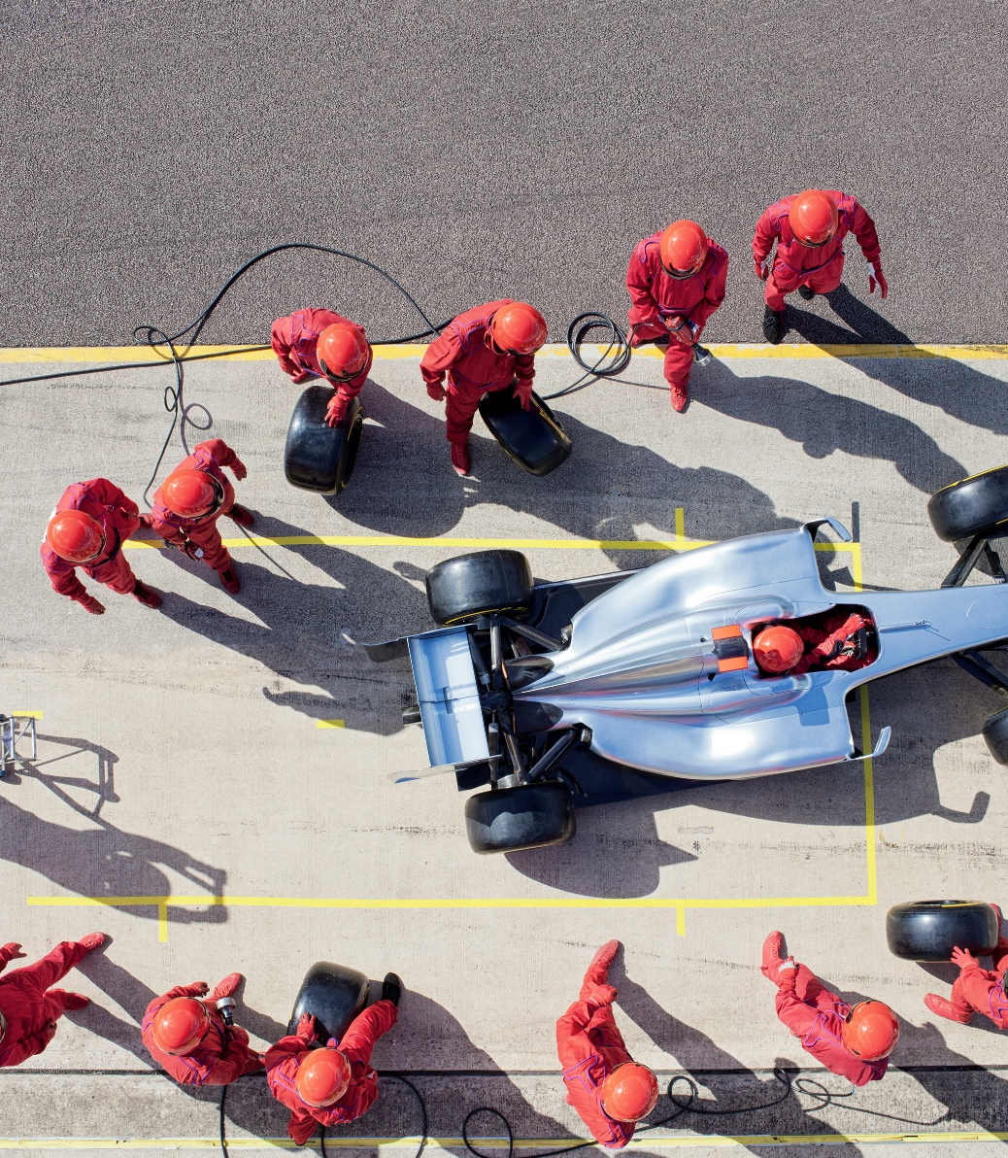
My Biggest Hack
Ask AI for help
How to solve the problem
What am I missing?
Write me a more effective prompt

Slide 12

Automation vs. AI

Slide 13

Allow me my soapbox…
Most of what people talk about today as AI is really just automation
Automation essentially is a complicated “if/then” statement
Automation is not bad, it is just not AI

Slide 14

Use Cases for automation
Work Order Routing
Work Order Triage and Routing
Fault Deduction
Fault Detection and Alerts
Predictive Maintenance
Parts and Inventory Reorder Triggers
Min/max thresholds
Auto Reporting Packs
Monthly KPIs, backlog, response time, DCRM snapshots)

Slide 15

Use Cases for “true” ai
Operational AI
Fault Diagnostics - (Likely Cause + Next Best Action)
Anomaly Detection & Early Warning
Continuous Commissioning
Strategic AI
Condition-Based Maintenance
Capital Planning Decision Support

Slide 16
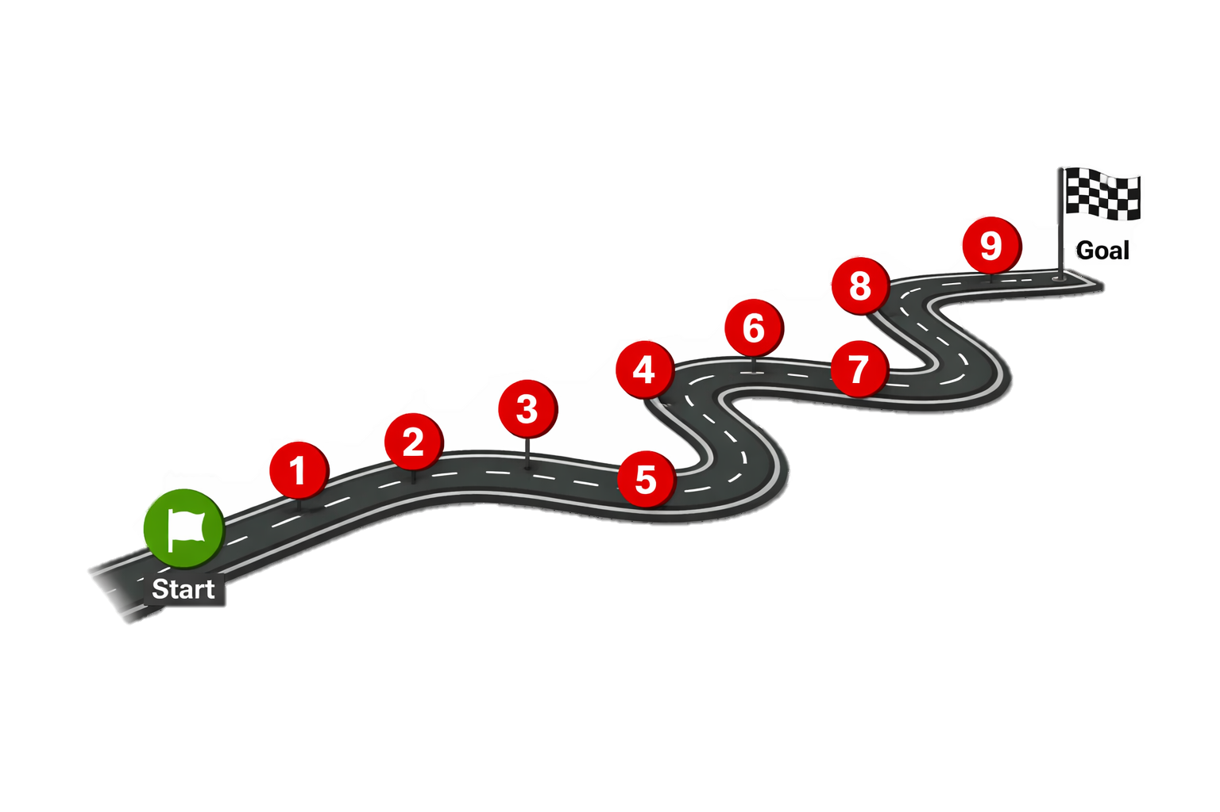


Keep
HUMANS approving recommendations
Road map for
a pilot
Run a
90-day pilot
Connect key systems
Scale with a repeatable playbook
Put governance and security in-place
Pick 1–2 problems to solve
Inform/engage your IT department
Measure outcomes
Clean-up the data you need

Slide 17

Let’s Make AI Work for Us!!!

Slide 18

Your Monday Morning Challenge
Pick ONE task you do repeatedly that involves writing, summarizing, or explaining something.
Give AI 20 minutes this week.
That's it!

Slide 19

Why It Matters
The gap is opening now. Facilities leaders using AI are pulling ahead of those who aren't — in report quality, in budget justifications, in how fast their teams operate.
Your expertise is the advantage. AI in the hands of a 30-year facilities veteran beats AI in the hands of a generalist every time. You know when it's wrong.
You don't need permission. Start personally. Start small. Show results. The organization will follow you!

Slide 20

The Last Words
Consistent and defensible data is more important than ever. AI powered bad data will just make you better and making worse decisions
AI is for Decision Support, not Decision Making. Human experience, combined with AI is an unbeatable combination

Slide 21

Q & A

Slide 22
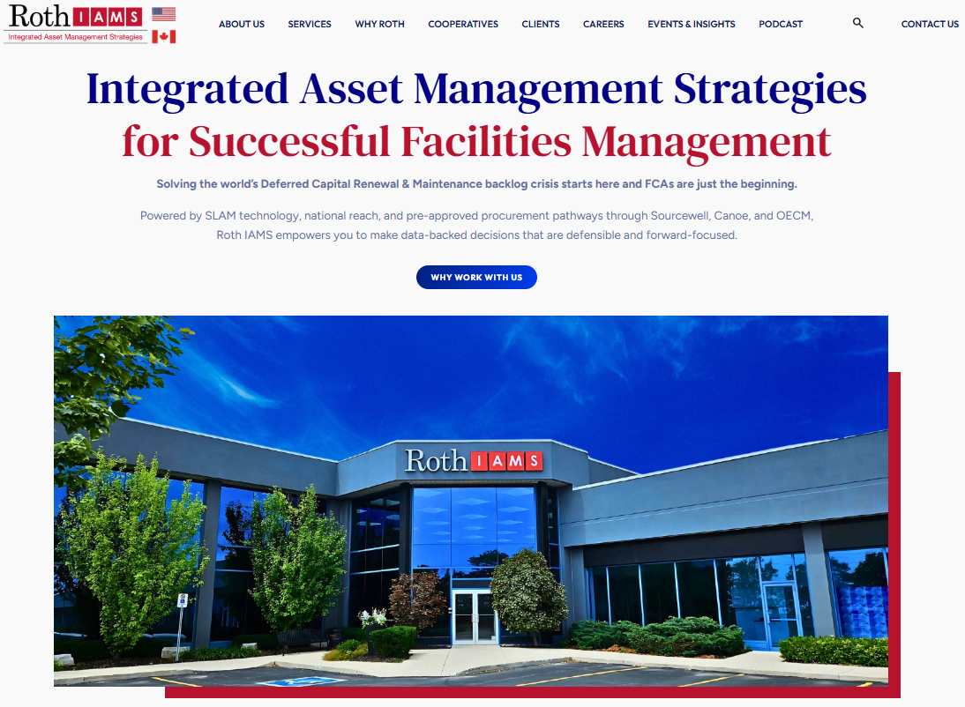
Thank you for attending
Connect with us directly!
Bill.Roth@rothiams.com
416-700-6678
Visit our website at rothiams.com
Follow us on LinkedIn

