Slide 1
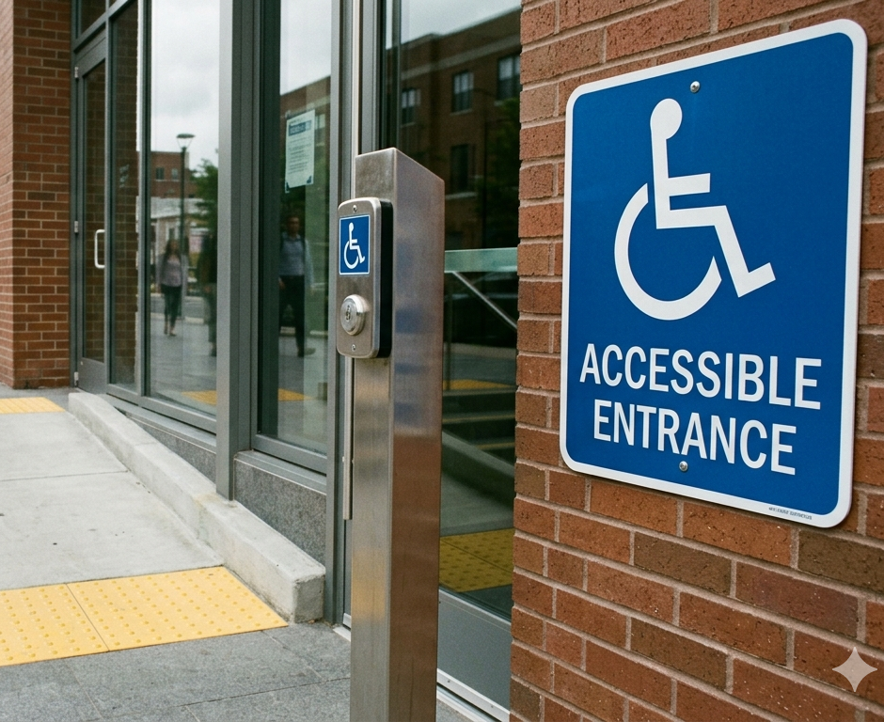
ACCESSIBILITY COMPLIANCE BEYOND MINIMUM CODE

Slide 2

introduction
Andrew Chow, P.Eng., M.Eng., CPI, RHFAC Professional Practice Leader - Accessibility, Senior Facility Assessor, Technical Reviewer, Roth IAMS
14 years of building condition assessment experience
11 years accessibility audit experience
Responsible for creating methodology and approach for accessibility audits at Roth IAMS
Rick Hansen Foundation Accessibility Certified
One of the primary assessors for IFAs

Slide 3

Limitations of Current Standards
Emerging Trends & Best Practices
Overcoming Real-World Constraints
Auditing Beyond Compliance
Accessibility Needs & Universal Design
Future-Proof Strategy
Q&A
Agenda

Slide 4
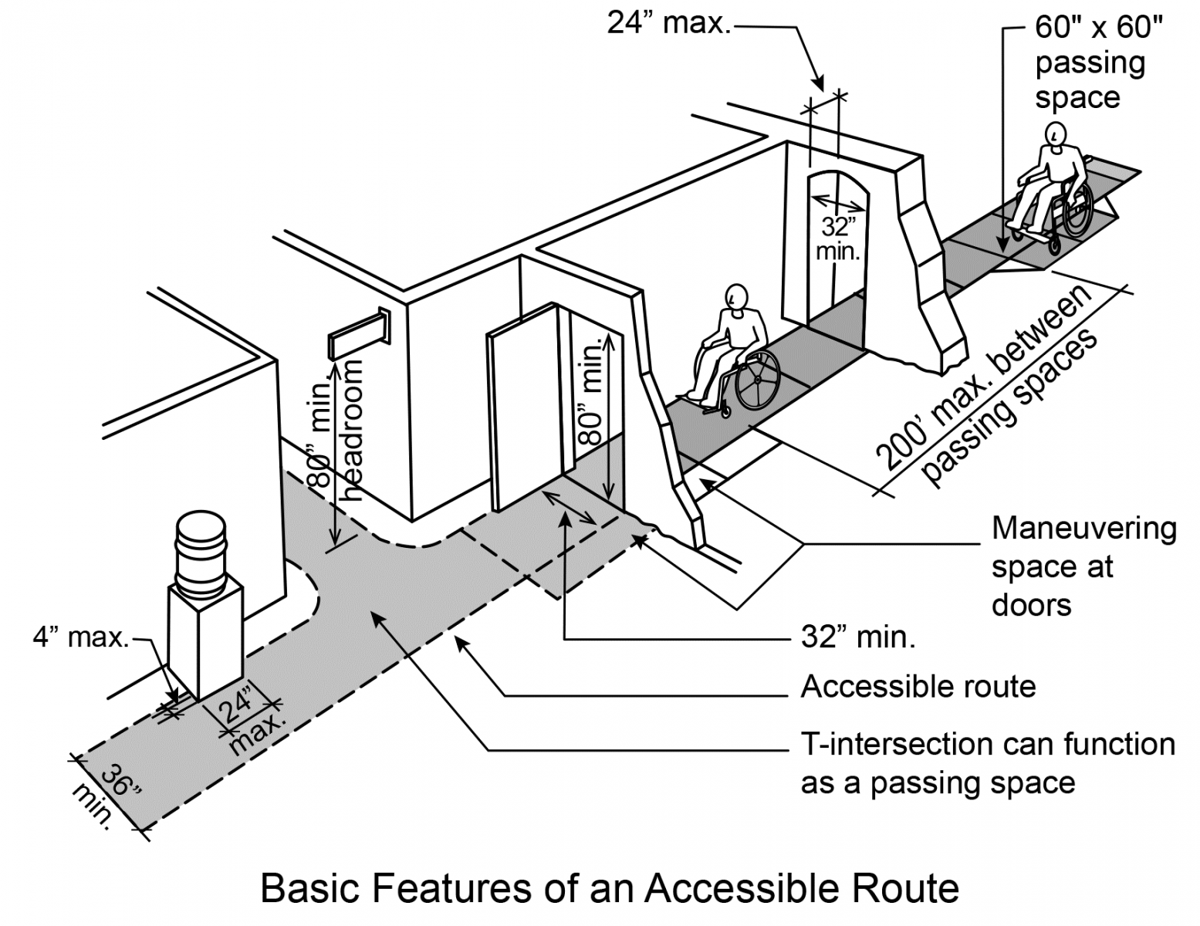
KEY QUESTIONs
Are your facilities truly accessible, or just barely compliant?
How do I exceed minimum code requirements?

Slide 5
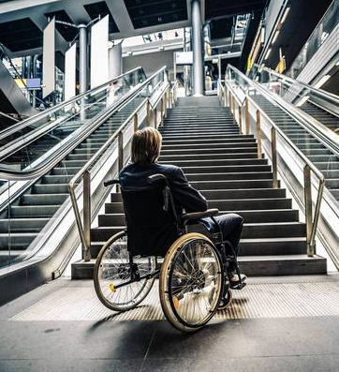
KEY QUESTION
Before aiming to exceed code, we should understand :
What do we need to address?
What is the end result we want to achieve?

Slide 6
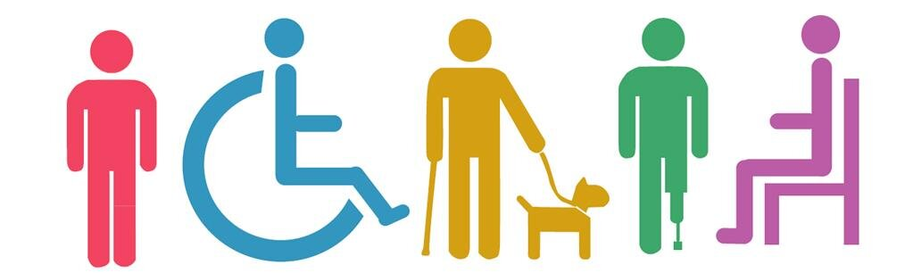
Overview of Disabilities
Image source: Pulrang, Andrew (2019). What Defines Members Of The “Disability Community?”
https://disabilitythinking.com/disabilitythinking/2019/9/15/cukmbl2x4k5eyvo2jj63lq9unifpwi

Slide 7


Overview of Disabilities
Oftentimes, we limit accessibility to wheelchair access only
We emphasize creating space for mobility
Image source: International Symbol of Access (ISA) and Modified ISA
https://en.wikipedia.org/wiki/International_Symbol_of_Access

Slide 8

Various Disabilities
Other disabilities to consider:
Vision
Hearing
Pain-related
Neurological
Image source: https://greatcareers.org/neurodiversity-in-the-workplace-and-international-day-of-persons-with-disabilities/
We must understand that there are a variety of disabilities that need to be addressed.

Slide 9
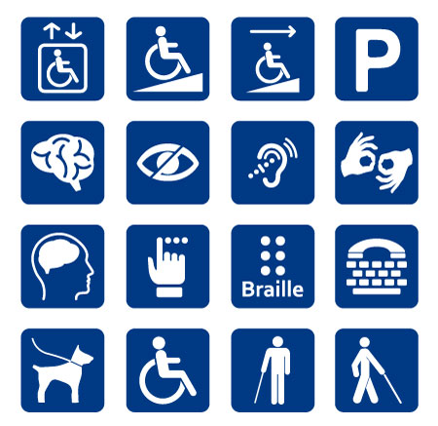
Means of Accessibility
Other than addressing paths of travel, we will have to address other disability needs in our facilities or built environment.

Slide 10

Universal Design vs. Barrier-free

Slide 11
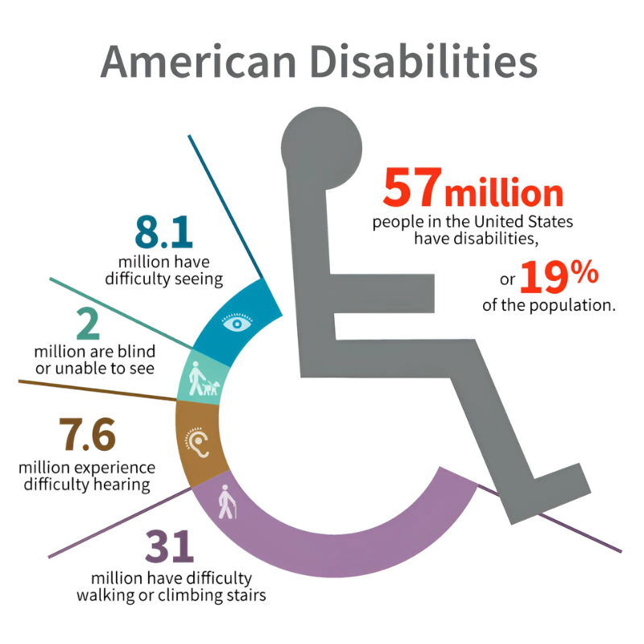
Disability Types & Demographics
Who We Are Designing For
Statistics Canada, Canadian Survey on Disability, 2022
Scale: 27% of Canadians — approx. 8 million people — have a disability
Youth (15–24): fastest-growing disability rate (2017–2022); most common: mental health & learning
Working-age adults: mental health and pain-related disabilities most prevalent
Seniors: pain-related, mobility, and flexibility challenges dominate
Key insight: disability is fluid and universal
A broken arm, a baby stroller, aging eyes, or sensory overwhelm — everyone experiences disability at some point
Disability types: mobility, vision, hearing, cognitive, neurological, pain-related, dexterity, memory

Slide 12
Definitions
What is Barrier-free Access?
Dictionary
Design for those with physical or other disabilities, involving the provision of alternative means of access to steps (e.g. ramps and lifts (elevators) for those with mobility problems)
National Building Code/Ontario Building Code
Barrier-free means that a building and its facilities can be approached, entered, and used by persons with physical or sensory disabilities
Canadian Standards Association (CSA B651)
Accessible - as applied to a site, building, or other facility, possessing the necessary characteristics for it to be entered, exited, and used by people, including those with physical, sensory, or cognitive disabilities.

Slide 13
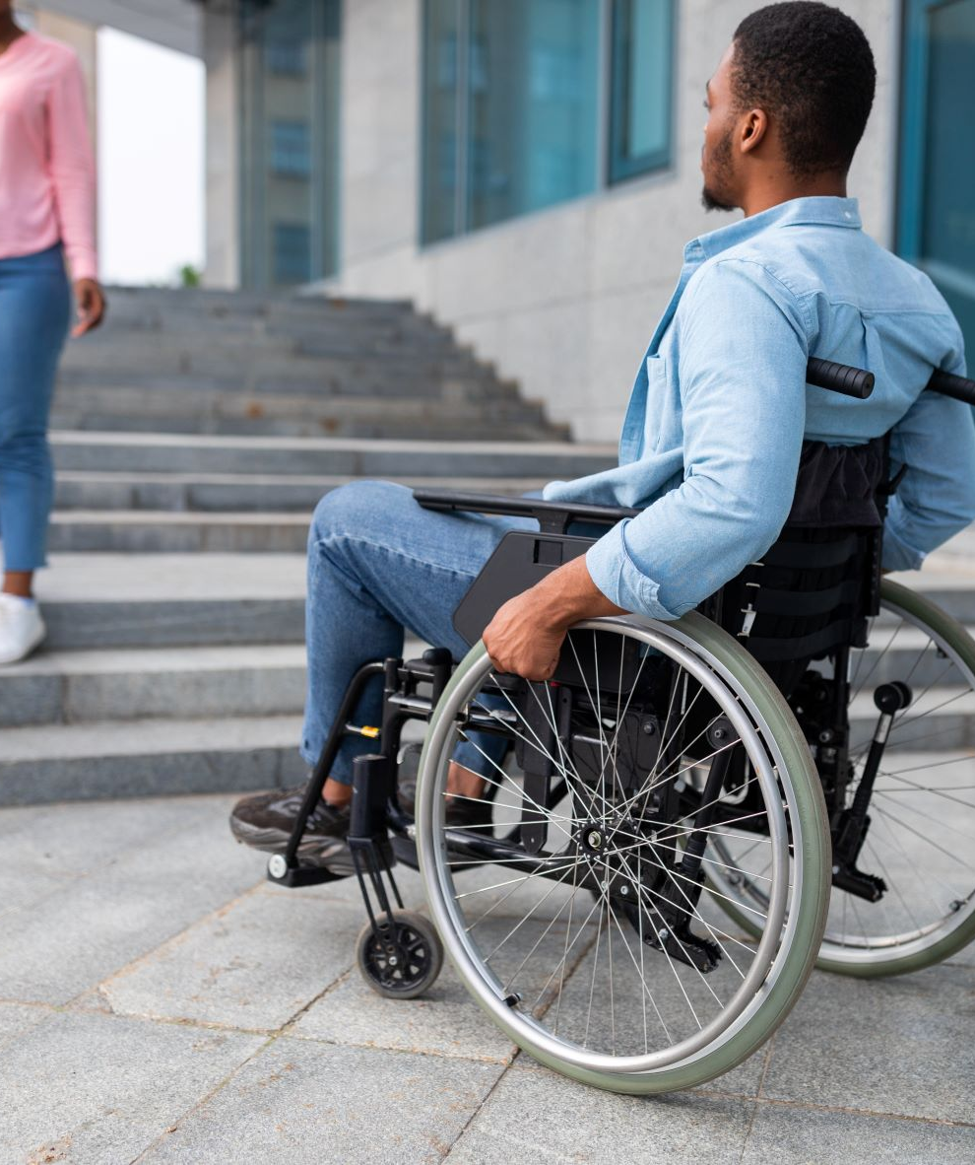
Objectives
Barrier-free
Remove barriers for people with disabilities, so that they may have access to and within a facility
ADA
Accessible Means of Egress. A continuous and unobstructed way of egress travel from any point in a building or facility that provides an accessible route to an area of refuge, a horizontal exit, or a public way.

Slide 14
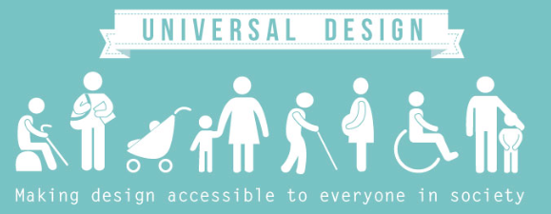
Objectives
Universal Design
Universal design is defined as “the design of products and environments to be usable by all people, to the greatest extent possible, without the need for adaption or specialized design.”
(Ronald Mace, 1988)

Slide 15
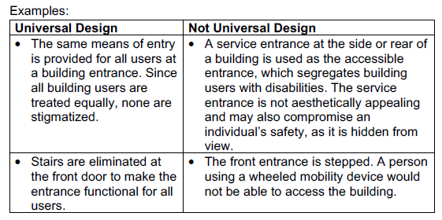
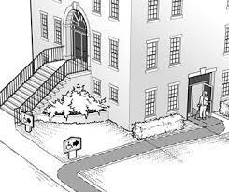
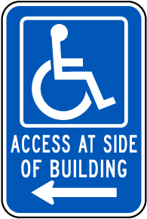
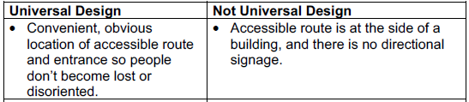
Background
Barrier-free Accessibility vs. Universal Design
Examples to Contrast “Barrier-free Accessibility” and “Universal Design”

Slide 16
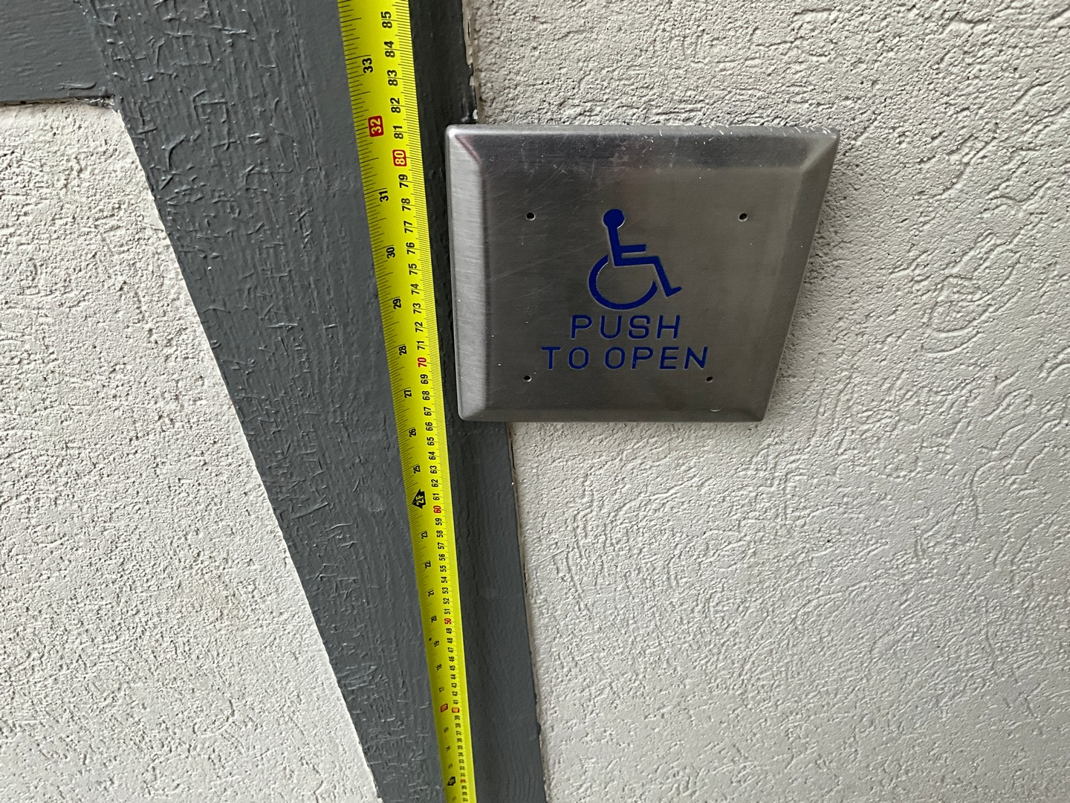
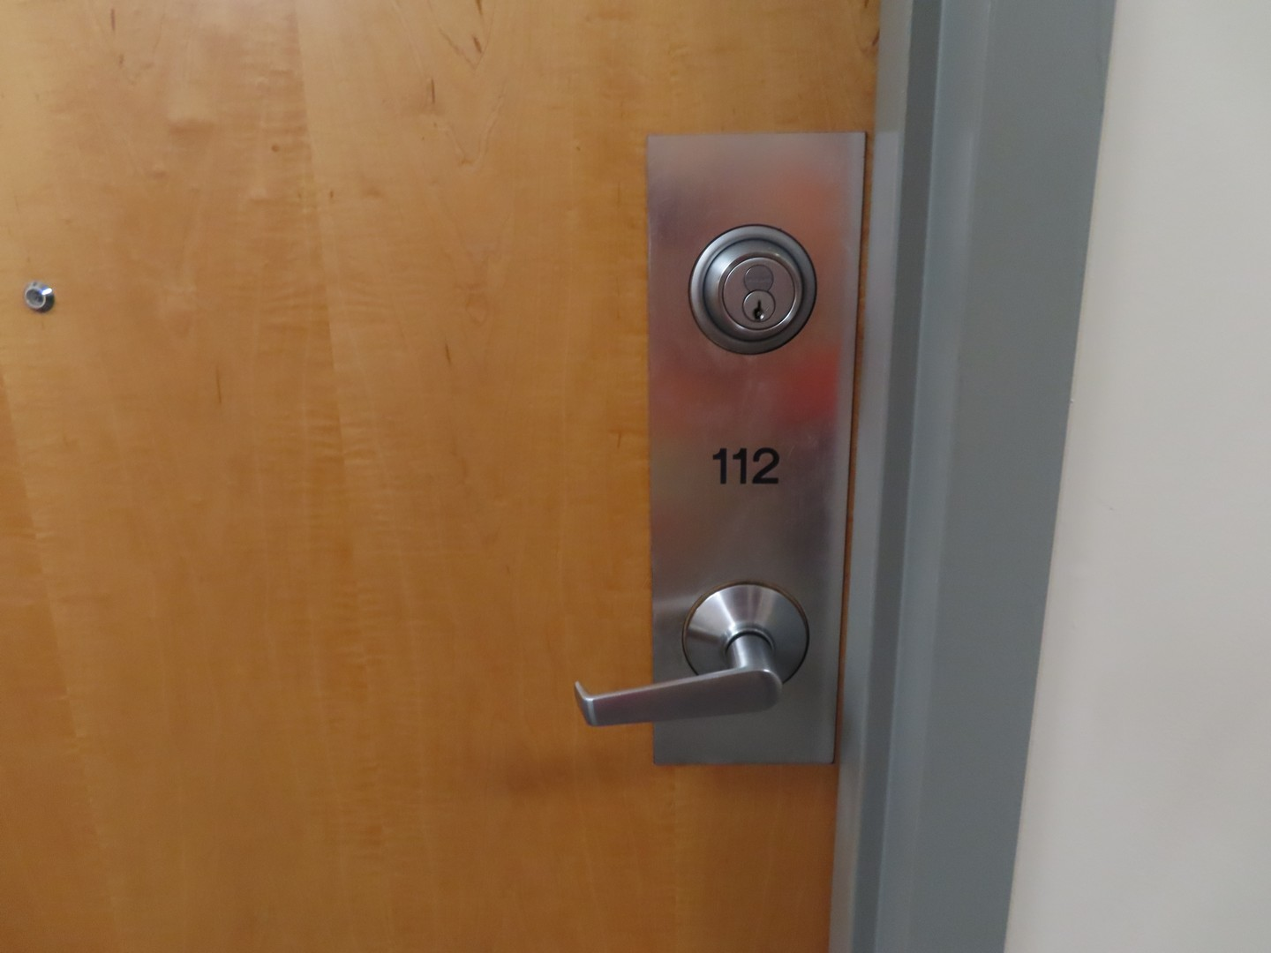
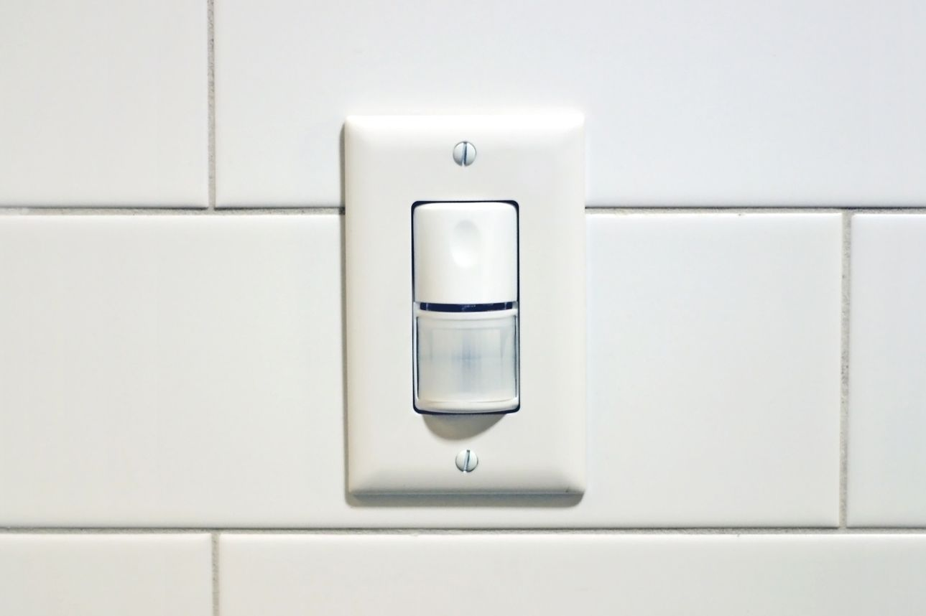
Background
Barrier-free Accessibility vs. Universal Design
Examples to Contrast “Barrier-free Accessibility” and “Universal Design”
Typical devices that all people use

Slide 17
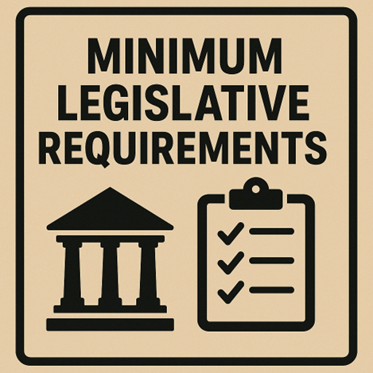

Minimum (Code) Requirements

Slide 18
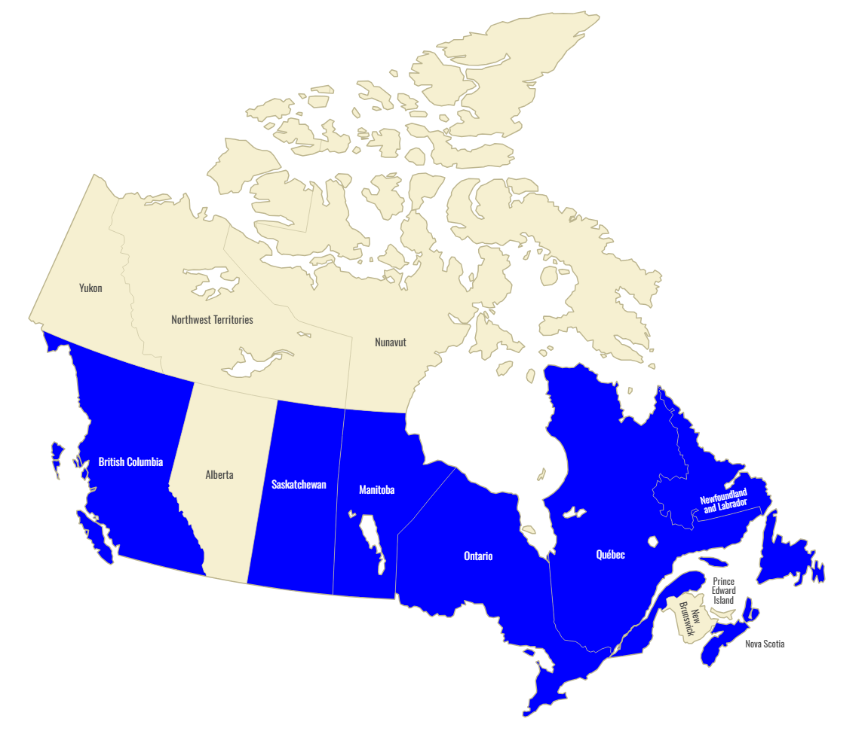

Canadian Regulations
Provinces in blue have accessibility acts
There is a federal accessibility act, but it is for federally-owned buildings

Slide 19


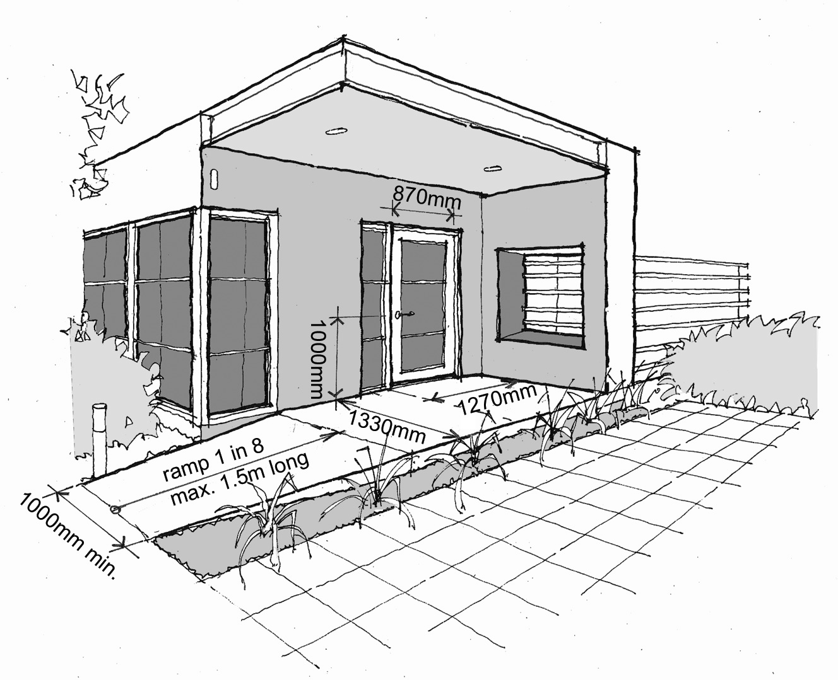

Canadian Regulations

Slide 20
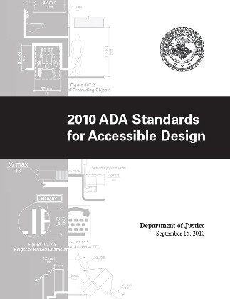
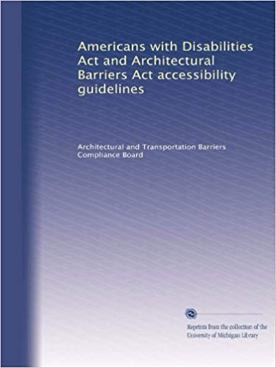
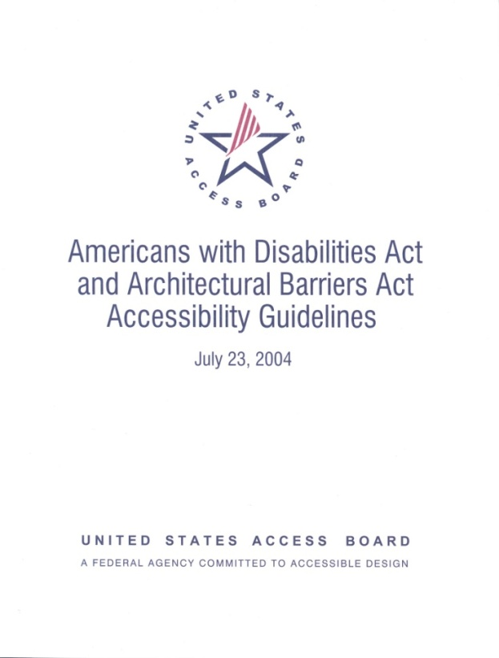

US Federal regulations

Slide 21
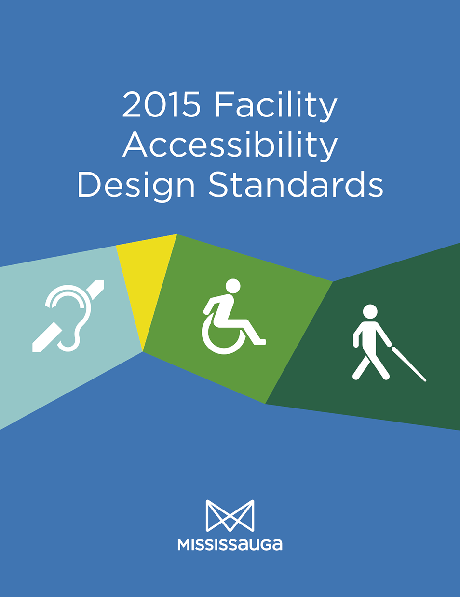
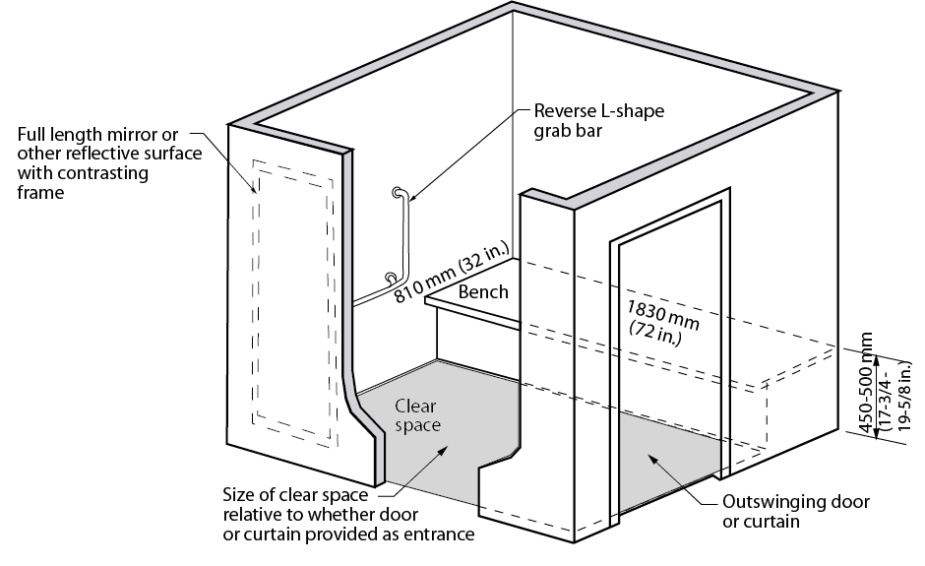

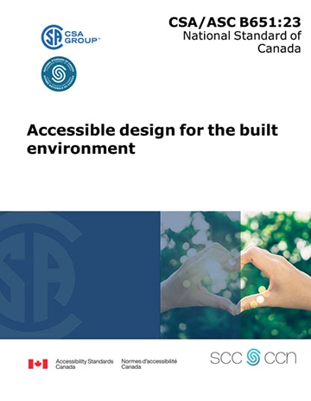
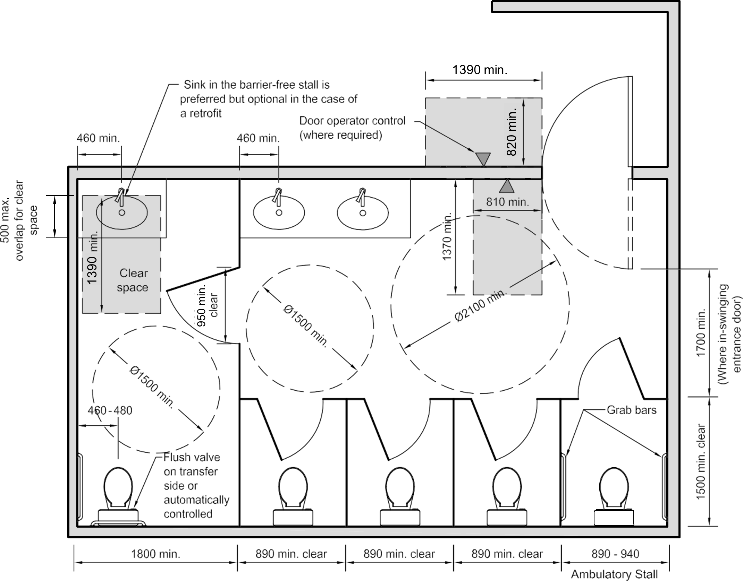






Facility accessibility Design Standards (FADS)

Slide 22
Limitations of Current Accessibility Codes
Codes Are Minimum
Snapshot in Time
OBC/IASR set the legal minimum. Meeting code alone does not guarantee real usability or inclusive access for all users.
Codes reflect the knowledge and political will at their drafting date. User needs, technology, and standards evolve faster than legislation.
Gaps in Scope
Enforcement Varies
Building codes may not address libraries, cafeterias, specialized spaces, or outdoor environments comprehensively.
Compliance is verified at time of permit — not continuously. Ongoing maintenance of accessible features is often inconsistent.
Conflict Between Standards
Physical & Financial Constraints
Code and other recognized accessibility design standards can conflict. Ambiguity exists on which governs; jurisdictional conflicts create compliance uncertainty.
Heritage buildings, structural limits, and budgets restrict what improvements are feasible even when desired.

Slide 23
Risks of minimum only
Human rights complaints • Reputational damage • Missed opportunities
⚖ Legal & Human Rights
📉 Reputational Risk
♿ User Exclusion
AODA non-compliance can trigger complaints, audits, and fines. Human Rights Code obligations extend beyond building codes.
Organizations perceived as inaccessible face community backlash, media scrutiny, and loss of public trust.
Technically compliant facilities can still be functionally unusable — defeating the purpose of accessibility for real users.
💰 Reactive Costs
📋 Regulatory Creep
🏛 Missed Revenue & Grant Eligibility
Retrofitting discovered barriers post-construction is 3-5× more expensive than designing inclusively from the start.
Standards evolve. Today's compliant facility becomes tomorrow's deficient one without proactive planning.
Government-funded capital programs require meeting or exceeding OBC accessibility levels as an eligibility criterion.

Slide 24

Emerging Trends in Accessibility
Image source: Accessibility Partners Canada
https://accessibilitypartners.ca/the-impact-of-accessibility-standards-on-construction/

Slide 25
Evolving Standards
Recognize best practices and new standards
OBC
Ontario Building Code — Section 3.8
Trends to Watch
Baseline legislated standard. Barrier-free design for entrances, interior paths, and amenities (2024 Version).
→ Larger scooter & powered wheelchair dimensions in updated CSA B651-23
IASR
Integrated Accessibility Standards Regulation
O. Reg. 191/11 under AODA. Addresses exterior paths of travel and accessible parking.
→ Growing adoption of organizational FADS exceeding code minimums
CSA B651
CSA B651-23 — Built Environment
→ Neurodiversity & cognitive accessibility gaining recognition
2023 update reflects new powered wheelchair turning radii (2250mm), scooter dimensions (3150mm), and expanded guidance.
→ "Accessibility by default" in procurement policies
FADS
Facility Accessibility Design Standards
Municipal/organizational standards that exceed code (e.g. City of London FADS 2021). Wider doors, turning diameters, specialized facilities.
→ Aging population driving demand (1 in 5 Canadians 65+ by 2030)
RHFAC
Rick Hansen Foundation Accessibility Certification
→ ADA benchmarking for Canadian organizations with US presence
Independent third-party rating system assessing meaningful access. Goes beyond code.

Slide 26
Emerging trends
Evolving standards, demographics, and design approaches
👴 Aging Population Pressure
🧠 Neurodiversity Recognition
1 in 5 Canadians will be 65+ by 2030. Accessibility needs are shifting from minority to majority concern — driving policy reform and capital investment at scale.
Autism, ADHD, dyslexia, and cognitive differences are gaining formal recognition in design standards. CSA B651-23 now includes updated guidance on functional and cognitive barriers (Clause 4.7.1).
📐 Updated Dimensional Standards
🏛 FADS Proliferation
CSA B651-23 reflects new anthropometric research: powered wheelchair turning radii increased to 2250mm, large scooters to 3150mm — many existing facilities built to older specs are now insufficient.
More municipalities and institutions are developing Facility Accessibility Design Standards (FADS) that exceed minimum codes — signaling a broader cultural shift toward inclusive design as default.
🌍 Accessible Canada Act (ACA)
♻ Accessibility + Sustainability Convergence
Accessibility Standards Canada is developing new national standards under the ACA, targeting a barrier-free Canada by 2040. Federal organizations face increasing compliance timelines and obligations.
Universal design and green building goals are increasingly aligned. Accessible routes, adaptable spaces, and sensory-friendly environments also support energy efficiency and long-term flexibility.

Slide 27
Innovative Ideas
From smart buildings to AI-powered navigation — what's coming and what it means for your facilities
AI & Smart Buildings
Indoor Navigation & Wayfinding
→ IoT sensors auto-adjust lighting, acoustics & door timing based on occupant needs in real-time
→ Smartphone apps using inertial sensors provide hands-free indoor navigation for blind users — no infrastructure needed (UC Santa Cruz, 2024)
→ AI-driven systems learn individual user preferences and adapt environments proactively
→ GoodMaps uses LiDAR + computer vision to create 3D indoor maps with voice/haptic guidance
→ Predictive maintenance flags failing accessible equipment (door operators, lifts) before they break
→ Evelity platform: inclusive wayfinding serving mobility, visual, hearing & cognitive users in complex venues
AR / VR & Digital Twins
Neurodiversity & Cognitive Design
→ AR glasses overlay real-time navigation directions on the user's field of view for visually impaired users
→ Sensory-inclusive design: quiet rooms, adjustable lighting zones, reduced visual clutter — emerging in schools & hospitals
→ Digital Twins of buildings allow planners to simulate barrier removal before construction — reducing costly retrofits
→ Cognitive wayfinding: simplified pictogram signage, consistent spatial patterns, and predictable layouts
→ VR used for stakeholder empathy training: experiencing a facility from a wheelchair user's or blind person's perspective
→ GPS-tracking wearables support independent navigation for users with cognitive impairments or dementia

Slide 28
Organizational Strategy
Translating emerging developments into practical facility strategy
👁 Watch & Monitor
🧪 Pilot & Test
📌 Embed in Strategy
▸ Track CSA B651 updates — new anthropometric data may render existing compliant spaces insufficient
▸ Trial indoor wayfinding apps (GoodMaps, Evelity) at a high-traffic facility — measure user experience impact
▸ Add 'technology-readiness' as a criterion in prioritization for capital planning — prioritize fixes that enable future accessibility upgrades
▸ Monitor Accessible Canada Act (ACA) standards pipeline — federal bodies are early adopters
▸ Introduce sensory rooms or quiet zones in one building as a neurodiversity pilot
▸ Include accessibility technology in capital planning alongside physical barrier remediation
▸ Follow FADS developments at peer organizations for benchmarking beyond minimum code
▸ Deploy IoT-enabled accessible door operators with remote monitoring in a high-priority location
▸ Engage users with disabilities in pilot evaluations — lived experience validates technology effectiveness
▸ Watch AI-assisted audit tools that may accelerate comprehensive assessments at lower cost
▸ Use digital twin or BIM models during capital projects to simulate barrier-free routes pre-construction
▸ Build 'accessibility by default' into procurement policies: new equipment must meet current CSA standards

Slide 29

Choosing the assessment type
Types of Assessments to evaluate
your Facilities

Slide 30
Back to KEY Questions
Are your facilities truly accessible, or just barely compliant?
How do I exceed minimum code requirements?
Selecting the most suitable audit and accessibility design standard
will help address these questions.

Slide 31
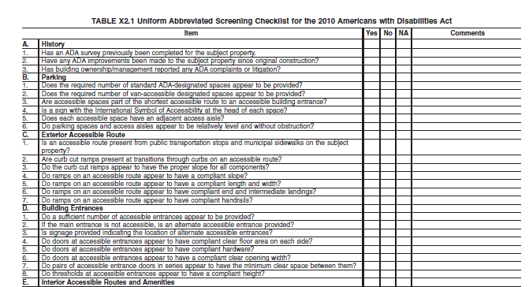
Baseline Screening Checklist
High-level checklist
Barriers evaluated mainly based on observation (i.e. no measurements)
Ideal for:
Quick evaluation of the building/site
General understanding of accessibility in a large portfolio of assets
Evaluation is not definitive or conclusive
Baseline checklist can be customized based on needs

Slide 32
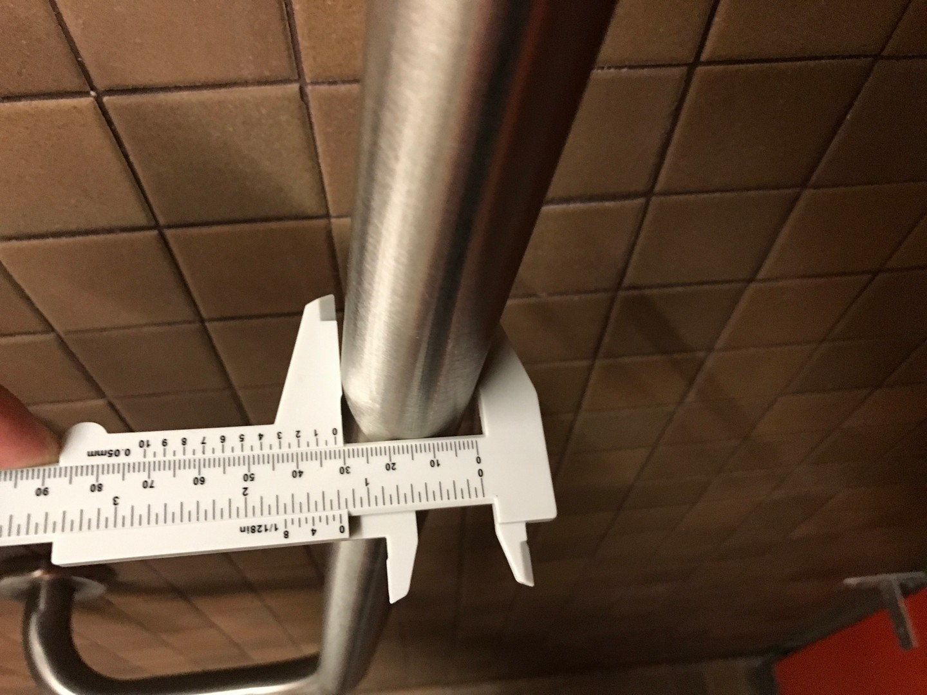
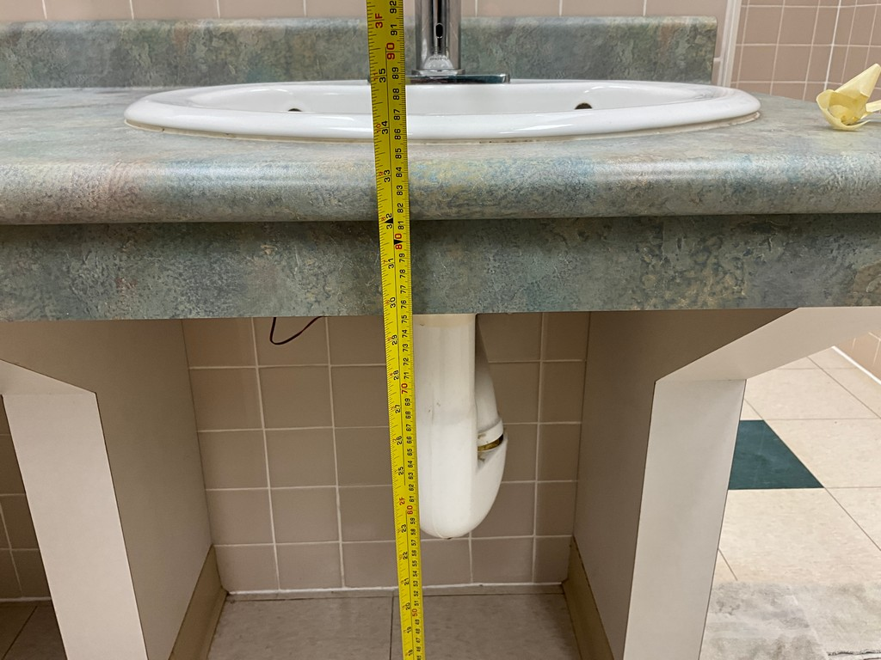
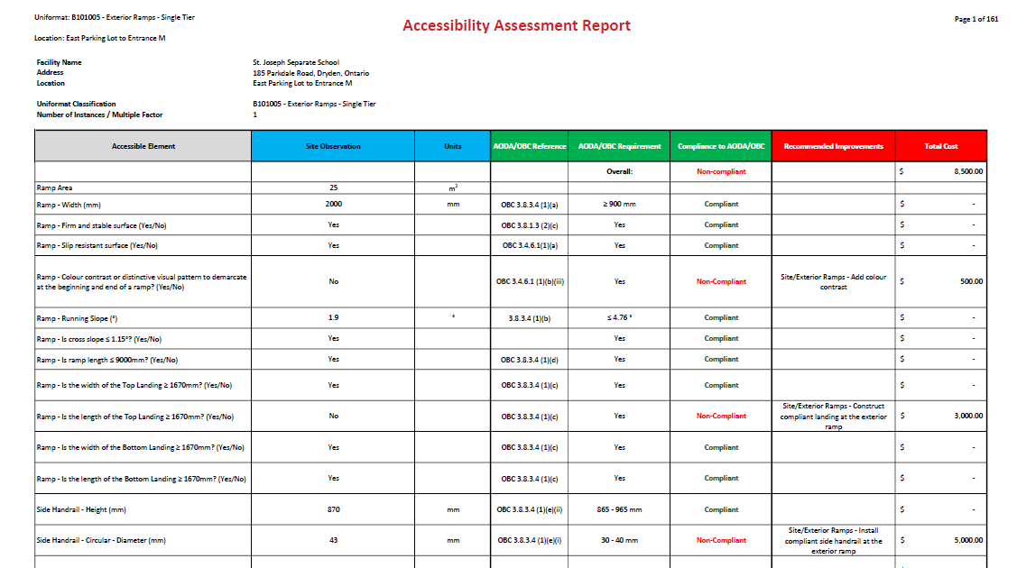
Comprehensive Accessibility Audit
Detailed audit that compares the parameters of a barrier with OBC/IASR
Optional inclusion of FADS
Comprehensive audit evaluates compliance to the code or design guideline line-by-line
Ideal for:
Confirmation of compliance to code/guideline
Identifying specific areas requiring improvement

Slide 33
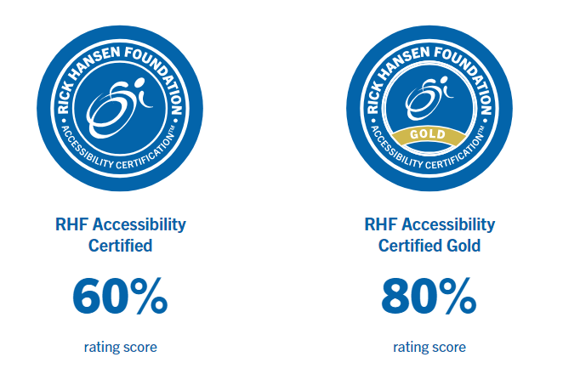
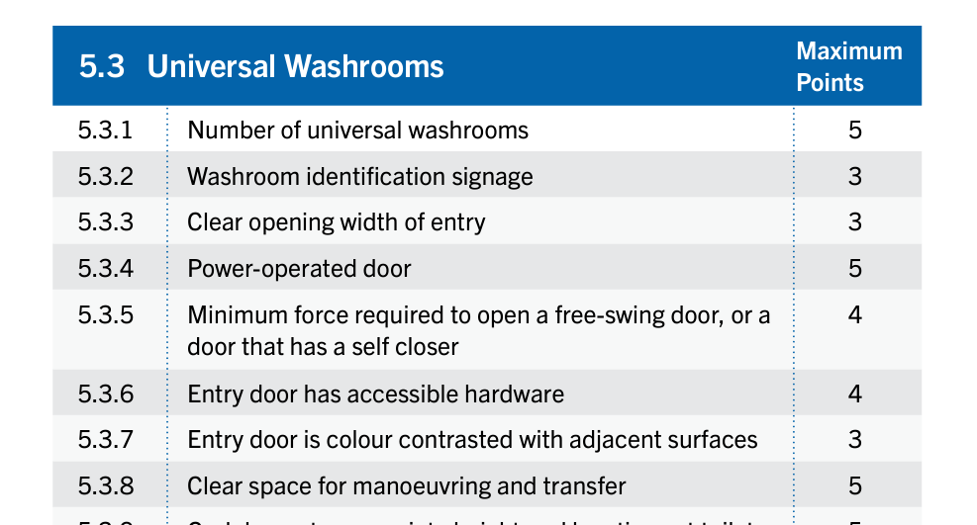
Rick Hansen Survey
Similar to a comprehensive audit, but using the Rick Hansen Rating Survey / Scoring System
Ideal for:
Promoting a particular asset (i.e. town hall)
Comparing levels of meaningful access between various assets
Note: The Survey does not specifically address guidelines based on code

Slide 34
Auditing approach
Understanding Facility Needs
Baseline Screening
Checklist
Comprehensive
Accessibility Audit
Rick Hansen Foundation Accessibility Certification (RHFAC) Survey
With BCA
Detailed Understanding
Third-Party Certification
✓ High-level, time-efficient
✓ Line-by-line code comparison
✓ Independent certification
✓ Identifies obvious barriers
✓ Captures all element types in scope
✓ Goes beyond code minimums
✓ Delivered concurrently with BCA
✓ Confirms compliance or identifies gaps
✓ Rates meaningful access
✓ Good starting point for portfolios
✓ Identify specific barriers and locations
✓ Recognized publicly & by funders
✓ Supports detailed recommendations
✓ Quantity-based remediation planning
Ideal for: High number of assets / quick triage
Ideal for: Single facility focus / compliance confirmation
Ideal for: Public-facing facilities / stakeholder communications

Slide 35

Engaging Stakeholders in the Accessibility Journey

Slide 36



Importance of Stakeholders
⚖ Legal & Human Rights
♿ Lived Experience
Under the Ontario Human Rights Code, and Ontario Human Rights Act, owners/employers have a duty to accommodate persons with disabilities.
Under Title I of the ADA, there is a duty to provide reasonable accommodation in the workplace. Title III mandates there should be reasonable changes made for businesses.
Understanding first-hand experience from users and occupants of your building, will help you identify barriers and possible solutions.
It will help target areas of priority and what the organization-specific needs are.

Slide 37
Engaging Stakeholders
Practical steps for meaningful participation
1
2
3
4
5
Identify
Stakeholders
Conduct
Consultation
Prioritize
Together
Communicate
Progress
Review &
Iterate
Users, facility teams, disability orgs, finance, executive sponsors
On-site walkthroughs with users, focus groups, comment periods
Apply Multi-Variable Prioritization (MVP) with stakeholder input on weights
Transparency on barriers found, timelines, and remediation plans
Annual reviews, updated audits, and continuous feedback loops
Key Principle: Accessibility planning is not a one-time event.
The most effective programs create feedback mechanisms that continuously capture user experience, incorporate new standards, and update the capital plan accordingly. Engaging those with lived experience of disability is not optional — it is essential to meaningful accessibility.

Slide 38

Limitations & Constraints

Slide 39
Real World Constraints &
How to Navigate Them
Understand limitations that affect the ability to follow latest standards
Heritage Buildings
Financial & Budget Limits
Physical & Structural
▸ Ontario Heritage Act allows modifications to defining features that would alter essential nature
▸ Prioritize high-occupancy, high-impact spaces first
▸ Existing structural systems may limit door widths, turning radii, ramp grades
▸ Assess heritage facilities individually for least-disruptive retrofit approach
▸ Integrate accessibility improvements into scheduled capital renewals
▸ Technical infeasibility must be documented — reduced dimensions are minimums, not targets
▸ Equivalent facilitation proposals reviewed by Director on a case-by-case basis
▸ Phased plans spread costs while demonstrating continuous progress
▸ Alterations that increase accessibility are always preferred even if full compliance is impossible
▸ IASR provides documented exception pathways for cultural heritage properties
▸ Government-funded programs require meeting OBC accessibility as eligibility criterion
▸ No alteration should decrease existing accessibility below new-construction requirements

Slide 40
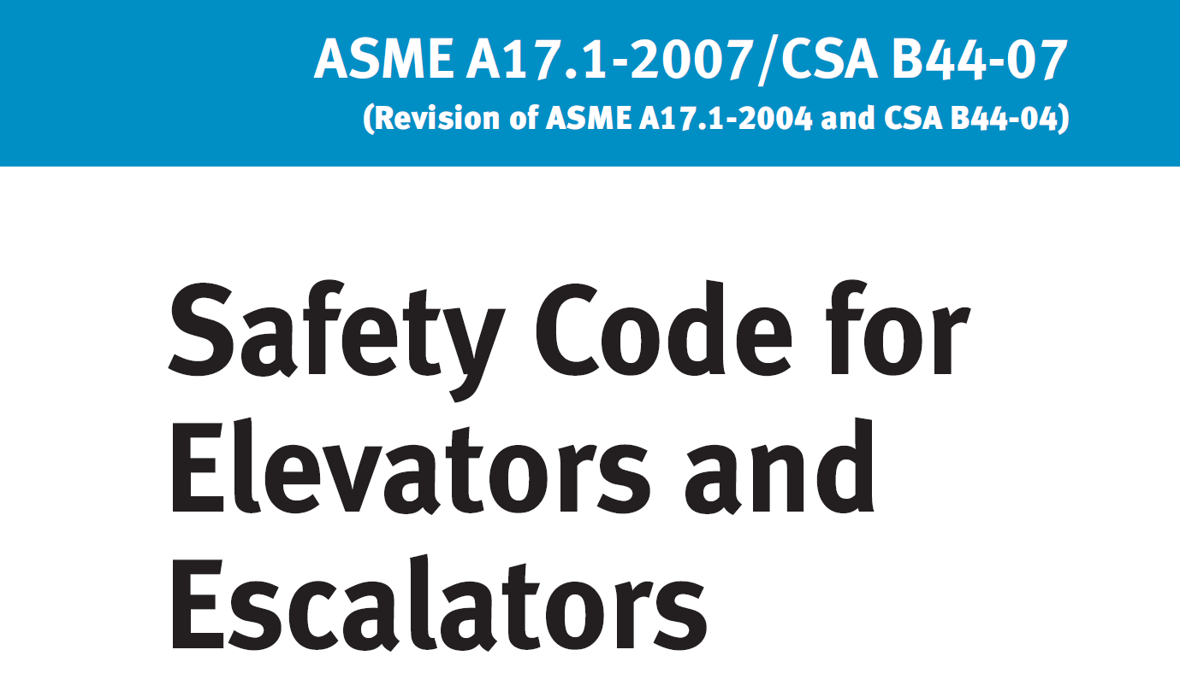

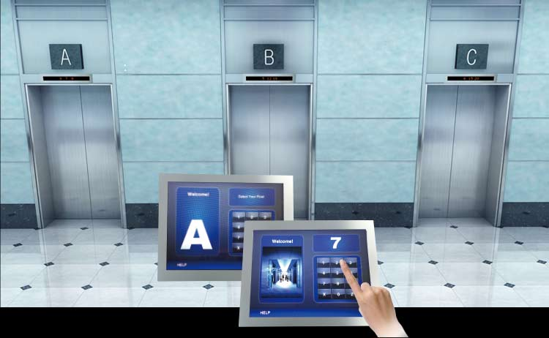
Competing Standards
One thing may be considered barrier-free (accessible) and not to another
There could be things that are considered accessible or universally designed in some standards, but not in others.
For example:
There is a section for barrier-free design in CSA B44 for Destination Elevators.
However, in the RHFAC standard, it is mentioned:
Destination elevators, also known as destination dispatch, refer to elevators that use digital technology to assign passengers to specific elevator cabs that would take them to the floors they need to go, especially in high density buildings. While effective for managing large volumes of traffic, destination elevators very often barriers to accessibility for individual users with disabilities.
vs.

Slide 41
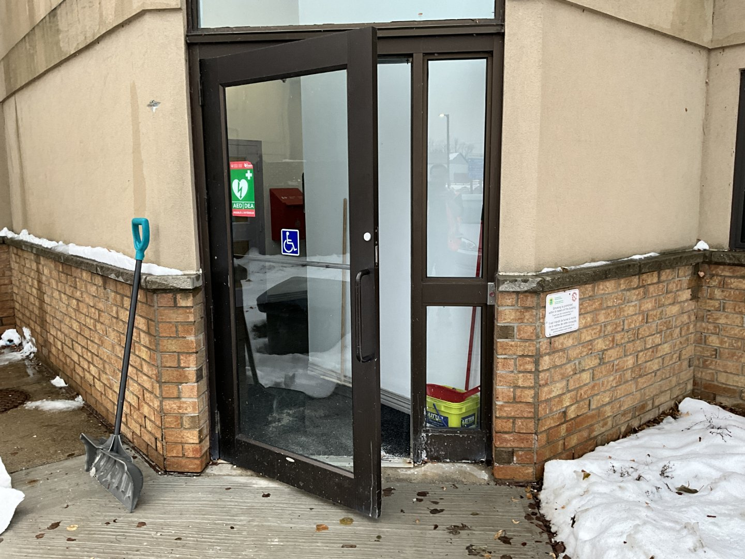
Competing Improvements
One Improvement may be a Barrier to Another
Power door operators are helpful for all users, especially those that struggle with strength or dexterity.
However:
Power doors generally require more force to open manually
Doors may close on people who move slowly

Slide 42
Competing Improvements
One Improvement may be a Barrier to Another
Conflict example | Affected user groups | Benefits | Downsides | Recommended compromise(s)
Tactile paving vs smooth surfaces | Helps: Blind and low vision (BLV); Hinders: mobility device users, older adults | Underfoot cues at hazards/decision points support independent mobility for BLV | Rough/textured surfaces can increase rolling resistance and vibration exposure for wheeled users | Keep primary paths smooth; confine tactile to hazards/decision points; provide bypass strip
Open-plan noisy spaces vs quiet rooms | Helps: supervision/collaboration; Hinders: DHH (deaf and hard hearing), neurodivergent, cognitive impairment | Visibility and informal communication | Noise harms satisfaction, productivity, and health outcomes in open-plan vs cellular offices | Acoustic zoning; quiet rooms; sound-absorptive finishes; “calm route” areas
Automatic doors with strong closing force vs manual handles | Helps: mobility/strength limits; Hinders: slower walkers, some cognitive/sensory users | Hands-free access; reduced force needed to open | Doors closing too quickly/forcefully can impede slower users; exterior force tradeoffs due to wind/pressure/seals | Low-energy operators where force high; tune closer speed; provide adequate maneuvering space
Bright uniform lighting vs low-stimulus lighting | Helps: low vision & safety; Hinders: neurodivergent, migraine, cognitive impairment | Uniform illumination reduces shadows and supports visibility | Brightness, flicker, glare, and color temperature can drive sensory discomfort; autistic participants report sensitivity to technical factors like brightness/flicker | Layered dimmable lighting; flicker control; “calm” zones; avoid high-gloss reflective finishes

Slide 43

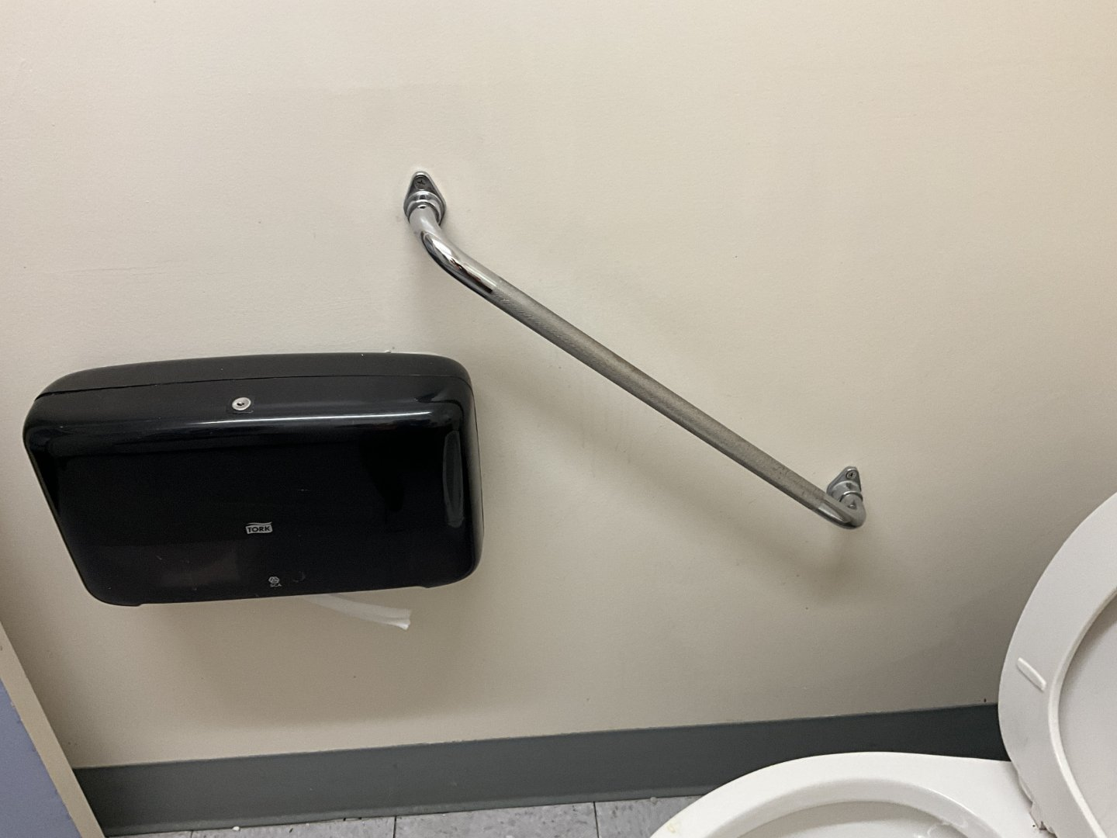
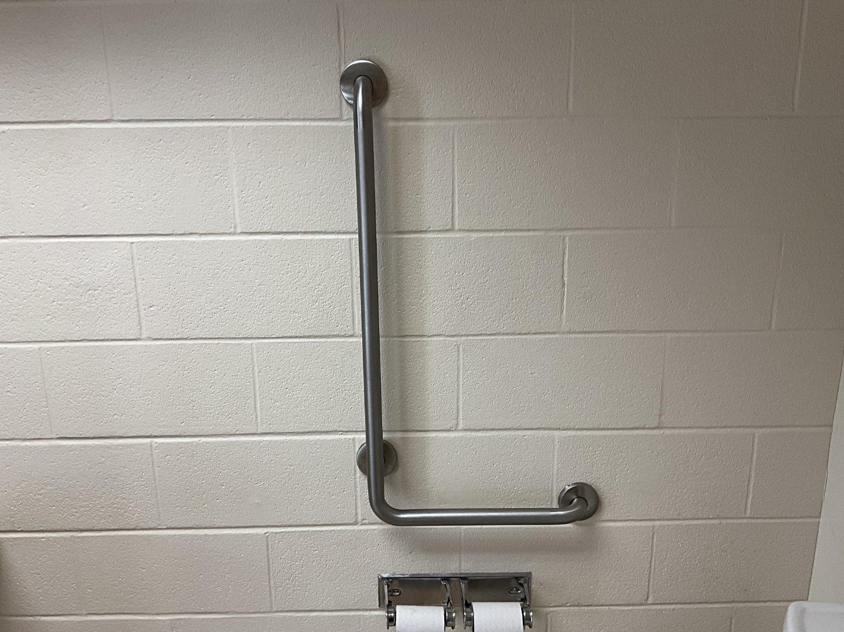
Subjectivity of lived experience
There is a lot of variety in lived experience
Consulting lived experience is key to accessibility improvements.
However, not all experiences of the same barrier may be the same.
Will need to understand:
Weigh various opinions
Importance of specific improvements to the organization
Consensus for accessibility improvements.
vs.

Slide 44
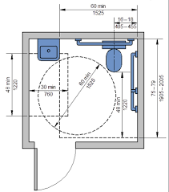
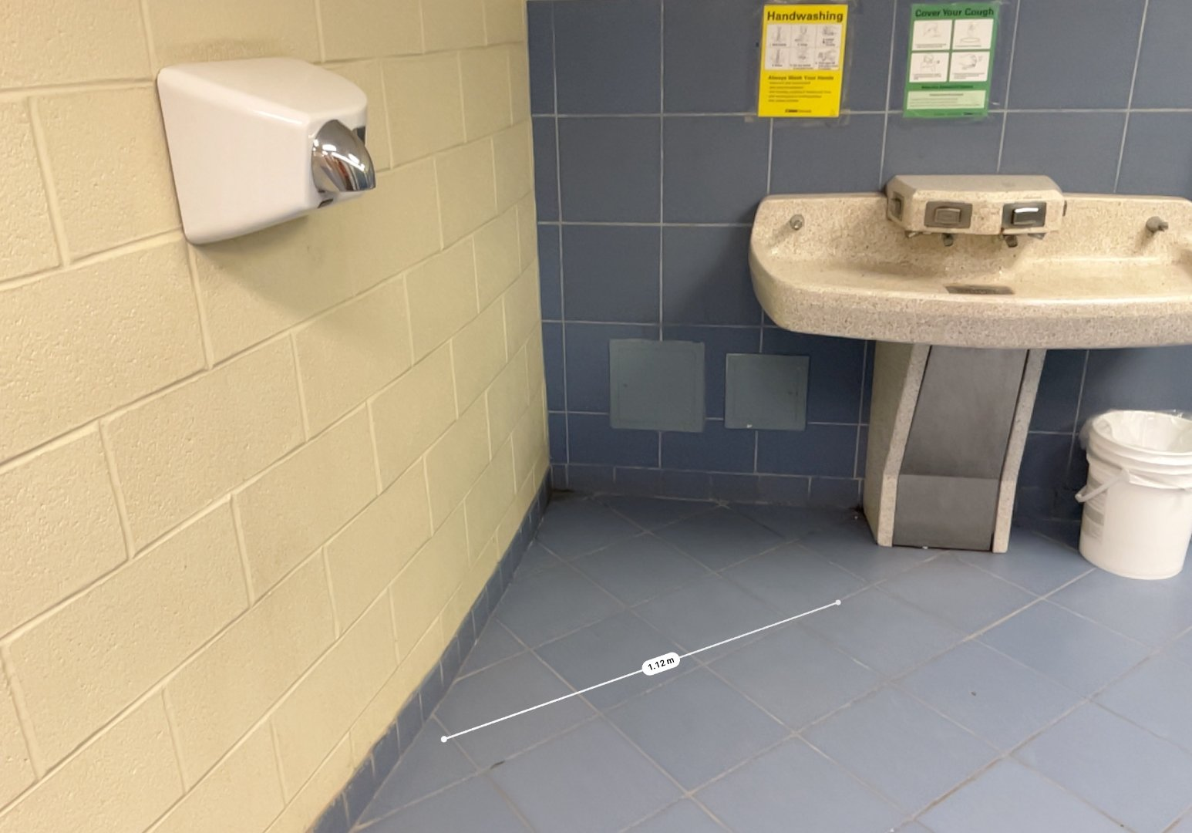
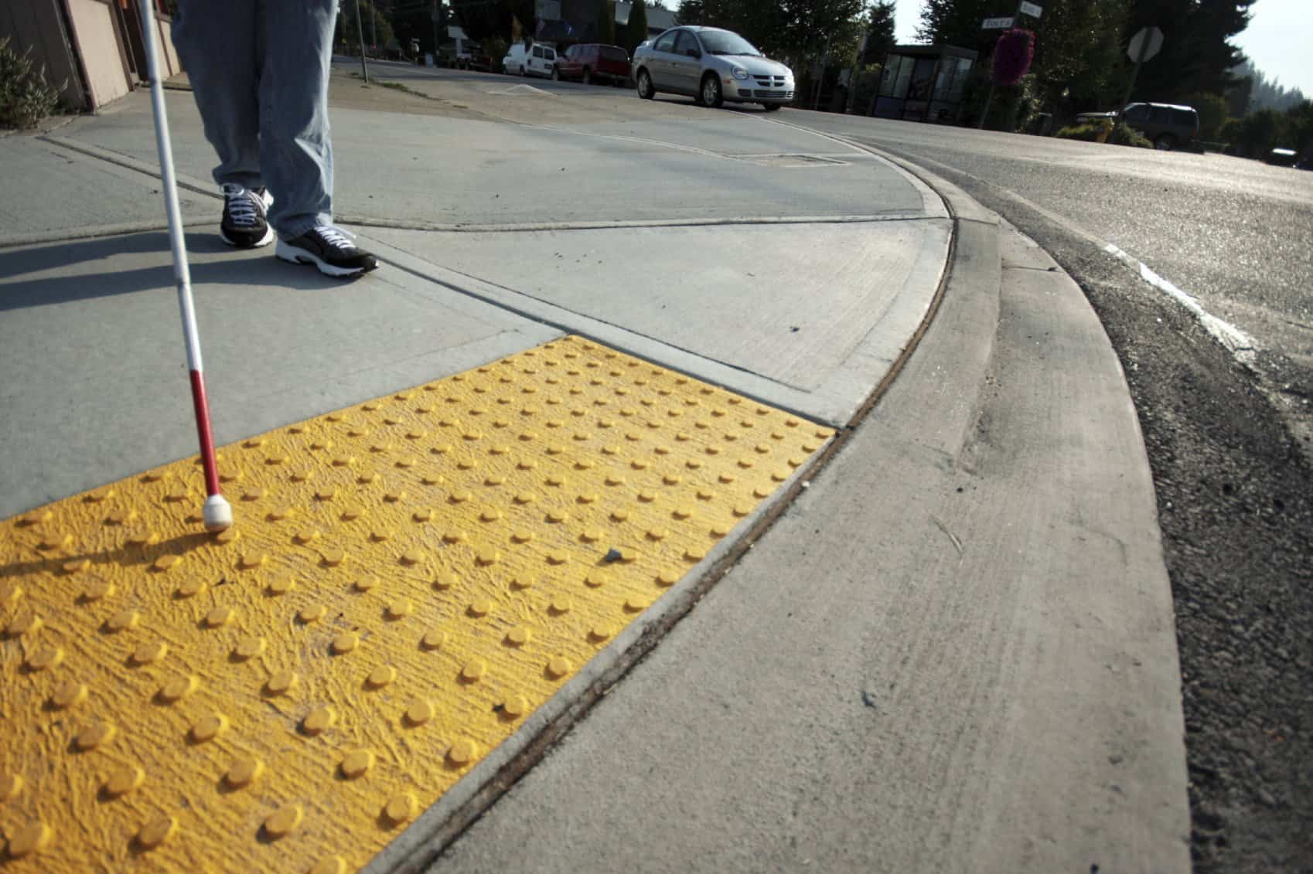
“Bigger is not better”
The trend appears that particularly for mobility and access, size requirements continue to increase:
Wider turning diameters
Wider clear door widths
However, “bigger is not always better”.
Example: Tactile Attention Indicators
Designed with specific parameters (length, dome spacing, etc.)
Based on research and study
Suggest:
Refer to latest versions of accessibility design standards
Consult organization’s stakeholders

Slide 45
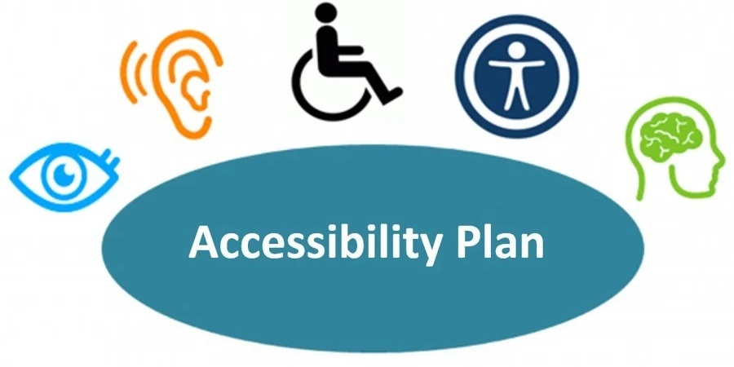
Building a Future-Proof Accessibility Strategy
Image source: Holy Family Roman Catholic Separate School Division #140
https://www.holyfamilyrcssd.ca/index.php/announcements/holy-family-develops-accessibility-plan

Slide 46
BUILDING A FUTURE-PROOF ACCESSIBILITY STRATEGY
Continuous improvement, risk management, and organizational strategy
🔍
→
📊
→
📋
→
🤝
→
🔄
ASSESS
PRIORITIZE
PLAN
ENGAGE
MONITOR
Choose the right audit type for your organization. Baseline for portfolios; Comprehensive for detailed improvements or specific areas to address.
Choose the most suitable design guideline
Apply MVP framework. Weight factors by facility type, occupancy, deferral consequence, and standard level.
Integrate accessibility improvements into your capital plan. Phase investments across a multi-year horizon.
Involve users, disability advocates, and leadership. Build accessibility into culture, not just construction.
In the construction design, seek feedback and implement latest trends.
Annual reviews. Track completed improvements. Update assessments when standards evolve or new needs emerge.

Slide 47
KEY TAKEAWAYS
Compliance ≠ Accessibility
Know Your Standards
Meeting minimum code is the floor, not the ceiling. Real usability requires going further. Also, need to consider human rights.
Important: Meeting minimum code is necessary and legislated.
OBC, IASR, CSA B651, FADS, and RHFAC each serve different purposes. Use them strategically.
Choose the Right Audit
Prioritize Strategically
Baseline checklists triage; comprehensive audits confirm; RHFAC certifies. Match to your need.
Multi-Variable Prioritization integrates compliance, user impact, and capital planning into a defensible plan.
Plan for Constraints
Future-Proof Continuously
Heritage, budget, and structural limits are real — but they are navigable with the right approach.
Build a feedback loop: assess → prioritize → plan → engage → monitor → repeat.

Slide 48

Q & A

Slide 49
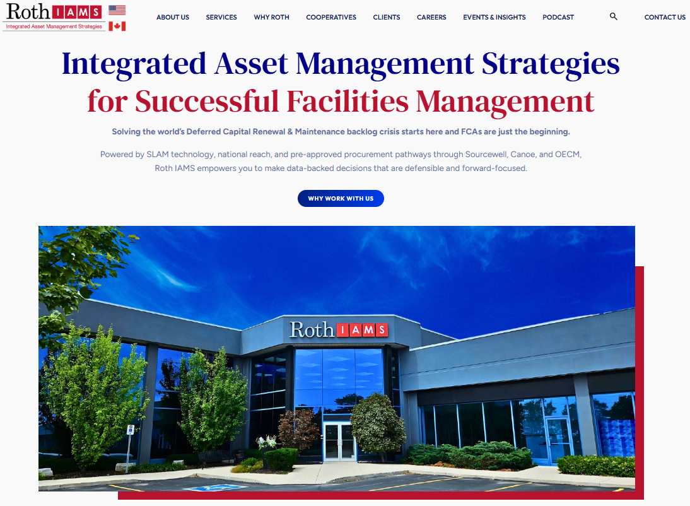
Thank you for attending
Connect with us directly!
Andrew.Chow@rothiams.com
accessibility@rothiams.com
416-419-7143

Slide 50
References & Sources
Standards & Legislation
Ontario Building Code (OBC) Section 3.8, 2012 (2015 Amendment) | O. Reg. 191/11 IASR | AODA 2005 | ODA 2001
Accessible Canada Act (ACA) 2019 | ADA Standards for Accessible Design, 2010 | Ontario Human Rights Code
Design Guidelines & Research
CSA B651-23: Accessible Design for the Built Environment (CSA Group, January 2023)
City of London Facility Accessibility Design Standards (FADS), 2021
NC State University, Center for Universal Design — Principles of Universal Design, v2.0, 1997
Tsai, C.H. et al. — Indoor Wayfinding Apps for Blind Travelers. ACM Trans. on Accessible Computing, 2024
GoodMaps (goodmaps.com) | Evelity (evelity.com) | Statistics Canada — Canadian Survey on Disability, 2022
Roth IAMS Sources
SOP 101 Accessibility On-Site Procedures (2026) | Accessibility Training (2025) | LAS Webinar Sept 2024

