Slide 1
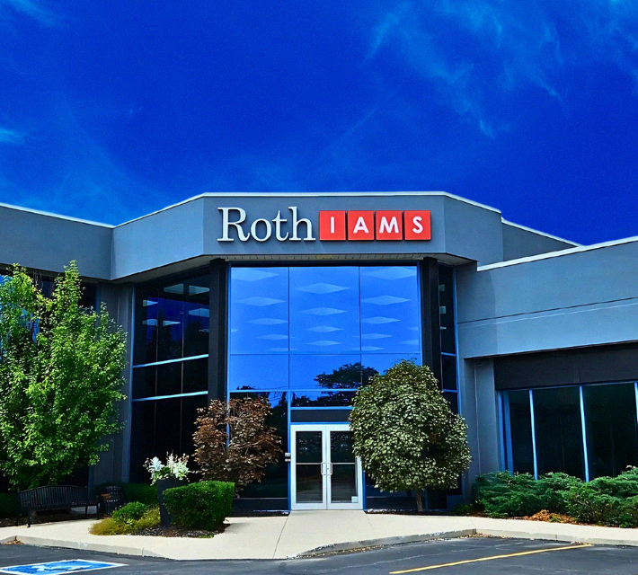
Roth IAMS
Integrated Asset Management Strategies for Successful Facilities Management

Slide 2

meet Roth IAMS
YOUR ESTABLISHED, TRUSTED PARTNERS
Imagine your organization’s buildings and assets just being…better.
We want to help you make this your reality.
Notes:
At Roth IAMS, we have guided public and private sector clients to make informed, data-driven decisions across North America.

Slide 3

GUIDED BY PURPOSE
WHAT DRIVES US FORWARD
Our passion? Turning defensible data into powerful asset management stories.
We follow this passion through our Core Values.
Collaborative: Only by understanding each other and our uniqueness can we tailor the best solutions for our clients.
Passionate - Our love for what we do and why we do it drives us towards excellence.
Consistently Curious - We are always seeking knowledge and challenging the status quo.

Slide 4

OUR VISION
To Solve the World’s Deferred Capital Renewal and Maintenance Backlog Crisis

Slide 5
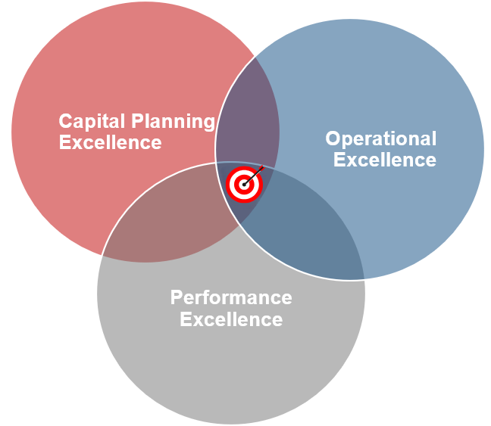
What is Integrated Asset Management?

Slide 6

SERVICES
BUILDING & FACILITY
CONDITION
ASSESSMENTS
Our BCA & FCA services deliver actionable insights tailored to your organization—empowering sound, strategic decisions.
  Customized Approach
  Defensible Data
  Collaborative Process

Slide 7

SERVICES
FACILITY MANAGEMENT CONSULTING
Facilities Management Planning
Preventative Maintenance Planning
Equipment Inventory & Tagging
Construction Handover Service
CMMS Selection & Configuration

Slide 8

SERVICES
BUILDING PERFORMANCE
Re-&-Retro Commissioning Services
Energy Auditing
Building Performance Check-Up
Building Science
Green Building Strategies
Renewable Energy Consulting

Slide 9

SERVICES
ASSET DATA MANAGEMENT
Outsourced Data Management
Data Mining & Analytics
Software Selection & Configuration
Lifecycle Cost Analysis
Capital Renewal Planning

Slide 10

SERVICES
ACCESSIBILITY CONSULTING
Identifying accessibility barriers through comprehensive assessments or audits is the first step to making accessibility accommodations.
Tier I ADA Survey / Baseline Screening Accessibility Checklist
Tier II ADA Survey / Enhanced Baseline Screening Checklist
Tier III ADA Survey / Full Accessibility Assessment
Rick Hansen Foundation Accessibility Certification

Slide 11

SERVICES
STRUCTURAL ENGINEERING
Phase 1:
  Non-invasive structural condition site assessments
Phase 2:
  In-depth structural condition site assessments
Forensic:
  Offered to assess the impact of fires, floods, seismic activities, etc.
Pre and Post Construction:
  Undertaken to study the effect of construction on buildings that may be in the zone of influence.

Slide 12

SERVICES
MASTER & SPACE PLANNING
Campus and District Master Planning
Space Programming and Utilization
Capital Prioritization and Phasing
Asset and Infrastructure Strategy

Slide 13

SECTORS
State Government
Municipal/Local Government
Federal Government Departments
Education
Healthcare
Social Housing
Commercial/Industrial Real Estate
Aviation

Slide 14

NORTH AMERICAN LEADER IN HIGHER EDUCATION ASSET MANAGEMENT
Trusted by 70+ universities and colleges across North America, delivering data-driven insights for better decision making.

Slide 15
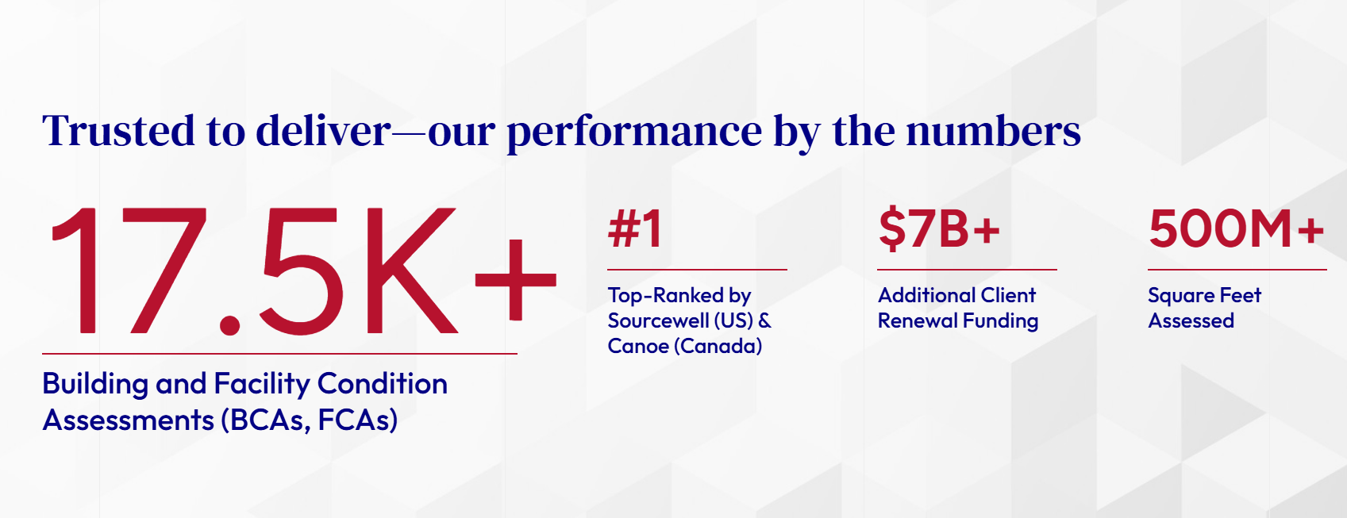

Slide 16
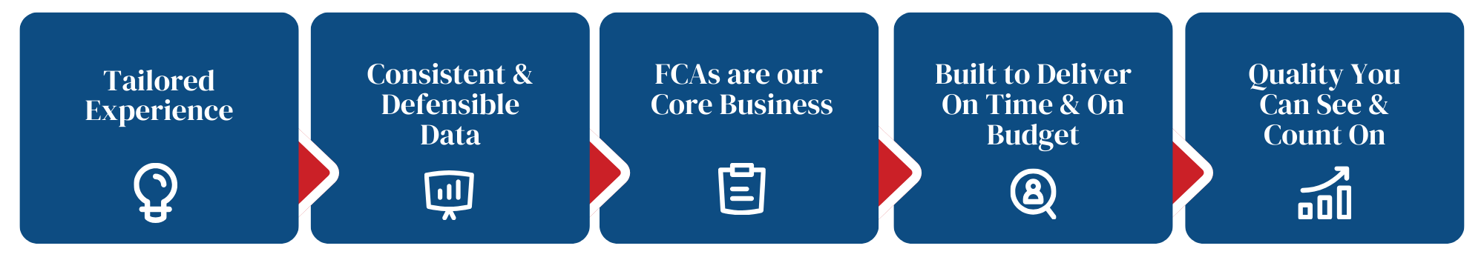
WHAT MAKES US DIFFERENT

Slide 17

PROUD TO BE THE HIGHEST RANKED PROPONENT
FOR FACILITY ASSESSMENT & PLANNING SERVICES
Awarded contract 102424-RTH

Slide 18

PROUD TO BE
THE HIGHEST-RANKING PROPONENT
IN THEIR RECENT FACILITY ASSESSMENT & PLANNING CONTRACT

Slide 19


ROTH IAMS HAS BEEN RECOGNIZED AS AN OECM PLATINUM SUPPLIER PARTNER
FOR 5 CONSECUTIVE YEARS

Slide 20
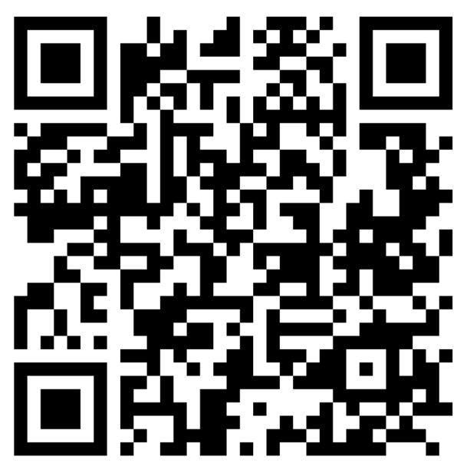
UNLOCK MORE
INSIGHTS IN
THOUGHT LEADERSHIP
Blog
Publications
Conferences
Webinars
Videos
E-Book
Podcasts – NEW

Slide 21
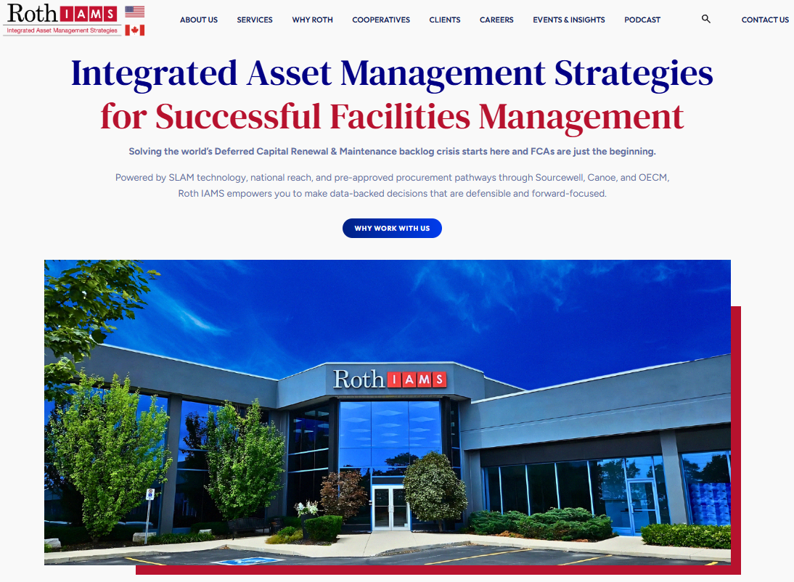
CONNECT
rothiams.com
info@rothiams.com
P 289.295.1065 (Canada)
P 813.379.9345 (USA)

Slide 22


