Slide 1

Moving the needle: Continuous Quality improvement for fm organizations

Slide 2

AGENDA
Identifying the Priorities
Introduction
Q & A, Resources & Next Steps
Measurable Components
Define the Outcomes
Scoring & Reporting

Slide 3

BOB ANDERSON
Manager, Facility Management Consulting
  Over 25 years of experience in designing and implementing facility management strategies.
  Implemented CQI – Continuous Quality Improvement programs in facility services using multiple platforms.
  Expertise across multiple markets: Education, Healthcare, Senior Services, Commercial, and Industrial.
  Known for developing a unique approach to maximizing ROI on facility investments by aligning strategies with market-specific needs.

Slide 4

Identifying the Priorities

Slide 5

Identify Priorities
  Technician Productivity
  Work Request Customer Satisfaction
  Preventative Maintenance Completion Compliance
  Subcontractor Compliance
  What are the top issues which need to be improved
  Survey the customers / users

Slide 6
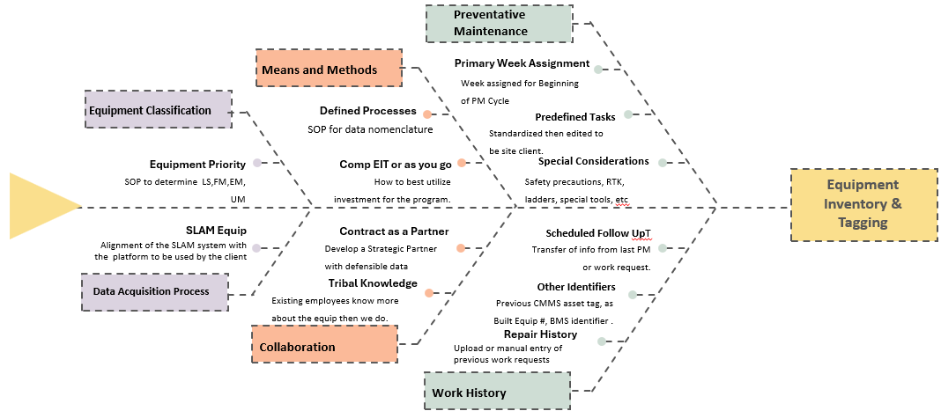
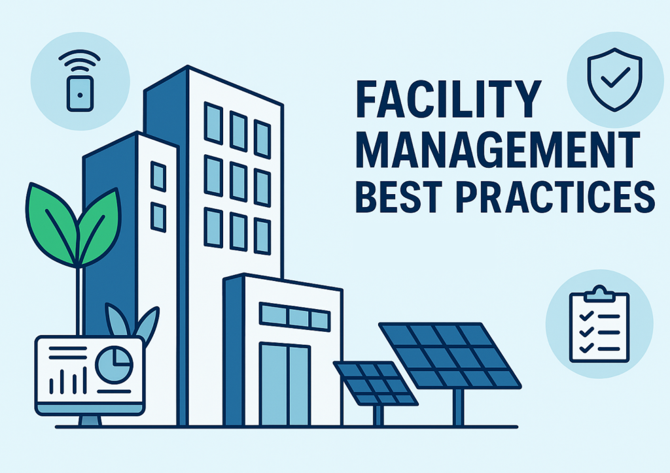
IMPROVE THE OUTCOME

Slide 7

Defining the outcomes

Slide 8

Improve Productivity
  Track productive hours available
  Track hours posted to:
    Work Orders
    Administrative time
    Rounds and Roving
    Training and Development
    PM Activities

Slide 9

Improve W/O Customer Satisfaction
  Contact Requestor prior to arrival
  Complete the work in a timely manor
  Confirm completion with requestor
  No debris left behind
  Costs properly tracked
  Time on job properly tracked
  Materials used recorded
  If billable, then costs are transferred
  Closed w/o categorized
  Failure Code identified

Slide 10

PREVENTATIVE MAINTENANCE W/O
  All tasks completed
  Recording of diagnostics results in CMMS Work History
  Time for completion tracked
  Time for completion tracked per time allotment
  Material used tracked and recorded
  Update the Work History to reflect observations from diagnostics

Slide 11
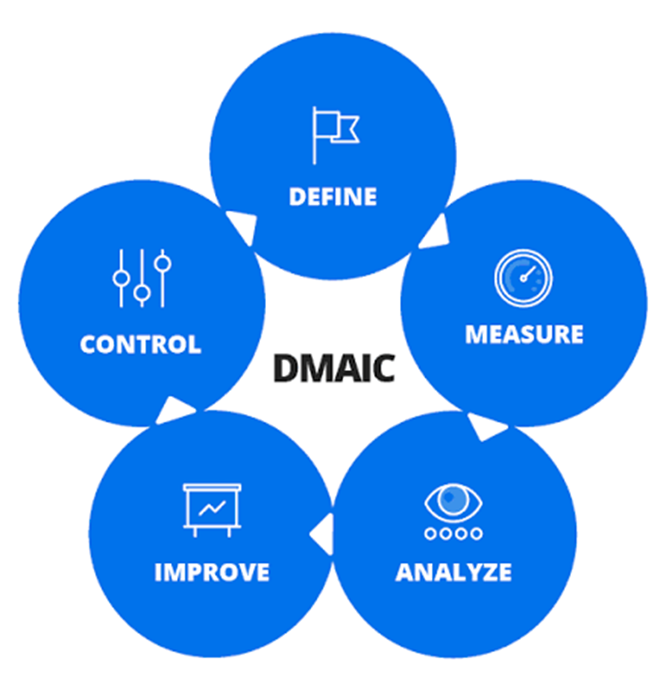
DEFINE YOUR CQI PROCESS
  Define the processes with the highest priority
  Determine the KPI Measurements which control the outcome
  Analyze over consistent time frame
  Improve the elements and measure results
  Bring process to a controlled state
  Move on to next process element to be improved

Slide 12

SOP - Standard Operating Procedure
  Measurable and compared to a standard
    BOMA
    IFMA
    ASHE
    APPA
  Develop the SOP with emphasis on the priorities determined by survey
  Written, published, communicated
  Measure compliance to the SOP through random scoring process

Slide 13

Scoring & reporting

Slide 14
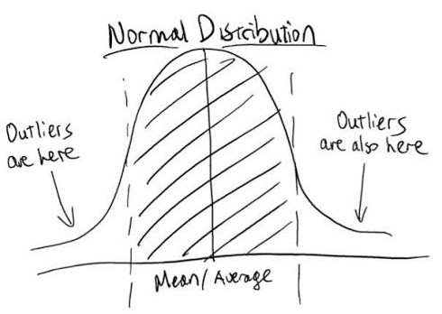
Driving Customer Satisfaction - W/O
  5-10% of average monthly work order requests
  100 Work orders – 10 are randomly sampled
  Scored based upon the points defined in your scoring
  Outliers are dealt with immediately from a supervisory perspective
  Monthly scoring posted for all to see results
  Offer incentives for top scores

Slide 15

Driving Customer
Satisfaction - W/O
  10 Contact Requestor prior to arrival
  10 Complete the work in a timely manor
  10 Confirm completion with requestor
  10 No debris left behind
  10 Costs properly tracked
  10 Time on job properly tracked
  10 Materials used recorded
  10 If billable then costs are transferred
  10 Closed w/o categorized
  10 Failure Code identified
  100 Total Score

Slide 16
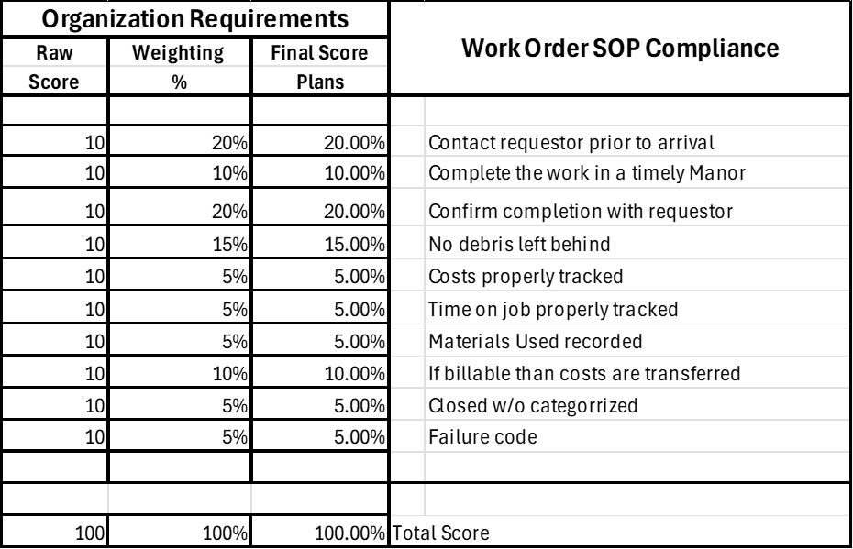
WEIGHTING PRIORITIES​
Weight Priorities based upon CQI survey
Use weighted scores to establish score for compliance
Eliminate subjectivity
Scoring methodology needs to be consistent
Multiple trade supervisors must agree to the methodology
Where possible mix up the evaluators and evaluate the scoring

Slide 17
Driving Customer Satisfaction - pmS
  5-10% of average Monthly PMs completed
  100PM completed – 10 are randomly sampled
  Scored based upon the points defined in your scoring
  Outliers are dealt with immediately from a supervisory perspective
  Monthly scoring posted for all to see results
  Offer incentives for top scores

Slide 18
Preventative Maintenance
  30 All tasks completed
  10 Recording of diagnostics results in CMMS Work History
  10 Time for completion tracked
  10 Time for completion tracked per time allotment
  10 Material used tracked and recorded
  10 Update the Work History to reflect observations from diagnostics
  10 Check parts availability for next PM
  10 Verify field information to CMMS Data
  100% Total

Slide 19

Measurable components

Slide 20

Measurable components
  WORKER PRODUCTIVITY FOR CQI
  Track productive hours available by technician
  Track hours posted to various categories:
    Work Orders
    Administrative time
    Rounds and Roving
    Training and Development
    PM Activities
  Productivity tracked as posted for all employees

Slide 21

Measurable components
  SUBCONTRACTOR COMPLIANCE
    Work order system used to track work completion
    Compliance to contract
    Safe work practices followed
    Time onsite by subcontractor – Resources used
    Worksite setup – Protection
    Roof protection
    Negative Air
    Equipment shutdown
    Equipment Restart
    Trip Charge recorded
    WO matches invoice
Scored the same way as WO and PMS

Slide 22
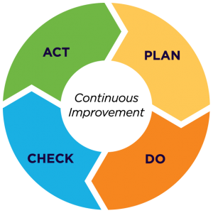
CQI PROCESS DELIVERS
Reduces time by elimination of Demand / Break / Fixes
Reduces operating costs via containment
Improves employee / technician relationships
Improves customer satisfaction
Becomes a continuous improvement process until all is stable

Slide 23

Q & A

Slide 24
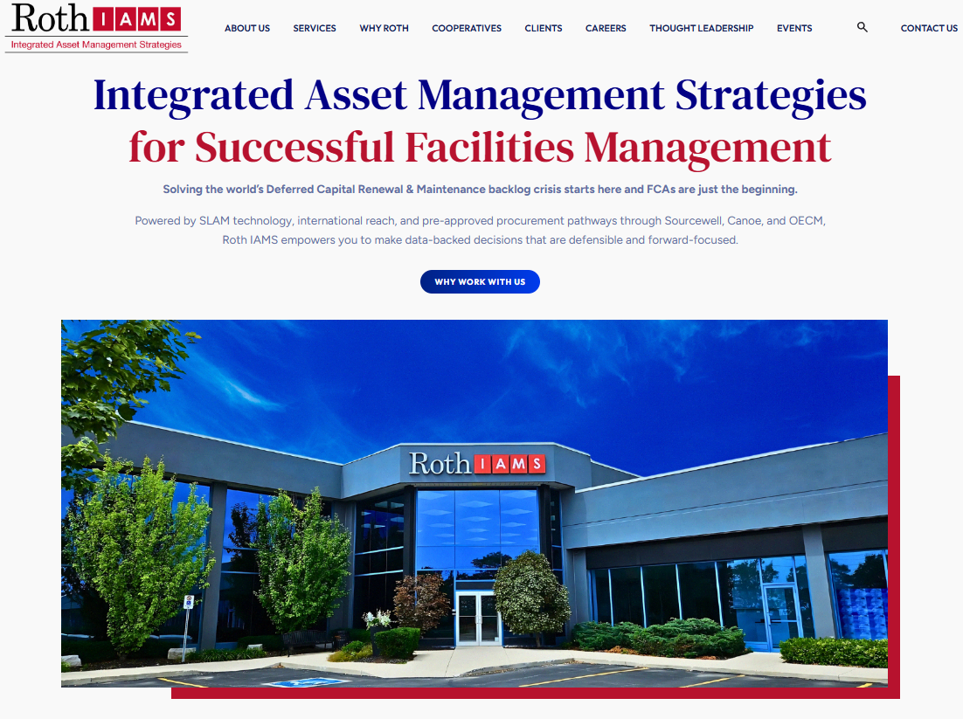
Thank you for attending
Connect with me directly!
  Bob.Anderson@rothiams.com
  780-206-9267

